Slide 1
RTC+B Task Force
Update
Matt Mereness
RTCBTF
March 25, 2025

Slide 2
Outline
Discussion today:
  Update on Issues List and Market Trials
  Snapshot of Market Readiness response scorecard
  Summary of three NPRRs (1268, 1269, 1270)
  Discussion of NPRR1269
  State of Charge / AS Duration Discussion
  Market Readiness
    Review 2 Handbooks
    Review 3 New training modules
  TWG Updates

Slide 3
RTCBTF Issues List
First red box is NPRR1269 for 3 policy issues (target April Board)
Second red box is IMM NPRR1268 for ASDC changes (target April Board)
Third red box is a clean-up NPRR1270 and remove automatic qualification (target April Board)
Blue Box is evaluation of State of Charge and AS Duration (target June Board)
Market Trials

Slide 4
Summary and Timeline of NPRRs
NPRR1268 for ASDC Modifications (IMM sponsor)
NPRR1269 for 3 Parameter/Policy Changes (ERCOT sponsor)
  AS Proxy Offer Floors
  ASDCs for Reliability Unit Commitment
  Ramp Rate Sharing
NPRR1270 for AS Qualification details (ERCOT sponsor)
State of Charge – Begin discussion today (March 25) and targeting June Board
Timeline and vetting of RTC+B NPRRs
PRS Urgency & Apprv 3/12
TAC approval
March 26
File NPRRs
(No impacts) Jan 28
PRS Table NPRRs
Feb 12
Board Approval
April 8
PUCT Approval
May 15
Jan 2025
Feb 2025
Mar 2025
Apr 2025
May 2025
June 2025
RTCBTF: Jan 14, 23, Feb 7,19, March 5, 25
ERCOT window for “re-factoring” development
ERCOT market trials deployed and begin on May 5, 2025
Stakeholder comments in Feb and March

Slide 5
Sequence and Dates for Market Trials to Go-Live
30-day Market Notice
11/5/25
March/April
2025
Start
5/5/25
Start
7/7/25
Start
9/2/25
Go-Live
12/5/25*
May 2025
June 2025
July 2025
Aug 2025
Sep 2025
Oct 2025
Nov 2025
Dec 2025
QSE Scorecards & Exit Criteria for each Trial Phase
RTC QSE Submission Testing
(Submit COP, RT AS Offers,
DAM Virtual AS, Outages for ESRs)
Open-loop RTC SCED
(QSE offers, SCED non-binding award/dispatch)
Ongoing Open-Loop
& Periodic Closed-loop SCED/LFC
(QSE RTC offers and telemetry to support closed-loop frequency control test 2-3 tests of 2-4 hour durations)
Transition to Go-Live
Upon completion of testing, confirmation of ERCOT and market readiness for Go-Live.
QSE/Vendor Submission Sandbox and Telemetry Points added Prod EMS model.
RTC QSE Telemetry Check-out (QSEs add/verify new telemetry points for UDSP, New ramp rates, ESR telemetry)
QSE Telemetry Tests
(Individual QSE to follow UDSP and support new ramp rate and ESR telemetry)
Day-Ahead Market
(Non-binding DAM using QSE offers for at least 2 tests)
* Go-Live date reflects 12/5/2025 as first Operating Day
where 12/4/2025 is planned software migration.

Slide 6
Other Updates
Update on Goal of strengthening communication and content in March
  Develop new folders on RTCBTF home page (done)
    Market Trials folder: Handbooks and supporting materials / FAQ (done but still need FAQ)
    Technical Support folder: Key TWG technical materials (done and continue to add to it)
  RTCB@ercot.com mailbox for support of stakeholder implementation questions (done)
  Post ICCP/telemetry explanation video (done)
  Following guidance from RTCBTF to engage DSWG separately (review content today)
  Next TWG meeting is March 26
    ERCOT will continue to support detailed technical conversations such as adding telemetry points to network model, digital certificates, accessing ERCOT systems in March/April timeframe
Closed-Loop LFC planning (April initial review)
Formal Market Trials begin in 6 weeks (May 5, 2025)
  Weekly WebEx every Monday 10am-10:30am (starting May 5 – December 8, 2025)

Slide 7
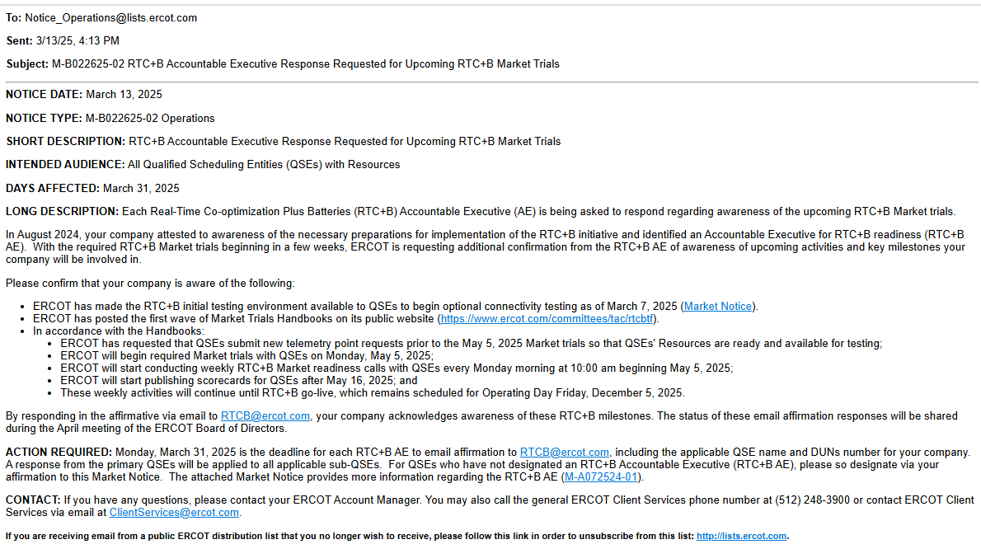
Market Notice on QSE Readiness (response due by March 31)
Market Notice sent March 13 with Monday March 31 due date:

Slide 8
QSE with Resources- Scorecard as of x/x/2025

Slide 9
Focus for remainder of RTCBTF today:
Review and discussion of NPRR1269 and analysis
Goal is to educate/prepare for TAC tomorrow
State of Charge / AS Duration Discussion
Market Readiness
Review Handbook #3- Open Loop SCED (Round 2)
Review Handbook #4- QSE Telemetry Tests (Round 2)
Review 3 New training modules
Demand Response Training- Steve
Day-Ahead Market Training- Alfredo
Operations Training- Abhi
TWG Updates/Questions

