Slide 1
Operations Working Group
Chair- Rickey Floyd
Vice-Chair- Tyler Springer
03/20/2025

Slide 2
ERCOT Updates and System Operation Report
No Update

Slide 3
Texas Reliability Entity Report
No update

Slide 4
NPRR 1070 - Planning Criteria for GTC Exit Solutions
Working on a rewrite on existing NPRR. Nothing for group yet.
Remains tabled.

Slide 5
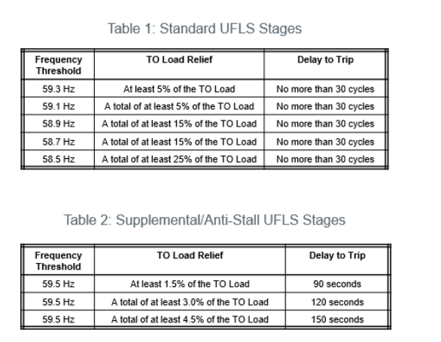
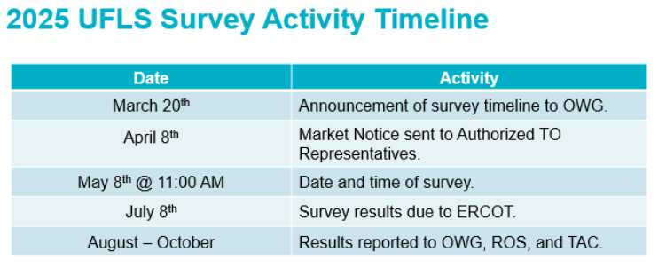
2025 UFLS Survey Announcement
Number of load shed stages is increased from 3 to 5.
25% of ERCOT system load shall be equipped with UFLS.
ERCOT presentation can be found on OWG 3/20 meeting page.

Slide 6
AEP Wildfire Reclosing Strategy
AEP Chris Shaffer shared a robust wildfire policy including removing reclosing on circuits in the threat area.

Slide 7
Other Business
None.

