Slide 1
Nodal Protocol Revision Request (NPRR) 1269
Impact of Proposed ASDC Floors for Real-Time and Day-Ahead
David Maggio
Principal, Market Design & Analytics
March 25, 2025
Real-Time Co-optimization plus Batteries Task Force (RTCBTF)
ERCOT Public

Slide 2
Introduction
On March 3rd, ERCOT filed comments to NPRR1269 to codify specific numbers that were previously left as variables, while analysis and discussion at the Real-Time Co-optimization plus Batteries Task Force (RTCBTF) was ongoing.
The comments were specific to the Ancillary Service Demand Curves (ASDCs) for Reliability Unit Commitment (RUC) and the Ancillary Service proxy offer floor parameters.
On March 4th, TCPA filed comments to NPRR1269 to take the ASDC floor for RUC and apply it to the Day-Ahead and Real-Time Markets (DAM and RTM).
This concept had been raised at the RTCBTF by market participants but had not yet been captured in proposed NPRR1269 language.
Both the Texas Industrial Energy Consumers (TIEC) and Independent Market Monitor (IMM) filed comments to the NPRR in advance of the Protocol Revision Subcommittee (PRS) meeting expressing concerns about an ASDC floor in the DAM and RTM, among other things.
This presentation is intended to provide ERCOT’s perspective and analysis on potential impacts to the RTM in having the ASDC floor concept applied. It builds off of the presentation of similar analysis to PRS on March 12th.

Slide 3
ERCOT’s Perspective on the Concept of a ASDC Floor for the DAM and RTM, as Proposed by TCPA
ERCOT is generally in favor in this concept moving forward:
In light of Ancillary Service quantities we see today and in the near-term, there is a legitimate concern that DAM and RTM pricing may be insufficient to incent self-commitment of Resources for the tail amounts of Ancillary Services and may lead to increased RUC instructions, even when there is sufficient Resource capability otherwise.
$15 per MW per hour (the ASDC floor proposed by ERCOT for RUC) is a relatively modest ASDC price for smaller levels of shortages and well below the minimum prices for Regulation Service (Reg) and Responsive Reserve Service (RRS) already included in NPRR1268. It can also allow Ancillary Service Offers below $15 per MW per hour to clear and support meeting the Ancillary Service Plan when that may not have been possible otherwise.

Slide 4
ERCOT’s Perspective on the Concept of TCPA’s Comments cont.
The distinction that this is a floor on the ASDCs and not a floor on the price for Ancillary Services is important. To the degree there are sufficient Ancillary Service offers and Resource capability, those offers would be setting the price, not the ASDCs. This is equivalent to what is seen in DAM today where current penalty prices are ~$5,000 per MW per hour, although that is almost never the clearing price.
The deeper concern for those opposed to the concept seems to be the quantities that feed into the Ancillary Service Plan generally. A more thorough review of the process for determining these quantities is already underway with the development of a “full statistical” analysis tool and the consideration of “closer to the Operating Day” Ancillary Service quantity determination. If there are Ancillary Service quantity reductions, this concept will automatically adjust to account for that.

Slide 5
ASDCs within the Optimization
ASDCs are included as inputs into the optimization and represent a willingness to procure a volume of an Ancillary Service at a given price.
The lower the price the more MW the optimization is willing to procure, and vice versa.
Under NPRR1269, a floor on an ASDC then represents a minimum price that is willing to be paid to achieve the Ancillary Service Plan published by ERCOT.
To the degree there is sufficient Resource capability to meet demand for electricity and the Ancillary Service Plan, offers are generally driving prices, not the ASDCs. An ASDC floor can also allow more offers to be awarded.
ASDCs and the proposed floors primarily come into play when procurement is “short” relative to the Ancillary Service Plan.
Individual ASDCs are derived from the shape of the Aggregate Operating Reserve Demand Curve (AORDC).

Slide 6
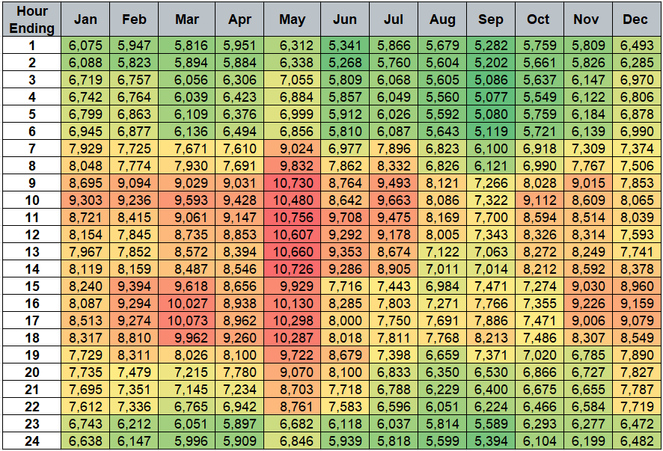
The Ancillary Service Plan and the AORDC
As it stands today, the AORDC is guaranteed to go to $0 per MW per hour at 10 GW of Ancillary Services and goes to pennies per MW per hour well before that.
In many hours, such as in May, the optimization is unwilling to procure the Ancillary Service Plan unless it would free or nearly free without an ASDC floor.
While a floor will not affect the ASDCs at all in some hours, in others it may be the only means for procuring the Ancillary Service Plan, even if there is more than sufficient Resource capability that would otherwise be available.
This is particularly relevant to ERCOT Contingency Reserve Service (ECRS) and Non-Spinning Reserve Service (Non-Spin).
Summed 2025 Ancillary Service Plan by Hour and Month in MW (Excluding Reg-Down)

Slide 7
Illustration of ASDCs with a Floor (ECRS and Non-Spin)
ECRS Plan: 2,559 MW
Non-Spin Plan: 1,942 MW
ECRS Plan: 2,514 MW
Non-Spin Plan: 4,482 MW

Slide 8
Illustration of ASDCs with a Floor (ECRS and Non-Spin) cont.
ECRS Plan: 1,555 MW
Non-Spin Plan: 2,403 MW
The actual effects of a floor on the ASDCs will vary by month and hour.
For some hours, like this October period, there is no impact to the ASDCs whatsoever.
In reviewing 2024, ASDCs for 32% of the month/hour ending combinations would not have been impacted by the ASDC floor proposal.
For others, like the May period on the previous slide, the floor creates a long tail to encourage self-commitment to meet the Ancillary Service Plan when true scarcity does not otherwise exist. It also allows non-zero offers to help in meeting the Ancillary Service Plan.
In all cases, the general shape of the ASDCs remains intact with the impact focused on the tail of the curves.

Slide 9
Analysis Framework for RTM Impacts
Scenarios Evaluated
Case 1: Real-Time Co-optimization (RTC) without ASDC floors using max(min(2000,”95%”)-0.01,0) for proxy floors
Case 2: RTC with $15 per MW per hour ASDC floors using (min(2000,”95%”) – 0.01) for proxy floors
Case 3 (for prices): Derived from case 1 and 2 outputs to explicitly isolate the impacts of the ASDC floor and ignore impacts from proxy offer floors and the lack of Ancillary Service Offer data available for the simulations.
If the ASDC floor sets the price for ERCOT Contingency Reserve Service (ECRS) or Non-Spinning Reserve Service (Non-Spin) in case 2, use the case 2 prices.
Otherwise use the case 1 prices.
Case 3 Ancillary Service procurement quantities are assumed equal to case 2 procurement quantities.
Simulations of historical days are hampered by a lack of existing Real-Time Ancillary Service Offers.
While we don’t expect this to be a typical case in practice, this means that the simulation results can be dominated by proxy offers.
Combined, cases 2 and 3 attempt to address this and provide the range of expected pricing outcomes with actual outcomes falling in between and being dependent on offer behavior.

Slide 10
Analysis Framework for RTM Impacts cont.
Dataset (~12,000+ intervals across 7 months and 216 Operating Days)
Aug. ’23 (hours ending 4-5, 13-14, and 20-21)
Oct. ’23 (hours ending 4-5, 13-14, and 20-21)
Jan. ‘24 (hours ending 4-5, 13-14, and 18-19)
Apr. ’24 (hours ending 20-21)
May ‘24 (hours ending 13-14)
Aug. ‘24 (hours ending 4-5, 13-14, and 20-21)
Oct. ‘24 (hours ending 4-5, 13-14, and 20-21)
Months in bolded text are new or have expanded hours (as compared to the March 12th PRS material) to evaluate a wider range of operating conditions and to focus less specifically on net peak load hours.
Metrics
Count of intervals where the ASDC floor is setting the price
Average price and total value of Ancillary Services and energy
Average quantity of Ancillary Service procurements and shortages

Slide 11
Summary of Results Across All Datasets Analyzed
Across the full study window, the ASDC floor for ECRS or Non-Spin set the price for only 177 intervals (1.4%).
Average hourly procurement for ECRS and Non-Spin increases by ~92 MW (2.0%)
Procurement increases are for intervals where shortages were relatively marginal, i.e., not deeper levels of scarcity.
ASDC floors improve procurement amounts but shortages are not eliminated, and it should not be expected that all shortages are eliminated.

Slide 12
Summary of Results Across All Datasets Analyzed cont.
With the lack of Real-Time Ancillary Service offers, case 2 provides a higher-end evaluation of potential price changes. Case 3 numbers provide the other end of the range of outcomes.
The increase in prices and values between cases 1 and 3 is negligible.
Even with case 2 being more extreme:
The change in overall prices and values is incremental with the percent increases in average energy prices and total energy value at 0.4% and 0.5%, respectively.
While ECRS and Non-Spin prices increase, they are in alignment with other Ancillary Services and historical outcomes. The more extreme estimate of increased energy and Ancillary Service value combined is 1.1%.
“Value” Measured as Price Multiplied by Awards (Base Points or Ancillary Services)

Slide 13
Additional Analysis Details by Study Month and Case

Slide 14
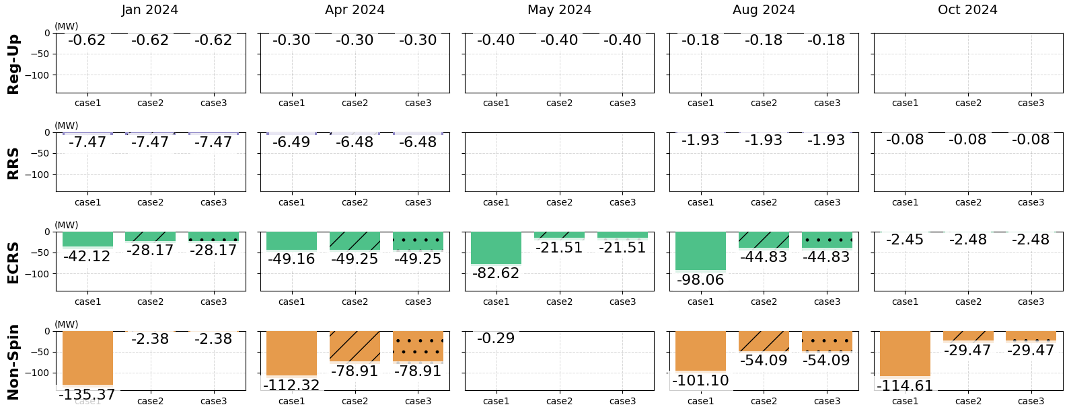
Average Ancillary Service Shortages by Month Studied
“Shortage” Measured Relative to the Ancillary Service Plan

Slide 15
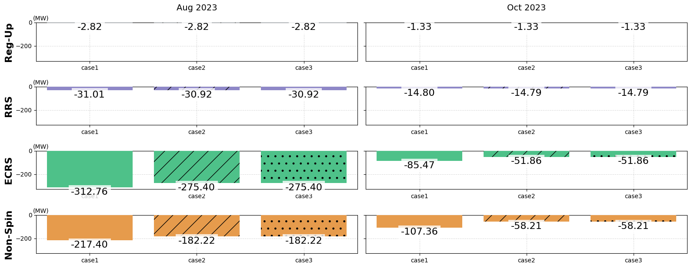
Average Ancillary Service Shortages by Month Studied cont.
“Shortage” Measured Relative to the Ancillary Service Plan

Slide 16
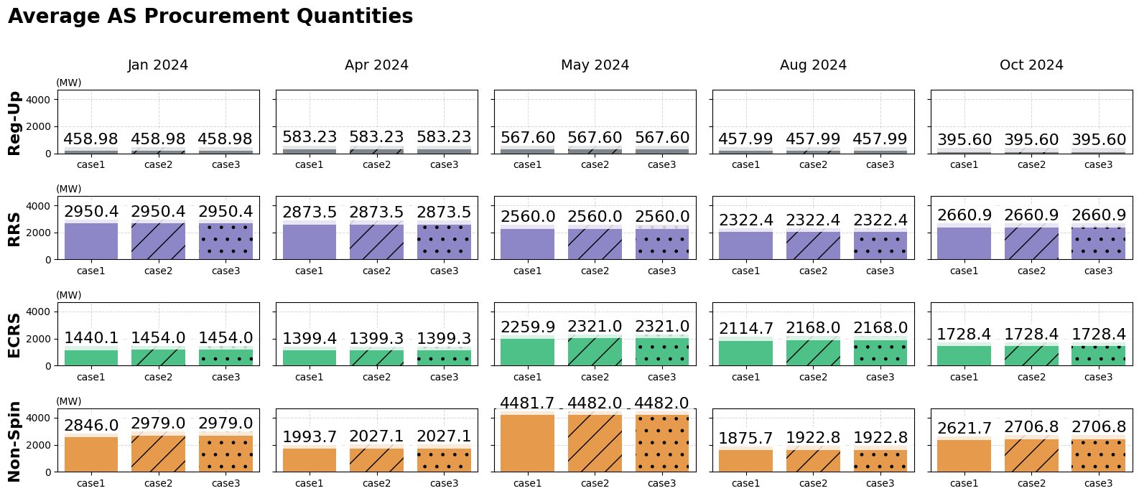
Average Ancillary Service Procurement by Month Studied

Slide 17
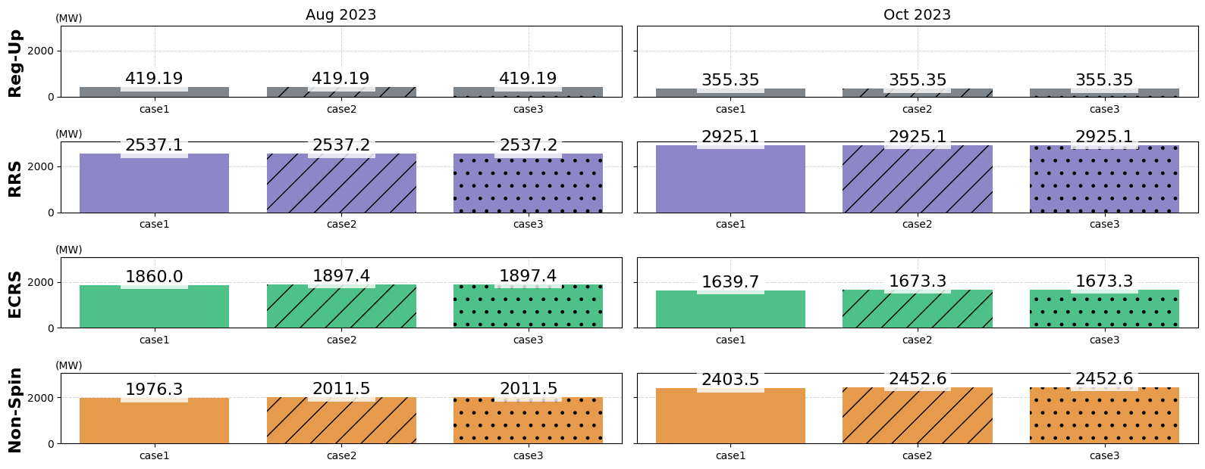
Average Ancillary Service Procurement by Month Studied cont.

Slide 18
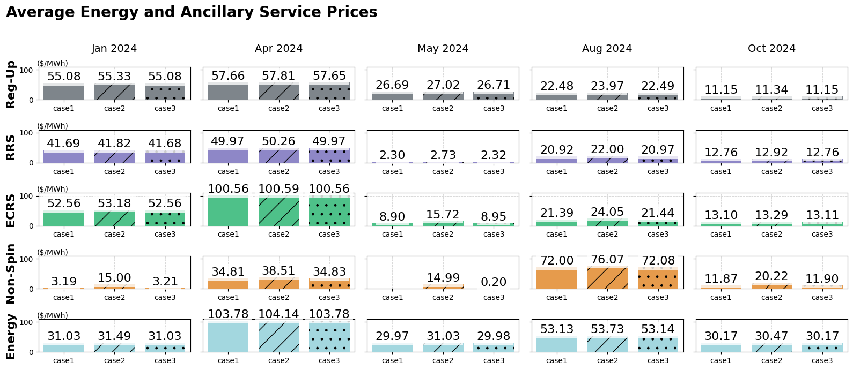
Average Real-Time Prices by Month Studied – Energy and Ancillary Services

Slide 19
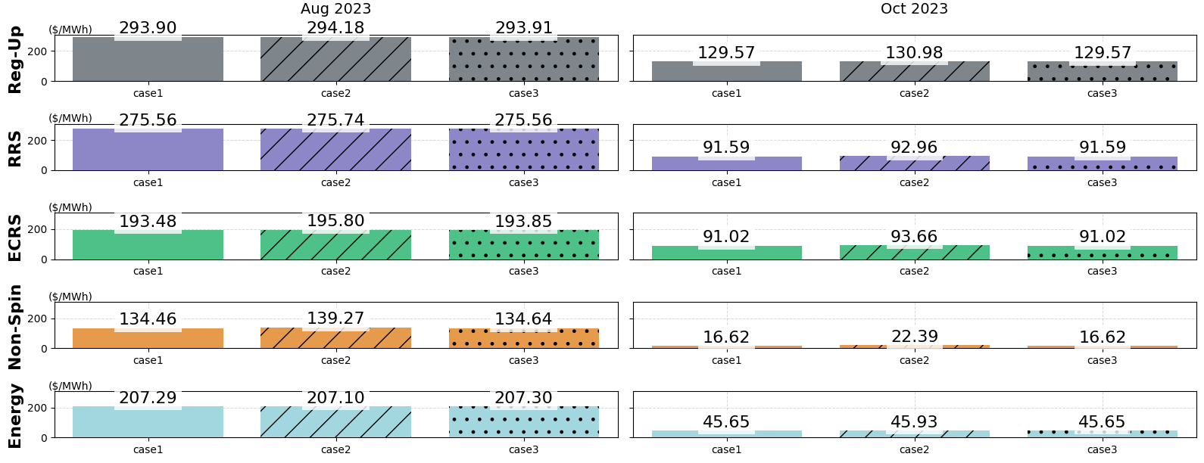
Average Real-Time Prices by Month Studied – Energy and Ancillary Services cont.

Slide 20
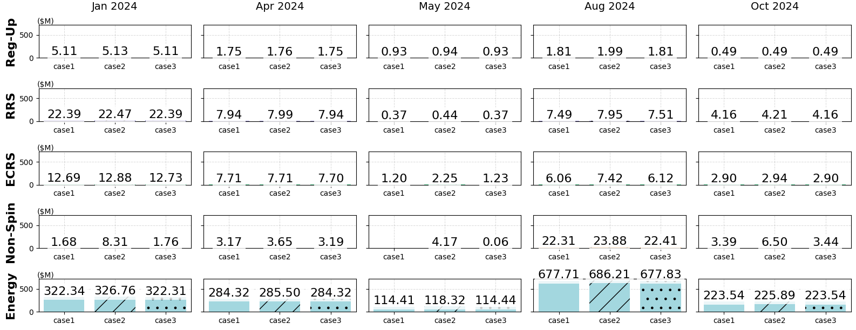
Total Real-Time Energy and Ancillary Service Value by Month Studied
“Value” Measured as Price Multiplied by Awards (Base Points or Ancillary Services)

Slide 21
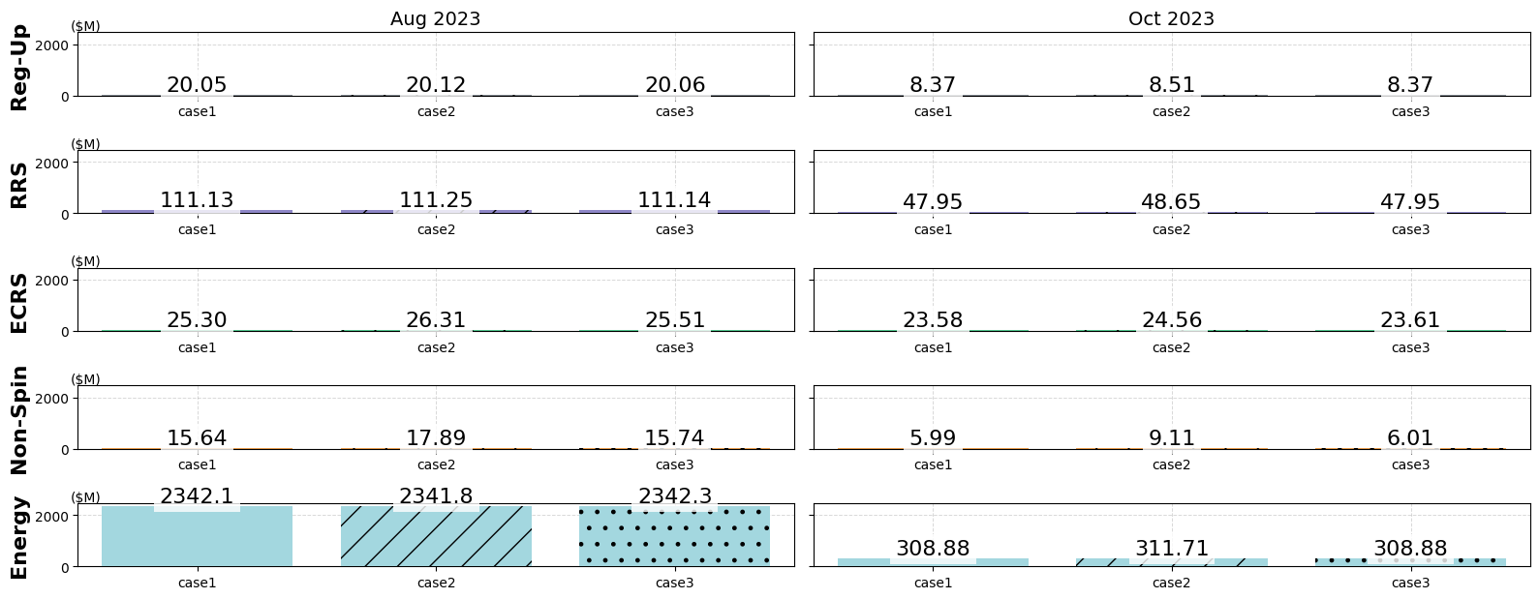
Real-Time Energy and Ancillary Service Value by Month Studied cont.
“Value” Measured as Price Multiplied by Awards (Base Points or Ancillary Services)

Slide 22
Conclusions
There is a legitimate concern that DAM and RTM pricing may be insufficient to incent self-commitment of Resources for the tail amounts of Ancillary Services and lead to increased RUC instructions, even when there is sufficient Resource capability otherwise.
$15 per MW per hour is a relatively modest ASDC price for smaller levels of shortages and the impact to average overall prices is minimal ($0.34/MWh, or 0.4% for the more extreme estimate of energy prices). The floors also help to lessen smaller levels of Ancillary Service shortages when there are sufficient competitive offers.
For those more concerned about the Ancillary Service Plan quantities, a more thorough review of the process for determining these quantities is already underway. Any ASDC floor that is applied would automatically adjust and have less effect on outcomes overall.

