Slide 1
NPRR 1268, 1269, 1270 Summary
Matt Mereness
RTCBTF
March 25, 2025

Slide 2
Summary and Timeline of NPRRs
NPRR1268 for ASDC Modifications (IMM sponsor)
NPRR1269 for 3 Parameter/Policy Changes (ERCOT sponsor)
AS Proxy Offer Floors
Ancillary Service Demand Curves (ASDCs) for Reliability Unit Commitment (RUC)
Ramp Rate Sharing
NPRR1270 for AS Qualification details (ERCOT sponsor)
Timeline and vetting of RTC+B NPRRs
PRS Urgency & Apprv 3/12
TAC approval
March 26
File NPRRs
(No impacts) Jan 28
PRS Table NPRRs
Feb 12
Board Approval
April 8
PUCT Approval
May 15
Jan 2025
Feb 2025
Mar 2025
Apr 2025
May 2025
June 2025
RTCBTF: Jan 14, 23, Feb 7,19, March 5, 25
ERCOT window for “re-factoring” development
ERCOT market trials deployed and begin on May 5, 2025
Stakeholder comments in Feb and March

Slide 3
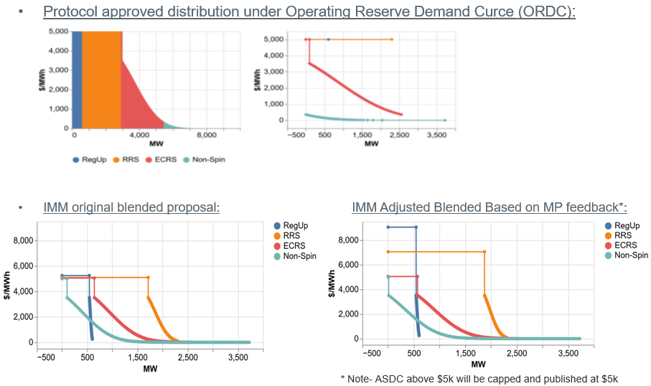
Summary of NPRR 1268
NPRR1268 RTC–Modification of Ancillary Service Demand Curves
Purpose: Improve shape of Ancillary Service Demand Curves in current protocols
History: Filed by IMM Jan 28, 2025 after RTCBTF analysis and discussion
Clarifying comments submitted by ERCOT and Hunt Energy
Unanimous PRS approval at March 12, 2025 meeting
IMM filed minor correction in comments March 19, 2025

Slide 4
Summary of NPRR1270
NPRR1270 Additional Revisions Required for Implementation of RTC
Purpose: Clarifications including removal of automatic Ancillary Service qualification and added details on qualification for Resources providing AS in real-time.
Removal of automatic qualification seen as key change to ensure reliable ancillary service awards and deployment, as well as help mitigate risk of market distortion by proxy offers.
Proxy offers are administratively created by ERCOT when a QSE does not provide an offer price for its full range of capability for energy and/or ancillary services in the real-time market.
History: Filed by ERCOT Jan 28, 2025 after RTCBTF discussion
No comments submitted
Unanimous PRS approval at March 12, 2025 meeting

Slide 5
Summary of NPRR1269
NPRR1269 RTC+B Three Parameter Policy Issues
Purpose: Determines and codifies a group of policy changes that were deferred from the original RTC-related Protocols developed in 2020. The three policy concepts below have been developed in coordination with the RTCBTF:
Scaling factor values for ramping;
Parameters for Ancillary Service proxy offers floors; and
ASDCs for use in RUC studies.
Scaling Factors for Ramping has been supported with no additional discussion by stakeholders
Parameters for Ancillary Service Proxy Offer Floors has been an evolving discussion since November 2024.
Originally ERCOT proposed and IMM supported a $0 proxy offer floor, while most RTCBTF stakeholders supported a $2,000 proxy offer floor.
After extensive debate over price distortions on both extremes, ERCOT proposed a compromise of using the minimum of $2,000 or X% of the ASDCs and was submitted as such in the original NPRR.
ERCOT submitted comments setting the values to 95% of the ASDC (reflective of the value used in numerous studies).
IMM and TIEC submitted concerns with the approach.

Slide 6
Summary of NPRR1269 (continued)
NPRR1269 RTC+B Three Parameter Policy Issues (continued)
ASDCs for use in RUC Studies has also been an evolving discussion to determine the appropriate price signals with the RUC study tool to drive efficient RUC commitments (as needed by the Operator)
ERCOT uses the RUC study tool to ensure there is enough capacity to meet demand for Energy and Ancillary Service requirements.
In developing the RTC Key Principles, it was assumed and planned for that that there would be a study to determine the appropriate ASDCs to use for RUC.
ERCOT provided analysis of the RUC tool and found that the ASDCs already planned for the RTM and DAM generally created effective solutions for the RUC operator and as such, could be used by RUC with only minimal changes (i.e., an ASDC floor).
To determine the specific value to use as an ASDC floor, ERCOT evaluated cases where there was more than sufficient capacity that could be committed by RUC or used to provide Ancillary Services, but where the RUC process would not solve for more incremental amounts of Ancillary Service shortages relative to ERCOT’s Ancillary Service Plan.
ERCOT codified $15 as the proposed ASDC floor in comments on March 3

Slide 7
Summary of NPRR1269 (continued)
NPRR1269 RTC+B Three Parameter Policy Issues (continued)
TCPA comments March 4 propose applying $15 ASDC floor to Real-Time and DAM ASDCs
RTCBTF has had on-going discussion of effectiveness of existing ASDCs
When ERCOT identified floor needed for RUC, multiple market participants voiced belief that floor should apply to real-time to provide similar price signal for self-commitment decision
When ERCOT identified ASDC floor needed for RUC, multiple market participants voiced belief floor should apply to real-time for similar price signal for self-commitment decision
ERCOT provided study to PRS to demonstrate the reliability and market impacts of the $15 floor
NPRR1269 approved at PRS March 12 by ballot vote for TCPA Comments:
3 Consumers against
All other segments unanimously supported
This would reflect:
AS Proxy Offer Floor as minimum of $2,000 or 95% ASDC
RUC ASDC with $15 floor
RTM and DAM ASDCs with $15 floor

