Slide 1
Reactive Requirement for Generation Resource netting with Load
Bill Blevins
ERCOT
PLWG discussions
March 18,2025

Slide 2
Generation Resource & Energy Storage Resource (ESR)-VSS Requirement
Nodal Protocol 3.15(2):
  All Generation Resources (including self-serve generating units) and Energy Storage Resources (ESRs) that are connected to Transmission Facilities and that have a gross unit rating greater than 20 MVA or those units connected at the same Point of Interconnection Bus (POIB) that have gross unit ratings aggregating to greater than 20 MVA, that supply power to the ERCOT Transmission Grid, shall provide Voltage Support Service (VSS).
Nodal Protocol 3.15 (4)
  Each Generation Resource and ESR required to provide VSS shall comply with the following Reactive Power requirements in Real-Time operations when issued a Voltage Set Point by a TSP or ERCOT:
  (a) An over-excited (lagging or producing) power factor capability of 0.95 or less determined at the unit's maximum net power to be supplied to the ERCOT Transmission Grid and for any Voltage Set Point from 0.95 per unit to 1.04 per unit, as measured at the POIB;
  (b) An under-excited (leading or absorbing) power factor capability of 0.95 or less, determined at the unit's maximum net power to be supplied to the ERCOT Transmission Grid and for any Voltage Set Point from 1.0 per unit to 1.05 per unit, as measured at the POIB;

Slide 3
Background
Key Discussions:
Protocol Revision Request (PRR) 830: In 2009, ERCOT proposed PRR 830 to clarify reactive power capability requirements for all generation resources. This proposal aimed to formalize the rectangle requirement, indicating that generators must maintain their reactive power capability across all output levels.
Notes:
2009 discussions and appeals https://www.ercot.com/calendar/11172009-ERCOT-Board-of-Directors

Slide 4
Historical understanding of the HSL and URL relating to VSS
High Sustained Limit-(HSL for a Generation Resource)- Limit established by the QSE, continuously updated in Real Time, that describes the maximum sustained energy production capability of the Resource.
Generation Resources required to provide VSS whose installations initially began operations on or after September 1, 1999, except as noted below, must have and maintain a URL which has an over-excited (lagging) power factor capability of 0.95 or less and an under-excited (leading) power factor capability of 0.95 or less, both determined at the generating unit's maximum net power to be supplied to the transmission grid and at the transmission system Voltage Profile established by ERCOT, and both measured at the point of interconnection to the TSP.
Notes:
Workshop on Reactive Testing June 14 2013

Slide 5
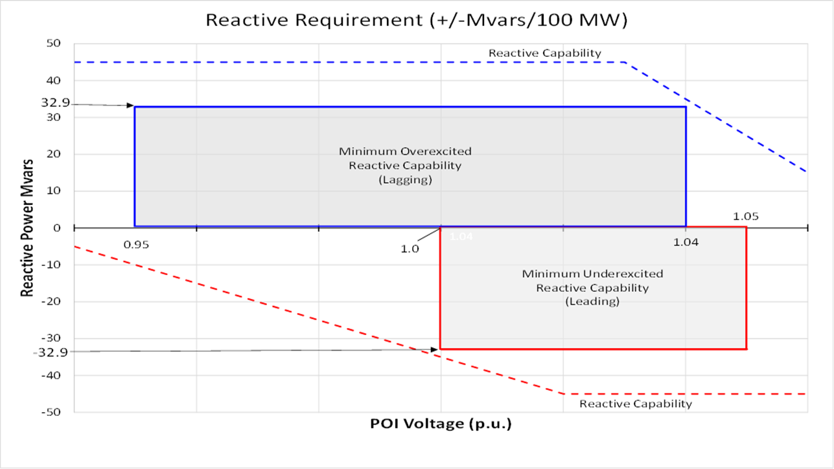
Generation Resource & Energy Storage Resource (ESR)-VSS Requirement
Nodal Protocol 3.15(4) is depicted as a rectangle.
Notes:
ERCOT formalized the rectangle configuration as the approved standard for reactive power requirements. This standard mandates that generators provide a consistent reactive power capability across all active power output levels, effectively representing the requirement as a rectangle on the reactive capability chart.

Slide 6
NPRR-945 impact on VSS
This Nodal Protocol Revision Request (NPRR) clarifies when an All-Inclusive Generation Resource may be netted against Load for Settlement purposes.
This NPRR confirms that an All-Inclusive Generation Resource and Load may be netted behind a single Point of Interconnection (POI) as long as the Load is otherwise being lawfully served without use of the ERCOT Transmission Grid. The Public Utility Regulatory Act (PURA) and existing Public Utility Commission of Texas (PUCT) rules and precedent legally determine when and how Load can be served without using the ERCOT Transmission Grid. This NPRR does not change or expand that existing law, but invokes it to limit generation netting behind a common POI.
This NPRR also sunsets provisions that previously allowed netting for sites with multiple interconnections, which were meant to address historical interconnection arrangements that are no longer common practice. Sites that are being netted today under these provisions are grandfathered in the NPRR.
Finally, this NPRR addresses outdated references to “Generation” or “generation” that should refer to All-Inclusive Generation Resources under today’s Resource definitions.

Slide 7
Generation Resource & ESR-VSS Requirement
With the addition of the load the Generation Resource is still obligated to meet its VSS requirement.
    Example: Generation Resource is registered at 100MW, 50 MW Load is added behind the meter. Addition of the Load does not reduce the maximum net amount the Generation Resource can inject to the ERCOT system. If the Load reduces its consumption or trips offline, the Generation Resource can inject up to its max net power (100MW) to the Transmission Grid.

Slide 8
Measure of VSS is at the POI for different scenarios
Co-Gen or Industrial process example
3rd Party Netted example
Notes:
These examples show the difference is the Net or the HSL will be always impacted for the Co-Gen or Industrial facility because the load and Gen operate together.

Slide 9

Questions?
Thank you!

