Slide 1
RTC+B Market Trials - Market Submissions Testing
Sruthi Hariharan/Susan Jinright
April 24, 2025

Slide 2
RTC+B Market Trials – Submissions Testing
This presentation covers the plan for ERCOT RTC+B Market Trial system configurations and digital certificates to support the stages of market trials and go-live to achieve the following:
Isolate initial testing path for QSE/Vendor Sandbox testing from current production
Minimize risk of RTC+B market submissions impacting current production
Start
03/2025
Start
05/2025
Start
07/2025
Start
09/2025
Go-Live
12/5/25*
Feb 2025
Feb 2025
Mar 2025
Apr 2025
May 2025
June 2025
July 2025
Aug 2025
Sep 2025
Oct 2025
Nov 2025
Dec 2025
Optional: RTC QSE/Vendor Developer
Submission Testing
RTC QSE
Submission Testing
Open-loop
RTC SCED
RTC Vendor
Submission Testing
RTC QSE
Submission Testing
Open-loop
RTC SCED
Ongoing Open-Loop
& Periodic Closed-loop SCED/LFC
Ongoing Open-Loop
& Periodic Closed-loop SCED/LFC
* Go-Live date reflects 12/5/2025 as first Operating Day
where 12/4/2025 is planned software migration.

Slide 3
RTC+B Market Submissions - Systems configurations
Start
03/2025
Start
05/2025
Start
07/2025
Start
09/2025
Go-Live
12/5/25*
Feb 2025
Mar 2025
Apr 2025
May 2025
June 2025
July 2025
Aug 2025
Sep 2025
Oct 2025
Nov 2025
Dec 2025
Optional: RTC QSE/Vendor Developer
Submission Testing
RTC QSE
Submission Testing
Open-loop
RTC SCED
Ongoing Open-Loop
& Periodic Closed-loop SCED/LFC
Certificate: Current MOTE
Env: ERCOT RTC Market Trial
URL: RTC MIS MOTE URL
Certificate: Current Production
Env: ERCOT RTC Market Trial
URL: RTC MIS Market Trial
Cert: Production
Env: Prod
URL: MIS Prod
QSE/Vendor developer can use MOTE certificates & RTC MIS MOTE API URL to test the submissions until end of submission testing phase (end of June) as needed. At the start of the Open Loop testing, RTC MOTE MIS URLs will be disabled.
URL links: RTC MOTE and Market Trial URL links to be used for MMSUI, OSUI and API submissions. Actual links are provided in next slide.
For notifications/responses to MPs from RTC Market Trials environment, MP will need to provide the listener URL to ERCOT

Slide 4
RTC+B Market Submissions - Systems configurations
Currently (pre-RTC),
 | Digital Certificate | MMSUI/OSUI | API
Current MOTE | Current MOTE | MOTE MIS URL: testmis.ercot.com/mmsui testmis.ercot.com/osui | MOTE MIS API URL: testmisapi.ercot.com /2007-08/Nodal/eEDS/EWS/ testmisapi.wan.ercot.com:9443/2007-08/Nodal/eEDS/EWS/
Current Prod | Current Production | PROD MIS URL: mis.ercot.com/mmsui mis.ercot.com/osui | PROD MIS API URL: misapi.ercot.com/2007-08/Nodal/eEDS/EWS/ api.wan.ercot.com:8443/2007-08/Nodal/eEDS/EWS/

Slide 5
RTC+B Market Submissions - Systems configurations (Updated with URLs)
RTC+B Market Trials and Go-live
RTC Phase | Digital Certificate | MMSUI / OSUI URL | API / WAN URL
Vendor/QSE Submissions Testing | Current MOTE | RTC MOTE MIS URLs https://testmarkettrials.ercot.com/mmsui/mmsui/displayTradesLanding.action https://testmarkettrials.ercot.com/osrui/osrui/Summary.action | RTC MOTE API/WAN URL https://testmarkettrialsapi.ercot.com/NodalAPI/EWS/ https://testmarkettrialsapi.wan.ercot.com/NodalAPI/EWS/
Open Loop and Closed Loop Testing | Current Production | RTC Market Trial URL https://markettrials.ercot.com/mmsui/mmsui/displayTradesLanding.action https://markettrials.ercot.com/osrui/osrui/Summary.action | RTC Market Trial API/WAN URL https://markettrialsapi.ercot.com/NodalAPI/EWS/ https://markettrialsapi.wan.ercot.com/NodalAPI/EWS/
From RTC Go-live onwards | Current Production | Current Prod MIS URL mis.ercot.com/mmsui mis.ercot.com/osui | New Production API/WAN URL

Slide 6
RTC+B Market Submissions - Systems configurations Public Key Update for WAN/API submissions
For API/WAN submissions into Market Trials environments, need to download public keys and place into the keystore location in system being used for RTC+B submissions.
No change to digital user certificates – continue to use existing MOTE and Production Certificates
Market Trail API Public key location: https://www.ercot.com/services/mdt/webservices

Slide 7
RTC+B Market Trials Systems Readiness Summary
RTC+B Market Trials Systems are built and setup for market submissions testing from Market Manager UI and through API.
Market Trials Systems is released for QSEs and their vendors developer level testing from 03/07/2025 and will be open until 04/30/2025.
The next phase of testing will include QSE submission testing as well as telemetry verification from 05/05/2025 to 06/30/2025.
Valid current MOTE certificates are required to connect to RTC+B Market Trials Systems for this phase of testing.
This first release into the Market Trials environment is being considered a “Sandbox release” as it is an early release with limited capability.
ERCOT is performing limited testing considering market facing environment setup. ERCOT will work with QSEs and with their vendors to resolve any issues.
Report issues to ERCOT at rtcb@ercot.com
Market Notice was sent on 2/26/2025 with details on QSE/Vendor sandbox testing.
https://www.ercot.com/services/comm/mkt_notices/M-B022625-01

Slide 8
Outage Submissions Testing Plan
For the initial phases of market trial testing including Vendor sandbox testing and QSE submission testing (spanning Mar-Jun 2025):
Request QSEs to send us an email request (to RTCB@ercot.com) with the details of the outage to be approved for ERCOT review/action.
ERCOT will manually approve the outages.
This will help QSEs, and their vendors test their Outage Scheduler software.
ERCOT is also reviewing the cutover plan for closed loop testing and Production go-live to carry the outages to the RTC systems and will add more details to the individual Market Trials handbooks.
Above 2.3.6 and 4.3.8 sections updates modifies XSDs, rest are EIP Specifications Document updates Only.

Slide 9
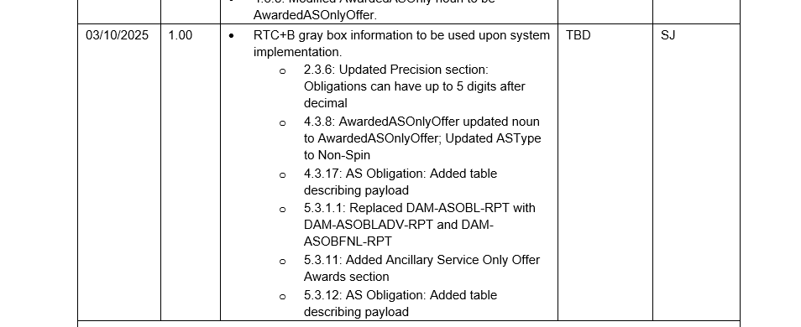
Updates to EIP External Specifications Document and Market Submissions XSDs
Updated RTC EIP External Interfaces Specification document and Market Submissions XSDs to include below minor changes.
Some of these are identified during ongoing Market Trials Sandbox Testing.
4.3.8 & 5.3.11 sections update 2 XSDs but no structural changes (value/comments changes only), rest are EIP Specifications Document updates.

Slide 10
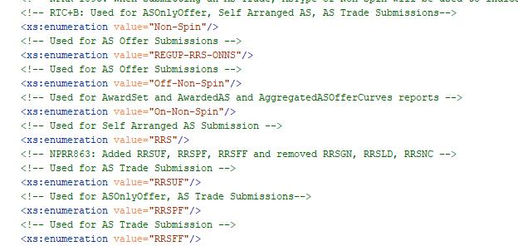
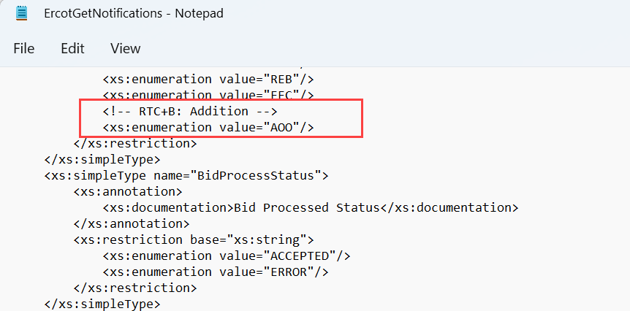
Updates to EIP External Specifications Document and Market Submissions XSDs
Following Market Submissions XSD files got updated
ErcotCommonTypes.xsd
ErcotGetNotifications.xsd
4.3.8: Updated ASType for AS Only Offer to Non-Spin
5.3.11: Added Ancillary Service Only Offer Awards section

Slide 11
Updates to EIP External Specifications Document and Market Submissions XSDs
Updated EIP External Specification document and XSD are posted to the ercot.com.
Specifications document
https://www.ercot.com/files/docs/2024/06/24/EIP_External_Interfaces_Specification_RTCB_v1.0.zip
XSDs
https://www.ercot.com/files/docs/2024/06/24/External_Web_Services_XSD_RTCB_v1.0.zip
These artifacts are also posted to developer portal
Specifications document - https://developer.ercot.com/applications/ews/ews/
XSDs - api-specs/ews/xsds at ews_rtc_b_updates · ercot/api-specs · GitHub

Slide 12
Updates to EIP External Specifications Document Related to Notifications (Alerts and Notices)
Additional changes related to Notifications (Notices and Alerts) from EMS are added to EIP External Specifications document (section 5.3.1)
Updated EIP Specification document (EIP External Interfaces Specification RTCB v1.0) is available at
Ercot.com - https://www.ercot.com/services/mdt/userguides
ERCOT developer portal -https://developer.ercot.com/applications/ews/Notifications%20Messages/Notices%20and%20Alerts/EMS%20System-Generated%20Notices/

Slide 13
FAQ - Market Trials Submission Testing
Q1. The following questions related to Market Trials submissions testing have been addressed in the RTC Market Trial handbooks. Details in the following two slides:
What are the different submissions that QSE needs to submit for each phase of Market Trials?
What is the duration for which QSE needs to submit for each phase of Market Trials?
What actions/applications will ERCOT be running during each phase?
What are performance evaluation criteria for the QSEs for each phase of Market Trial testing?

Slide 14
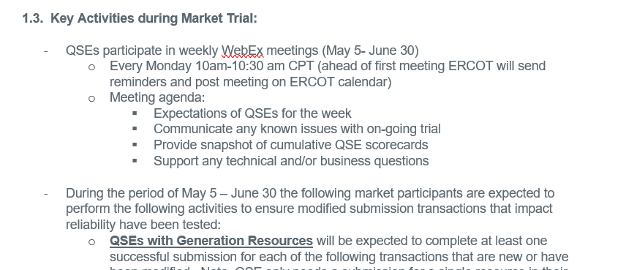
Market Submissions Handbooks Review
For each phase of Market Trial testing, a handbook will be posted to the RTBTF web page - https://www.ercot.com/committees/tac/rtcbtf
Handbook to cover the expectations for each phase of testing, including
the key activities for that testing phase,
required submissions and expectations of submissions data entry with regard to current Production submissions. For example, during closed loop testing we would expect RTC submissions to closely align with current Production submissions to ensure smooth transition into and out of closed loop testing,
QSE performance evaluation criteria,
and high-level timelines for each phase.
For example: screenshot from Handbook 1 – RTC QSE Submission Testing https://www.ercot.com/files/docs/2025/04/07/RTCB_Market_Trials_Handbook_1_MarketSubmissions_Updated_04072025.docx

Slide 15
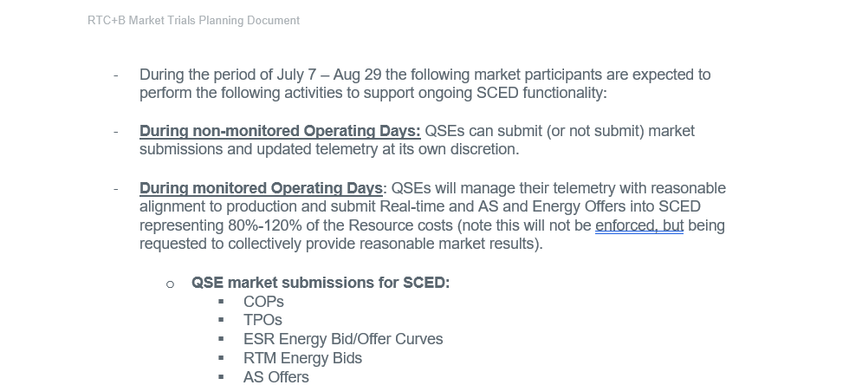
Market Submissions Handbooks Review
Example 2: RTC Market trials Handbook 3 - Open loop testing https://www.ercot.com/files/docs/2025/04/07/RTCB_Market_Trials_Handbook_3_OpenLoop_RTC_SCED_03252025_DRAFT.docx

Slide 16
FAQ - Market Trials Submission Testing
Q2. Request for IP/DNS information
A2. These are not changed for RTC. For any IP address or DNS names for Ercot API or Ercot Notification Source IP address, please contact the ERCOT client reps/account managers, or send a request email to RTCB mailbox.
Q3. Notifications from ERCOT
A4. To support testing notifications from ERCOT for API submissions, QSEs should submit API Listener URL set up information using the template available from the “Technical RTC+B Details” section of the RTCBTF page. QSEs are expected to complete this template and send it to RTCB@ercot.com.
The specific coded alerts/notifications from ERCOT can be found in the EIP External Specs document Section 5.3.1 - https://www.ercot.com/files/docs/2024/06/24/EIP_External_Interfaces_Specification_RTCB_v1.0.zip
For Market submission validations and corresponding error messages – the only changes are related to the submission changes for RTC. The updated RTC+B submission validation rules can be found here - https://www.ercot.com/mp/data-products/data-product-details?id=NP4-450-M. These messages do not include an error code, and the message text for these vary based on the submission error and are specific to the resource/values submitted.

Slide 17
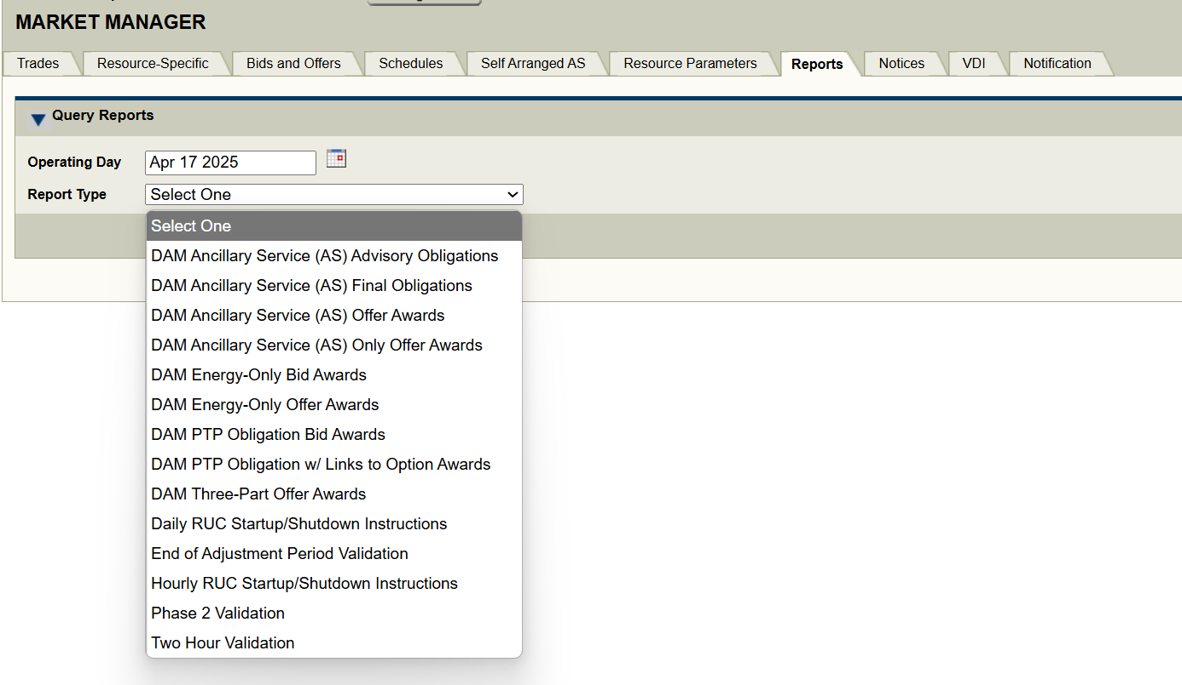
FAQ - Market Trials Submission Testing
Q4. When can MPs start testing DAM and SCED awards data along with reports in Market Trials?
A4. Currently the Market Trial environment is setup with limited functionality. For the first two phases of testing, the functionality is limited to vendor and QSE market submission testing and telemetry validations. Starting with Open Loop testing till go-live, the environment will be updated to allow for DAM/SCED runs, and ERCOT will plan to publish the details of the data available to MPs during this time.
DAM award reports will be available on MMSUI/via EWS on the days when DAM is run on RTC market trials

Slide 18
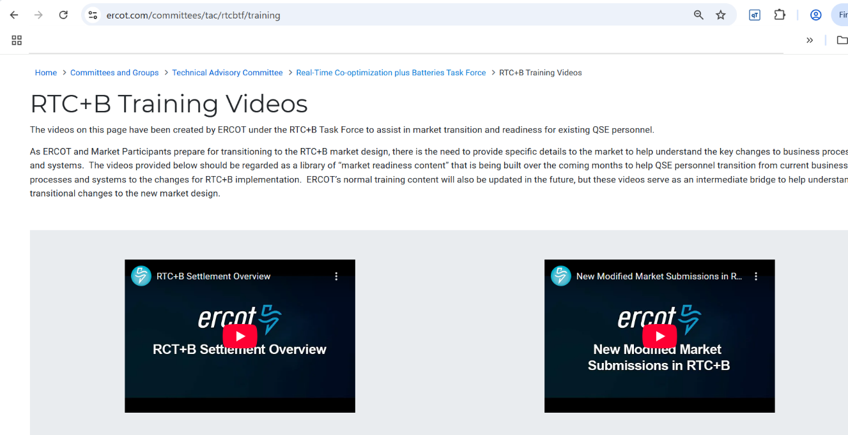
FAQ - Market Trials Submission Testing
Q5. RTC+B Settlements Extracts in Market Trials?
A5. Market Trials are limited for Settlements and Billing:
ERCOT will not be providing QSE specific statement files, however, generalized sample DAM and RTM Statements will be posted in the next 1-2 months for review.
These statements do not structurally change, but will include changes in the billing determinants for RTC
ERCOT has provided training on the RTC billing determinants and posted in a YouTube on this page:
https://www.ercot.com/committees/tac/rtcbtf/training (Select RTC+B Settlement Overview)

Slide 19
RTC+B Market Trials - Market Submissions Testing
Questions?
Provide feedback to ERCOT on any concerns/questions at rtcb@ercot.com

