Slide 1
CRR Updates
Samantha Findley
CRR Market Operations
CMWG
March 17, 2025

Slide 2
Agenda
LTAS transactions and solution times
Update on NPRR1261 Operational Flexibility for CRR auction limits

Slide 3
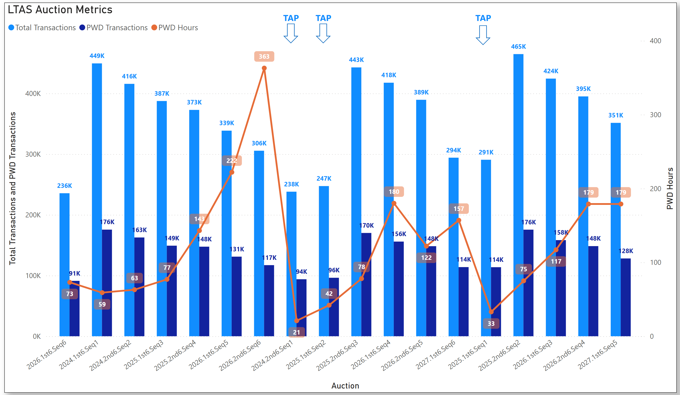
Historical LTAS transactions and solution times

Slide 4
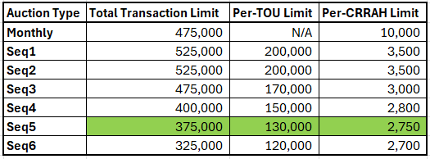
Update on NPRR1261 Operational Flexibility for CRR auction limits
NPRR1261 Operational Flexibility for CRR auction limits was approved by the PUCT on March 13.
https://www.ercot.com/mktrules/issues/NPRR1261
The 2025.2nd6.AnnualAuction.Seq1 will be the first LTAS to use the transaction limit table below.
Seq5 limits have been reduced by 25K/20K/50 due to the most recent Seq5 solution time.

