Slide 1
Project Update
March 12, 2025
Troy Anderson
ERCOT Portfolio Management

Slide 2
Project Update Agenda
  Recent / Upcoming Project Highlights
  2025 Release Targets
  Major Projects
  Priority/Rank Recommendations for Revision Requests with Impacts
    NPRR1234 – Interconnection Requirements for Large Loads and Modeling Standards for Loads 25 MW or Greater
    NPRR1256 – Settlement of MRA of ESRs
    SCR829 – API for the NDCRC Application
    Additional time needed to complete IAs
      NPRR1226 – Estimated Demand Response Data
      SCR830 – Expose Limited API Endpoints Using Machine-to-Machine Authentication
  Technology Working Group (TWG)
    Next meeting is 3/26/2025
See link below for new go-live history posting
Location of Revision Request Project Information: http://www.ercot.com/services/projects

Slide 3
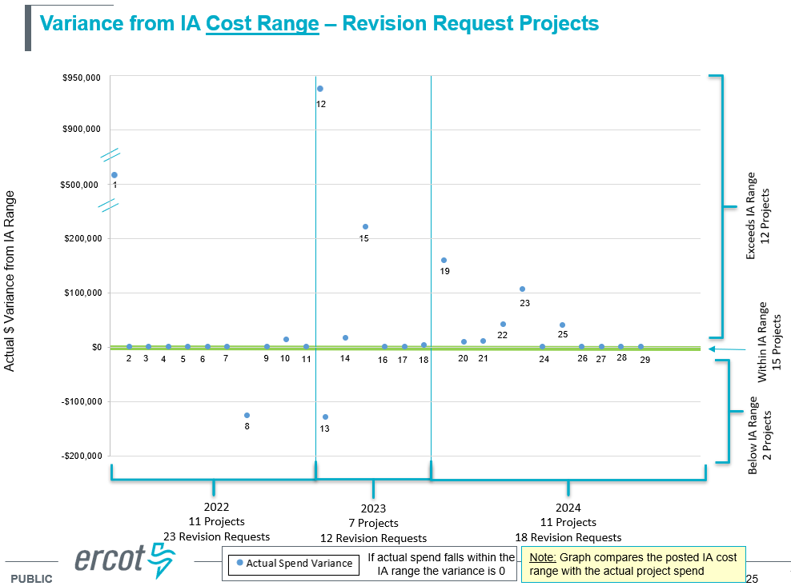
Recent / Upcoming Project Highlights
2025 March Effective Date – 3/1/2025 Complete
  NPRR1254 – Modeling Deadline for Initial Submission of Resource Registration Data
RTC+B Market Trials Sandbox Deployed – 3/7/2025 Complete
  2/26/2025 Market Notice details for connectivity
2025 March Release – R3 – 3/28/2025 In Flight
  NPRR1145 – Use of State Estimator-Calculated ERCOT-Wide TLFs in Lieu of Seasonal Base Case ERCOT-Wide TLFs for Settlement
2025 May Release – R5 – 5/29/2025 In Flight
  NPRR1253 – Incorporate ESR Charging Load Information into ICCP
    ICCP and Public API implementation
Follow-up from February PRS meeting on IA variances:
  Total Revision Request project cost delivered in 2022-2024 $14.52M
  Cost overruns for the 12 projects that exceeded IA estimates $ 2.06M
    $930k for NPRR863 ECRS
    $507k for NPRR863 FFR Advancement
    $620k for remaining 10 projects
  Cost underruns for the 2 projects that fell below IA estimates ($256k)
Note: Projected Go-Live dates are subject to change.
Please watch for market notices as the effective dates approach.

Slide 4
2025 Release Targets – Approved NPRRs / SCRs / xGRRs
R1
R3
R5
January 1/30 | February 2/27 | March 3/27 | April 4/24 | May 5/29 | June 6/26
NPRR945 NPRR1219 | NPRR1254 RTC+B Market Trials Sandbox Deployed | NPRR1145 NPRR1253(a) | RTC+B Market Trials begin on 5/5/2025 | NPRR1253(b)
R2
R4
R6
ü
ü
E
RTC QSE Submission Testing
3/1
ü
RTC QSE Telemetry Check-out
1/1
3/7
ü
E
RTC+B
12/5
July 7/31 | August 8/28 | September 9/25 | October 10/23 |  | December 12/18
 |  |  |  |  | RTC+B Stabilization begins
R7
R8
R9
R10
E
R11
NPRR1007-1013
Open-loop RTC SCED
Closed-loop SCED/LFC
NPRR963(a)
NPRR965
NPRR1000
NPRR1014
NPRR1054
NPRR1058
NPRR1172
NPRR1204
NPRR1216
NPRR1236
NPRR1245
NPRR1246
NOGRR211
NOGRR268
OBDRR020
OBDRR052
PGRR118
QSE Telemetry Tests
Day-Ahead Market
Go-live dates can differ from Protocol effective dates – Please refer to market notices for more details
APPENDIX
Red Text: New additions and target release changes
Strike-Through Text: Previous target release
(a), (b), etc.: Multiple phase release
Project Status Codes
NS = Not Started
I = Initiation
P = Planning
E = Execution
H = On Hold
NPRR963(a) – Portion of NPRR
NPRR1253(a) – ICCP
NPRR1253(b) – Public API
RTC+B Market Trials
RTC+B Stabilization
Release targets are subject to change

Slide 5
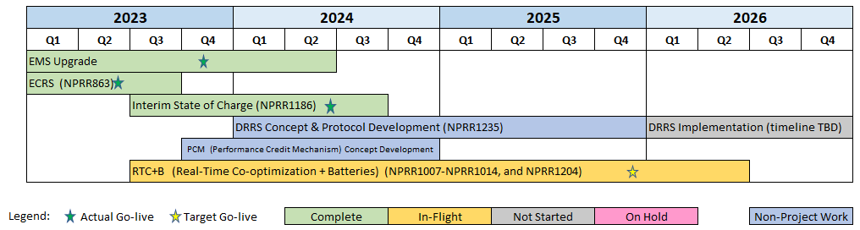
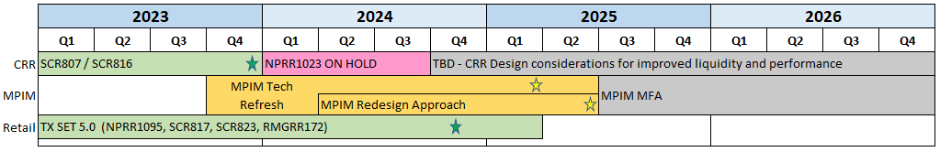
Major Projects
Other Project Highlights

Slide 6
Priority / Rank Recommendations for Revision Requests with Impacts
Recommendations for…
Revision Request | Description | Priority | Rank | Comments
NPRR1226 | Estimated Demand Response Data | TBD | TBD | Additional time needed to complete IA
NPRR1234 | Interconnection Requirements for Large Loads and Modeling Standards for Loads 25 MW or Greater | 2026 | 4730 | $600k-$800k, 12-18 months Impacted Systems: RIOO, EMS, MMS, NMMS, Reporting RIOO implementation of current processes
NPRR1256 | Settlement of MRA of ESRs | 2027 | 4800 | $25k-$50k, 3-5 months Impacted Systems: Settlements Priority aligns with NPRR885 timeline
SCR829 | API for the NDCRC Application | 2025 | 4560 | $100k-$200k, 7-10 months Impacted Systems: NDCRC No conflicts with RTC+B
SCR830 | Expose Limited API Endpoints Using Machine-to-Machine Authentication | TBD | TBD | Additional time needed to complete IA
PPL Rank Information
Next available 2025 Rank in Business Strategy = 4560
Next available 2026 Rank in Business Strategy = 4730
Next available Rank in Regulatory = 400

Slide 7
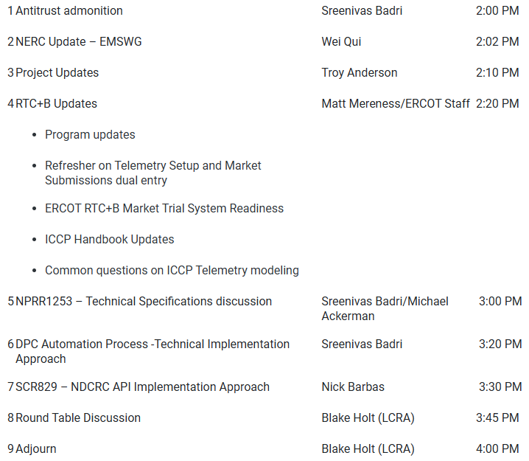
Technology Working Group (TWG)
Agenda for TWG meeting held on 2/27/2025:
Next TWG scheduled for 3/26/2025

