Slide 1
Nodal Protocol Revision Request (NPRR) 1269
Impact of Proposed ASDC Floors for Real-Time and Day-Ahead
David Maggio
Principal, Market Design & Analytics
March 12, 2025
Protocol Revision Subcommittee (PRS)
ERCOT Public

Slide 2
Introduction
On March 3rd, ERCOT filed comments to NPRR1269 to codify specific numbers that were previously left as variables, while analysis and discussion at the Real-Time Co-optimization plus Batteries Task Force (RTCBTF) was ongoing.
  The comments were specific to the Ancillary Service Demand Curves (ASDCs) for Reliability Unit Commitment (RUC) and the Ancillary Service proxy offer floor parameters.
On March 4th, TCPA filed comments to NPRR1269 to take the ASDC floor for RUC and apply it to the Day-Ahead and Real-Time Markets (DAM and RTM).
  This concept had been raised at the RTCBTF by market participants but had not yet been captured in proposed NPRR1269 language.
This presentation is intended to provide ERCOT’s perspective and analysis on potential impacts to the RTM in having the ASDC floor concept applied.

Slide 3
ERCOT’s Perspective on the Concept of TCPA’s Comments
ERCOT is generally in favor in this concept moving forward:
  In light of Ancillary Service quantities we see today and in the near-term, there is a legitimate concern that DAM and RTM pricing may be insufficient to incent self-commitment of Resources for the tail amounts of Ancillary Services and may lead to increased RUC instructions, even when there is sufficient Resource capability otherwise.
  $15 per MW per hour (the ASDC floor proposed by ERCOT for RUC) is a relatively modest ASDC price for smaller levels of shortages and well below the minimum prices for Regulation Service (Reg) and Responsive Reserve Service (RRS) already included in NPRR1268.

Slide 4
ERCOT’s Perspective on the Concept of TCPA’s Comments cont.
  The distinction that this is a floor on the ASDCs and not a floor on the price for Ancillary Services is important. To the degree there are sufficient Ancillary Service offers and Resource capability, those offers would be setting the price, not the ASDCs. This is equivalent to what is seen in DAM today where current penalty prices are ~$5,000 per MW per hour, although that is almost never the clearing price.
  The deeper concern for those opposed to the concept seems to be the quantities that feed into the Ancillary Service Plan generally. A more thorough review of the process for determining these quantities is already underway with the development of a “full statistical” analysis tool and the consideration of “closer to the Operating Day” Ancillary Service quantity determination. If there are Ancillary Service quantity reductions, this concept will automatically adjust to account for that.

Slide 5
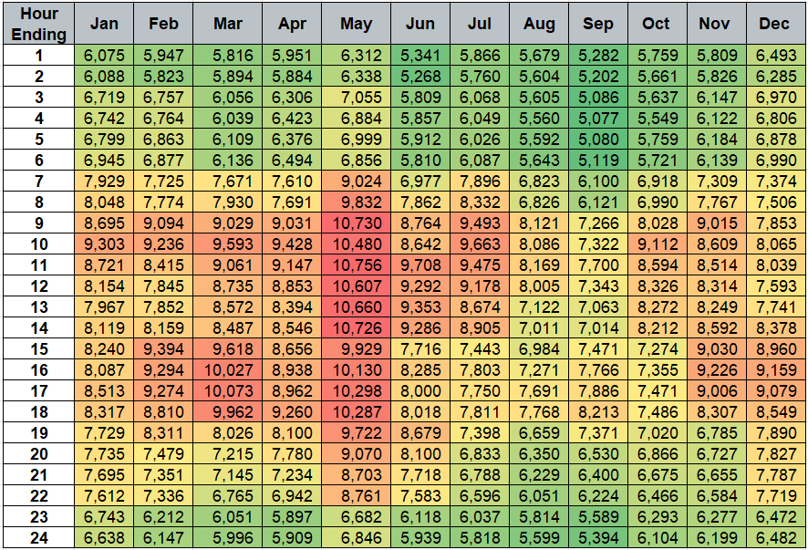
Ancillary Service Plan for 2025
As it stands today, the Aggregate Operating Reserve Demand Curve (AORDC) is guaranteed to go to $0 per MW per hour at 10 GW of Ancillary Services and goes to pennies per MW per hour well before that.
While a floor will not affect the ASDCs at all in some hours, in others it may be the only means for procuring the Ancillary Service Plan, even if there is more than sufficient Resource capability that would otherwise be available.
Summed 2025 Ancillary Service Plan by Hour and Month in MW (Excluding Reg-Down)

Slide 6
Analysis Framework for RTM Impacts
Scenarios Evaluated
  Case 1: Real-Time Co-optimization (RTC) without ASDC floors using max(min(2000,”95%”)-0.01,0) for proxy floors
  Case 2: RTC with $15 per MW per hour ASDC floors using (min(2000,”95%”) – 0.01) for proxy floors
  Case 3 (for prices): Derived from case 1 and 2 outputs to explicitly isolate the impacts of the ASDC floor and ignore impacts from proxy offer floors and the lack of Ancillary Service Offer data available for the simulations
    If the ASDC floor sets the price for ERCOT Contingency Reserve Service (ECRS) or Non-Spinning Reserve Service (NSpin) in case 2, use the case 2 prices.
    Otherwise use the case 1 prices.
Dataset (~3,800 intervals across 5 months and 154 Operating Days)
  Jan. ‘24 (hours ending 18-19)
  Apr. ’24 (hours ending 20-21)
  May ‘24 (hours ending 13-14)
  Aug. ‘24 (hours ending 20-21)
  Oct. ‘24 (hours ending 20-21)
Metrics
  Count of intervals where the ASDC floor is setting the price
  Average price of Ancillary Services and energy
  Average quantity of Ancillary Service procurements and shortages
Simulations of historical days are hampered by a lack of existing Real-Time Ancillary Service Offers.
While we don’t expect this to be a typical case in practice, this means that the simulation results can be dominated by proxy offers.
Combined, cases 2 and 3 attempt to address this and provide the range of expected pricing outcomes with actual outcomes falling in between and being dependent on offer behavior.

Slide 7
Illustration of ASDCs with a Floor (ECRS and NSpin)
ECRS Plan: 2,559 MW
NSpin Plan: 1,942 MW
ECRS Plan: 2,514 MW
NSpin Plan: 4,482 MW

Slide 8
Illustration of ASDCs with a Floor (ECRS and NSpin) cont.
ECRS Plan: 1,555 MW
NSpin Plan: 2,403 MW
The actual effects of a floor on the ASDC shape will vary by month and hour.
For some hours, like this October period, there is no impact to the ASDCs whatsoever.
For others, like the May period on the previous slide, the floor creates a long tail to encourage self-commitment to meet the Ancillary Service Plan when true scarcity does not otherwise exist.

Slide 9
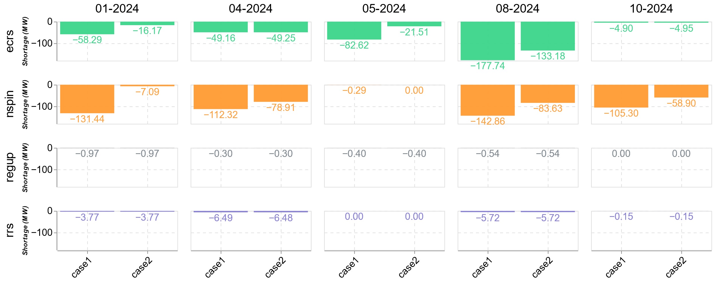
Average Ancillary Service Shortages by Month Studied
Measured Relative to the Ancillary Service Plan
Impacts were limited to ECRS and NSpin and for intervals where shortages were relatively marginal, i.e., not deeper levels of scarcity in which prices were further up the ASDCs. This improved average shortages overall.
The ASDC floors infrequently set the price (1.5% of the intervals studied).
For case 3, shortage amounts and time that the ASDC floor is setting the price would effectively be equivalent to case 2.
Count of Intervals w/ Floor Setting Price
Month | ECRS | NSpin
Jan. ‘24 | 0 | 5
Apr. ‘24 | 0 | 3
May ‘24 | 10 | 0
Aug. ‘24 | 25 | 7
Oct. ‘24 | 1 | 10

Slide 10
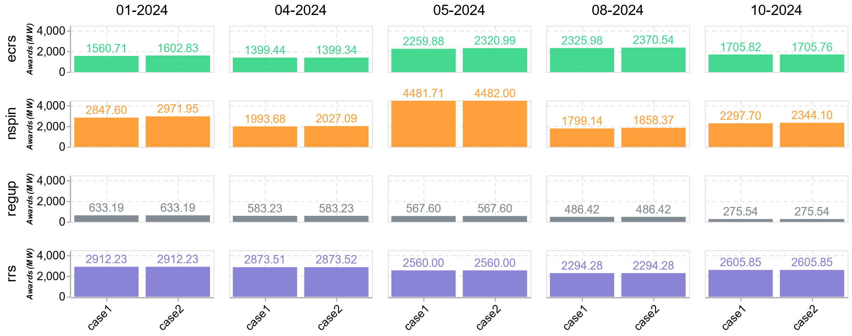
Average Ancillary Service Procurement by Month Studied
As noted with the shortage data on the previous slide, impacts to Ancillary Service procurement were limited to lower levels of shortages. However, the floor increased average procurement quantities generally.

Slide 11
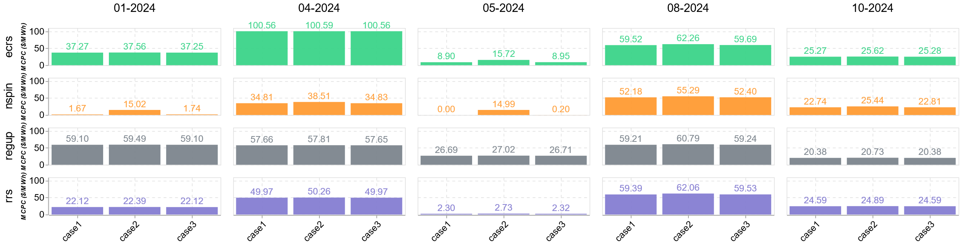
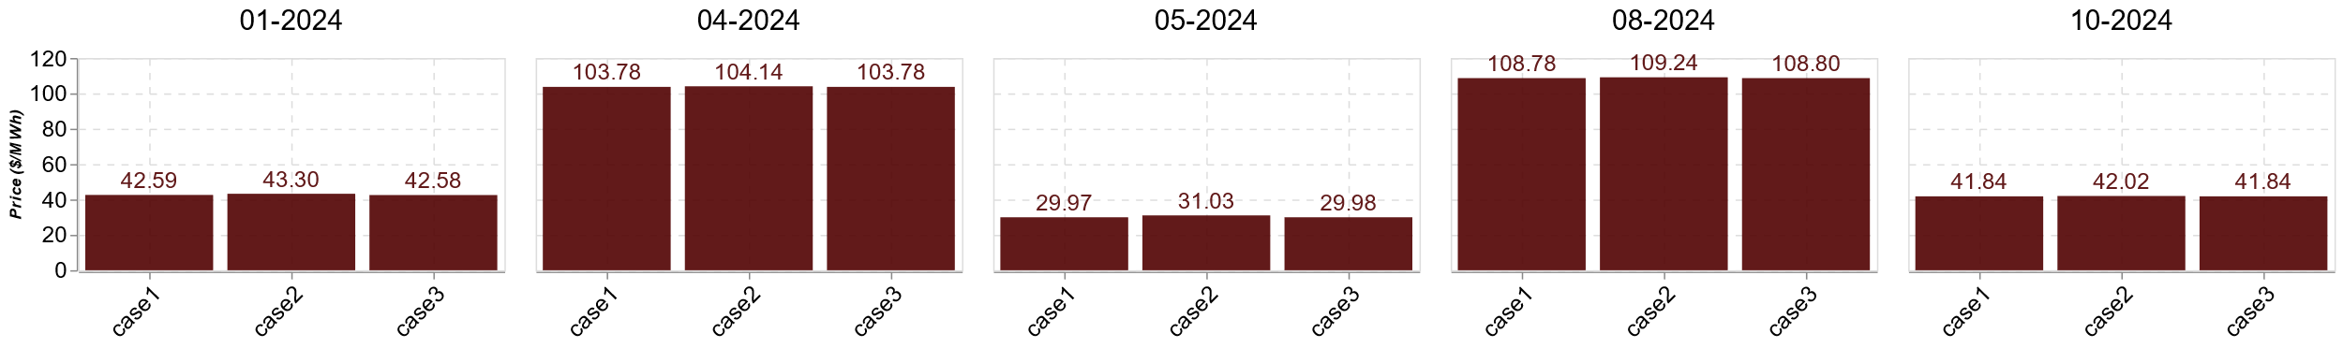
Average Real-Time Prices by Month Studied
Ancillary Service Prices
Energy Prices
With the lack of Real-Time Ancillary Service offers and the dependency on proxies for simulation, case 2 provides a conservative evaluation of potential price changes. Case 3 numbers provide the other end of the range of outcomes.
Even considering case 2 outcomes, ECRS and NSpin prices are in alignment with other Ancillary Service and historical prices and energy price impacts are minimal.

Slide 12
Conclusions
There is a legitimate concern that DAM and RTM pricing may be insufficient to incent self-commitment of Resources for the tail amounts of Ancillary Services and lead to increased RUC instructions, even when there is sufficient Resource capability otherwise.
$15 per MW per hour is a relatively modest ASDC price for smaller levels of shortages and the impact to average overall prices is minimal ($0.56/MWh, or 0.8%, for case 2 for energy prices). The floors also help to lessen smaller levels of Ancillary Service shortages.
For those more concerned about the Ancillary Service Plan quantities, a more thorough review of the process for determining these quantities is already underway. Any ASDC floor that is applied would automatically adjust and have less effect on outcomes overall.

