Slide 1
PDCWG Report to ROS
Chair: Chad Mulholland, NRG
Vice Chair: N/A
ROS
March 6th, 2024

Slide 2
Report Overview & Notes
Report Overview
Meeting Minutes
ERCOT Frequency Control Metrics and Regulation Reports
TRE Report
Analysis of Disturbances
Other Items
Analysis – Why are there fewer FMEs? (future PDC)
IBRs under deep curtailment (future PDC & IBRWG)
Status on BAL-001-TRE, SAR-13
BAL-001-TRE-2 FMEs and IMFR
0 FME in the month of January
Note that occurrence of FMEs is down a lot – 2021 had 19; 2022 had 16; 2023 had 7; 2024 had 6
Frequency Control Report

Slide 3
Frequency Measurable Events Performance

Slide 4
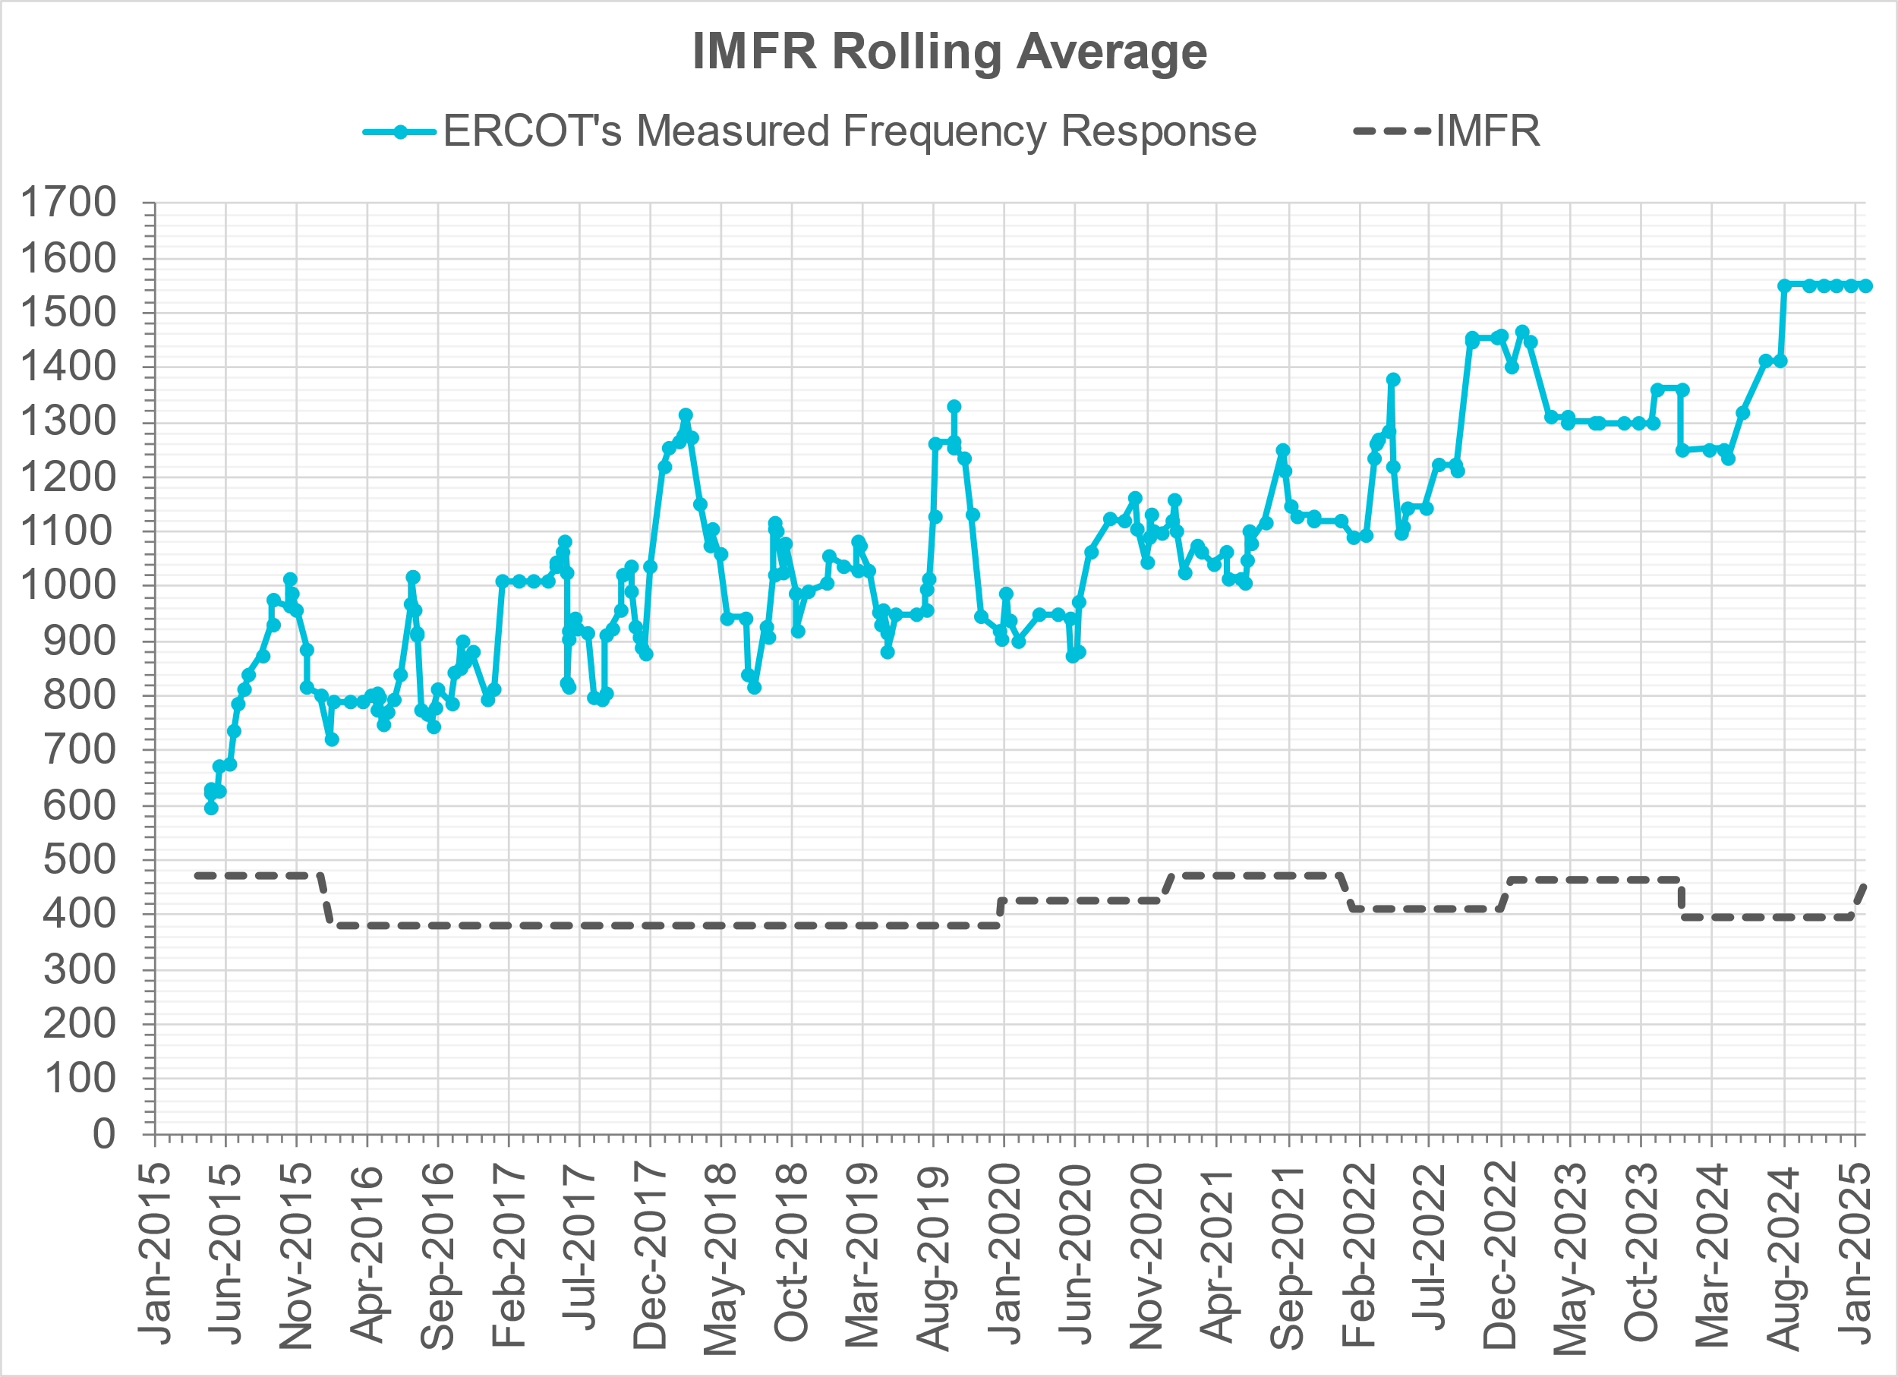
Interconnection Minimum Frequency Response (IMFR) Performance
IMFR Performance currently
1552.00 MW/0.1HZ
Frequency Response Obligation (FRO): 455 MW/0.1 Hz

Slide 5
Questions?

Slide 6
Frequency Control Report
January 2025

Slide 7
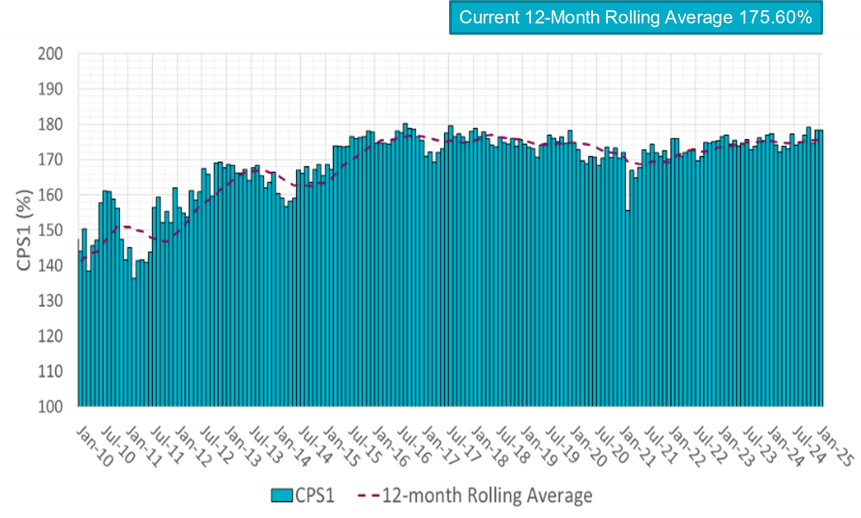
CPS1 Performance

Slide 8
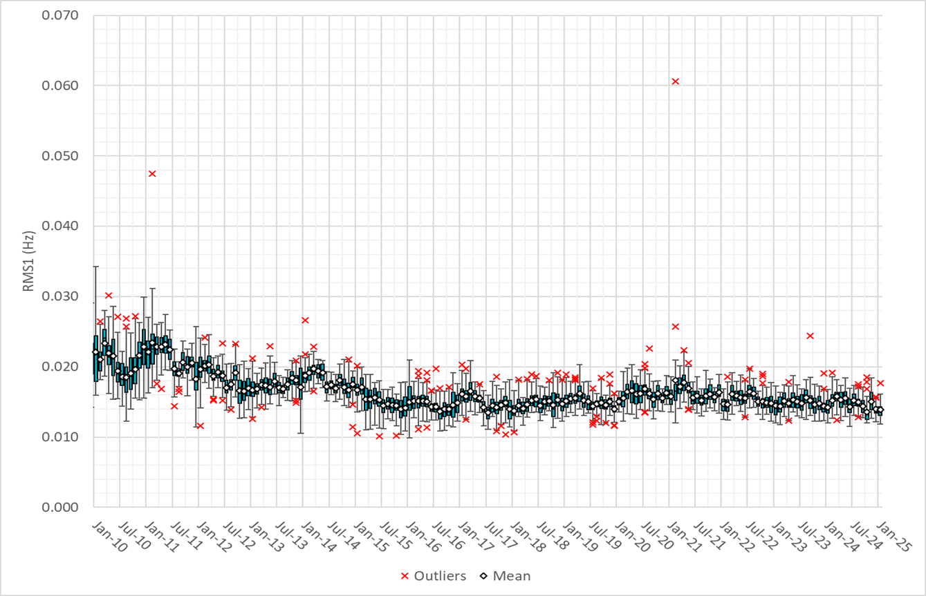
RMS1 Performance of ERCOT Frequency
Notes:
13.89 mHz on avg for January 2025

Slide 9
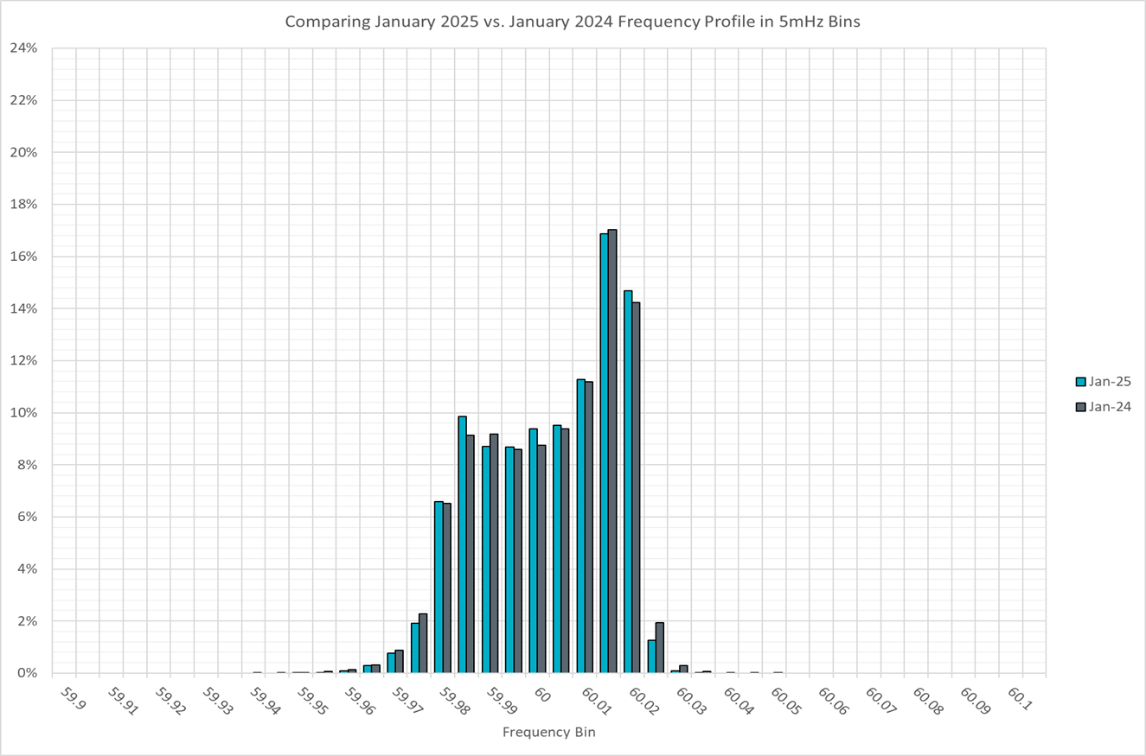
Frequency Profile Analysis

Slide 10
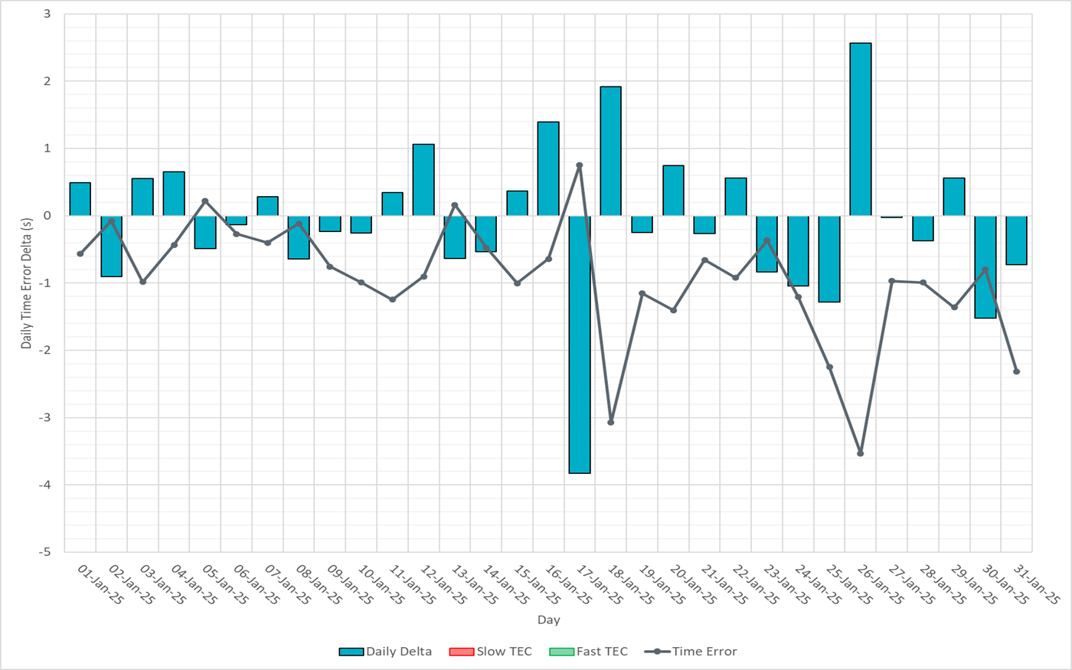
Time Error Corrections

Slide 11
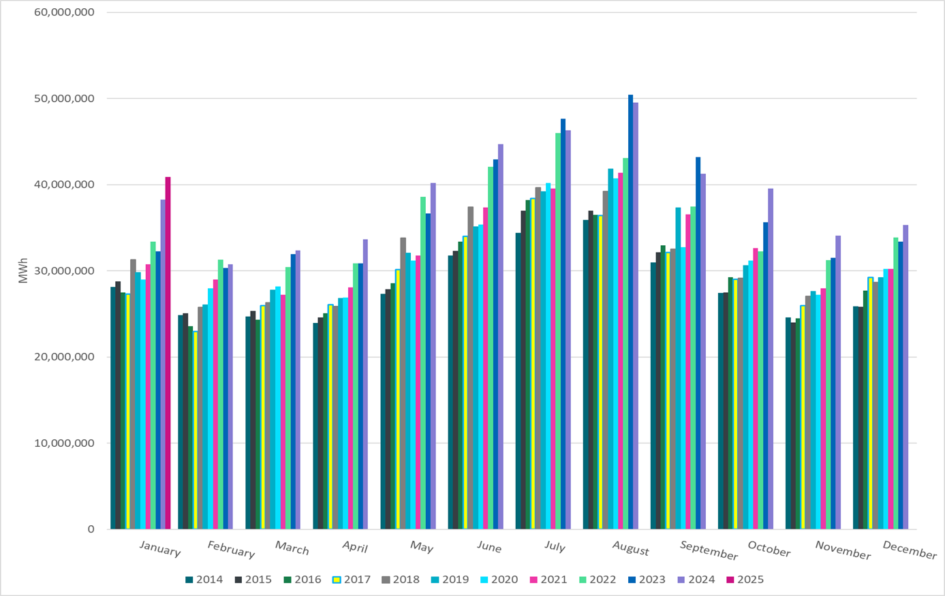
ERCOT Total Energy
Notes:
40,875,342 MWh

Slide 12
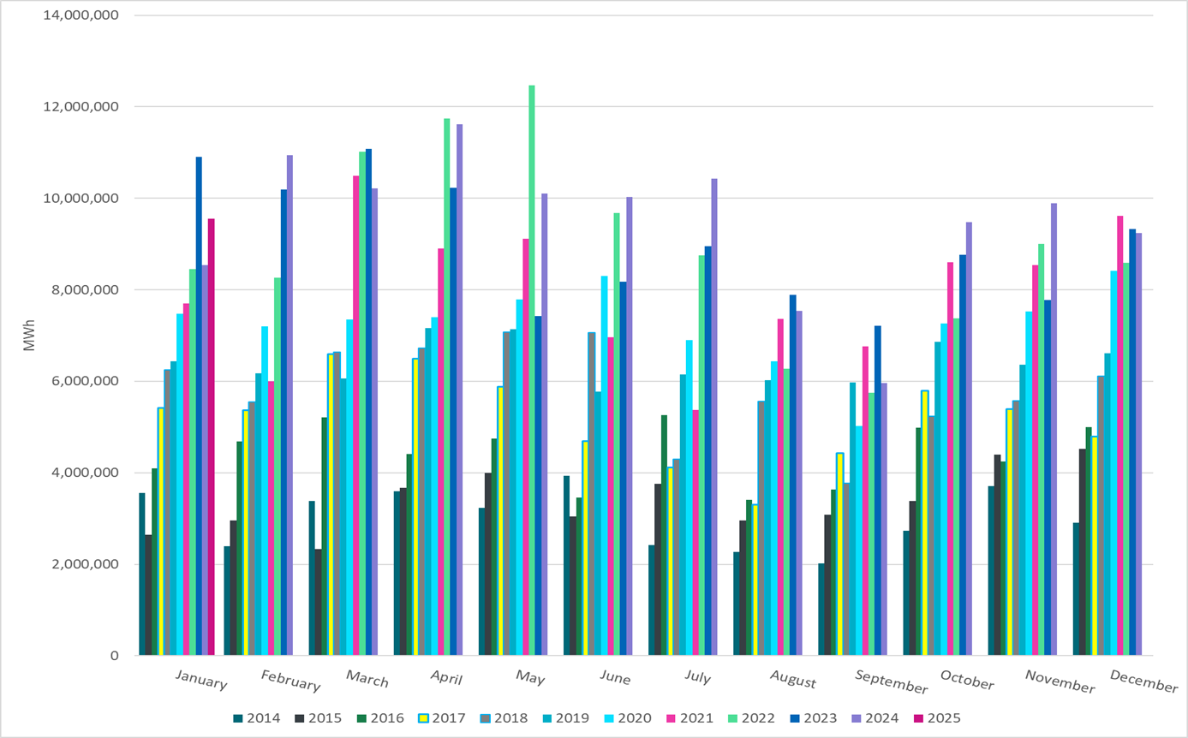
ERCOT Total Energy from Wind Generation
Notes:
9,558,873 MWH

Slide 13
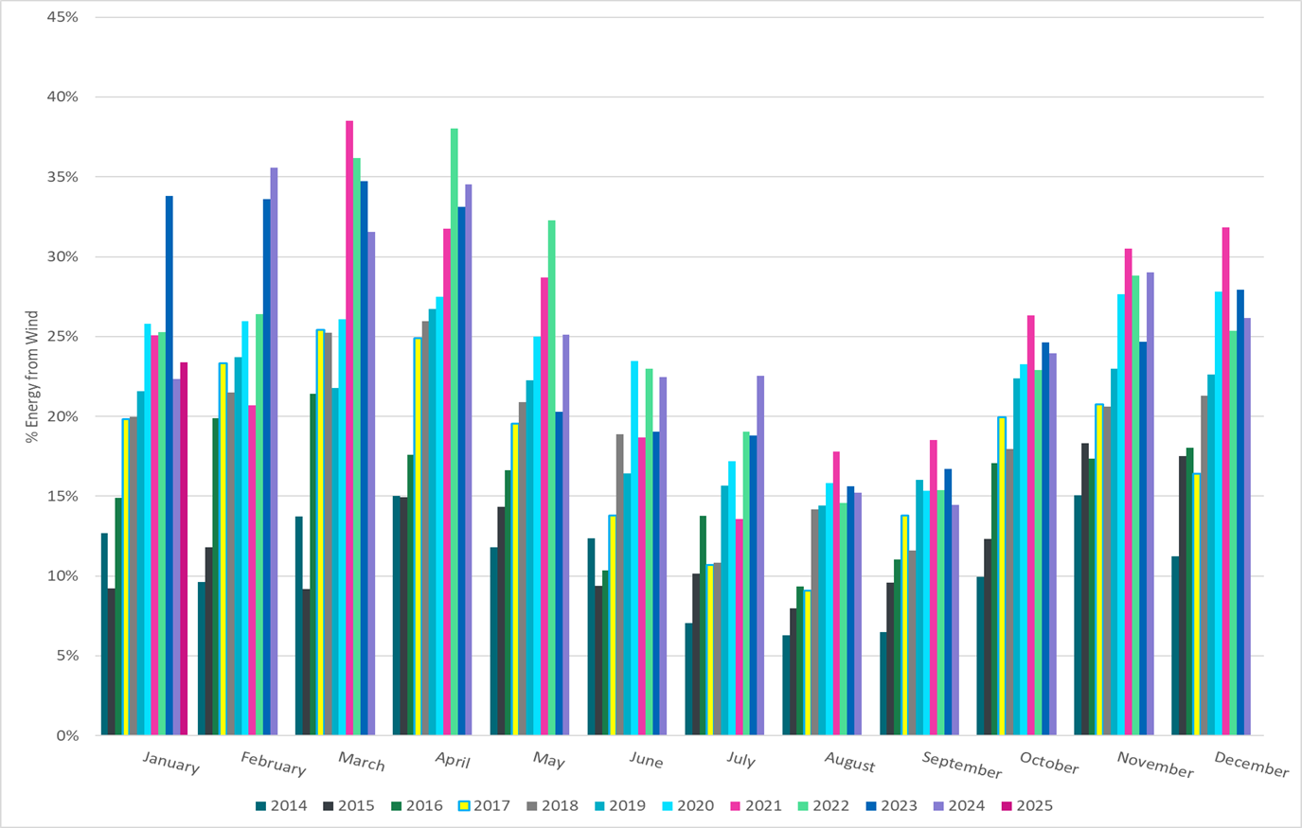
ERCOT % Energy from Wind Generation
Notes:
23.39% of total energy was provided by wind generation

Slide 14
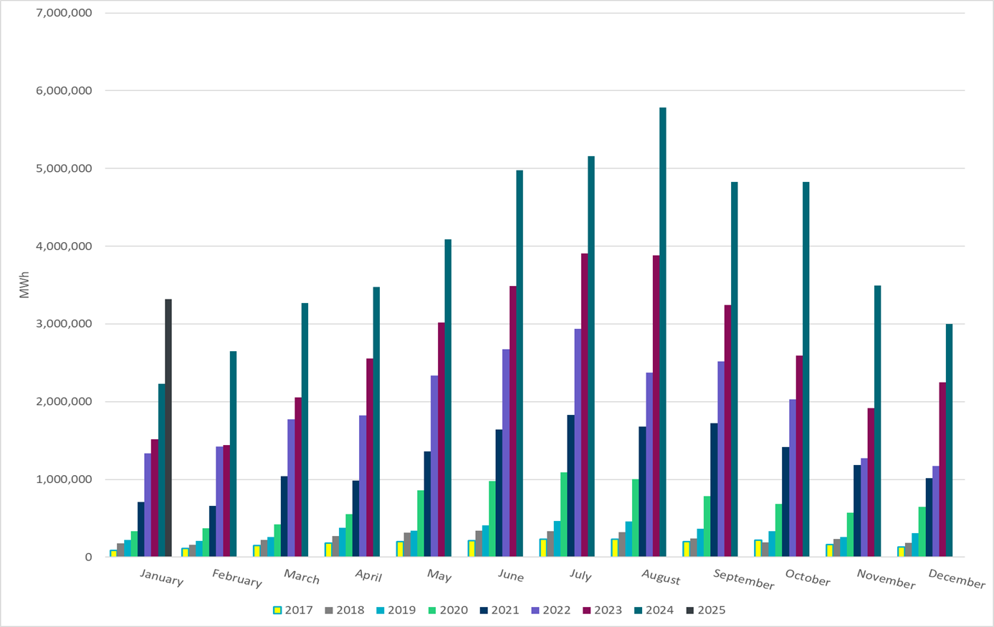
ERCOT Total Energy from Solar Generation
Notes:
3,315,884 MWh

Slide 15
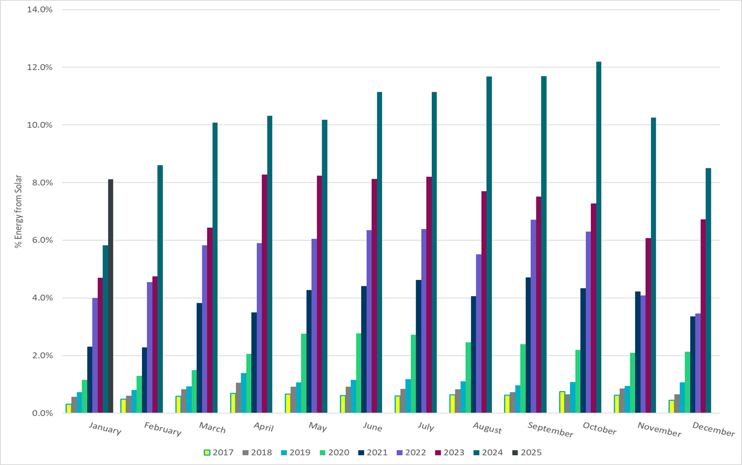
ERCOT % Energy from Solar Generation
Notes:
8.11% of total energy was provided by solar generation

Slide 16
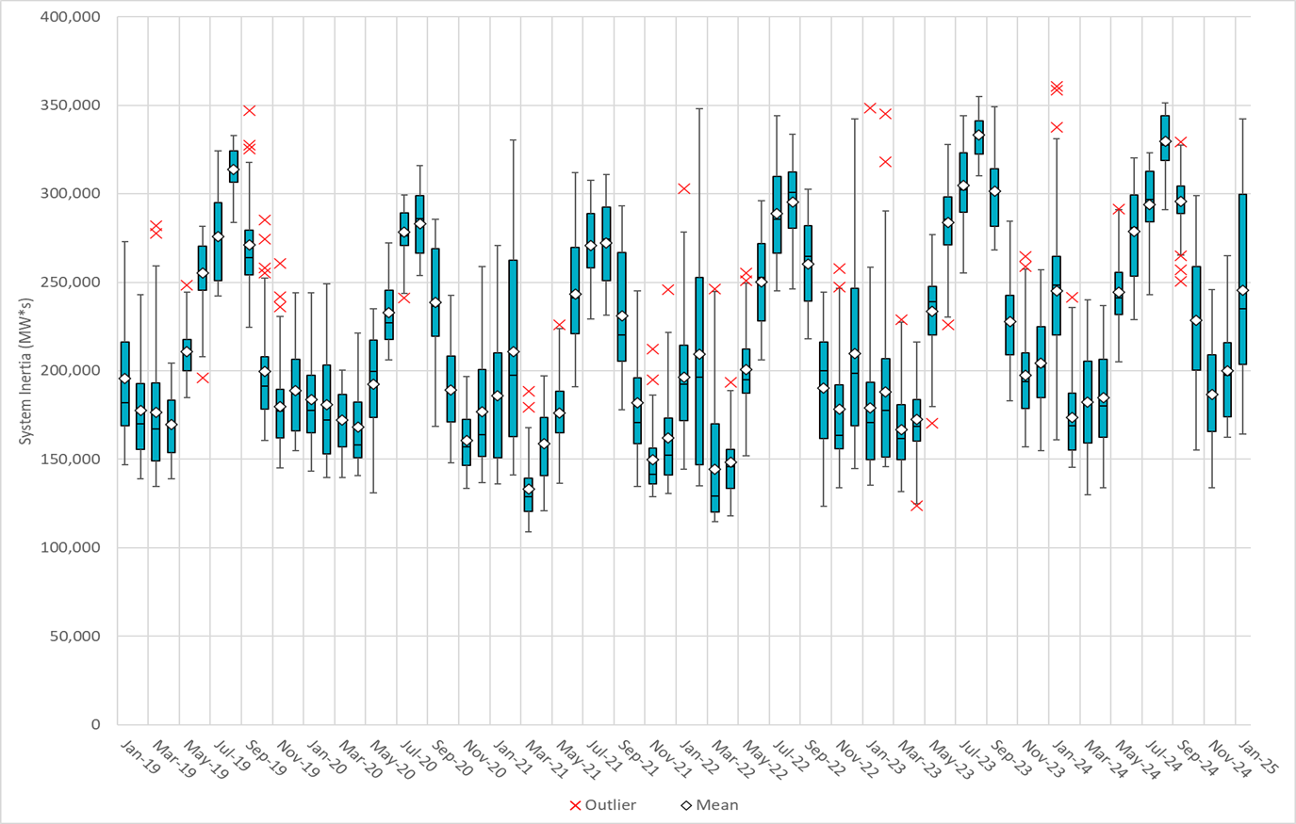
ERCOT Daily Minimum System Inertia
Notes:
Minimum Inertia in January 2025 = 164,095 MW*s on January 30th
Historical Overall Minimum was 109,029 MW*s on 3/22/2021
January Data:
Mean: 245,600 MW*s
Max: 342,313 MW*s on January 21st
Min: 164,095 MW*s on January 30th

Slide 17
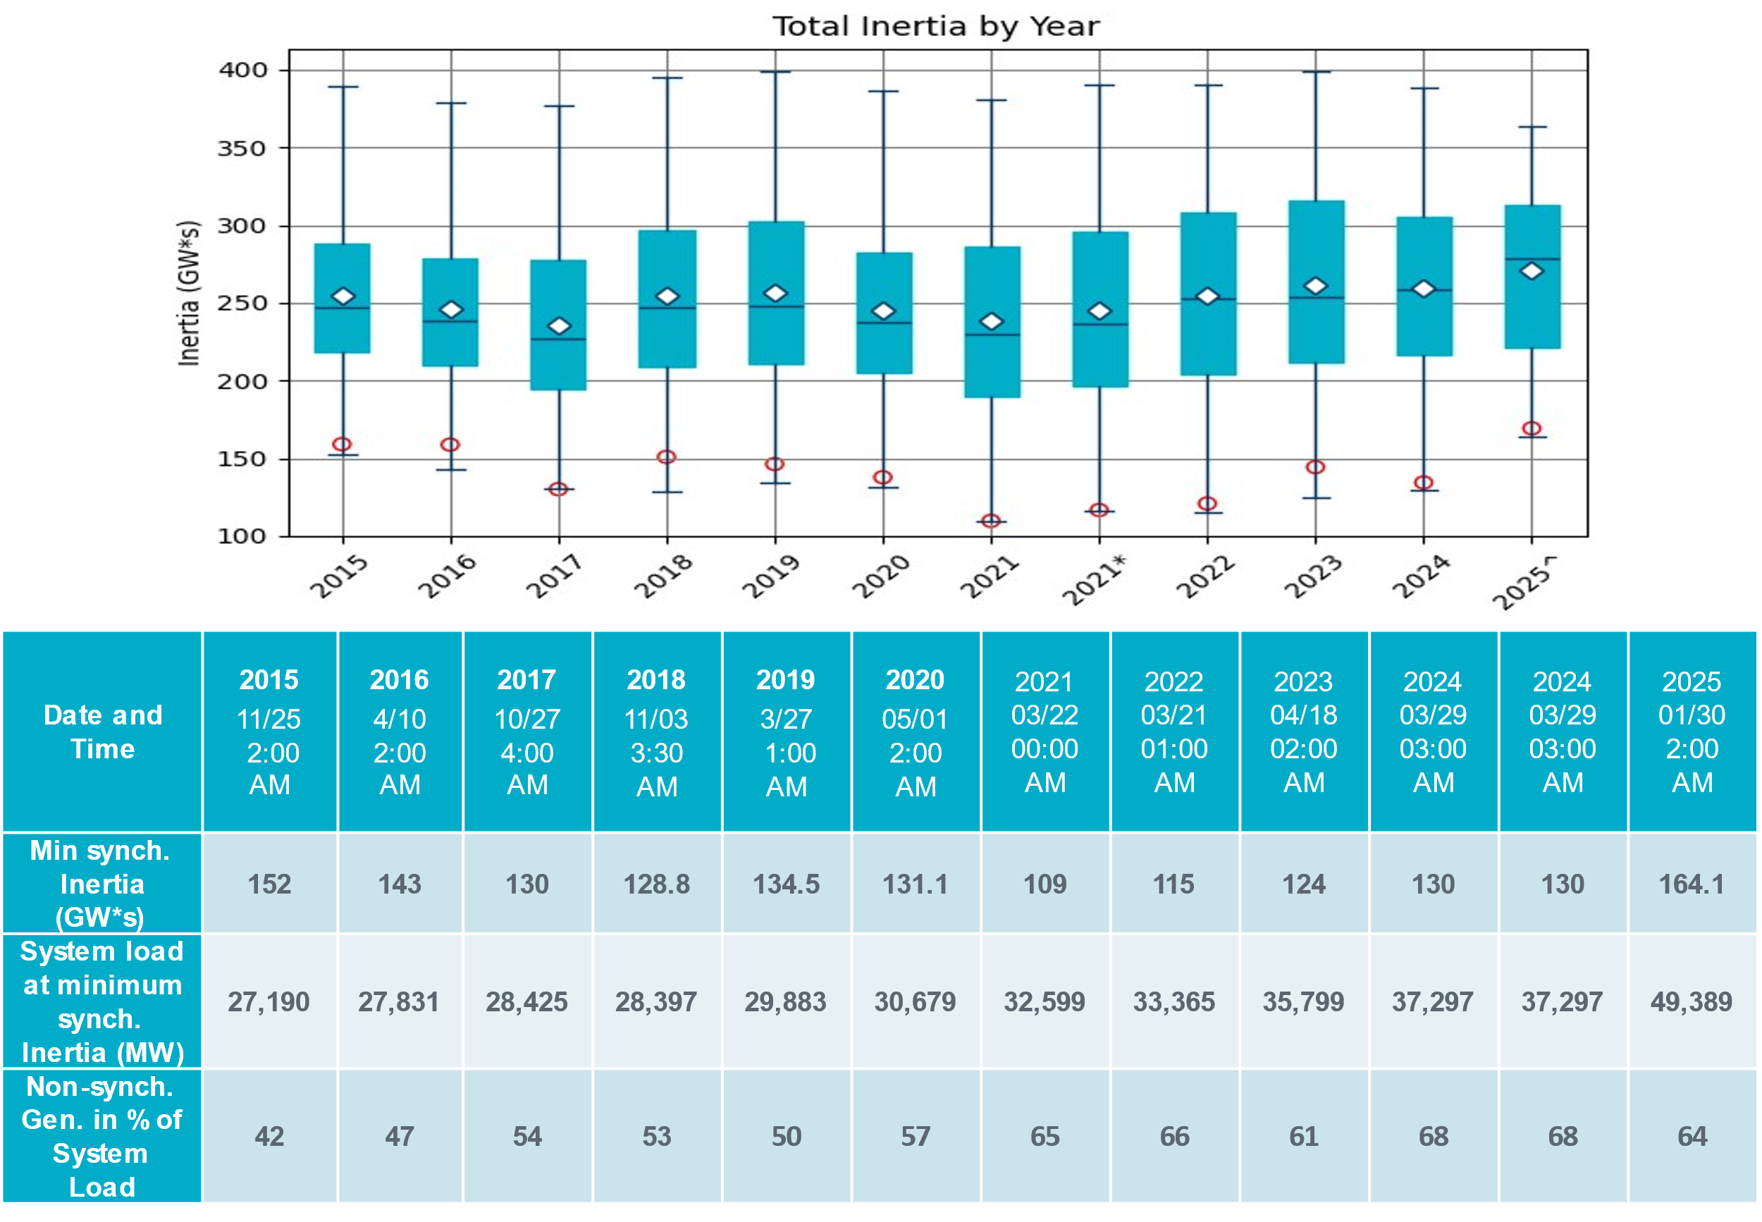
ERCOT Inertia Trend
Notes:
Summary of ERCOT inertia for the previous 10 years. Lowest inertia this year was on January 30th.
For each box, the central mark (red line) is the median, the edges of the box (in blue) are the 25th and 75th percentiles, the whiskers correspond to +/- 2.7 sigma (i.e., represent 99.3% coverage, assuming the data are normally distributed. The corresponding lowest inertia in each year is given in the table.
The circle on each boxplot is showing inertia during time when highest portion of load was served by wind/solar generation in that year.

