Slide 1
Data center operations task force
Large flexible load task force
March 4, 2025

Slide 2
Today’s discussion points
Large Load/AI Data Center growth in Texas
Data Center Study

Slide 3
Large load additions & Types (from RTP)

Slide 4
Where is it going?

Slide 5

Growth is Not without risk
Low voltage ride through (PGRR122)
Real problem observed in Dominion territory (1.5GW load drop)
Causes frequency overshoot; potential generation loss due to overspeed
Low voltage throwover schemes for backup generation
Fix may be to add time delay on throwover, but needs study
ERCOT solution, not functional (could limit south Dallas to 1,000MW total!)
Rapid load ramping
AI loads can rapidly ramp from full consumption to little consumption based on immediate demand (frequency problems, flicker…)
Solutions are being reviewed such as batteries, bitcoin mining loads, and programming.
Harmonics and other distortions
Other???
Moral of the story – What worked when the load was 1MW may not work when the load is 1GW!

Slide 6
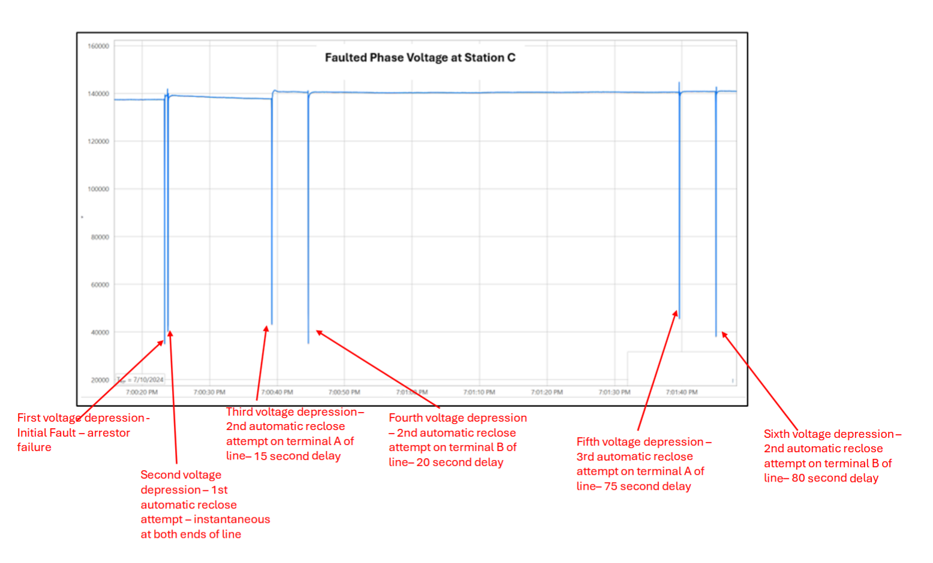
NERC report on 7/10/24 event
Cause: Faulted lightning arrester on 230kV system
Lines programmed for 3 recloses (5 recloses total)
1,500MWs of data center load curtailed from system
Automatic throwover to backup generation
Highest frequency observed – 60.047 Hz (Eastern Int.)
Duration of 6 disturbances ranged from 42 – 66 ms about 4 cycles
“Most of the sustained load reduction occurred simultaneously with the third voltage depression, which coincided with the third automatic reclosing attempt.” (due to programmed controls)
Several recommendations surrounding future modeling, studies and monitoring
“Critical questions:”
Should large loads be a NERC registered entity?
Should NERC Reliability Standard modifications be developed for large load interconnection requirements?
What studies should TOPs perform to “consider” the impacts of large load operation?
What is the definition of a large load?

Slide 7

Data center load study
Two studies commencing
EPRI – DC Flex
ERCOT internal study
Goal to determine potential problems and solutions
LVRT
Ramping
Small signal or other transient issues
Need broad coalition of members

Slide 8
Process
Divide project into “Immediate Needs” and “Longer Term”
Need answer(s) for Low Voltage Ride Through immediately
Many sites already exceed 1,000MW limit
All other potential issues can possibly be relegated to Longer Term
Process should allow for reprioritization of issues
Grandfathering a real concern
A spot assessment should be made of current potential risks
Evaluation of projects build as well as addition of FEAs already released
Models must be built that can accurately assess system conditions dynamically through a fault sequence
Commissioning testing for very large loads before allowed on grid

Slide 9

Task Force members
Need a diverse group technical experts from:
Transmission Service Providers
Independent System Operators
Data Center Developers
Component Manufacturers
Others?
Data Access
Relevant Experience
Modeling
Operations
Functionality
Sanity Check on Solutions

Slide 10

Questions?

