Slide 1
Large Load Oscillation Event
Patrick Gravois
Operations Engineer – Operations Analysis
LFLTF Meeting
March 4, 2025

Slide 2
ERCOT Initial Observations and Actions
On July 24, 2024, ERCOT observed an oscillation with ~40 MW swings in the telemetry of a large load
Oscillation was not observed in any line telemetry or closest PMUs
ERCOT directed interconnecting TO (Oncor) to investigate the cause of the oscillation seen in the load telemetry
Initially reported that oscillation may be associated with circulating currents due to customer transformer configuration and TO metering arrangement. Supplemental power quality equipment was being installed at the load to verify
ERCOT continued to see intermittent oscillations in load telemetry when load consumption was greater than 130 MW
Existing power quality meter at POIB showed much smaller oscillation than seen in load telemetry
ERCOT requested TO of POIB to configure relay to capture high resolution data (PMU/DFR)
ERCOT received PMU data (30 sample/sec) from the POIB in early September that showed a ~10-12 MW oscillation on the line to the load
Interconnecting TO reported to ERCOT there was likely a harmonic distortion issue causing the oscillation and they were still investigating

Slide 3
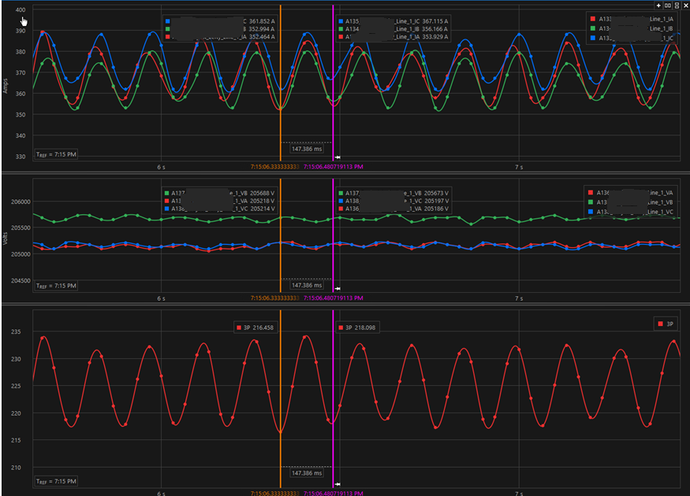
ERCOT Received Additional Data – Late September
ERCOT observed load consumption had increased in early September from ~140 MW to ~225 MW
ERCOT requested additional PMU data to verify if oscillation magnitude had increased
PMU data showed ~15-20 MW peak to peak oscillations when consumption was > 200 MW
Voltage was stable, oscillation seen in current magnitude
Still believed to be local harmonics issue with minimal reliability risks
TO confirmed load consumption not expected to increase in near future

Slide 4
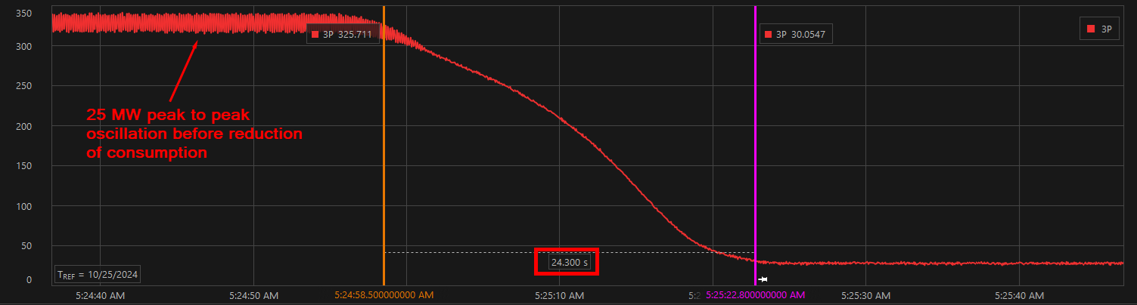
October 25 Event
ERCOT observed the load dropped ~300 MW within a single telemetry scan on Oct. 25
Load had increased consumption to ~330 MW over the previous week
ERCOT sent RFI to interconnecting TO and requested PMU data from TO of POIB
PMU data showed no fault preceding drop in consumption; load reduced ~300 MW over 24 second period
Oscillation magnitude preceding reduction was ~25 MW peak to peak and ~7.5 Hz (later determined true oscillation mode was ~23 Hz from higher resolution data)
Cause of reduction was reported to be an offsite telecommunication failure that triggered a load control issue

Slide 5
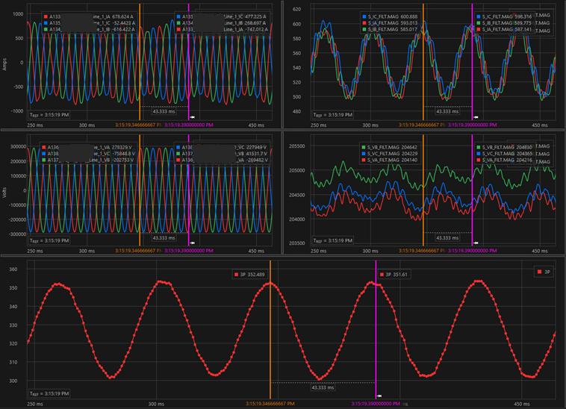
ERCOT Received DFR Data – Late October
ERCOT requested TO of POIB to manually trigger DFR to capture higher resolution data when load is consuming above 300 MW
ERCOT received 20 sample/cycle DFR data showing a ~23 Hz oscillation with ~50 MW peak to peak magnitude on Oct. 28
ERCOT determined oscillation is a reliability risk that needs immediate mitigation
ERCOT and interconnecting TO confirmed load is the source due to dissipating energy levels of oscillation on lines leaving POI station

Slide 6
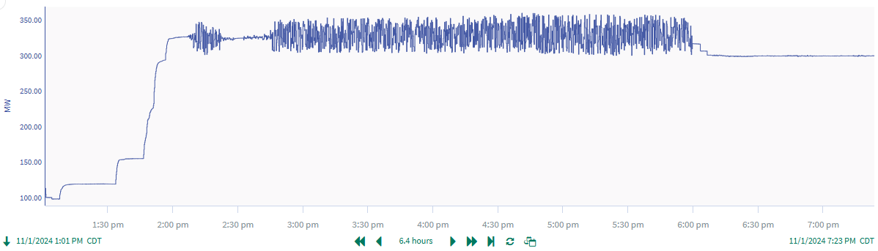
Mitigation Action – November 1, 2024
ERCOT notified interconnecting TO that control room will give an Operating Instruction to reduce consumption of the load to 120 MW (below level at which oscillation originally appeared in July)
TO notified load owner and operator that they will need to reduce consumption
ERCOT met with TO and load owner/operator and agreed that load could be reduced to level that oscillation is no longer present in load telemetry and verified with PMU data
ERCOT gave Operating Instruction and load reduced consumption to 300 MW; oscillations were no longer present in load telemetry

Slide 7
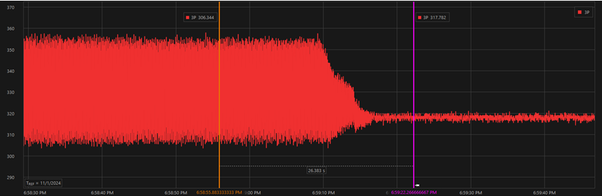
Follow Up Investigation
ERCOT received PMU data (60 samples/sec) from Nov. 1 showing 23 Hz oscillation was present before load reduced and mitigated by reducing load consumption to 300 MW
Load telemetry continued to show no oscillation in following weeks at reduced consumption
DFR data (20 samples/cycle) still showed significant harmonic distortion at 3rd harmonic but not a 23 Hz oscillation
ERCOT notified TO and load owner/operator that site shall remain at 300 MW until root cause of 23 Hz oscillation is identified and mitigated and harmonic distortion is improved to meet TO requirements

Slide 8
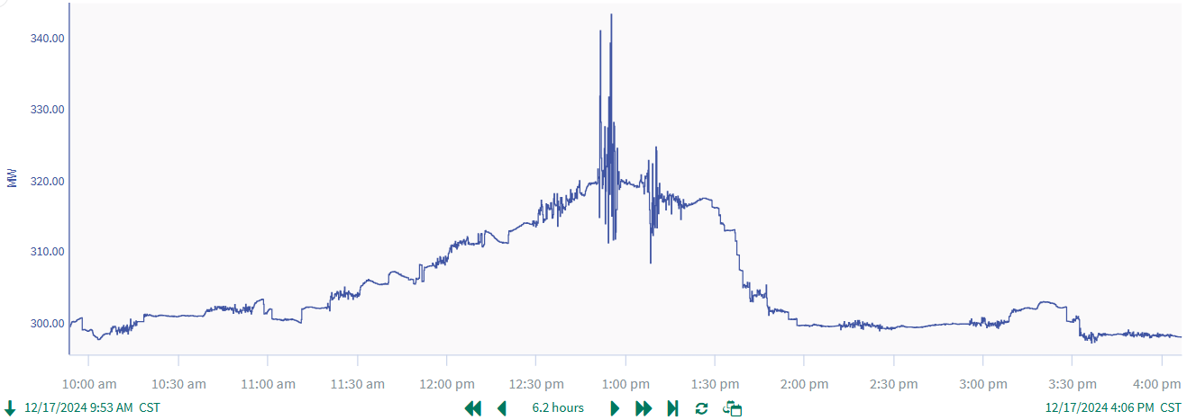
Initial Test – Mid December
Load owner and operator developed test plan to help determine root cause of oscillation
Test plan involved increasing load consumption in 2 MW intervals while collecting data
ERCOT approved test plan and coordinated with load operator to monitor for oscillations during test
Oscillation was observed when load consumption increased to ~320 MW
Load ramped back down to 300 MW after test

Slide 9
Second Test and Return to Full Consumption – Early January
Data collected in December helped load owner/operator determine root cause of oscillation
Root cause determined to be older firmware versions on certain equipment
Older firmware versions updated over the holidays
Load operator submitted new test plan which was approved by ERCOT
No oscillations observed during test as load ramped consumption to ~330 MW
Load allowed to remain at full consumption; no oscillations observed since January
TO verified that harmonic distortion had significantly improved while still not in compliance with IEEE 519
Load owner/operator continues to work with TO to improve harmonic distortion

Slide 10
Key Takeaways
ERCOT will take action to mitigate observed oscillations coming from large loads, up to potentially disconnecting the load from the system
Direct communication between ERCOT and large load owners/operators should be established to identify and mitigate observed oscillations coming from large loads
High resolution data (PMU/DFR) is essential to identify oscillations and determine oscillation magnitudes and frequency modes
ERCOT, TO, and load owners/operators need to have good understanding and maybe requirements of actual Load performance (steady state and dynamic) to ensure reliable integration
Lack of industry standard to define the large load performance needed for electric grid reliability and equipment security
Lack of the accurate models to properly represent these large loads need to be addressed

Slide 11
Questions?

