Slide 1
ERCOT Large Load Loss/Reduction Events 2020-2024
Patrick Gravois
Operations Engineer – Operations Analysis
LFLTF Meeting
March 4, 2025

Slide 2
ERCOT Loss/Reduction of Load Events 2020-2023
13 events identified by ERCOT Operations that involved system fault followed by significant reduction of one or more large loads
Event chart previously presented at April 2024 LFLTF; needed more context
Recently reviewed events to distinguish reduction of large loads that have gone through interim Large Load Interconnection (LLI) process since 1/1/2022
  LLI loads are greater than 25 MW and may include crypto, AI, data center, hydrogen fuel cell loads, or industrial loads and are aggregated into single PI tag for monitoring purposes
  To date, ERCOT has approved to energize ~6,300 MW of large load through LLI process
    Observed peak simultaneous consumption of ~3,100 MW
    Non-simultaneous peak consumption is 4,616 MW
  All LLI loads involved in events are power electronic loads (PEL), and specifically crypto (to our knowledge)
8 events involve a single large industrial load on the Texas coast (non-LLI)
3 events involve either multiple 3-phase faults or significantly delayed fault clearing
  Events involve wide-spread reduction of consumption of many load types and sizes
2 events involve simultaneous loss of both IBR generation and PELs

Slide 3
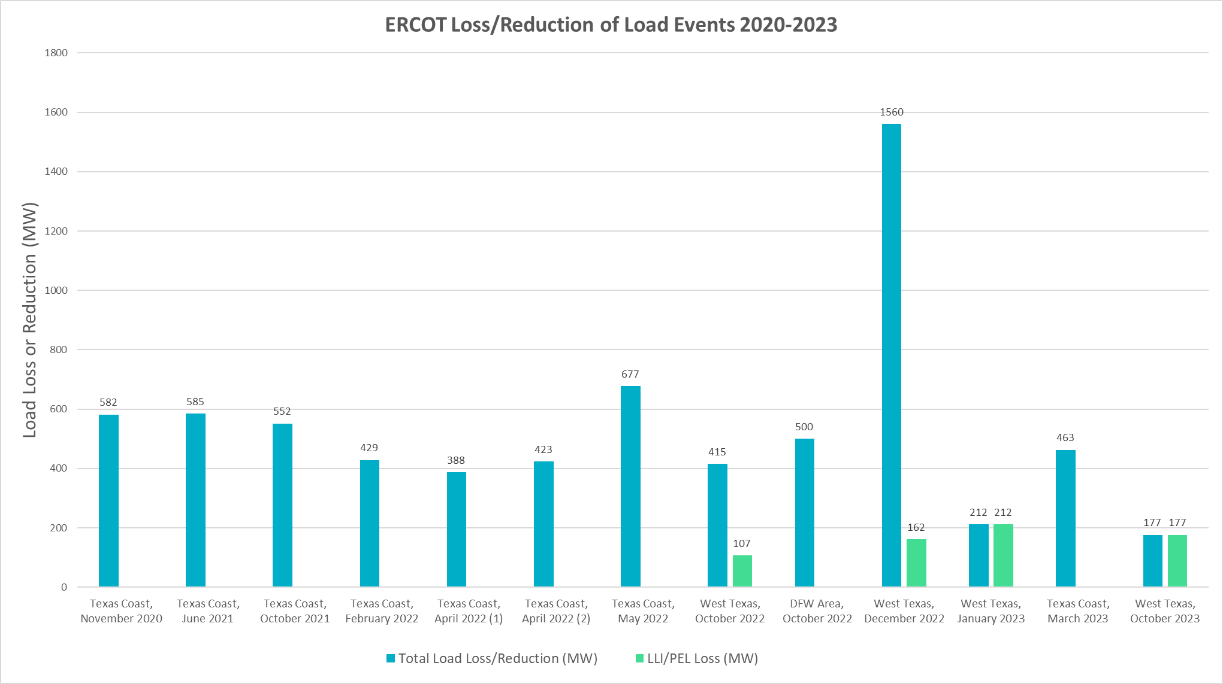
ERCOT Loss/Reduction of Load Events 2020-2023
LLI/PEL Load Loss included in Total Load Loss
Reduction of affected PELs varies from 39% to 82% of pre-disturbance consumption

Slide 4
ERCOT Loss/Reduction of Load Events 2020-2023
Texas Coast Load Loss Events (8 Events from Nov. 2020 – Mar. 2023)
Single large industrial load
Repeated large load reductions of ~400-700 MWs due to faults in the area
Updated variable frequency drive settings and internal systems to improve ride-though capabilities
Improved performance seen in 2024
West Texas Event – Oct. 12, 2022 @ 05:56 CT – 415 MW load reduction
Multiple normally cleared Three-Phase Line-to-Ground (3LG) faults within one minute at 345 kV station
~60 loads in West Texas reduced a combined ~415 MW during the event
7 large PELs reduced a combined 107 MWs (52% of consumption)
DFW Event – Oct. 31, 2022 @ 23:12 CT – 500 MW load reduction
3LG fault at 138 kV station with delayed ~10 cycle clearing due to breaker misoperation
~100 loads in the area temporarily reduced ~500 MW during the event
No large PEL loss identified during the event
System frequency increased to 60.086 Hz
System frequency increased to 60.132 Hz
High system frequencies up to ~60.11 Hz

Slide 5
ERCOT Loss/Reduction of Load Events 2020-2023
West Texas Event – Dec. 7, 2022 @ 03:50 CT – 1560 MW load reduction
Multiple Single-Phase Line-to-Ground (SLG) faults and a 3LG ground fault at 138 kV station with delayed 19-cycle clearing due to beaker failure
Hundreds of loads in Far West Weather zone reduced ~1,560 MW during the event due to extended low voltage period
10 large PELs reduced a combined ~162 MW (39% of consumption)
Largest load reduction from oil and gas production, processing, and delivery facilities (~420 MW from 24 loads)
System frequency increased to 60.235 Hz and recovered in 12m27s
112 MW of thermal generation tripped during event
MW Range of Load Reduction | # of Far West Loads in Range | Total MW Reduction
Greater than 10 MW | 41 | 816
Between 5 MW and 10 MW | 46 | 318
Between 2 and 5 MW | 93 | 314
Between 0 and 2 MW | 193 | 118

Slide 6
ERCOT Loss/Reduction of Load Events 2020-2023
West Texas Event – Jan. 23, 2023 @ 12:19 CT
SLG fault at 138 kV station with normal 4-cycle clearing
5 large PELs reduced a combined 212 MWs (82% of consumption)
West Texas Event – Oct. 26, 2023 @ 10:28 CT
SLG Fault at 138 kV station with normal 4-cycle clearing
6 large PELs reduced a combined 177 MWs (57% of consumption)
246 MW of IBR generation loss (all solar)
253 MW of IBR generation loss (all solar)
PEL loss identified during event analysis of IBR generation loss
PEL loss identified during event analysis of IBR generation loss

Slide 7
Large Power Electronic Load Ride-Through Events
November 2023 - Present
Searched for events in which LLI aggregate tag dropped >100 MW combined with PMU fault flag and system frequency spike
Collected PMU/DFR data at POIB of large loads from interconnecting TSPs
  Data availability (NOGRR 255)
  Confirm fault details and low voltage at POIB during events
  Confirm MW reduction in consumption and observe dynamics of large loads during faults
24 events from areas of concentrated large PELs (all crypto loads)
  8 events involving 4 loads in Central Texas
    890 MW of ERCOT approved consumption
  7 events involving 5 loads in 1st pocket in Far West Texas
    410 MW of ERCOT approved consumption
  4 events involving 3 loads in 2nd pocket in Far West Texas
    345 MW of ERCOT approved consumption
    All consequential loss – loss of line connecting loads during fault
  4 events involving 11 loads in multiple pockets in Far West Texas
    1,785 MW of ERCOT approved consumption
  1 event involving single load in North load zone
    264 MW of ERCOT approved consumption

Slide 8
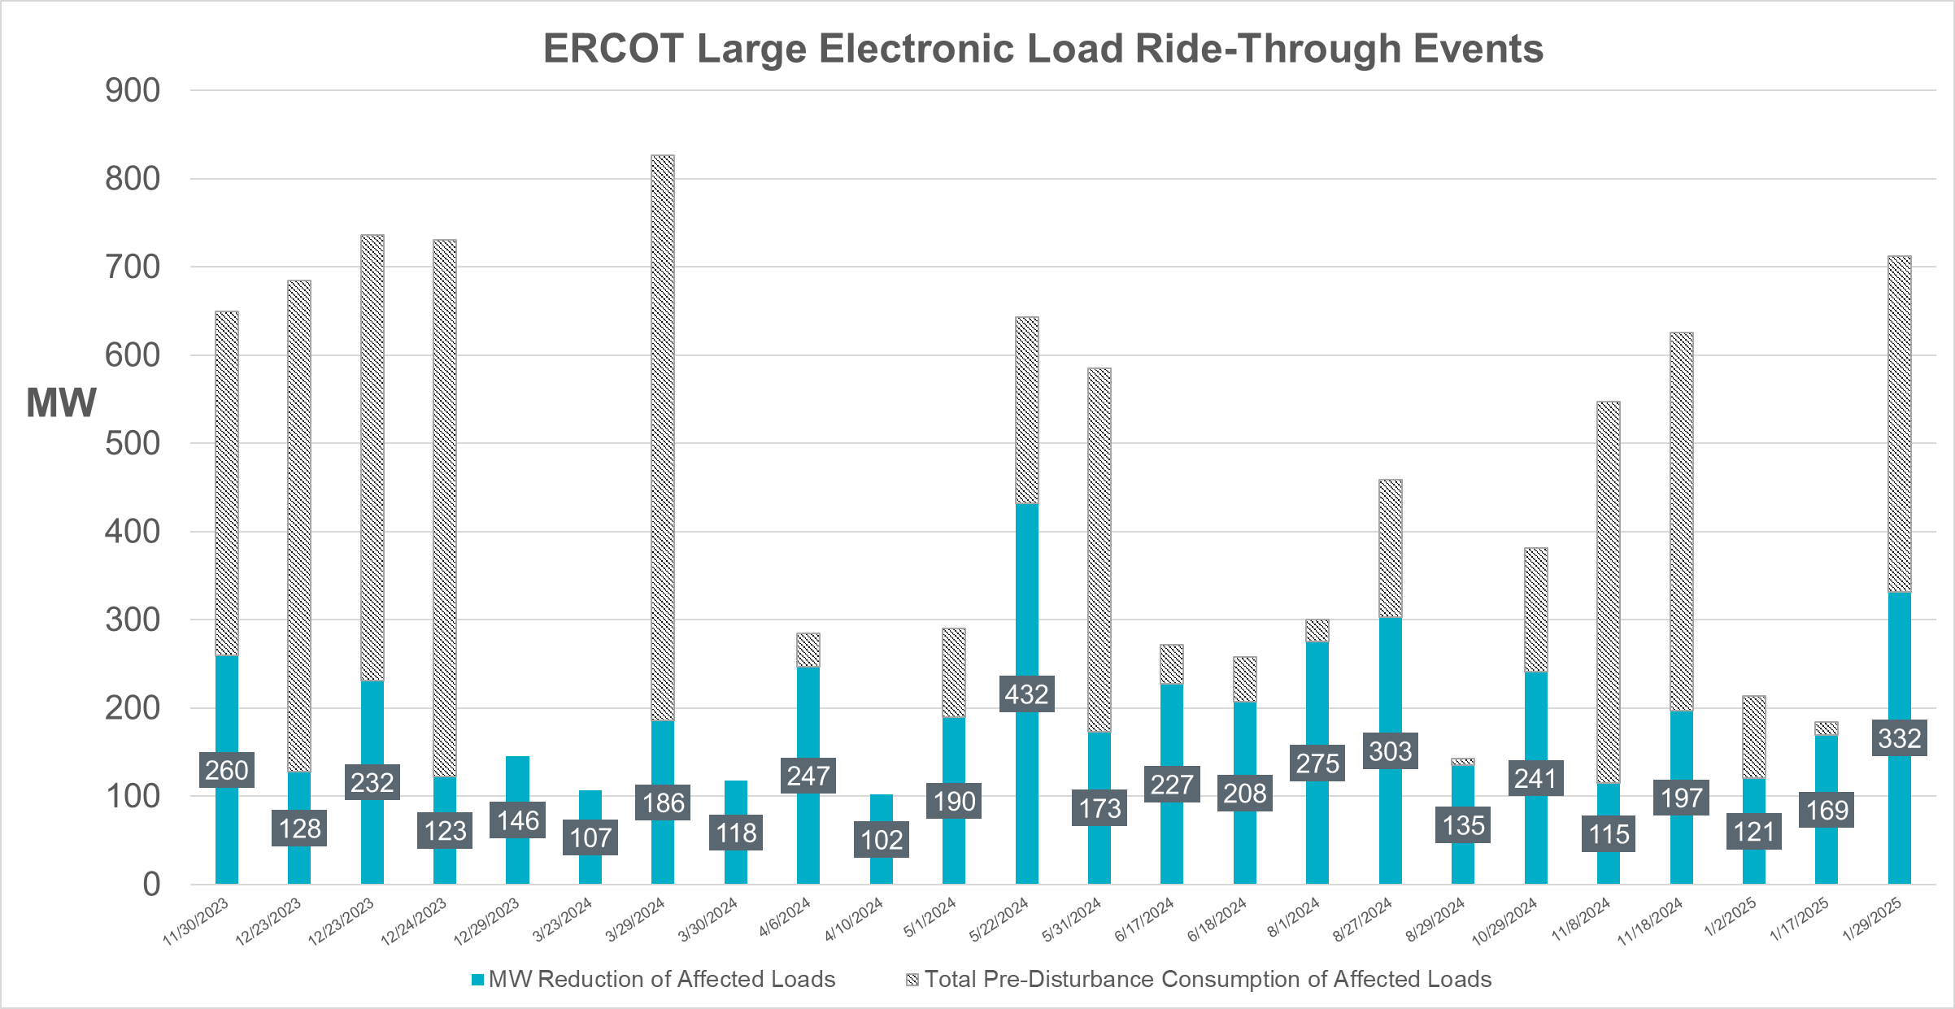
Large Power Electronic Load Ride-Through Events
November 2023 - Present

Slide 9
Central Texas Events
Reductions range from 17% - 67% of pre-disturbance consumption
% reduction larger for 3LG faults (~65%) than for SLG faults (17% - 40%)
19% reduction seen for shallow voltage dip of 0.844 on single phase

Slide 10
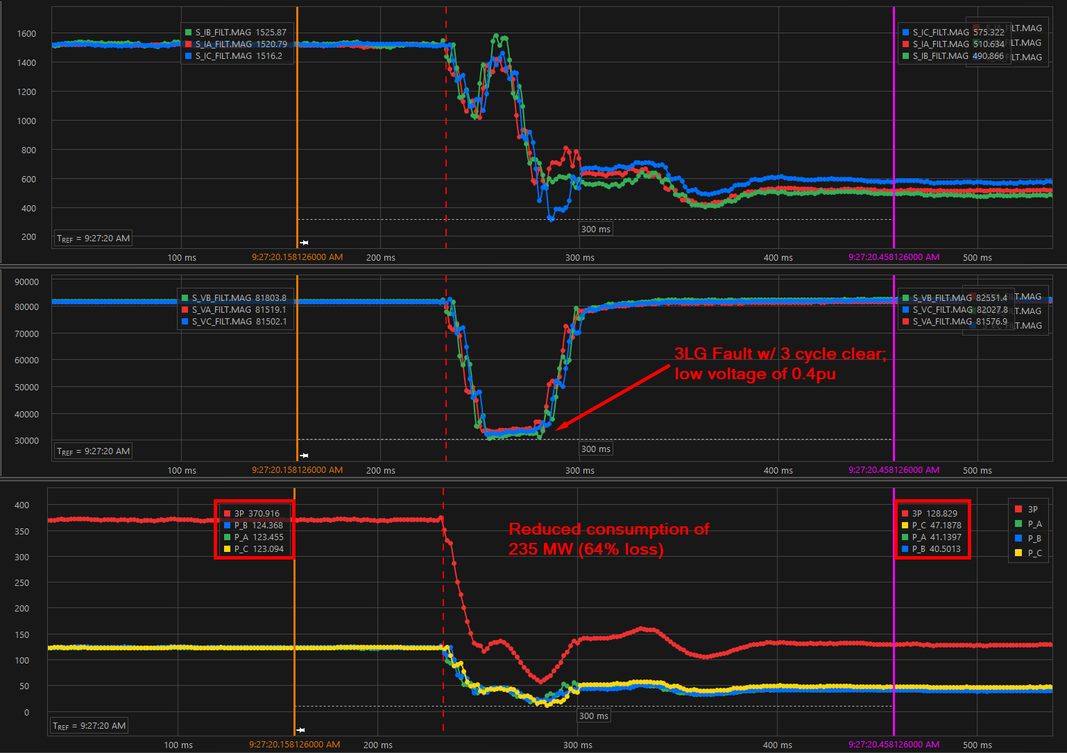
Central Texas LOAD B – 8/27/2024 Event

Slide 11
Far West Texas Events (1st Pocket)
Date | Fault Details | Load Zone | Load | Load Type | ERCOT Approved MW | Low Voltage at POI (pu & kV) | Pre-Disturbance Consumption (MW) | Post-Disturbance Consumption (MW) | Total Load Reduction (MW) | % Load Reduction
12/29/2023 | 138 kV line Unknown fault type & clearing time | West | LOAD F | Crypto | 80 | 0.00 (138 kV) | 72.7 | 0 | 72.7 | 100.00
 |  |  | LOAD H | Crypto | 80 | 0.00 (138 kV) | 73.1 | 0 | 73.1 | 100.00
 |  |  | TOTAL |  | 160 |  | 145.8 |  | 145.8 | 100.00
4/6/2024 | 138 kV line AG Fault 3 cycle clear | West | LOAD E | Crypto | 130 | 0.356 (138 kV)(Aφ) | 53.4 | 12 | 41.4 | 77.53
 |  |  | LOAD F | Crypto | 80 | 0.804 (138 kV)(PS) | 69.5 | 0 | 69.5 | 100.00
 |  |  | LOAD G | Crypto | 80 | 0.804 (138 kV)(PS) | 65.1 | 0 | 65.1 | 100.00
 |  |  | LOAD H | Crypto | 80 | 0.804 (138 kV)(PS) | 63 | 0 | 63 | 100.00
 |  |  | LOAD I | Crypto | 40 | 0.804 (138 kV)(PS) | 33.4 | 25.5 | 7.9 | 23.65
 |  |  | TOTAL |  | 410 |  | 284.4 |  | 246.9 | 86.81
5/1/2024 | 138 kV line AG Fault 3 cycle clear | West | LOAD E | Crypto | 130 | 0.398 (138 kV)(Aφ) | 55.5 | 12.5 | 43 | 77.48
 |  |  | LOAD F | Crypto | 80 | 0.866 (138 kV)(PS) | 66.8 | 61.3 | 5.5 | 8.23
 |  |  | LOAD G | Crypto | 80 | 0.866 (138 kV)(PS) | 67.1 | 0 | 67.1 | 100.00
 |  |  | LOAD H | Crypto | 80 | 0.866 (138 kV)(PS) | 67.2 | 0 | 67.2 | 100.00
 |  |  | LOAD I | Crypto | 40 | 0.866 (138 kV)(PS) | 33.5 | 26.8 | 6.7 | 20.00
 |  |  | TOTAL |  | 410 |  | 290.1 |  | 189.5 | 65.32
6/17/2024 | 138 kV line AG Fault 3 cycle clear | West | LOAD E | Crypto | 130 | 0.384 (138 kV)(Aφ) | 52.9 | 20 | 32.9 | 62.19
 |  |  | LOAD F | Crypto | 80 | 0.846 (138 kV)(PS) | 63.3 | 0 | 63.3 | 100.00
 |  |  | LOAD G | Crypto | 80 | 0.843 (138 kV)(PS) | 60.5 | 0 | 60.5 | 100.00
 |  |  | LOAD H | Crypto | 80 | 0.846 (138 kV)(PS) | 62.7 | 0 | 62.7 | 100.00
 |  |  | LOAD I | Crypto | 40 | 0.843 (138 kV)(PS) | 32.6 | 25 | 7.6 | 23.31
 |  |  | TOTAL |  | 410 |  | 272 |  | 227 | 83.46
6/18/2024 | 138 kV line BG Fault 3 cycle | West | LOAD E | Crypto | 130 | 0.683 (138 kV)(Bφ) | 31.4 | 23.9 | 7.5 | 23.89
 |  |  | LOAD F | Crypto | 80 | 0.010 (138 kV)(PS) | 62.7 | 0 | 62.7 | 100.00
 |  |  | LOAD G | Crypto | 80 | 0.717 (138 kV)(PS) | 67.2 | 0 | 67.2 | 100.00
 |  |  | LOAD H | Crypto | 80 | 0.010 (138 kV)(PS) | 62.1 | 0 | 62.1 | 100.00
 |  |  | LOAD I | Crypto | 40 | 0.717 (138 kV)(PS) | 34.1 | 26.1 | 8 | 23.46
 |  |  | TOTAL |  | 410 |  | 257.5 |  | 207.5 | 80.58
8/1/2024 | 138 kV line BG and BC Faults; 3-4 cycle clearing times | West | LOAD E | Crypto | 130 | 0.380 (138kV)(Bφ) | 80.2 | 0 | 80.2 | 100.00
 |  |  | LOAD F | Crypto | 80 | 0.716 (138 kV)(PS) | 63.6 | 0 | 63.6 | 100.00
 |  |  | LOAD G | Crypto | 80 | 0.756 (138 kV)(PS) | 63.2 | 0 | 63.2 | 100.00
 |  |  | LOAD H | Crypto | 80 | 0.716 (138 kV)(PS) | 61.3 | 0 | 61.3 | 100.00
 |  |  | LOAD I | Crypto | 40 | 0.756 (138 kV)(PS) | 31.9 | 25 | 6.9 | 21.63
 |  |  | TOTAL |  | 410 |  | 300.2 |  | 275.2 | 91.67
10/29/2024 | 138 kV line AG Fault 3 cycle clear | West | LOAD E | Crypto | 130 | 0.305 (138 kV)(Aφ) | 110.8 | 87.4 | 23.4 | 21.12
 |  |  | LOAD F | Crypto | 80 | 0.643 (138 kV)(Aφ) | 68.7 | 0 | 68.7 | 100.00
 |  |  | LOAD G | Crypto | 80 | 0.628 (138 kV)(Aφ) | 68.4 | 0 | 68.4 | 100.00
 |  |  | LOAD H | Crypto | 80 | 0.643 (138 kV)(Aφ) | 67.8 | 0 | 67.8 | 100.00
 |  |  | LOAD I | Crypto | 40 | 0.628 (138 kV)(Aφ) | 34.4 | 26.7 | 7.7 | 22.38
 |  |  | LOAD J | Crypto | 36 | 0.490 (138 kV)(Aφ) | 31.5 | 26.9 | 4.6 | 14.60
 |  |  | TOTAL |  | 446 |  | 381.6 |  | 240.6 | 63.05
All 138 kV SLG faults with exception of one LL fault
Missing single phase voltage data for several events
Significant reduction in consumption for shallow positive sequence voltage dips; single phase voltage likely dipping below 0.7 pu at POIs causing reductions

Slide 12
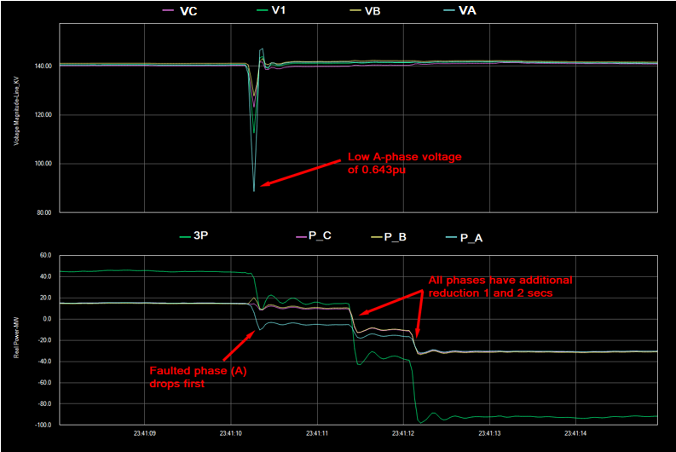
Far West LOAD F and LOAD H – 10/29/2024 Event
PMU data at POI towards two co-located sites; Change in line MW flow corresponds to reductions seen in load telemetry (~136 MW and 100% of pre-disturbance consumption)
Similar performance seen for multiple events for Loads F,G,H, and I
Possible phase balance of load protection within facilities?

Slide 13
Far West Texas Events (Multiple Pockets)
345 kV faults in West Texas affecting larger area and number of loads
Events were all SLG faults; possible larger reductions for 3LG fault
Multiple loads show reduced active power in faulted phase only
Some affected loads involved in 2022-2023 events and had larger reductions
Pre-disturbance load consumption for all LLI loads in West Texas was between1,300 and 1,400 MW for all events (table above is just affected loads that reduced consumption)

Slide 14
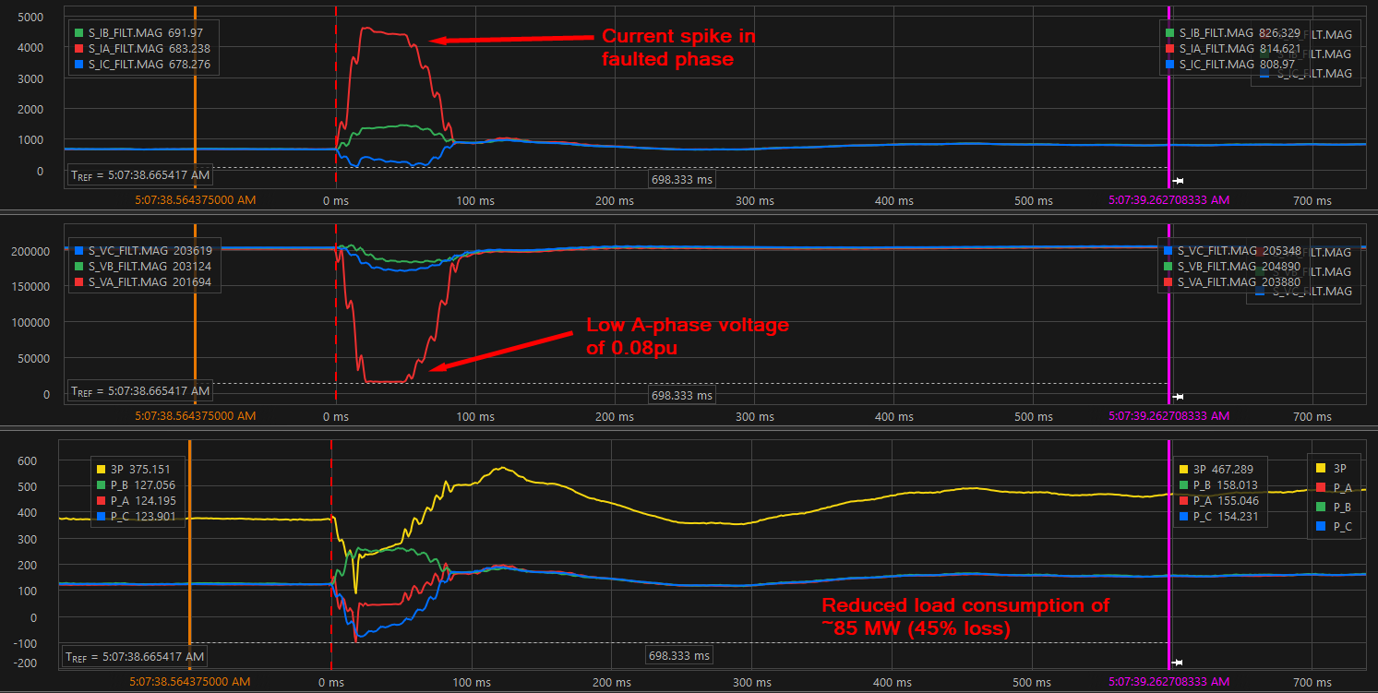
Far West LOAD K – 11/8/2024 Event
Co-located with thermal generation; DFR data monitoring line to facility
Increase in line flow of ~85 MW corresponds with load loss in telemetry (net injection from generation increased after load loss)
Load balanced between all 3 phases immediately after fault clears

Slide 15
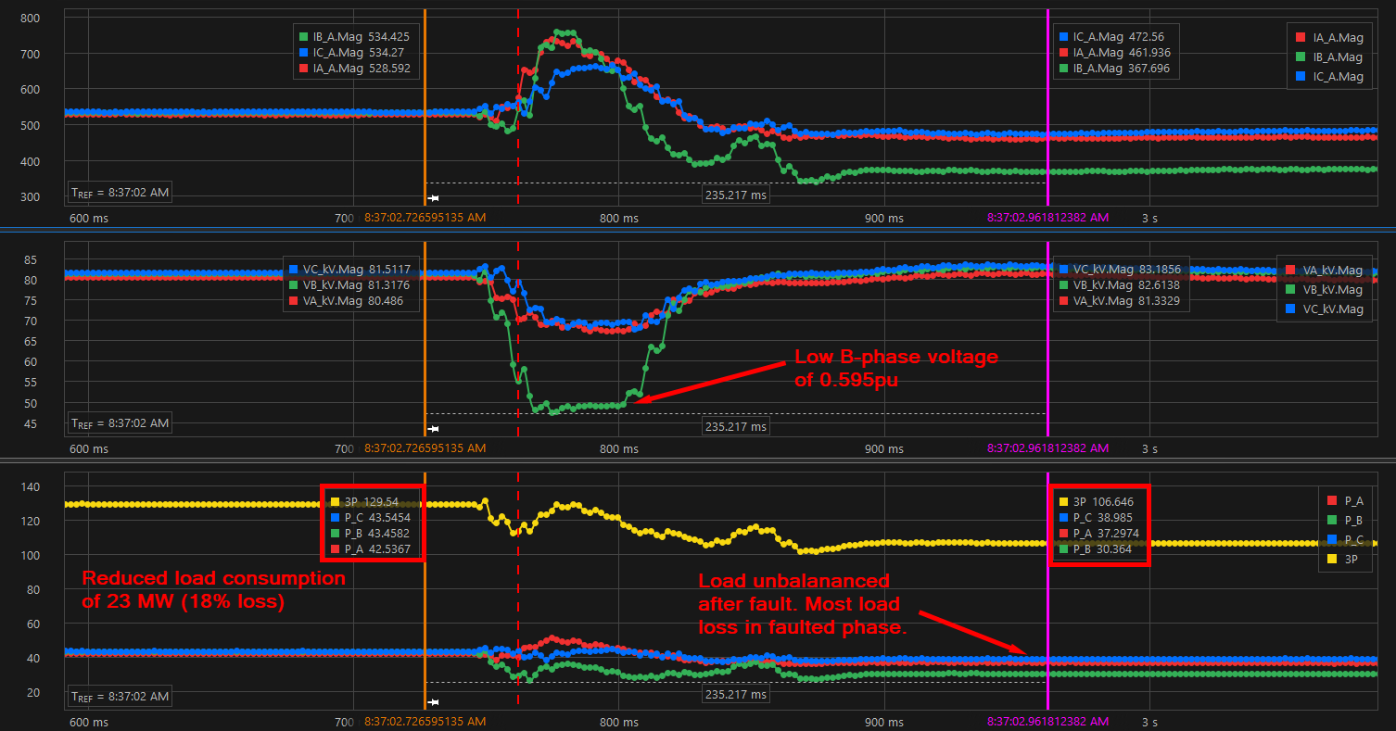
Far West LOAD L – 11/18/2024 Event
DFR data directly monitoring load
Load balanced before fault and unbalanced after fault
Majority of load loss in faulted phase only

Slide 16
Key Observations
Large variance in % of reduction with similar voltage dips at POIB
  Some large PELs more sensitive to voltage disturbances than others
  Possible facility protection systems not visible to ERCOT nor included in dynamic models
  More information needed to understand partial trips/reductions
SLG faults causing significant reductions for shallow positive sequence voltage dips
  Faulted phase likely reducing below ~0.7pu causing load reductions
  Single-phase high-resolution data required for analysis
  Data from facility (low side) would aid in analysis and understanding
SLG faults far more common; 3LG faults will have bigger impact
~1,950 MW of operational large load in Far West Texas weather zone
  Additional ~2,600 MW in West Texas has been approved and have signed IAs
  ERCOT running studies to determine potential load loss in West Texas
    Preliminary assessment shows potential trip of many large loads with 3LG on 345 kV, assuming large loads trip below 0.75 pu at POIB
    Transmission improvements have limited impact to mitigate total reduction
Other weaker grid areas may see similar events with projected large load growth

Slide 17
Key Takeaways and Next Steps
ERCOT Operations to continue monitoring and tracking large load ride-through events
ERCOT Operations to continue working with TSPs to retrieve event data and ensure proper Disturbance Monitoring Equipment is in place
Establish communication between ERCOT, TSPs, and load owners to evaluate ride-through performance of large PELs
Potential NERC report on large load reduction events in ERCOT
Challenges and issues to be addressed
  Determine actual ride-through capabilities of each type of large load
  Verify and validate load models for accurate representation of ride-through capabilities
  Develop reliability criteria through studies
  Examine potential ways to mitigate and/or minimize large load loss during fault events
  Difficulty performing event analysis without formal RFI process for loads

Slide 18
Questions?

