Slide 1
SSWG Report to ROS
March 6, 2025
Chair: Zach Walker (Zachary.Walker2@oncor.com)
Vice Chair: Chris Ramirez (cramirez@wettllc.com)

Slide 2
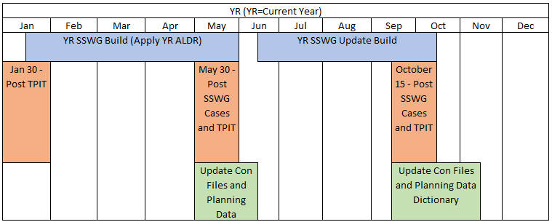
SSWG Updates
Schedule & Key Dates
25SSWG TPIT Update # 1
Posted to MIS 1/31/25
Next TPIT Update: 5/23/25
25SSWG Case Build #1
Currently Ongoing
Load & Topology Deadline: 3/28/25
Target Posting: 5/23/25
Upcoming Training
SSWG Tuning Training: 3/20/25
SSWG Report to ROS External

Slide 3
SSWG Updates
Meeting Updates
Potential SSWG Procedure Manual (PM) Revisions
Minor language edits & additions
Potential reevaluation of extraordinary dispatch methodology
Discussion still ongoing
NERC 2024 Case Quality Metrics Assessment
Texas Reliability Entity (TRE) presented on results for Texas Interconnection
Multiple metrics are showing an increase in performance
Suggested focus on 3 areas for Powerflow modeling:
Voltage Schedule Conflicts
Generator Reactive Limits
Generator Reactive Limit Power factor
Full report can be found on NERC website
https://www.nerc.com/pa/RAPA/ModelAssessment/ModAssessments/2024_Case_Quality_Metrics_Assessment_finaldraft.pdf
SSWG Report to ROS External

