Slide 1
Project Update
February 12, 2025
Troy Anderson
ERCOT Portfolio Management

Slide 2
Project Update Agenda
Recent / Upcoming Project Highlights
SCR820 Update
2025 Release Targets
Major Projects
2022-2024 Impact Analysis Accuracy Results
Priority/Rank Recommendations for Revision Requests with Impacts
VCMRR042 – SO2 and NOx Emission Index Prices Used in Verifiable Cost Calculations
Additional time needed to complete IAs
SCR829 – API for the NDCRC Application
SCR830 – Expose Limited API Endpoints Using Machine-to-Machine Authentication
Technology Working Group (TWG)
Next meeting is 2/27/2025
Location of Revision Request Project Information: http://www.ercot.com/services/projects

Slide 3
Recent / Upcoming Project Highlights
2025 January Off-Cycle Release – 1/1/2025 Complete
NPRR1219 – Methodology Revisions and New Definitions for the Report on Capacity, Demand and Reserves in the ERCOT Region (CDR)
2025 January Release – 1/30/2025 Complete
NPRR945 – Net Metering Requirements
2025 March Release – 3/28/2025 In Flight
NPRR1145 – Use of State Estimator-Calculated ERCOT-Wide TLFs in Lieu of Seasonal Base Case ERCOT-Wide TLFs for Settlement
NPRR1253(a) – Incorporate ESR Charging Load Information into ICCP
ICCP implementation in March 2025 release (Public API implementation to follow by 6/1/2025)
SCR820 – Operator Real-Time Messaging During Emergency
Update from 1/30/2025 TWG Meeting
Note: Projected Go-Live dates are subject to change. Please watch for market notices as the effective dates approach.

Slide 4
2025 Release Targets – Approved NPRRs / SCRs / xGRRs
R1
R3
R5
January 1/30 | February 2/27 | March 3/27 | April 4/24 | May 5/29 | June 6/26
NPRR945 NPRR1219 |  | NPRR1145 NPRR1253(a) | RTC+B Market Trials begin on 5/5/2025 | NPRR1253(b)
R2
R4
R6
ü
ü
E
NS
RTC QSE Submission Testing
1/1
RTC QSE Telemetry Check-out
NS
RTC+B
12/5
July 7/31 | August 8/28 | September 9/25 | October 10/23 |  | December 12/18
 |  |  |  |  | RTC+B Stabilization begins
R7
R8
R9
R10
E
R11
NPRR1007-1013
Open-loop RTC SCED
Closed-loop SCED/LFC
NPRR963(a)
NPRR965
NPRR1000
NPRR1014
NPRR1054
NPRR1058
NPRR1172
NPRR1204
NPRR1216
NPRR1236
NPRR1245
NPRR1246
NOGRR211
NOGRR268
OBDRR020
OBDRR052
PGRR118
QSE Telemetry Tests
Day-Ahead Market
Go-live dates can differ from Protocol effective dates – Please refer to market notices for more details
APPENDIX
Red Text: New additions and target release changes
Strike-Through Text: Previous target release
(a), (b), etc.: Multiple phase release
Project Status Codes
NS = Not Started
I = Initiation
P = Planning
E = Execution
H = On Hold
NPRR963(a) – Portion of NPRR
NPRR1253(a) – ICCP
NPRR1253(b) – Public API
RTC+B Market Trials
RTC+B Stabilization
Release targets are subject to change

Slide 5
Major Projects
Other Project Highlights

Slide 6
Percent Variance from IA Cost Range – Revision Request Projects
19
15
Exceeds IA Range
12 Projects
12
Actual $ Variance from IA Range
23
10
22
1
20
21
25
14
Within IA Range
15 Projects
2
3
4
5
6
7
9
11
16
17
18
24
26
27
28
29
13
Below IA Range
2 Projects
8
2022
11 Projects
23 Revision Requests
2023
7 Projects
12 Revision Requests
2024
11 Projects
18 Revision Requests
If actual spend falls within the IA range the variance is 0
Note: Graph compares the posted IA cost range with the actual project spend

Slide 7
Variance from IA Cost Range – Revision Request Projects
$950,000
12
$900,000
$500,000
1
Exceeds IA Range
12 Projects
15
Actual $ Variance from IA Range
19
23
22
25
Within IA Range
15 Projects
2
3
4
5
6
7
9
10
11
14
16
17
18
20
21
24
26
27
28
29
8
13
Below IA Range
2 Projects
2022
11 Projects
23 Revision Requests
2023
7 Projects
12 Revision Requests
2024
11 Projects
18 Revision Requests
If actual spend falls within the IA range the variance is 0
Note: Graph compares the posted IA cost range with the actual project spend

Slide 8
Percent Variance from IA Duration Range – Revision Request Projects
19
Exceeds IA Range
10 Projects
Number of Months from IA Range
1
21
15
24
22
25
26
Within IA Range
11 Projects
10
3
4
6
8
12
13
14
16
17
18
20
23
29
2
5
11
9
Below IA Range
8 Projects
7
28
27
2022
11 Projects
23 Revision Requests
2023
7 Projects
12 Revision Requests
2024
11 Projects
18 Revision Requests
If actual duration falls within the IA range the variance is 0.
Note: Graph compares the posted IA duration range with the actual project duration

Slide 9
Variance from IA Duration Range – Revision Request Projects
19
1
Exceeds IA Range
9 Projects
Number of Months from IA Range
15
21
24
22
25
26
10
Within IA Range
12 Projects
3
4
6
8
12
13
14
16
17
18
20
23
29
5
11
27
9
28
2
Below IA Range
8 Projects
7
2022
11 Projects
23 Revision Requests
2023
7 Projects
12 Revision Requests
2024
11 Projects
18 Revision Requests
If actual spend falls within the IA range the variance is 0
Note: Graph compares the posted IA cost range with the actual project spend

Slide 10
Revision Request Project Legend
NPRR863, NPRR1015, NPRR1079, NOGRR187, FFR Advancement
NPRR917, NPRR1016, NPRR1052, NPRR1065, NOGRR212, PGRR082, RRGRR026, DGR DESR Implementation Strategy
NPRR939, Modification to Load Resources Providing RRS to Maintain Minimum PRC on Generators During Scarcity Conditions
SCR815, MarkeTrak Upgrade & Enhancements
NPRR1103, NPRR1114, Securitization Phase 2A - Maine Invoice and Credit Exposure
SCR800, SCR809, Implementation
NPRR1093, NPRR1101, Load Resource Participation in Non-Spinning Reserve
NPRR1108, ERCOT Shall Approve or Deny All Resource Outage Requests
NPRR1120, Create Firm Fuel Supply Service
NPRR1097, Create Resource Forced Outage Report
SCR812, Create Intermittent Renewable Generation Integration Report
NPRR863, NPRR1085, NPRR1096, NPRR1148, Creation of ERCOT Contingency Reserve Service (ECRS)
SCR789, Update NMMS Topology Processor to PSS_E 34 (35) Capability – Phase 2
NPRR1020, EPS Metering - Allow Some Integrated Energy Storage Designs to Calculate Internal Loads
SCR807, SCR816, Implementation
NPRR1103, NPRR1114, Securitization Phase 2A - Maine Invoice and Credit Exposure
NPRR1154, Include Alternate Resource in the Availability Plan for the Firm Fuel Supply Service
SCR822 Create Daily Energy Storage Integration Report and Dashboard
NPRR1040 Compliance Metrics for Ancillary Service Supply Responsibility
SCR819, NPRR1111, Improving IRR Control to Manage GTC Stability Limits
NPRR1092 Reduce RUC Offer Floor and Limit RUC Opt-Out Provision
NOGRR249, NERC FAC Standard Changes Alignment
NPRR1149, NPRR1121, NPRR1090, NPRR962
NPRR1186, Implement consideration of ESR SOC in ERCOT tools and studies
NPRR1026 BESTF-7 Self-Limiting Facilities
NPRR1002, NPRR1132, NPRR1153, RIOO-IS_RS ESR-Single Model & Validation Rules Update
NPRR1139 Adjustments to Capacity Shortfall Ratio Share for IRRs
NPRR1131, NPRR1058, Controllable Load Resource Participation in Non-Spin
NPRR1183 ECEII Definition Clarification and Updates to Posting Rules for Certain Documents without ECEII

Slide 11
Priority / Rank Recommendations for Revision Requests with Impacts
Recommendations for…
Revision Request | Description | Priority | Rank | Comments
VCMRR042 | SO2 and NOx Emission Index Prices Used in Verifiable Cost Calculations | 2026 | 4720 | $90k-$140k, 6-8 months Impacted Systems: Settlements, Integration Post-RTC+B candidate – discussed at WMS
SCR829 | API for the NDCRC Application | TBD | TBD | Additional time needed to complete IA
SCR830 | Expose Limited API Endpoints Using Machine-to-Machine Authentication | TBD | TBD | Additional time needed to complete IA
PPL Rank Information
Next available 2025 Rank in Business Strategy = 4560
Next available 2026 Rank in Business Strategy = 4720
Next available Rank in Regulatory = 400

Slide 12
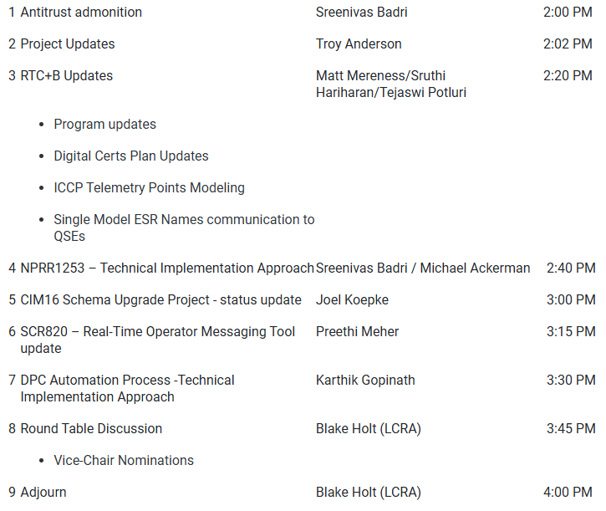
Technology Working Group (TWG)
Agenda for TWG meeting held on 1/30/2025:
Next TWG scheduled for 2/27/2025

