Slide 1

NERC EMSWG Update
Wei Qiu, NERC EA
ERCOT TWG Conference Call
February 27, 2025

Slide 2
2025 Monitoring and Situational Awareness Technical Conference
Location: SPP in Little Rock, AK
Date and Time:
  Tuesday, October 21, 2025
  Wednesday, October 22, 2025
Theme: TBD

Slide 3
NERC EMSWG Workplan 2025
Lessons Learned - Redundancy of control rooms
Lessons Learned – EMS failover issue
Lessons Learned – More frequent testing of seldom used EMS procedures

Slide 4
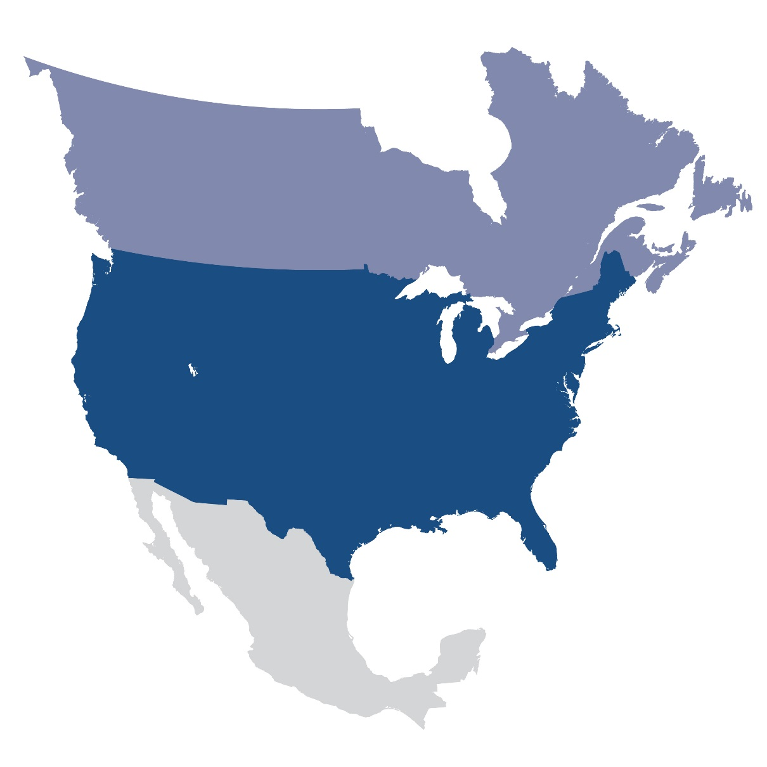
Questions and Answers
Contact Information:
wei.qiu@nerc.net

