Slide 1
NDCRC SCR829 – Test Request API
Nick Barbas
February 27, 2025

Slide 2
NDCRC – SCR829
Timeline Update
  SCR829 submitted to ERCOT on behalf of Constellation Energy Generation, Tenaska Power Services, NRG Texas Power LLC, and Lower Colorado River Authority
  QSEs are requesting API access to streamline operations related to submitting and managing unit testing requests, which went live in October 2024
  Requested as high priority after RTC+B development is complete (timeline TBD)
  SCR is going through Impact Analysis (IA) Process at ERCOT.
  Project will be initiated after stake holders and ERCOT review/approval of IA and ERCOT Internal Prioritization.
Project Goals
  Deliver REST API endpoints to market that deliver functional equivalence to the NDCRC UI for submitting and managing test requests
  currently in prototype phase – expect changes to material presented today as design and development begins.
  Collaborate and collect feedback from TWGs on implementation details and acceptance criteria
  Will post OpenAPI specification for every release milestone as project progresses
  API end points and specifications shown in rest of the slides is intended to show the prototyping work to have a discussion and to solicit market participant's feedback.

Slide 3
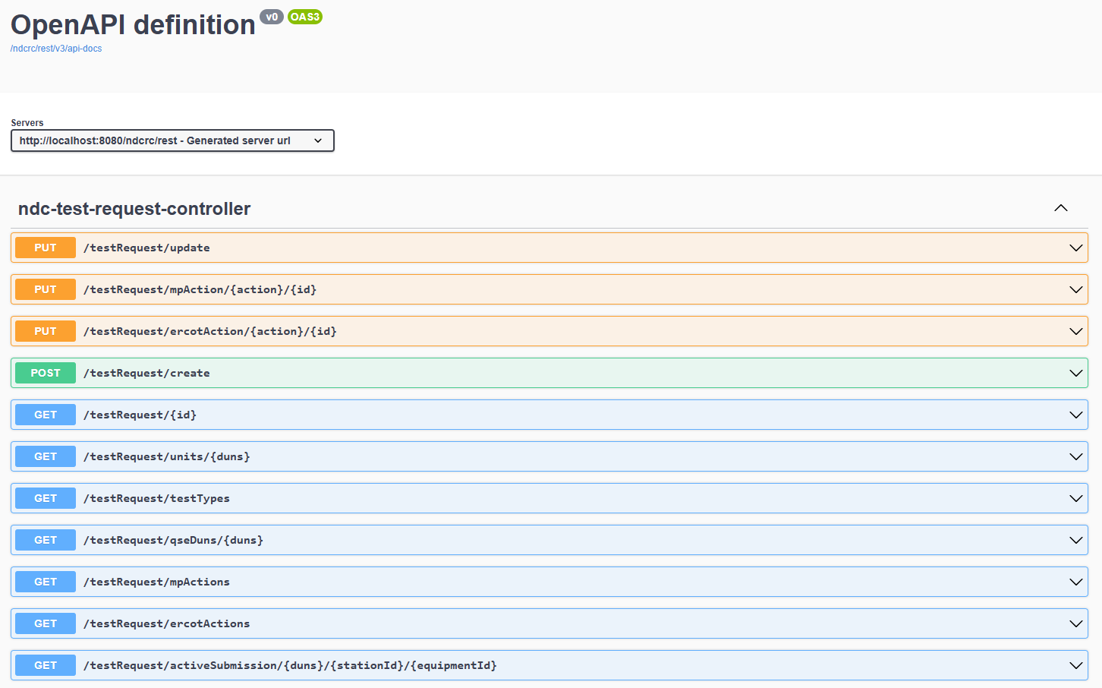
NDCRC – SCR829

Slide 4
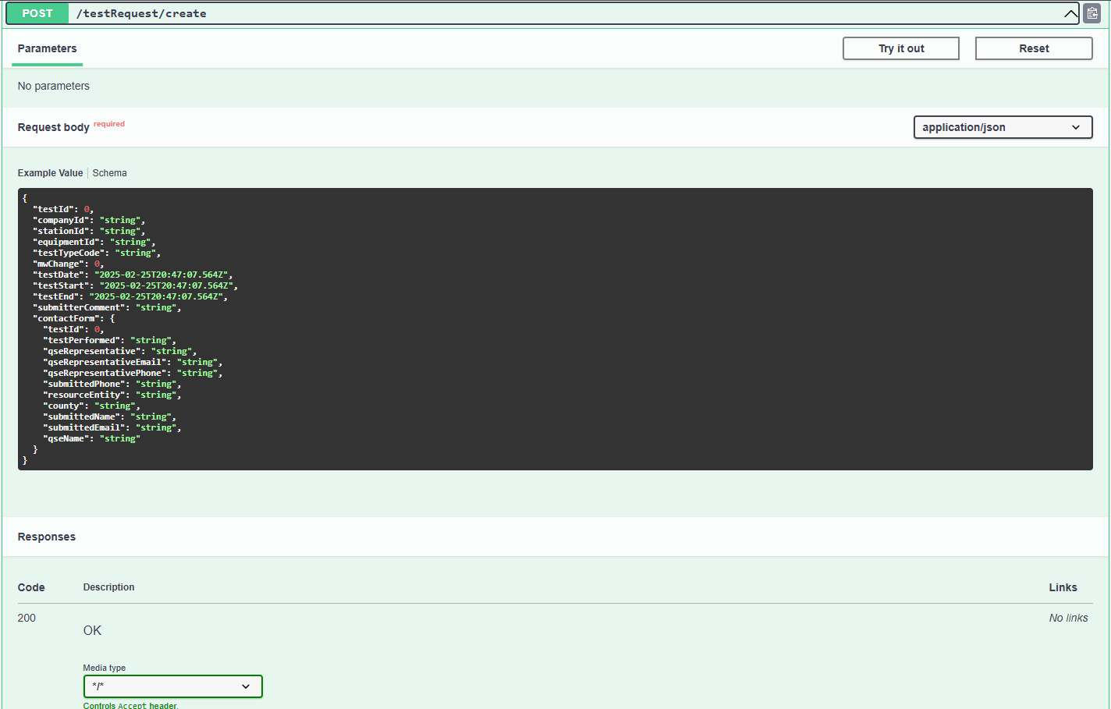
NDCRC – SCR829

