Slide 1
RTC+B Task Force
Update to TWG
Matt Mereness
TWG
Feb 27, 2025

Slide 2
RTCBTF Issues List
First red box is NPRR1269 for 3 policy issues (target April Board)
Second red box is IMM NPRR1268 for ASDC changes (target April Board)
Third red box is a clean-up NPRR1270 and remove automatic qualification (target April Board)
Still need evaluation of State of Charge and AS Duration (target June Board)
Market Trials

Slide 3
Sequence and Dates for Market Trials to Go-Live
30-day Market Notice
11/5/25
March/April
2025
Start
5/5/25
Start
7/7/25
Start
9/2/25
Go-Live
12/5/25*
May 2025
June 2025
July 2025
Aug 2025
Sep 2025
Oct 2025
Nov 2025
Dec 2025
QSE Scorecards & Exit Criteria for each Trial Phase
RTC QSE Submission Testing
(Submit COP, RT AS Offers,
DAM Virtual AS, Outages for ESRs)
Open-loop RTC SCED
(QSE offers, SCED non-binding award/dispatch)
Ongoing Open-Loop
& Periodic Closed-loop SCED/LFC
(QSE RTC offers and telemetry to support closed-loop frequency control test 2-3 tests of 2-4 hour durations)
Transition to Go-Live
Upon completion of testing, confirmation of ERCOT and market readiness for Go-Live.
QSE/Vendor Submission Sandbox and Telemetry Points added Prod EMS model.
RTC QSE Telemetry Check-out (QSEs add/verify new telemetry points for UDSP, New ramp rates, ESR telemetry)
QSE Telemetry Tests
(Individual QSE to follow UDSP and support new ramp rate and ESR telemetry)
Day-Ahead Market
(Non-binding DAM using QSE offers for at least 2 tests)
* Go-Live date reflects 12/5/2025 as first Operating Day
where 12/4/2025 is planned software migration.

Slide 4
Summary and Timeline of NPRRs that will be in flight
NPRR1268 for ASDC Modifications (IMM sponsor)
NPRR1269 for 3 Parameter/Policy Changes (ERCOT sponsor)
AS Proxy Offer Floors
ASDCs for Reliability Unit Commitment
Ramp Rate Sharing
NPRR1270 for AS Qualification details (ERCOT sponsor)
State of Charge – TBD but targeting late-June Board
Timeline and vetting of RTC+B NPRRs
No QSE System Impacts
PRS Urgency & Apprv 3/12
TAC approval
March 26
File NPRRs
(No impacts) Jan 28
PRS Table NPRRs
Feb 12
Board Approval
April 8
PUCT Approval
May 15
Jan 2025
Feb 2025
Mar 2025
Apr 2025
May 2025
June 2025
RTCBTF: Jan 14, 23, Feb 7,19, March 5, 25
ERCOT window for “re-factoring” development
ERCOT market trials deployed and begin on May 5, 2025
Stakeholder comments in Feb and March

Slide 5
Recent RTCBTF Discussion
Discussion of NPRR 1268- IMM Modifications to ASDCs / IMM staff
a. Hunt Energy Presentation and prior comments
b. ERCOT presentation and draft comments
Discussion of NPRR 1269- ERCOT 3 Parameter Policy issues / ERCOT staff
a. AS Proxy Offer Floor
- IMM comments filed 2/6/25
b. RUC ASDC
- ERCOT to share analysis in presentation
c. Ramp sharing
Discussion of NPRR 1270 Clarification and AS Qualification / Nitika Mago
a. No comments filed
Market Readiness / ERCOT Staff
a. Initial Review of Handbook #3 – Open Loop SCED
b. Initial Review of Handbook #4 – QSE Telemetry Tests
c. Draft Operator Training Seminar slides (work-in-progress)
DRAFT HANDBOOKS POSTED HERE (RTCBTF 2/19/25 meeting page)
Extra meeting- Friday March 7 for NPRRs (before March 12 PRS meeting)

Slide 6
Other Updates
TWG Meetings- ERCOT will continue to support detailed technical conversations such as adding telemetry points to network model, digital certificates, accessing ERCOT systems in March/April timeframe
Goal of strengthening communication and centralize content in March
Developing new folders on RTCBTF home page
Market Trials folder: Handbooks and supporting materials / FAQ
Technical Support folder: Key TWG technical materials
Leverage RTCB@ercot.com mailbox for support of stakeholder implementation questions
Post ICCP/telemetry explanation video (recorded and posting later this week)
Following guidance from RTCBTF to engage DSWG separately (ERCOT developing content)
Acknowledge need to get ahead of Closed-Loop LFC planning
Formal Market Trials begin in about 10 weeks

Slide 7
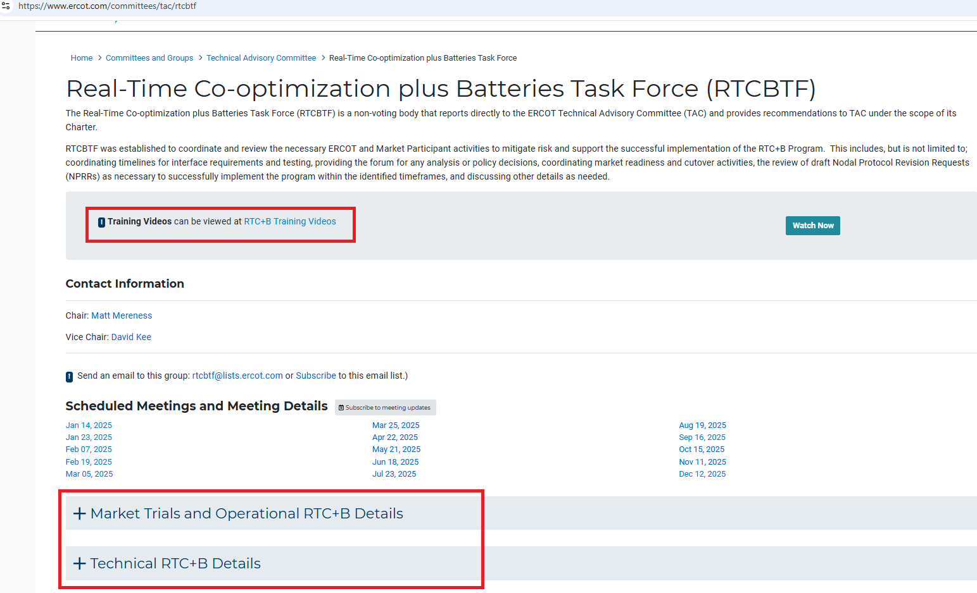
Snapshot of Folders on RTCBTF webpage

Slide 8
RTC+B Training videos

Slide 9
Next steps
Market Notice being released about Sandbox
RTCBTF
March 5- Half day meeting for NPRR changes
March 25- Full meeting (Discuss market comments back on Handbooks #3 and #4)
Questions?

