Slide 1
ERCOT Technology Working Group (TWG)
February 27, 2025

Slide 2
ERCOT TWG
WELCOME

Slide 3
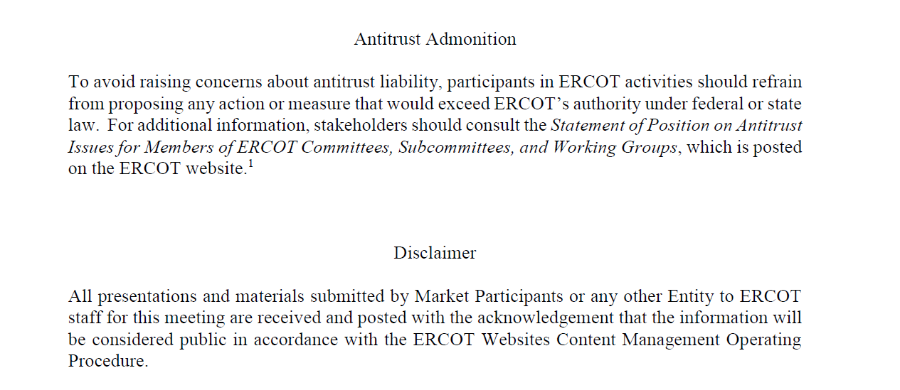
ERCOT TWG

Slide 4
ERCOT TWG Agenda
Item # | Item Description | Presenter | Start Time
1 | Antitrust admonition | Sreenivas Badri | 2:00 PM
2 | NERC Update – EMSWG | Wei Qui | 2:02 PM
3 | Project Updates | Troy Anderson | 2:10 PM
4 | RTC+B Updates Program updates Refresher on Telemetry Setup and Market Submissions dual entry ERCOT RTC+B Market Trial System Readiness ICCP Handbook Updates Common questions on ICCP Telemetry modeling | Matt Mereness/Sruthi Hariharan/Tejaswi Potluri/Kevin McGarrahan | 2:20 PM
5 | NPRR1253 – Technical Specifications Discussion | Sreenivas Badri/Michael Ackerman | 3:00 PM
6 | DPC Automation Process -Technical Implementation Approach | Sreenivas Badri | 3:20 PM
7 | SCR829 – NDCRC API Implementation Approach | Nick Barbas | 3:30 PM
8 | Round Table Discussion | Blake Holt (LCRA) | 3:45 PM
9 | Adjourn | Blake Holt (LCRA) | 4:00 PM

Slide 5
NERC Update - EMSWG
NERC Updates - EMSWG – Wei Qui

Slide 6
Project Updates
Project Updates – Troy Anderson

Slide 7
RTC+B Updates
RTC+B Updates – Matt Mereness/Sruthi Hariharan/Tejaswi Potluri/Kevin McGarrahan

Slide 8
NPRR1253 – Technical Implementation Approach
NPRR1253 – Technical Specifications Discussion – Sreenivas Badri/Michael Ackerman

Slide 9
DPC Automation Process -Technical Implementation Approach
DPC Automation Process -Technical Implementation Approach – Sreenivas Badri

Slide 10
SCR829 – NDCRC API Implementation Approach
SCR829 – NDCRC API Implementation Approach – Nick Barbas

Slide 11
ERCOT TWG – Round Table Discussion
ERCOT TWG – Round Table Discussion
  Seeking Vice-Chair Nominations
  Future Topics of Interest
    MPIM Redesign
  Topics and presentations from TWG members

Slide 12
ERCOT TWG
Thank You
You can reach Sreenivas at
Sreenivas.Badri@ercot.com and Blake at Blake.Holt@LCRA.ORG

