Slide 1
PLWG 02/24/25
Private Use Network
Reactive Capability Requirements

Slide 2
ERCOT Protocol 3.15 (4)
(4) Each Generation Resource and ESR required to provide VSS shall comply with the following Reactive Power requirements in Real-Time operations when issued a Voltage Set Point by a TSP or ERCOT:
An over-excited (lagging or producing) power factor capability of 0.95 or less determined at the unit's maximum net power to be supplied to the ERCOT Transmission Grid and for any Voltage Set Point from 0.95 per unit to 1.04 per unit, as measured at the Point of Interconnection Bus (POIB);
An under-excited (leading or absorbing) power factor capability of 0.95 or less, determined at the unit's maximum net power to be supplied to the ERCOT Transmission Grid and for any Voltage Set Point from 1.0 per unit to 1.05 per unit, as measured at the POIB;

Slide 3
Measurement of Reactive Capability
For non-IRRs Reactive Capability is measured and reported at the Generator Terminals
For IRRs the Corrected Unit Reactive Limit (CURL) is reported at the low side of the Main Power Transformer (MPT)
3.15 (4) (e): “…For Intermittent Renewable Resources (IRRs), the Reactive Power requirements shall be available at all MW output levels at or above 10% of the IRR’s nameplate capacity…”
Per 3.15 (4) the Generator, even on a Private Use Network, must be able to maintain +/- 0.95 PF at the POIB at the real time maximum net capability to the grid
We 100% agree with all of the above! The purpose of NPRR 1272 is to clarify PUNs meet all the above without punitive treatment.

Slide 4
Private Use Network Reactive Support
Any time the Generator and a Load on a Private Use Network (PUN) are independently running at +/-0.95 Power Factor the corresponding Power Factor at the POI is 0.95.
In the case where power is being exported to the grid the Power Factor will be +0.95
In the case where power is being imported from the grid the Power Factor will be -0.95
The Load on a PUN is always required to maintain its Power Factor as required by the Utility tariff
Since Generators are generally pushing MW/MVAR and Industrial Loads are pulling MW/MVAR, each MW/MVAR produced by a Generator on a PUN simply cancels out a MW/MVAR from the Load as measured at the POIB

Slide 5
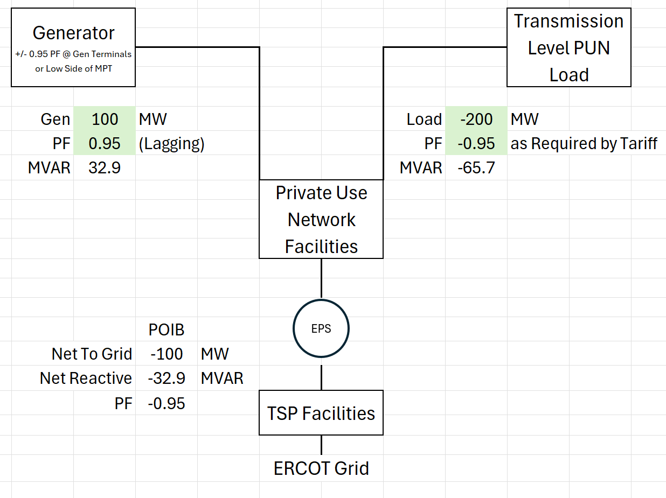
Example 1- PUN is a Net Load

Slide 6
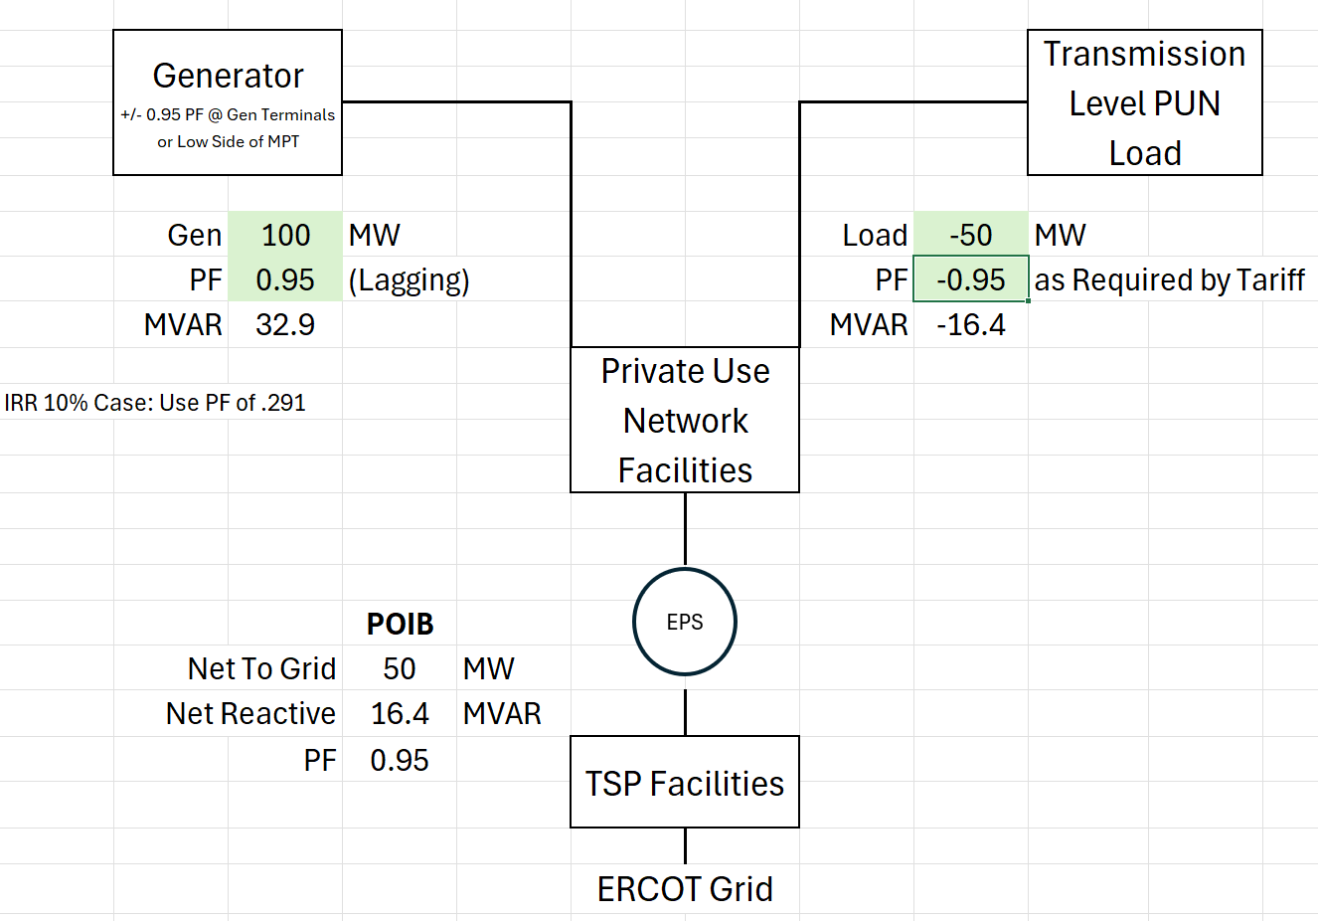
Example 2- PUN is a Net Generator

Slide 7
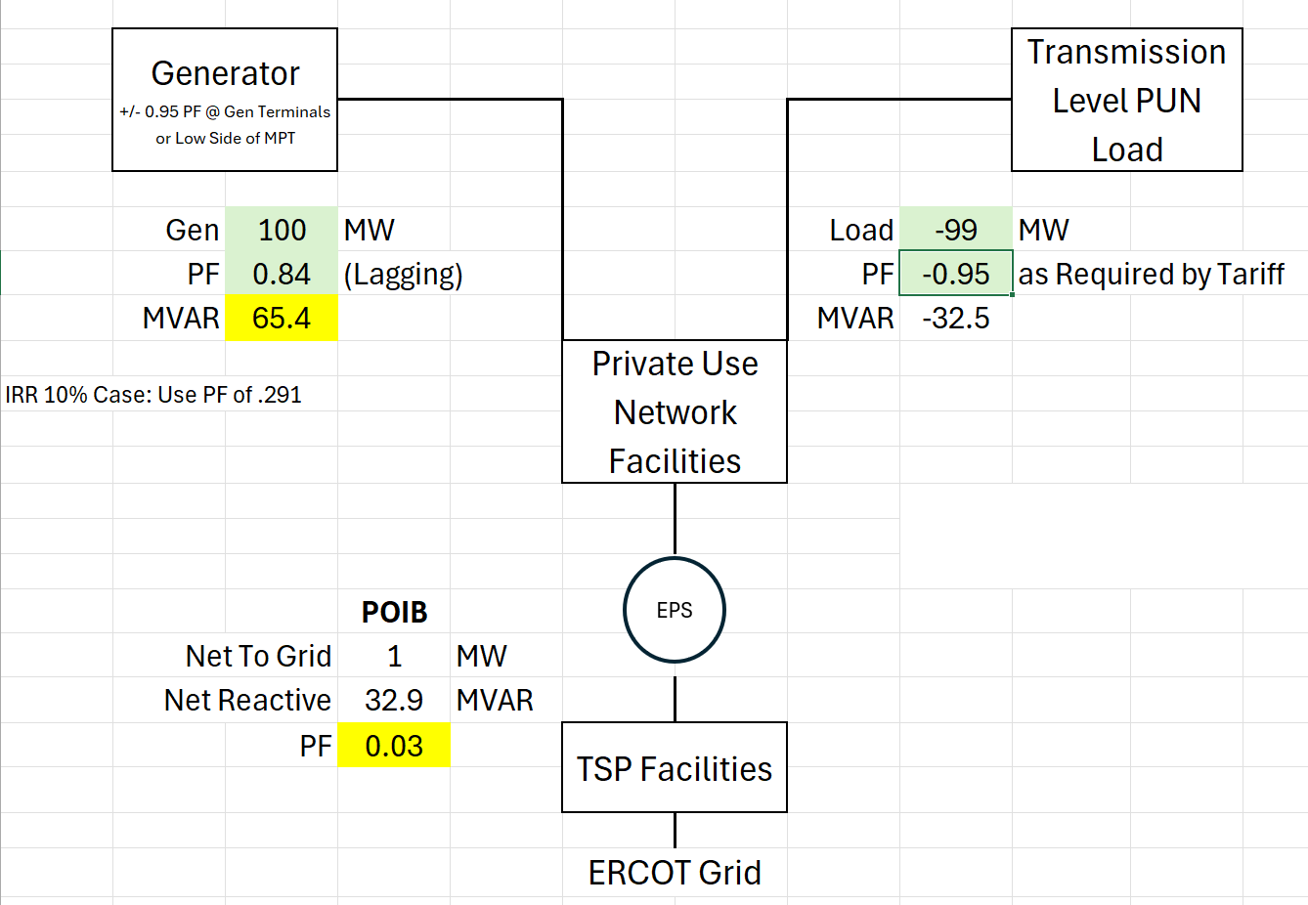
Example 3- Protocol Misinterpretation

Slide 8
Excel spreadsheet submitted to illustrate the situation where the Protocols are being misinterpreted and to run scenarios as PLWG members wish.
Questions?

