Slide 1
Lone Star proposal to eliminate oscillatory risks on ERCOT system in near and long term
PLWG 02/24/2025
Presented by: Nihal Mohan/Aditi Upadhyay
Lonestar Transmission

Slide 2

Executive summary of recommendation
LST’s proposal to update the PGRR120 language to eliminate SSO risks
LST believes a blanket ban by ERCOT on new interconnection requests on series compensated lines is not a prudent solution for several reasons:
  Several other regions in the US have successfully managed series compensation with effective solutions over the past several decades.
  The ban further exacerbates the capacity shortfall projections* in ERCOT region to meet increasing load demand.
  Series compensated lines are high ampacity lines. Prohibiting generation on these lines will result in underutilization.
LST proposes the following potential solutions:
  Modify the proposed PGRR 120 language to include valid exceptions for generators.
  Propose cost-effective, short-lead-time operational schemes to reduce SSO risk in the near term, and transmission-based solutions for long-term horizon.
  Ensure accurate modeling of non-linear phenomenon such as transformer saturation, controls in EMTP planning studies to accurately capture oscillatory issues.
https://www.ercot.com/files/docs/2025/02/12/CapacityDemandandReservesReport_December2024.pdf

Slide 3
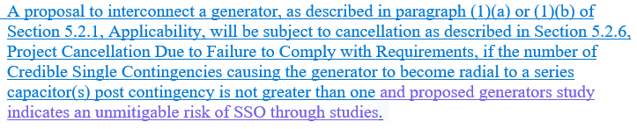
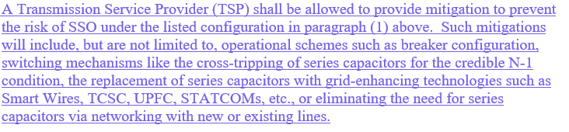
Proposed Language changes
Valid exceptions for generators which mitigate the risk
Allows Transmission Service Providers to propose mitigations to resolve reliability risks due to oscillatory issues
LST recommends updating PGRR120 to incorporate valid exceptions and allow TSPs to propose mitigations

Slide 4

LST’s solutions to address SSR issues both in the near term and the long term
 |  | Potential Solutions |  |  | Status | Comments
Cost (Increasing) |  |  |  | Networking with other transmission lines |  | LST has developed networking solutions with future Permian Import path which eliminates reliability risk of SSR by permanently retiring the series cap banks and additionally increases WESTEX GTC limit. For networking solution, neighboring TSP has indicated support for a joint RPG project
 |  |  | Substation Upgrades: STATCOM, TCSC, UPFC |  |  | Other potential solutions to replace series compensation with dynamic devices to maintain WESTEX limits.
 |  | Operational : Substation Re-Config. Protection based : Cross Trip |  |  |  | Two layers of defense: LST has implemented a protection based (cross-trip) mechanism which will bypass the series cap banks upon detection of N-1 condition. SSFR relays implemented at the two generator sites provide 2nd layer of defense
 |  | Lead Time (Increasing)

Slide 5

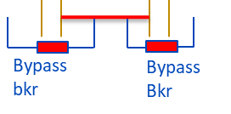
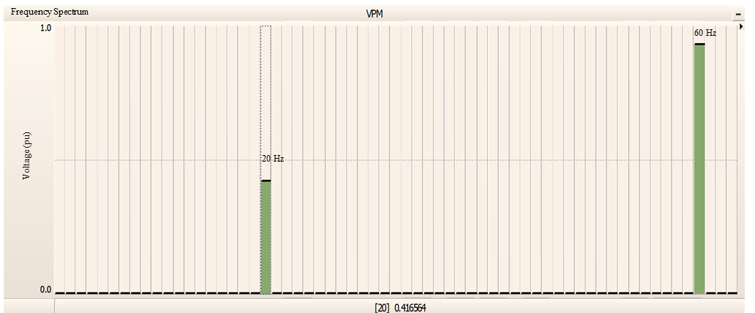
Plots for Series Capacitor bypassed for N-1 Radial scheme successfully mitigating SSFR
The LST planning process has successfully identified oscillatory issues during the interconnection process and has developed mitigations
LST’s scheme to eliminate N-1 Radial to series capacitors condition
Wind Farm 1
Wind Farm 2
Cap bank2
Cap bank1
Loss of line bypasses the series caps by closing the breakers
Scans identified resonant frequencies typical of Ferro resonance
Instantaneous voltage and current profile at the POI(Damped SSFR)
Voltage
Successful damping within 1 seconds
20 Hz
40 Hz

