Slide 1
ERCOT IBRTF: Industry Updates
Julia Matevosyan
Associate Director and Chief Engineer
ESIG
02/21/2025

Slide 2
SRP Published GFM Specs and Test Procedures
Salt River Project (SRP) recently released a Business Practice on Grid Forming Battery Energy Storage System Specification and Simulation Test Procedures, effective February 14, 2025.
The Business Practice emphasizes the rapid growth of IBRs that SRP is experiencing and recognizes the need to maintain high levels of grid stability and reliability.
SRP is "adopting GFM technology for BESS on a case-by-case basis” and the Business Practice serves as the technical requirements for SRP to test performance against for applicable interconnections.
The Business Practice applies to “to any standalone BESS or the BESS component of a co-located facility where SRP specifies that the BESS shall operate in GFM mode.”
The functional specification mirrors NERC specification closely and the simulation test procedures are a simplified version of the NERC tests, using one test system and simulation test with pass/fail criteria defined.
IBRs are expected to meet other SRP IBR performance specifications and allows for exemptions requested by the interconnection customer for any challenges meeting those requirements (considering that SRP has adopted many parts of IEEE 2800-2022 already).
SRP will review the submitted GFM model and accompanying simulation test report to ensure all pass/fail criteria are met. Interconnection customers can resubmit models and simulation test reports to address any issues identified.
Source: Ryan Quint (Elevate Energy Consulting)

Slide 3
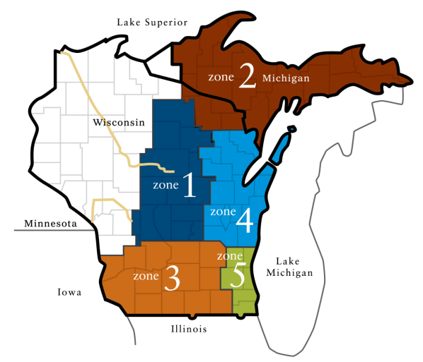
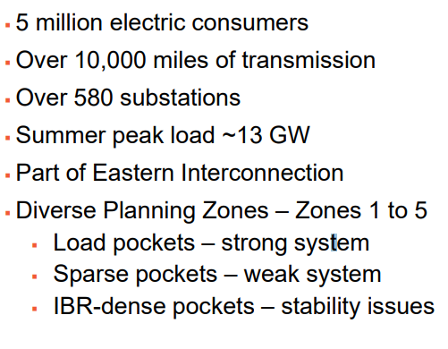
Study: Benefits of Grid Forming Battery Energy Storage Systems
Objectives of the work were to verify:
GFM is “do no harm” solution Yes
GFM and GFL interoperability Yes
GFM benefits in weak grids Yes
GFM operates stably in strong grids Yes
GFM works across multiple OEMs Yes
GFM to defer other options Yes
Growth of GFM BESS cause reliability issues? No
Recommendations to OEMs
Tested 4 OEM-specific GFM BESS Models to NERC GFM Functional Specifications, Microcosm System Tests and Near-Actual System Studies (ATC system’s EMT model).
Source: ESIG Webinar Benefits of GFM Study Discussion, by Ryan Quint and Farhad Yahyaie (Elevate), Andrew Isaacs and Lukas Unruh (Electranix)

Slide 4
Study Recommendations
Develop models and conduct EMT studies to quantify the benefits of GFM BESS on your local system; understand the value it can bring
Use GFM BESS as a solution in your toolbox to solve grid stability issues like weak grids, near series capacitors, etc.; consider even in strong grids to help stability
Consider GFM BESS to maximize project value: lower risk for new IBR interconnections, increase IBR hosting capacity, reduce curtailments, and minimize network upgrades
Pilot GFM BESS projects to gain operational experience
Develop GFM BESS technical requirements and integration into facility interconnection requirements; incorporate into RFPs for new resources
Don’t wait – take advantage of BESS interconnections today; retrofits are expensive
Source: ESIG Webinar Benefits of GFM Study Discussion, by Ryan Quint and Farhad Yahyaie (Elevate), Andrew Isaacs and Lukas Unruh (Electranix)

Slide 5
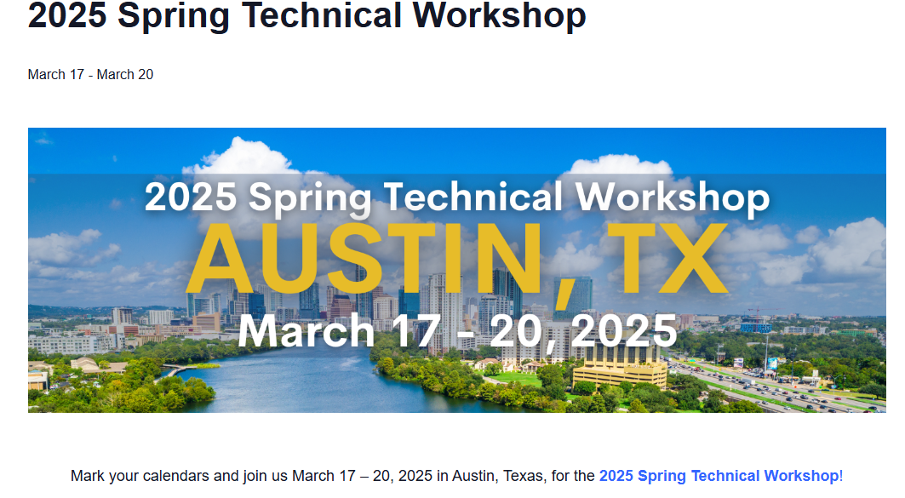
ESIG Spring Workshop in Austin, March 17-20
Select Topics (of interest to IBRWG)
Oscillations and Stability
Grid Forming Inverters
FERC Order 901, NERC Milestone 3
Large Load Integration

Slide 6
Julia Matevosyan
julia@esig.energy

