Slide 1
ERCOT Frequency Events
January 2025
ERCOT
Operations Planning
PDCWG | Feb 18, 2024

Slide 2
1/17/2025 12:56:54 (Non-FME)
Notes:
The unit experienced runback while carrying ~686 MW and tripped offline
Starting Frequency: 60.004 Hz
Minimum Frequency: 59.933 Hz
A-C Time : 4 seconds
Recovery Time(back to deadband): 3 minutes 49 seconds
ECRS Released: 0 MW
Trip Reason: Unknown at this time
Contextual Information: A total of 452 MW of regulation Up was deployed during the event.
Reason for no selection: C point is 59.933

Slide 3
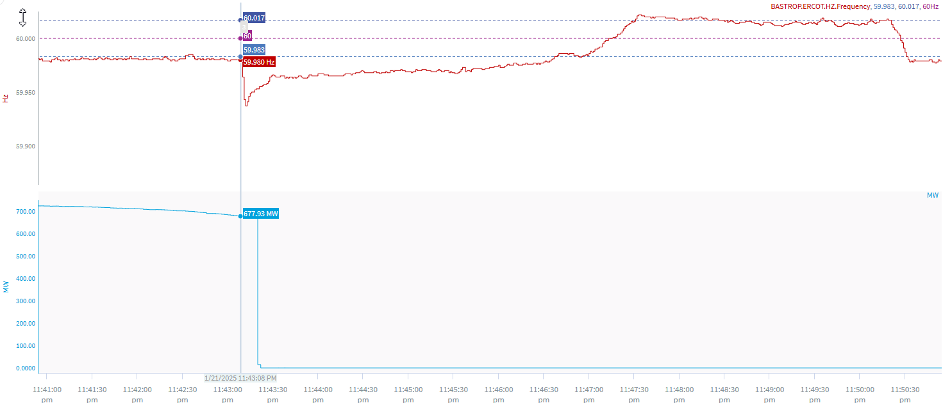
1/21/25 23:43:08 (Non-FME)
Notes:
The unit experienced runback and tripped offline while carrying ~ 678 MW
Starting Frequency: 59.980 Hz
Minimum Frequency: 59.937 Hz
A-C Time : 4 seconds
Recovery Time(back to deadband): 3 minutes 46 seconds
ECRS Released: 0 MW
Trip Reason: Loss of water pump
Contextual Information: A total of 232 MW of regulation up was deployed and SCED manual offset of 100 MW was applied during the event
Reason for no selection: The C point is 59.937

Slide 4
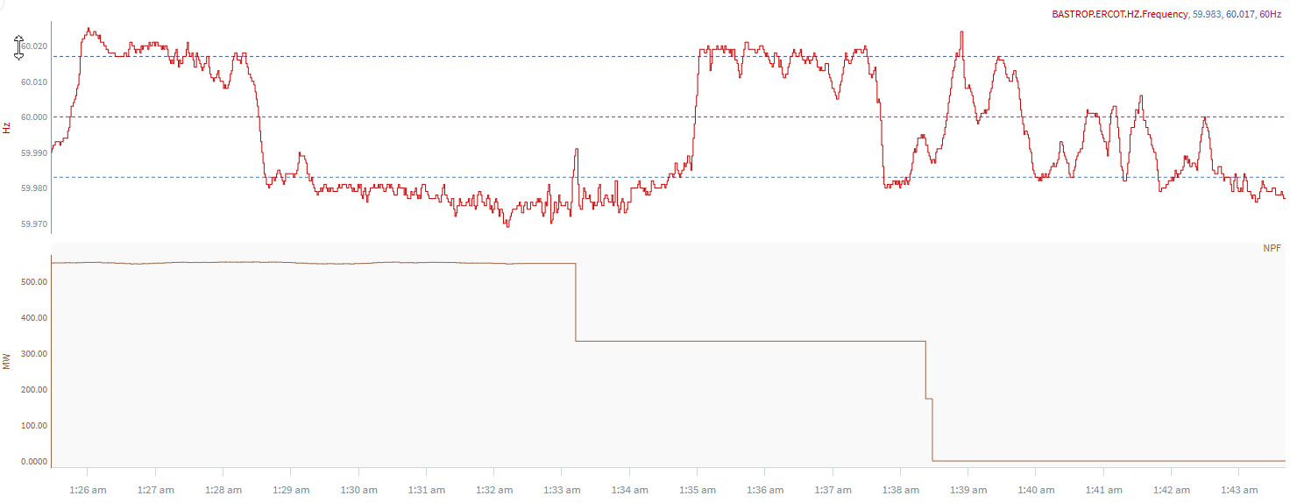
1/29/2025 1:28:19(Non-FME)
Notes:
A combined cycle tripped in steps for loss of ~552 MW
Starting Frequency: 60.017Hz
Minimum Frequency: 59.959 Hz
A-C Time :
Recovery Time(back to deadband): 4 minutes 12 seconds
ECRS Released: 0 MW
Trip Reason: insulator failure
Contextual Information: A total of 224 MW of regulation up was deployed during this time
No selection reason: The unit trip is not clean

Slide 5
Questions?
Thank you!

