Slide 1
Nodal Protocol Revision Request (NPRR) 1268 Discussion
David Maggio
Principal, Market Design & Analytics
February 19, 2025
Real-Time Co-optimization plus Batteries Task Force (RTCBTF)
ERCOT Public

Slide 2
Introduction
With the on-going presentations for Hunt Energy Network’s (HEN’s) proposed changes to NPRR1268, ERCOT wanted to provide analysis giving a clearer view of the impact of their proposal as compared to other more minor changes to the underlying historical data and curve fit for the Aggregate Operating Reserve Demand Curve (AORDC).
The presentation also provides a more accurate view of the expected AORDC at implementation by making updates to what was previously presented by ERCOT to RTCBTF, specifically updates to the “mu” and “sigma” to reflect the most recent values and an update to the set of historical data adding data from 2024.
HEN’s proposal uses a formula for “ORDC” that doesn’t really exist for the current ORDC design in the ERCOT market. The value of reserves is set using the formula below and HEN’s proposal is a departure from this current ORDC policy.
  (𝟎.𝟓∗(𝟏−𝒑𝒏𝒐𝒓𝒎(𝑹𝑻𝑶𝑳𝑪𝑨𝑷−𝑿, 𝟎.𝟓∗mu, 𝟎.𝟕𝟎𝟕∗sigma))
  +𝟎.𝟓∗(𝟏−𝒑𝒏𝒐𝒓𝒎(𝑹𝑻𝑶𝑳𝑪𝑨𝑷+𝑹𝑻𝑶𝑭𝑭𝑪𝑨𝑷−𝑿, mu, sigma)))
  ∗(𝑽𝑶𝑳𝑳−𝑺𝒚𝒔𝒕𝒆𝒎 𝑳𝒂𝒎𝒃𝒅𝒂)

Slide 3
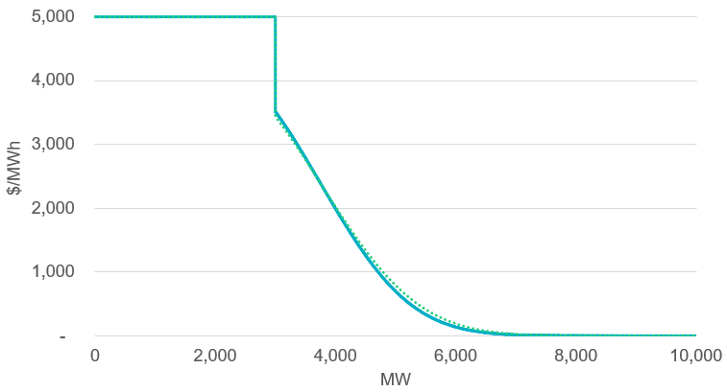
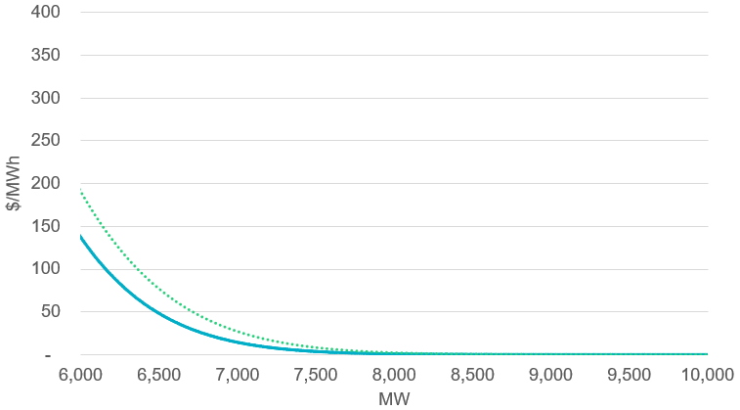
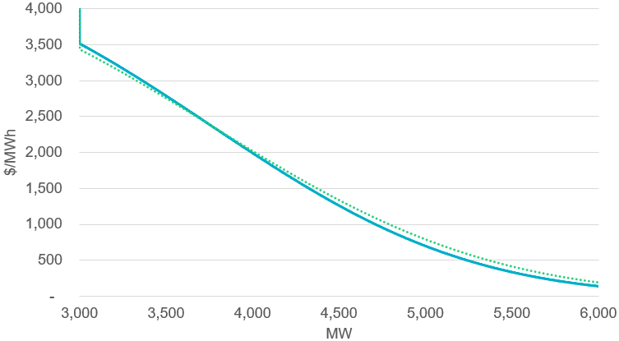
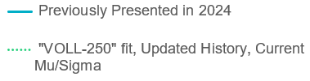
Updated Mu and Sigma with Increased History
In our presentation in 2024, the analysis had used dated mu and sigma values (925 and 1213, respectively) and there was less historical data available (through 2023). The graphs below reflect the impact of using the most recent mu and sigma (917 and 1340, respectively) and using historical data through 2024. These updates for implementation were already planned for and are part of the Protocols.
These are all graphs of the same data, just focused on different parts of the graph to understand differences

Slide 4
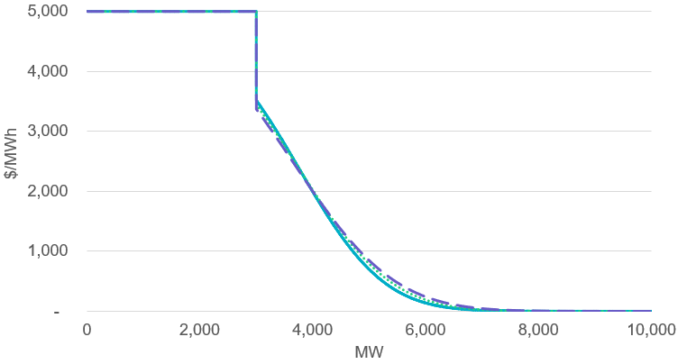
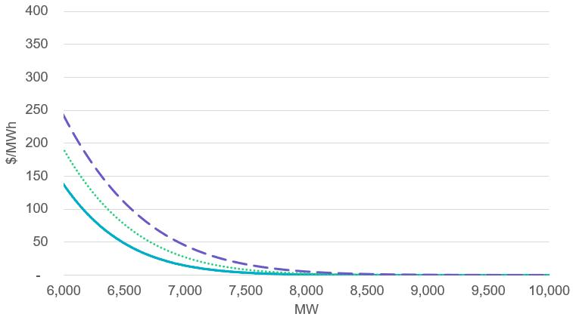
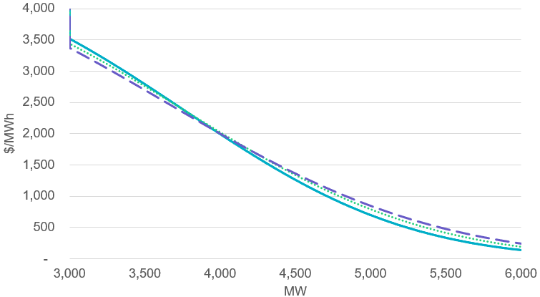
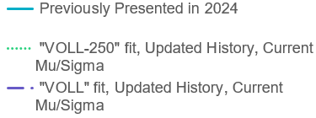
Change in Curve Fit from “VOLL-250” to “VOLL”
The comments from HEN raised concern about use of “VOLL-250” for the curve fit, but the impacts may not have been understood. The graphs below demonstrate the impact of using “VOLL” for the curve fit vs. “VOLL-250” on top of the other updates.
These are all graphs of the same data, just focused on different parts of the graph to understand differences

Slide 5
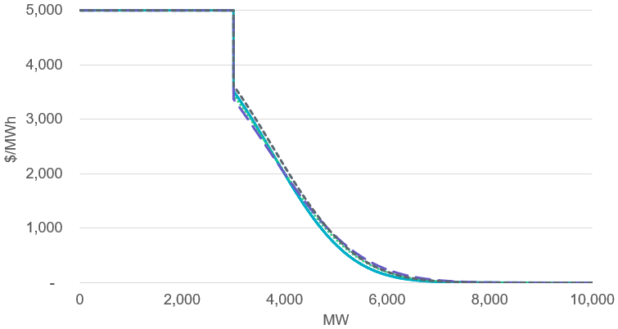
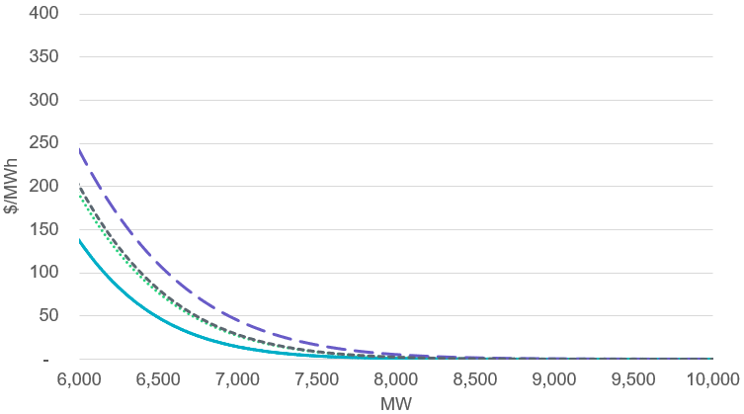
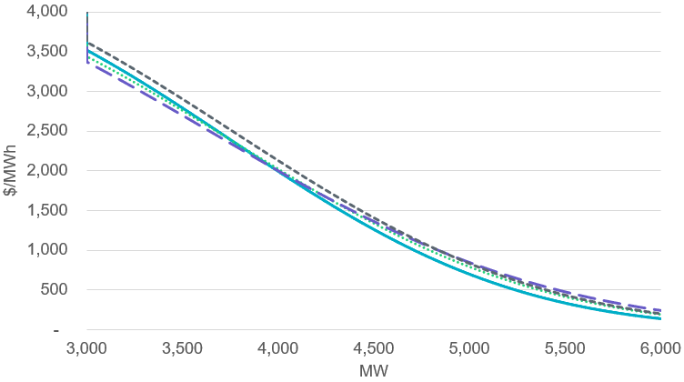
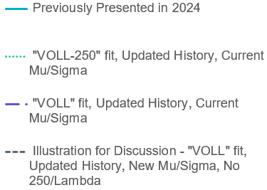
Replacing “VOLL-min(System Lambda,250)” with “VOLL” within the historical analysis
HEN’s proposal also suggests removing “min(System Lambda,250)” from the calculations for the underlying historical observations. While this would be a change from what was agreed to in developing NPRR1008, the isolated impacts of that change are illustrated below, again on top of the previously presented data.
These are all graphs of the same data, just focused on different parts of the graph to understand differences

Slide 6
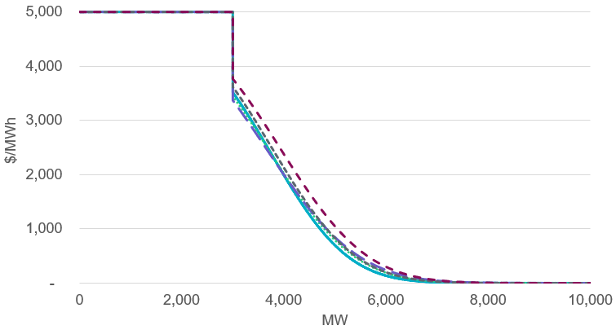
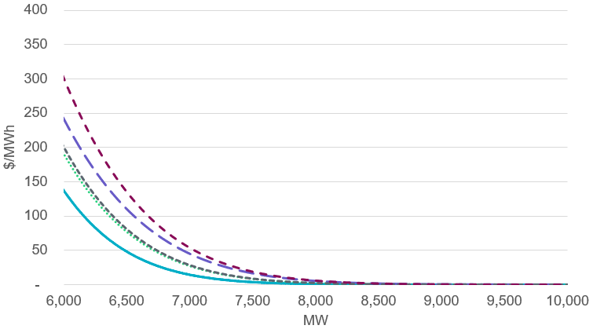
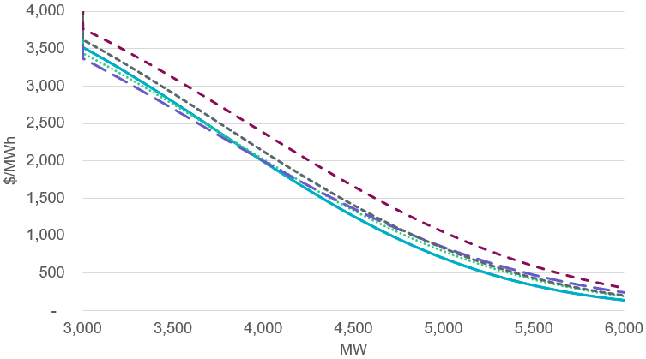
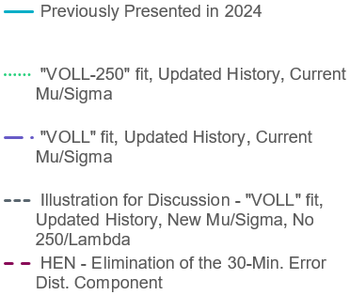
Comparison to HEN’s Proposal
Lastly, all these curves are compared to the proposal from HEN. For proper comparison, the HEN proposal is updated to use the current mu and sigma values used throughout this presentation. The difference in outcomes are driven by eliminating the 30-minute error distribution component of the calculation which is a fundamental part of the current ORDC design in ERCOT.
(𝟏−𝒑𝒏𝒐𝒓𝒎(Reserves − 3000,917,1340))* 𝑽𝑶𝑳𝑳
These are all graphs of the same data, just focused on different parts of the graph to understand differences

Slide 7
Conclusions
The clear intent in developing the Key Principles and Protocols was for the AORDC design and Real-Time Co-optimization (RTC) outcomes to reasonably reflect the outcomes expected from the current ERCOT market ORDC design.
HEN’s proposal is a departure from the current ORDC design in the ERCOT market, specifically the elimination of the 30-minute error distribution component of the calculation.
We understand that multiple parties are interested in reconsidering the underlying ORDC policy, but ERCOT’s position continues to be that that should happen as part of more deliberate discussion on ORDC policy and should not be part of NPRR1268.

