Slide 1
NPRR1265 Unregistered Distributed Generator
Bill Blevins / Thinesh Devadhas Mohanadhas
ERCOT
NDSWG
02/18/2025

Slide 2
Background
HB 3390 – PURA Section 39.9165. DISTRIBUTED GENERATION FACILITY REPORTING: HB3390, which passed on June 2, 2023, helped to clarify reporting responsibilities of distributed generation. HB 3390 introduced language that authorizes ERCOT to require owners or operators of Distributed Generation to provide information to their respective TDSPs that ERCOT determines necessary for maintaining system reliability. Additionally, HB 3390 authorizes ERCOT to require TDSPs to report to ERCOT, in aggregate by delivery port, the reported information regarding Distributed Generation.
Unregistered DG (UDG) Workshops : To communicate and update ERCOT goals for Unregistered Distributed Generation (UDG) data collection. ERCOT wants to avoid the planning and operational impacts from lack of information about the remaining DG growth – Data collection and Planning Requirements. Also align with NERC SPIDERWG for DG.
  https://www.ercot.com/calendar/03302021-Unregistered-DG-Workshop-I
  https://www.ercot.com/calendar/06152023-Unregistered-DG-Workshop-II
The Resource Definition Task Force (RTF): This NPRR incorporates the Resource Definition Task Force’s (RTF’s) RTF-5 defined term “Unregistered Distributed Generator (UDG)” to clarify the appropriate use of DG or subtype of DG throughout the Protocols and meets the RTF’s objectives to “identify problematic terms” in the Protocols and “improv[e] the current structure and terms where practical.”
Appropriate representation of DER in planning and operational assessments is recommended by NERC through numerous published reliability guidelines and other technical documents. Additionally, there is ongoing work to incorporate DER into reliability standards as necessary, including work related to FERC Order No. 901.
  https://www.nerc.com/pa/Documents/DER_Quick%20Reference%20Guide.pdf

Slide 3
UDG Data Update Process
ERCOT will facilitate a yearly process to request, collect, and incorporate updates to UDG information into the model
ERCOT
Transmission Service Provider
Corrections
requested
Operations Modeling
Updated UDG
4.
An updated worksheet will be submitted to ERCOT
Application
Changes
Worksheet
(NMMS)
imported
Worksheet submitted to
ERCOT
TSP-specific pre-populated files will be generated containing all associated loads
Pre
DSP
-
1.
Populated
Pre
-
UDG
Populated
Pre
-
UDG
Populated
Worksheet
UDG
Files generated
Worksheet
for each TSP
Updated UDG
Worksheet
Worksheet
TSP
-
ERCOT MIS
specific
?
worksheets posted
Requested Information
to MIS
(TSP
-
Specific Location)
Via internal processes the TSP will update the UDG data within the spreadsheet
A single file will be provided to each TSP via the MIS
Pre
-
2.
Populated
Download
3.
UDG
Internal Processes
Worksheet

Slide 4
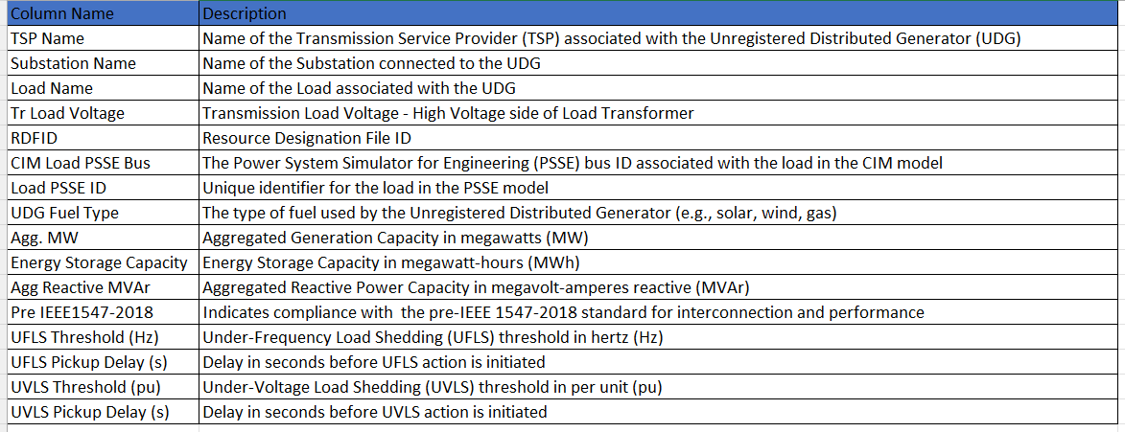
Sample Pre-Populated UDG Worksheet
ERCOT will create a pre-populated worksheet for each Transmission Service Provider (TSPs) at the start of each UDG data collection cycle
The spreadsheet will provide the existing UDG characteristics of all loads associated to the Transmission Service Provider (TSPs)

Slide 5
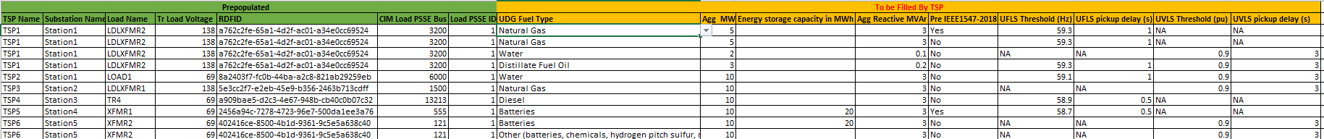
Sample Pre-Populated UDG Worksheet
ERCOT will create a pre-populated worksheet for each Transmission Service Provider (TSPs) at the start of each UDG data collection cycle
The spreadsheet will provide the existing UDG characteristics of all loads associated to the Transmission Service Provider (TSPs)

Slide 6
Example with Feeders Armed for UFLS/UVLS
Transmission Line
Substation X
HV Bus/PSSE Bus
~
C
~
TSF1
Substation XFMR (CIM Load-TYP)
UFLS:
59.3 Hz
UVLS:
None
UFLS:
None
UVLS:
None
UFLS:
59.1 Hz
UVLS:
None
UFLS:
58.9Hz
UVLS:
None
UFLS:
58.9 Hz
UVLS:
0.91pu
UFLS:
59.3 Hz
UVLS:
None
Feeder 1
Feeder 2
Feeder 3
Feeder 4
Feeder 5
Feeder 6
MV Bus
Aggregate UDG:
2 MW solar
Aggregate UDG:
2 MW solar
2 MW battery
Aggregate UDG:
1 MW diesel
2 MW solar
Aggregate UDG:
2 MW solar
1 MW solar*
Aggregate UDG:
1 MW solar
1 MW battery*
Aggregate UDG:
1 MW solar*
Distribution system
* Indicates UDG installed with IEEE1547-2018 capabilities aligned with potential new PUC ruling.

Slide 7
Worksheet entries for UFLS/UVLS example
UDG Fuel Type | Agg MW | Energy storage capacity in MWh | Agg Reactive MVAr | Pre IEEE1547-2018 | UFLS Threshold (Hz) | UFLS pickup delay (s) | UVLS Threshold (pu) | UVLS pickup delay (s)
solar | 4 |  | 1 | Yes | 59.3 | 0.5 | NA | NA
solar | 1 |  | 0 | No | 59.3 | 0.5 | NA | NA
diesel | 1 |  | 0 | Yes | 59.3 | 0.5 | NA | NA
solar | 2 |  | 0 | Yes | NA | NA | NA | NA
solar | 1 |  | 0 | Yes | 59.1 | 0.5 | NA | NA
Battery | 1 | 2 | 0 | No | 59.1 | 0.5 | NA | NA
solar | 2 |  | 0 | Yes | 58.9 | 0.5 | NA | NA
Battery | 2 | 6 | 0 | Yes | 58.9 | 0.5 | NA | NA
solar | 1 |  | 0 | No | 58.9 | 0.5 | 0.91 | 3

Slide 8
UDG Data Collection Summary
ERCOT will use the UDG data incorporating this into in models to use in operations and planning uses cases
ERCOT will initiate a yearly process to collect updates to UDG data
  Pre-populated forms will be generated for each Transmission Service Providers
  Forms will be uploaded to the MIS website
  TSPs will modify the provided worksheet and submit the updates to ERCOT
  ERCOT staff will incorporate changes into the NMMS

Slide 9
Use Cases in Planning
UDG information is expected to improve the accuracy of steady-state and dynamic simulations by better representing its operational characteristics
Incorporating UDG information is expected to support reliability assessments by evaluating its impact on the ERCOT grid under various operating conditions
UDG information will facilitate the transition to discrete modeling by providing necessary data for aggregating UDG based on feeder, fuel type, and IEEE-1547-2018 ride-through capabilities, ensuring alignment with potential new PUC rulings

Slide 10
Use Cases for Operations
Load Forecasting
  Better understanding in areas with large amounts of solar how the load is impacted due to the UDG for that area.
Situational Awareness
  Determine impacts to other DG types
  Visibility into high penetration of load points with potential to back flow into Network

