Slide 1
Credit Exposure Update
Market Credit Work Group
ERCOT Public
February 19, 2025

Slide 2
Monthly Highlights: December 2024 – January 2025
Market-wide average Total Potential Exposure (TPE) increased from $1.76 billion in December 2024 to $1.96 billion in January 2024
  TPE increased due to higher prices and forward adjustment factors
    Discretionary Collateral is defined as Secured Collateral in excess of TPE,CRR Locked ACL and DAM Exposure
  Average Discretionary Collateral increased from $3.98 billion in December 2024 to $5.10 billion in January 2025
No unusual collateral call activity

Slide 3
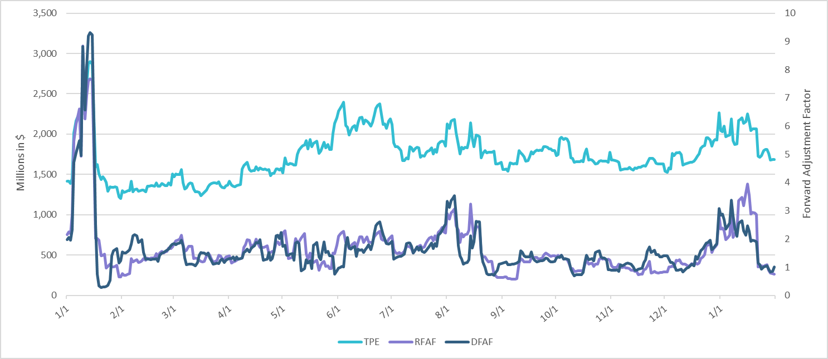
TPE and Forward Adjustment Factors: January 2024 – January 2025

Slide 4
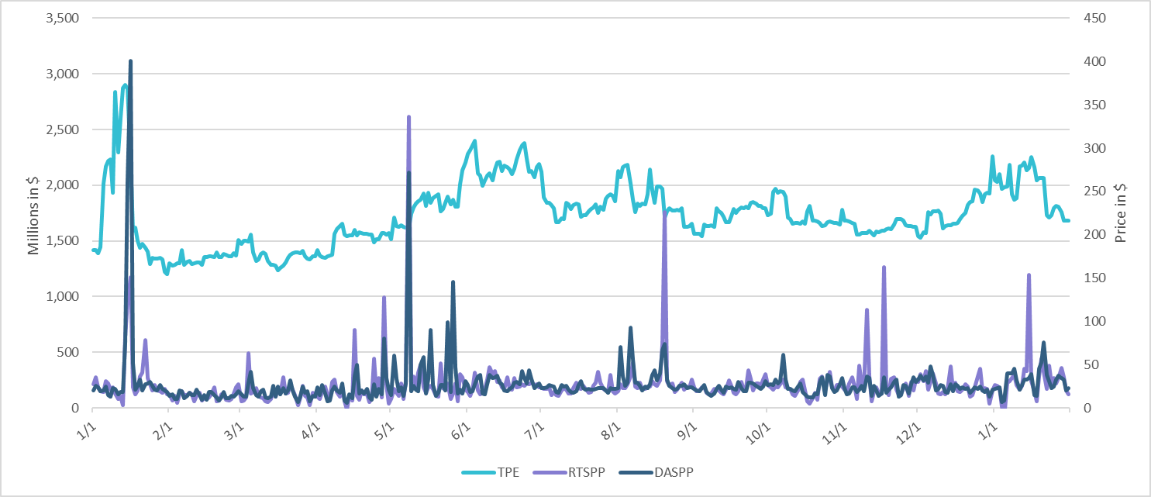
TPE/Real-Time & Day-Ahead Daily Average Settlement Point Prices for HB_NORT:H January 2024 – January 2025

Slide 5
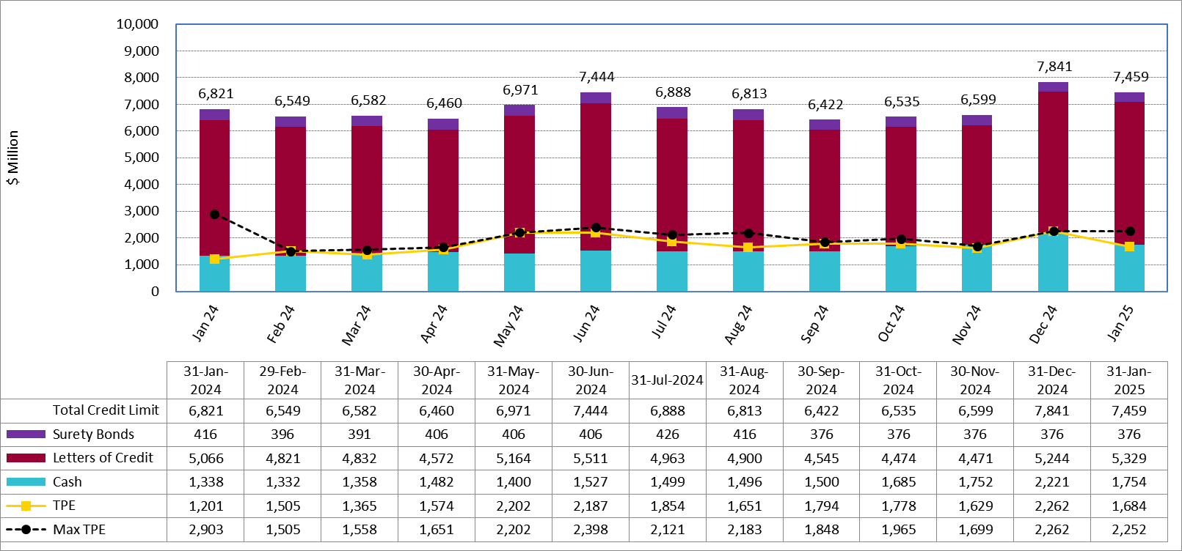
Available Credit by Type Compared to Total Potential Exposure (TPE):
January 2024 – January 2025
Numbers are as of month-end except for Max TPE
Max TPE is the highest TPE for the corresponding month

Slide 6
Issuer Credit Limits vs Total LC Amounts Per Issuer: End-January 2025
As of January 31, 2025
There are a total of 36 banks that have issued LCs.

Slide 7
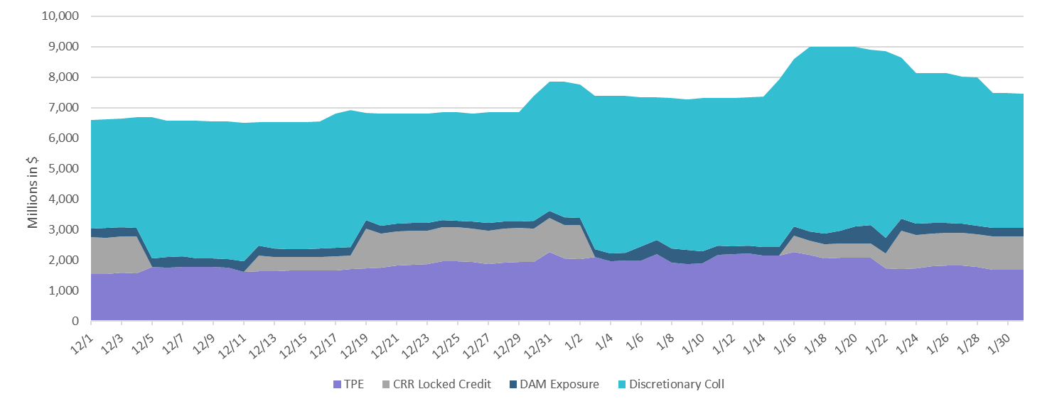
Discretionary Collateral December 2024 – January 2025

Slide 8
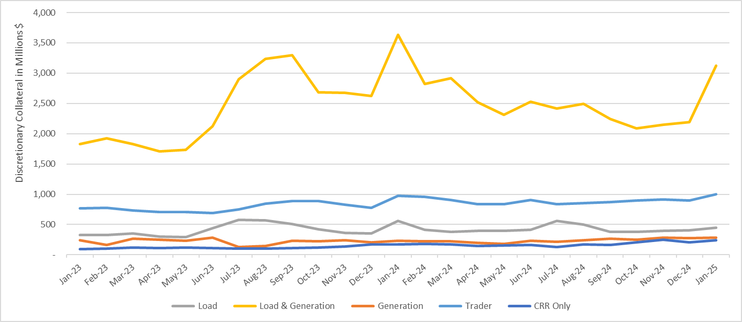
Discretionary Collateral by Market Segment January 2022 - January 2025
* Discretionary Collateral adjusted to exclude short pay amounts eliminating data skew

Slide 9
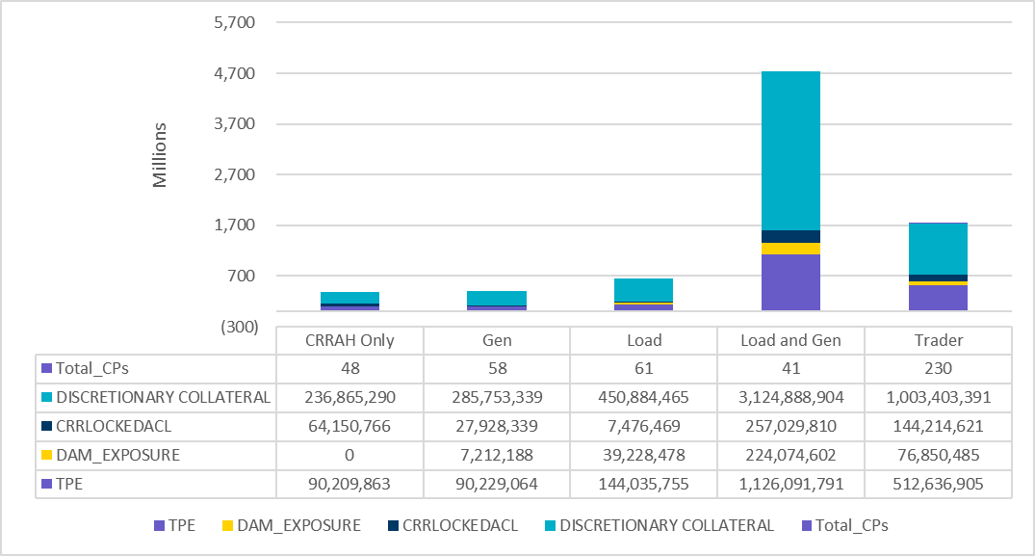
TPE and Discretionary Collateral by Market Segment - January 2025
Load and Generation entities accounted for the largest portion of discretionary collateral

Slide 10
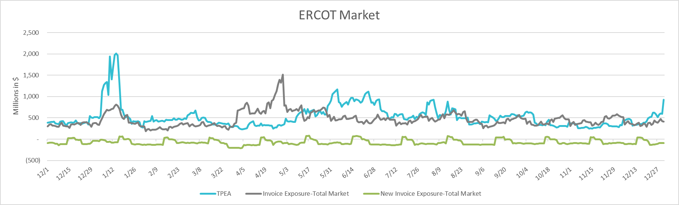
TPEA Coverage of Settlements December 2023 - December 2024
Invoice Exposure | Historical | Future
Existing Invoice Exposure | RTLCNS + UDAA | M1 Days (including current day) Forward Charge Invoice Amounts
New Invoice Exposure | 7 Days Back Net Invoice Amounts (Charges & Credits) | M1 Days (including current day) Forward Net Invoice Amounts (Charges & Credits); Excluding: 1) Securitization Invoices; 2) CRR Auction Invoices; and 3) Subchapter N Funds Distribution Invoice
TPEA closely approximates actual/invoice exposure

Slide 11
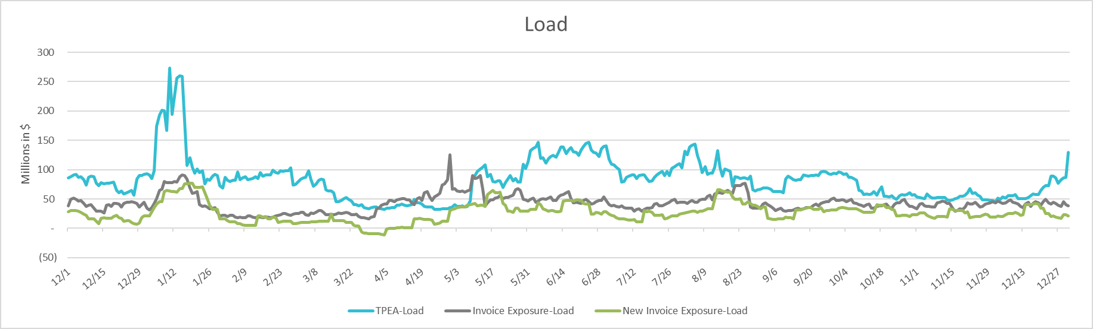
TPEA Coverage of Settlements December 2023 - December 2024
Invoice Exposure | Historical | Future
Existing Invoice Exposure | RTLCNS + UDAA | M1 Days (including current day) Forward Charge Invoice Amounts
New Invoice Exposure | 7 Days Back Net Invoice Amounts (Charges & Credits) | M1 Days (including current day) Forward Net Invoice Amounts (Charges & Credits); Excluding: 1) Securitization Invoices; 2) CRR Auction Invoices; 3) Subchapter N Funds Distribution Invoice
*TPEA exceeds invoice exposure

Slide 12
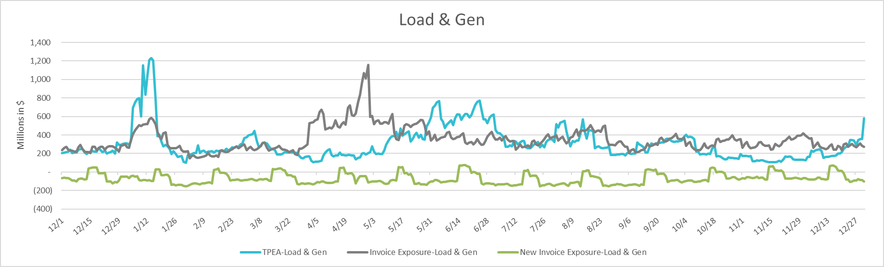
TPEA Coverage of Settlements December 2023 - December 2024
Invoice Exposure | Historical | Future
Existing Invoice Exposure | RTLCNS + UDAA | M1 Days (including current day) Forward Charge Invoice Amounts
New Invoice Exposure | 7 Days Back Net Invoice Amounts (Charges & Credits) | M1 Days (including current day) Forward Net Invoice Amounts (Charges & Credits); Excluding: 1) Securitization Invoices; 2) CRR Auction Invoices; 3) Subchapter N Funds Distribution Invoice
Invoice exposure generally exceeds TPEA

Slide 13
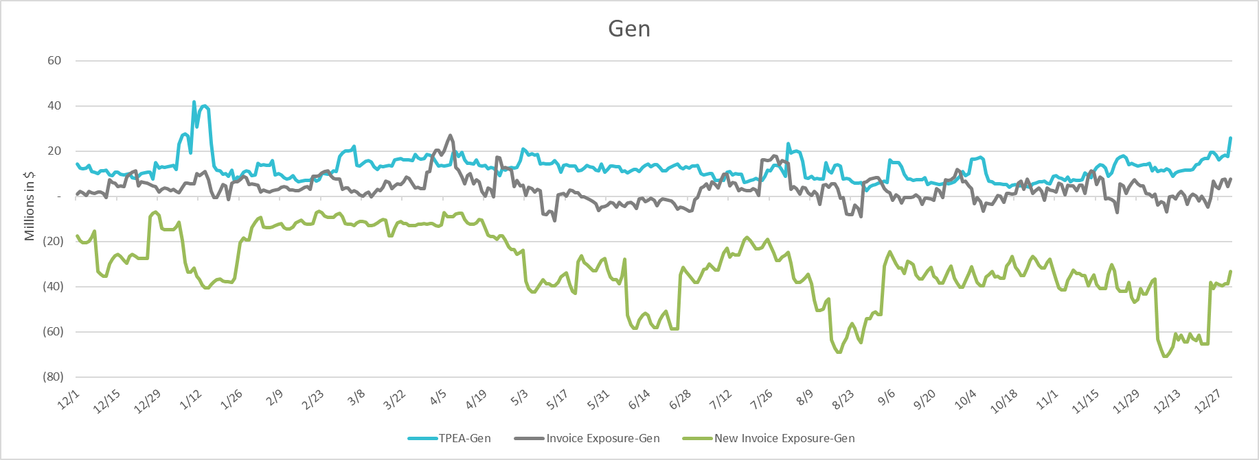
TPEA Coverage of Settlements December 2023 - December 2024
Invoice Exposure | Historical | Future
Existing Invoice Exposure | RTLCNS + UDAA | M1 Days (including current day) Forward Charge Invoice Amounts
New Invoice Exposure | 7 Days Back Net Invoice Amounts (Charges & Credits) | M1 Days (including current day) Forward Net Invoice Amounts (Charges & Credits); Excluding: 1) Securitization Invoices; 2) CRR Auction Invoices; 3) Subchapter N Funds Distribution Invoice
* TPEA generally exceeds Invoice exposure

Slide 14
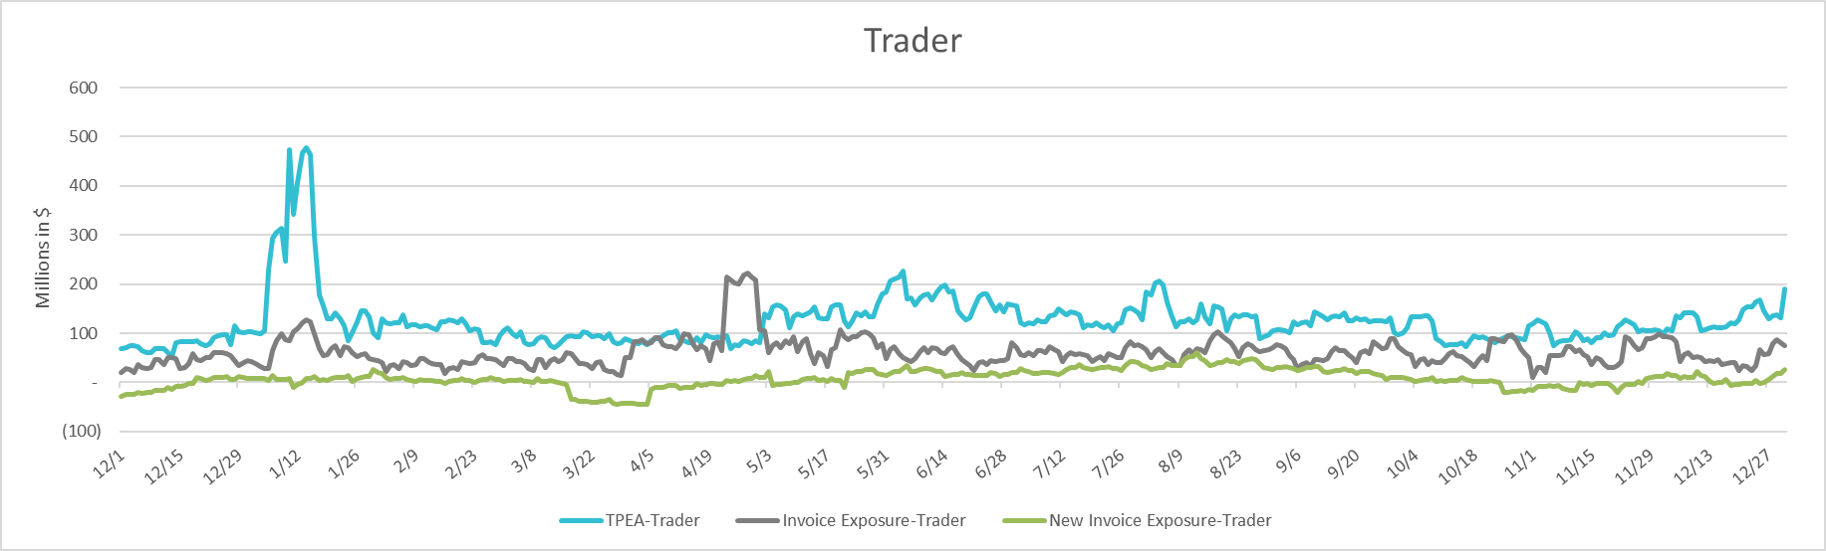
TPEA Coverage of Settlements December 2023 - December 2024
Invoice Exposure | Historical | Future
Existing Invoice Exposure | RTLCNS + UDAA | M1 Days (including current day) Forward Charge Invoice Amounts
New Invoice Exposure | 7 Days Back Net Invoice Amounts (Charges & Credits) | M1 Days (including current day) Forward Net Invoice Amounts (Charges & Credits); Excluding: 1) Securitization Invoices; 2) CRR Auction Invoices; 3) Subchapter N Funds Distribution Invoice
*TPEA generally exceeds invoice exposure

Slide 15
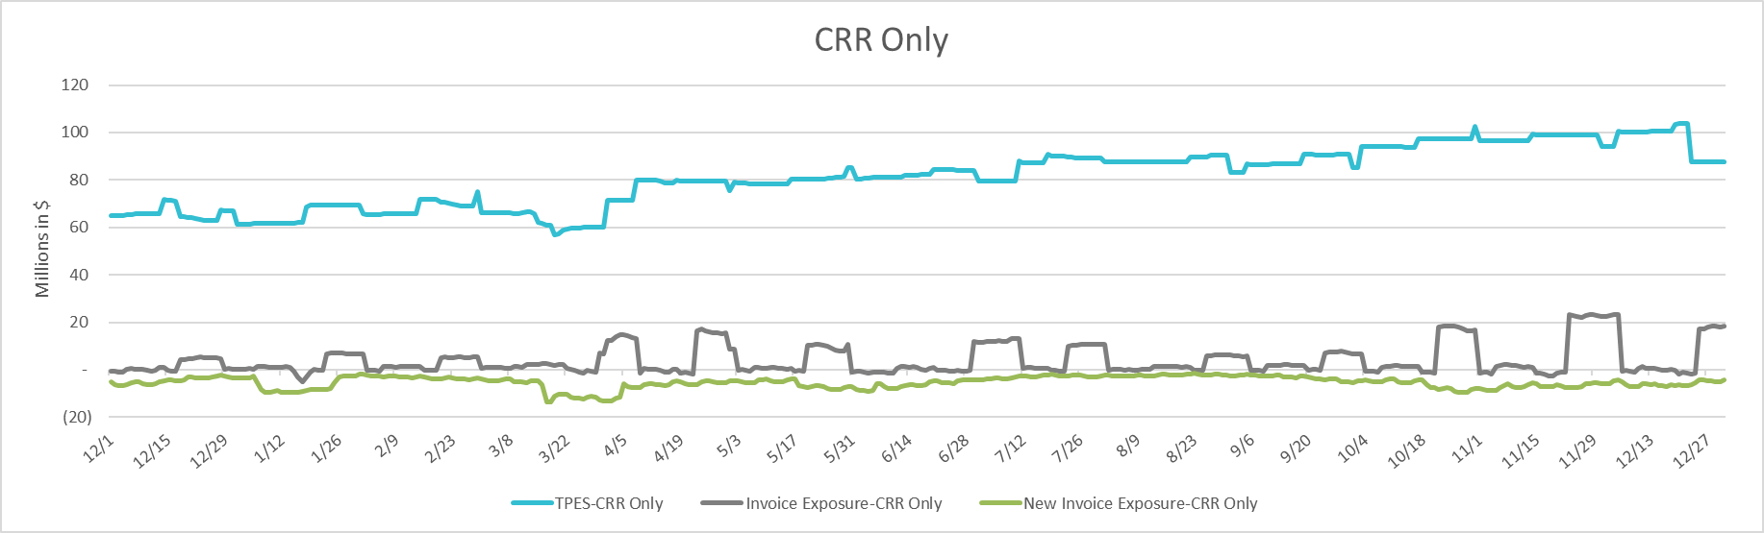
TPEA Coverage of Settlements December 2023 - December 2024
Invoice Exposure | Historical | Future
Existing Invoice Exposure | RTLCNS + UDAA | M1 Days (including current day) Forward Charge Invoice Amounts
New Invoice Exposure | 7 Days Back Net Invoice Amounts (Charges & Credits) | M1 Days (including current day) Forward Net Invoice Amounts (Charges & Credits); Excluding: 1) Securitization Invoices; 2) CRR Auction Invoices; 3) Subchapter N Funds Distribution Invoice
*TPES exceeds actual/invoice exposure

Slide 16
Questions

