Slide 1
CRR Updates
Samantha Findley
CRR Market Operations
CMWG
February 18, 2025

Slide 2
Agenda
LTAS transactions and solution times
Update on NPRR1261 Operational Flexibility for CRR auction limits and CRR draft NPRRs

Slide 3
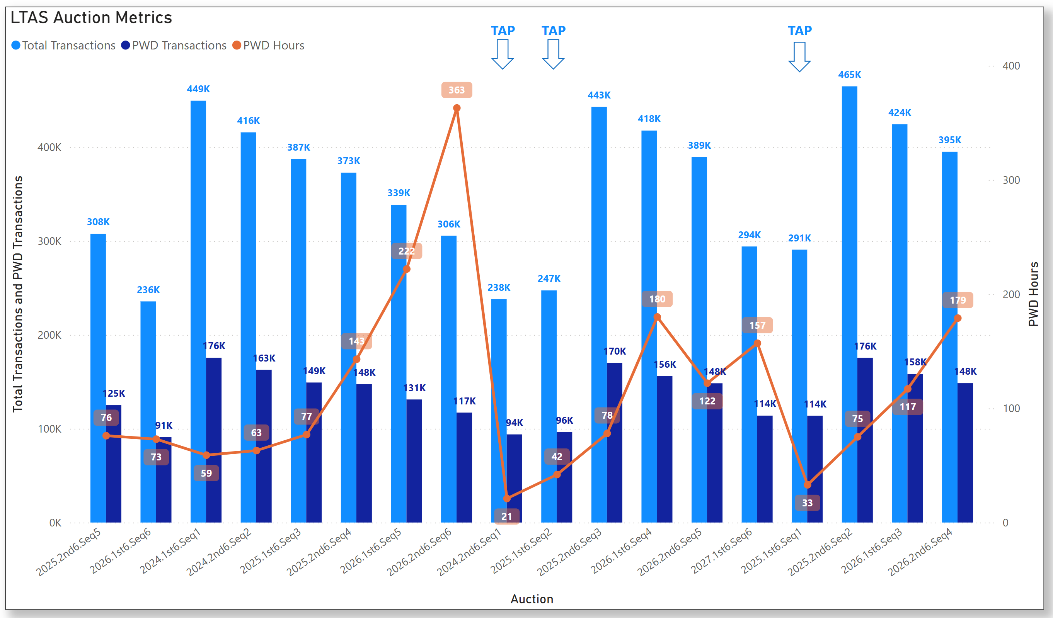
Historical LTAS transactions and solution times

Slide 4
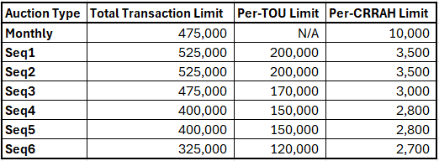
Update on NPRR1261 Operational Flexibility for CRR auction limits
NPRR1261 Operational Flexibility for CRR auction limits will go to the PUCT on March 13.
  https://www.ercot.com/mktrules/issues/NPRR1261
  Until NPRR1261 is implemented, 3,000 limit will be used for all LTAS auctions.
  If approved by the PUCT on March 13, the 2025.2nd6.AnnualAuction.Seq1 will be the first LTAS to use the transaction limit table below.

Slide 5
Update on CRR NPRRs in progress
ERCOT continues to work with the vendor to get IAs for the draft NPRRs for Removing Multi-month Bidding functionality and Option Pricing Report. We hope to be able to submit the NPRRs with IAs in March.
Note: NPRR749 was implemented in 2019 to provide clearing prices for all CRRs in baseload after each auction. The updated ShadowPricePerMWH can be found in the Baseloading report for each auction after auction results are posted. The Baseloading report is in the CRR MUI and is also posted with CRR Auction Results on MIS public.

