Slide 1
HEN ORDC avoids shortcomings of ERCOT AORDC
Shams Siddiqi, Ph.D.
Hunt Energy Network (HEN)
(512) 619-3532
shams@crescentpower.net
RTCBTF Meeting
February 19, 2025

Slide 2
ORDC v ORDC Adder: Huge Difference
By definition:
ORDC=(𝟏−𝒑𝒏𝒐𝒓𝒎(𝑹𝑻𝑶𝑳𝑪𝑨𝑷−𝑿, mu, sigma))∗𝑽𝑶𝑳𝑳
ORDC Adder=(𝟎.𝟓∗(𝟏−𝒑𝒏𝒐𝒓𝒎(𝑹𝑻𝑶𝑳𝑪𝑨𝑷−𝑿, 𝟎.𝟓∗mu, 𝟎.𝟕𝟎𝟕∗sigma))
+𝟎.𝟓∗(𝟏−𝒑𝒏𝒐𝒓𝒎(𝑹𝑻𝑶𝑳𝑪𝑨𝑷+𝑹𝑻𝑶𝑭𝑭𝑪𝑨𝑷−𝑿, mu, sigma)))
∗(𝑽𝑶𝑳𝑳−𝑺𝒚𝒔𝒕𝒆𝒎 𝑳𝒂𝒎𝒃𝒅𝒂)
With RTOFFCAP=0 and System Lambda=0, one would expect the two to converge but, in reality, ORDC>>ORDC Adder [this is a shortcoming of ORDC Adder formulation]
E.g., for mu=925 and sigma=1213 at RTOLCAP=6,400MW: ORDC=$103/MW and ORDC Adder=$50/MW
ERCOT AORDC is a curve fit to these suppressed ORDC Adders [and not to the ORDC values – which would result in recreating the ORDC] resulting in AORDC at 6,400MW=$60/MW [<ORDC=$103/MW]
If ERCOT’s AORDC were used to set the Adder for the exact same historical situation, new ORDC Adder=$29/MW [<$50/MW and <<$103/MW]
The stakeholder intent when adopting the RTC Protocols was to create an AORDC that would result in similar historical outcomes – unaltered ORDC does exactly that whereas ERCOT AORDC significantly suppresses historical ORDC Adders and RTC ASDCs derived from that AORDC.

Slide 3
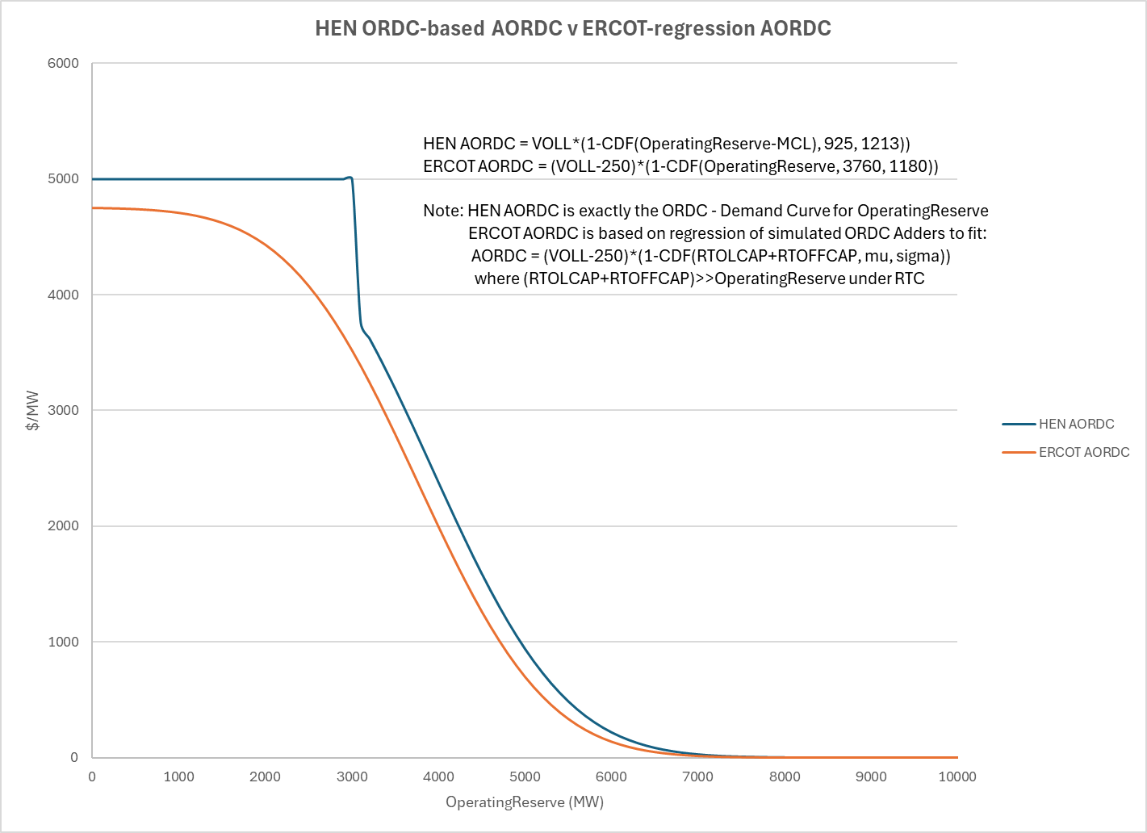
Use ORDC instead of Adder-fitted AORDC

Slide 4
RTC Example: HEN v ERCOT AORDC
For MCL=3000, mu=925, sigma=1213, ORDC=$103/MW at Operating Reserve=6,400MW - by definition the value of Operating Reserve and thus a point on the cumulative ASDCs at total 6,400MW of Operating Reserve
If a marginal Resource offers Energy at $150/MWh, AS [i.e., Operating Reserve] at $0/MW, and $103/MW is the value of the AS [based on 6,400MW of total AS awarded] and the next Resource offer for Energy is $300/MWh and AS is $200/MW, then, under RTC:
SCED AS MCPC=$103/MW and Energy LMP=$253/MWh [reflecting $103/MW AS opportunity cost]
This is exactly the expected outcome and HEN AORDC provides this under RTC
If ERCOT AORDC is used, then, under RTC:
SCED AS MCPC=$60/MW and Energy LMP=$210/MWh [reflecting $60/MW AS opportunity cost]
Thus, ERCOT AORDC would NOT provide the expected outcome under RTC
This approximately reflects “poor man’s” inaccurate estimate of AS opportunity cost [i.e., Adder pre-RTC] but not the ASDC itself

Slide 5
Summary of HEN Changes
HEN’s changes to use unaltered ORDC as the AORDC is a correction to make Protocols consistent with stakeholder intent – it is not a policy change.
Using unaltered ORDC [by definition the Demand Curve for Operating Reserves] to create ASDCs instead of the ERCOT-estimated [but not defined in Protocols] AORDC based on regression of Adders avoids unintended additional price suppression with RTC implementation.
ORDC Adders should not and were never used to procure Ancillary Services and are always lower than ORDC values due to their flawed formulation.
It’s unclear from the Protocol language what AORDC should be fit using historical simulated data. ERCOT has chosen to fit AORDC=(VOLL-250)*(1-CDF(RTOLCAP+RTOFFCAP, mu, sigma)). This implies that the AORDC can never reach VOLL, reduces the VOLL by $250/MW/hour for the entire curve thereby undervaluing all points on the AORDC, and is further undervaluing AS capacity since AS capacity is typically much less than (RTOLCAP+RTOFFCAP) – HEN proposal avoids these issues & debates.
Also, there is no need to post mu and sigma values once RTC is implemented and ORDC-related OBD is no longer needed. Thus MCL, mu and sigma values should be specified is this section of the Protocols.

