Slide 1
2024 Survey/Analysis of REP and NOIE Demand Response
Carl L Raish
Principal Load Profiling and Modeling
Retail Market Subcommittee – Feb 11, 2024

Slide 2
Overview
  Summer 2024 Analysis Update
  Total System-level Demand Response
    Total ERCOT Demand Response
    Responding NOIE and ESIID counts
  4CP Participation Trends
  DR/PR Events

Slide 3
Total System-Level Demand Response

Slide 4
‘Super’ Price Responders
Identified Indexed pricing ESIIDs that respond at prices below $200/Mwh.
Examined non-summer months … to remove 4CP related load reductions.
Purposes
  More accurate identification of Near-CP days.
  More accurate baselines (limit days used to construct baselines for ‘Super’ Responders to those with price events < $70.
784 ESIIDs identified as ‘super’ responders.
Will consider screening non-indexed pricing ESIIDs in the future.

Slide 5
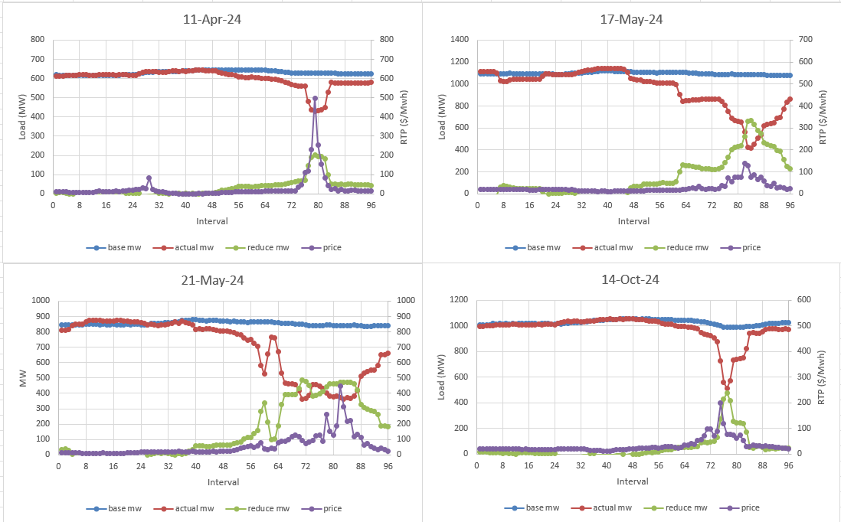
‘Super’ Price Responders

Slide 6
Load Reductions by Category/System Level
HE 17:00 MW Reductions
Table shows Days with HE 17 Total System DR > 3,500 MW (59 days > 50 MW)
Overlap = Category Total – Total System DR (To eliminate double counting)

Slide 7
ESIIDs/NOIEs by Category/System Level
HE 17:00 ESIIDs/NOIEs with Reductions
Table shows Days with HE 17 Total System DR > 3,500 MW (59 days > 50 MW)
Overlap = Category Total – Total System DR (To eliminate double counting)

Slide 8
Peak Net Load Hours Summer 2024
Net Load = Total Generation – (Solar + Wind Generation).
Peak Net Load now is more critical to ERCOT than Actual Peak Load.
 | Peak Net Load Hour – Summer 2024
Month | 15 | 16 | 17 | 18 | 19 | 20 | 21 | 22
Jun | 0 | 1 | 1 | 0 | 0 | 0 | 27 | 1
Jul | 1 | 0 | 1 | 1 | 0 | 0 | 28 | 2
Aug | 0 | 0 | 1 | 0 | 0 | 11 | 19 | 0
Sep | 0 | 0 | 0 | 0 | 0 | 24 | 6 | 0

Slide 9
Load Reductions by Category/System Level
Peak Net Load MW Reductions
Table shows Days with HE 17 Total System DR > 3,500 MW (59 days > 50 MW)
Overlap = Category Total – Total System DR (To eliminate double counting)

Slide 10
Responding ESIIDs and Reductions – HE-17
Table Shows Days with HE 17 Total System DR > 3,750 MW

Slide 11
Respond ESIIDs and Reductions – Peak Net Load
Table Shows Days with HE 17 Total System DR > 3,750 MW

Slide 12
Responding NOIEs and Reductions
All NOIEs analyzed were identified as responding to both Price and 4CP

Slide 13
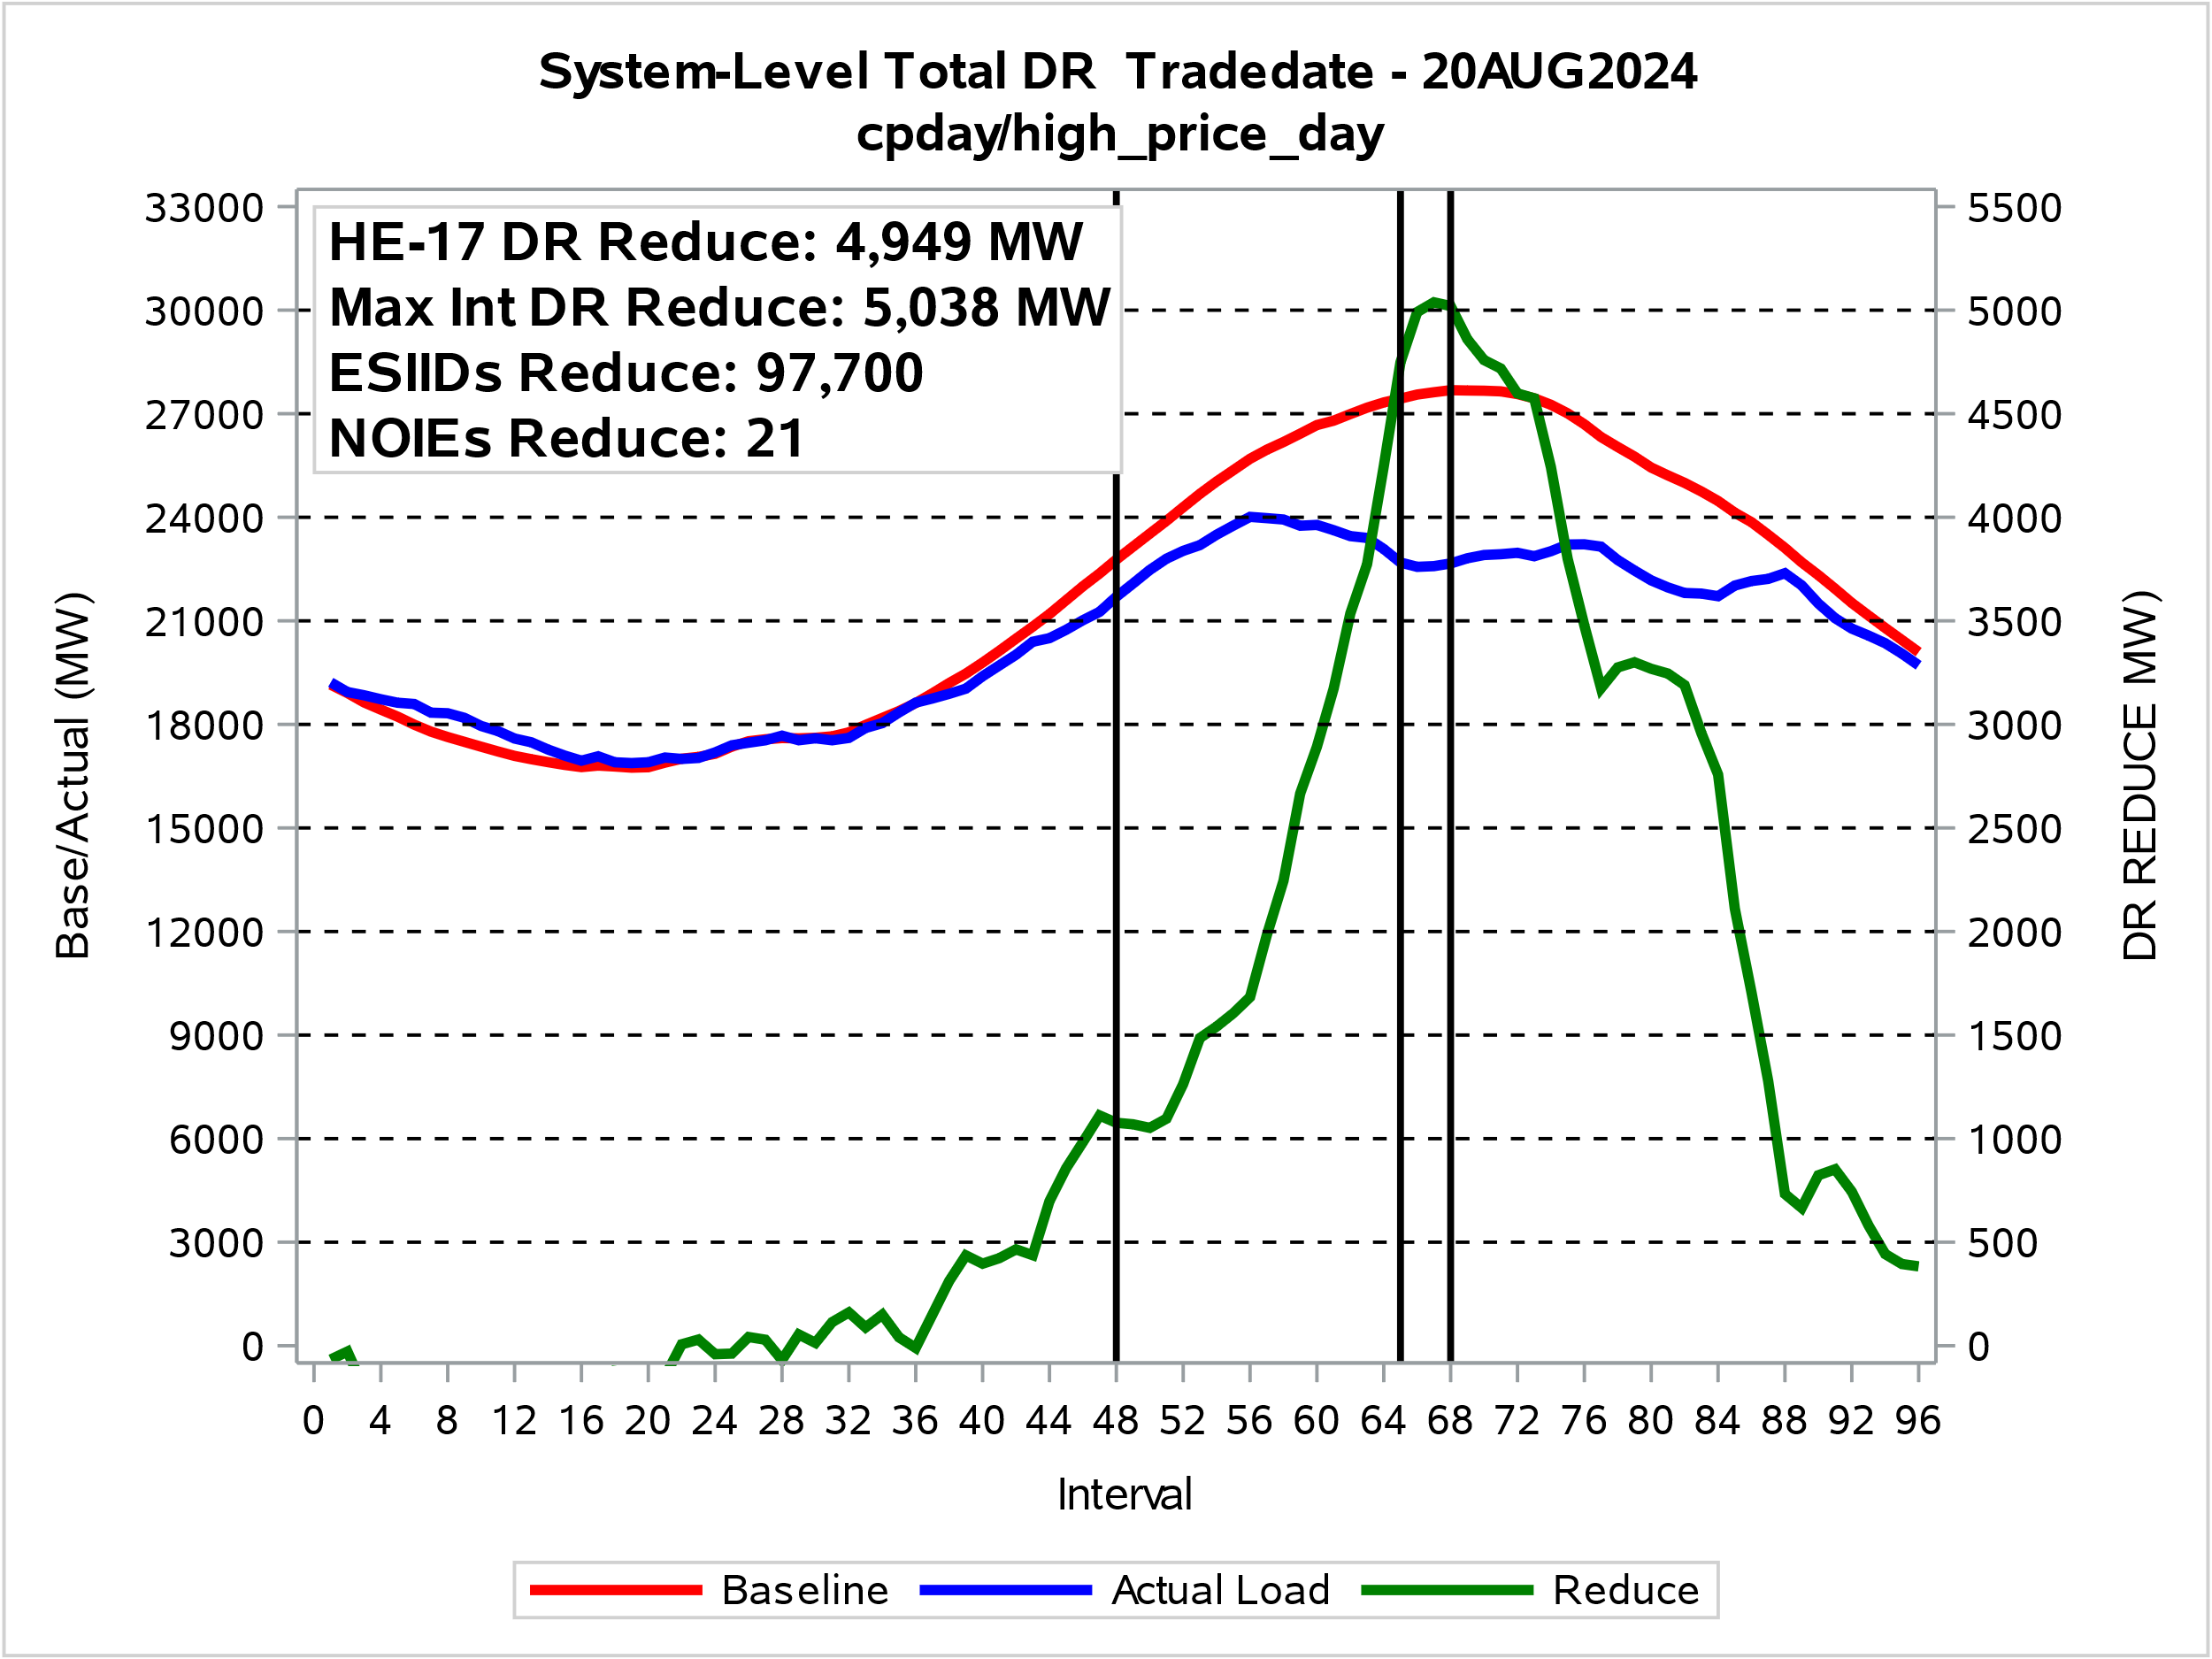
Total Competitive and NOIE Demand Response
Day with Highest HE 17 Total System DR

Slide 14
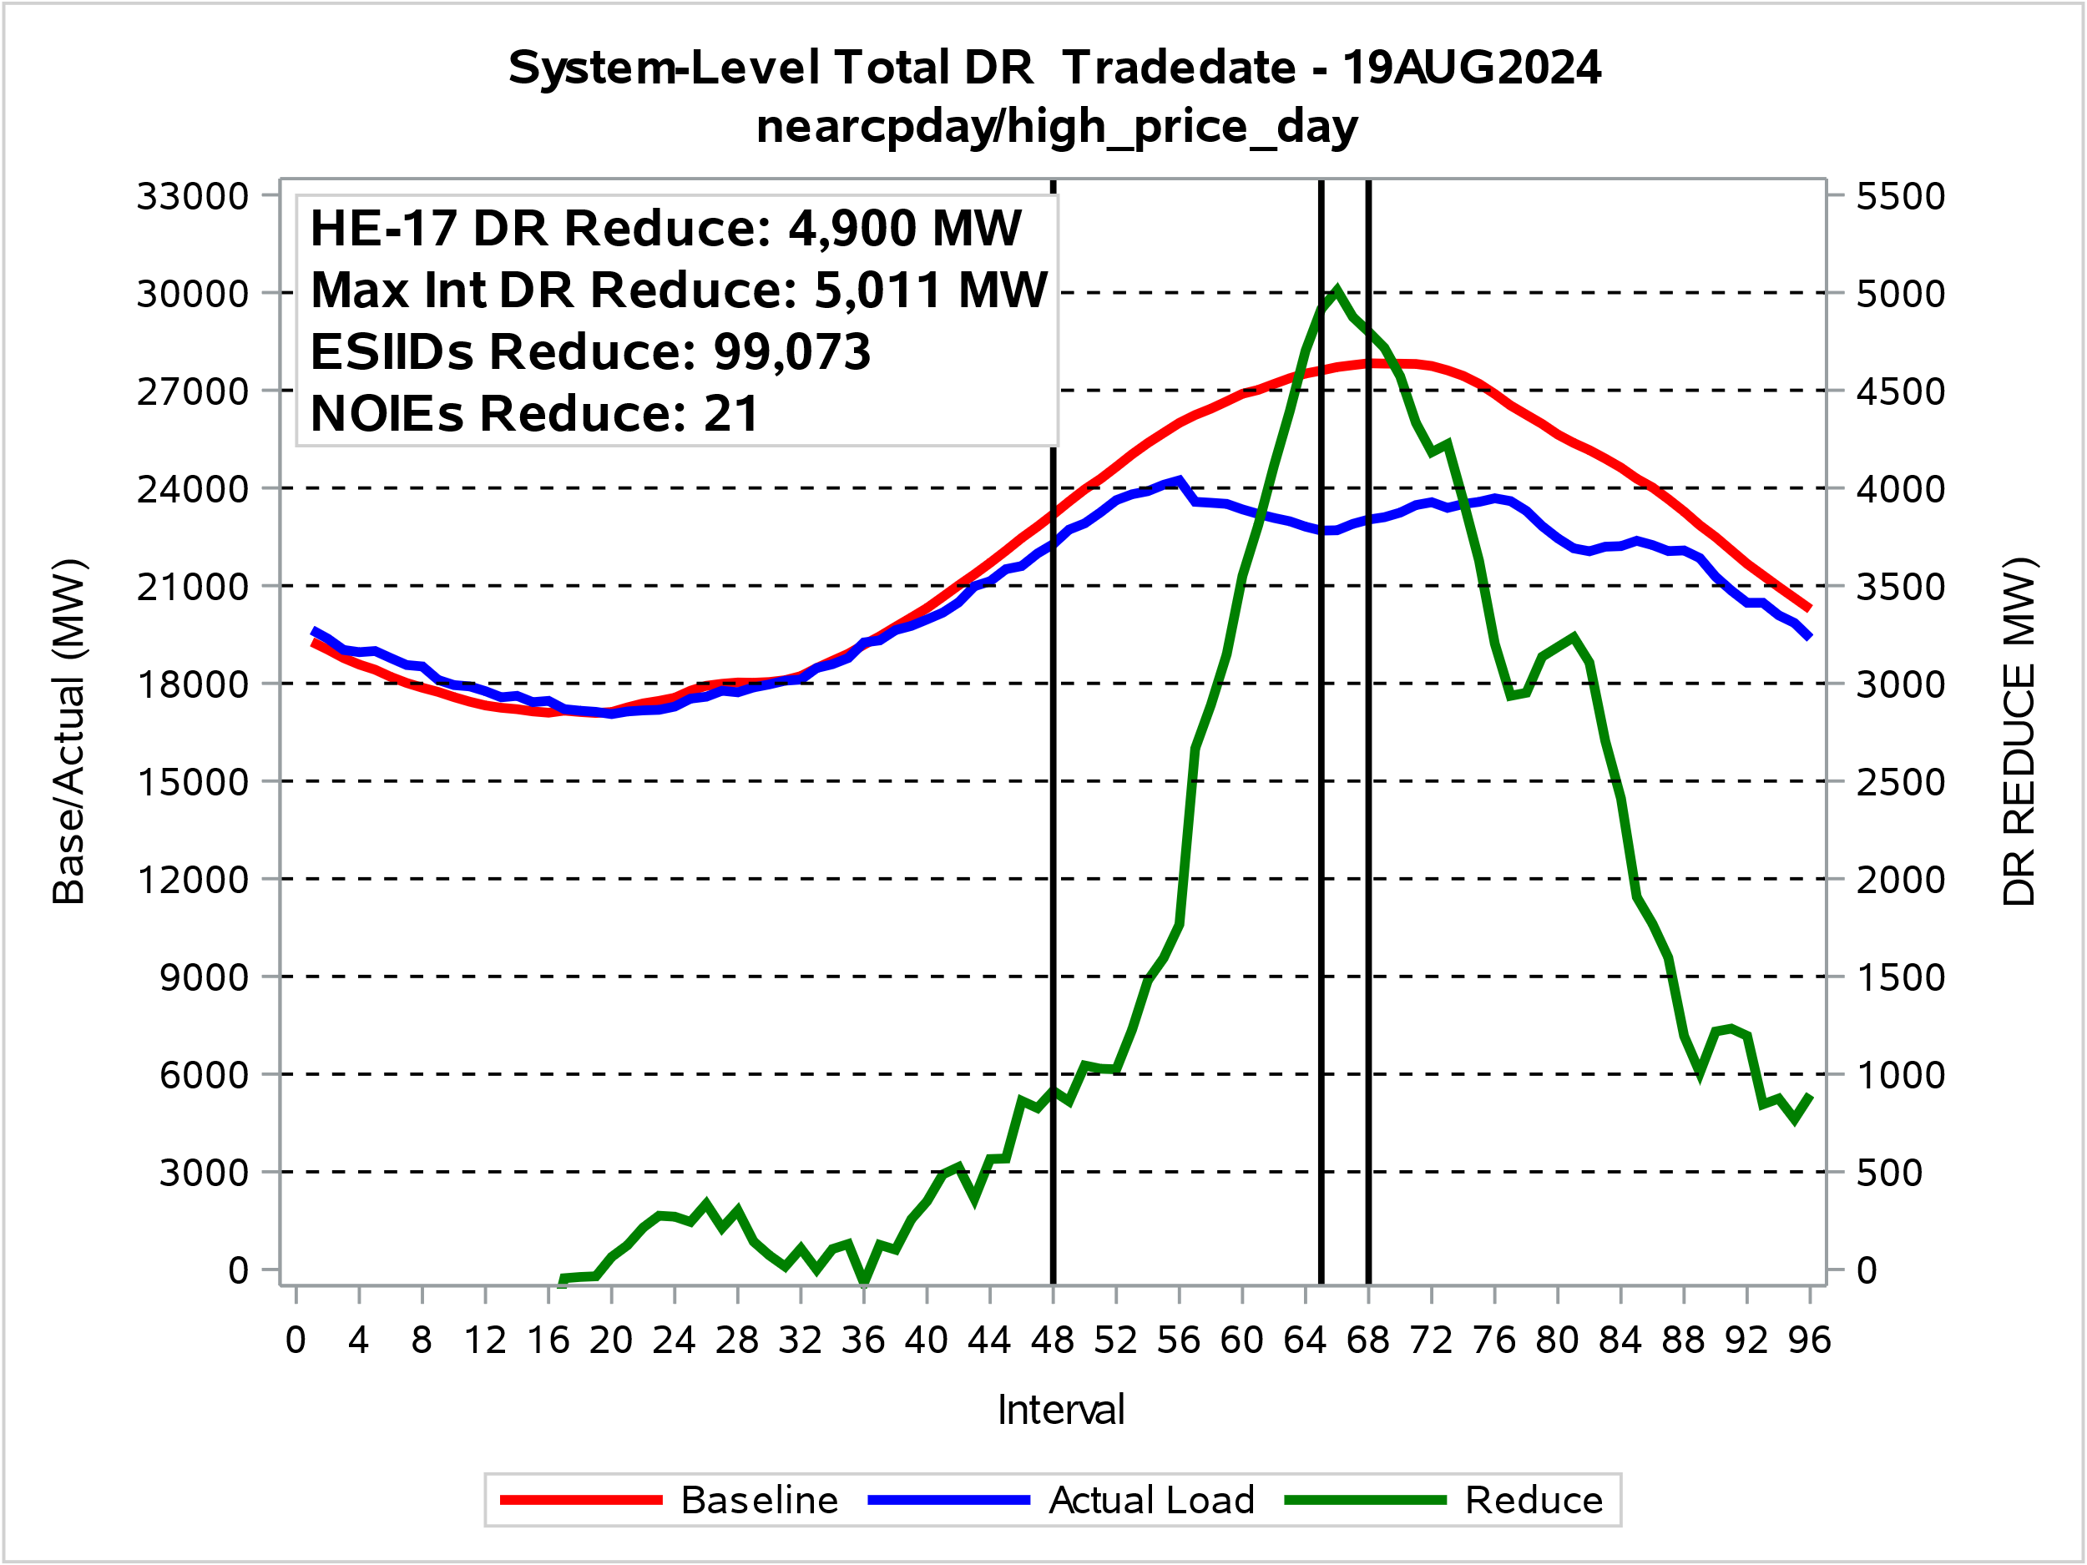
Total Competitive and NOIE Demand Response
Day with 2nd Highest HE 17 Total System DR - ERCOT Peak Day

Slide 15
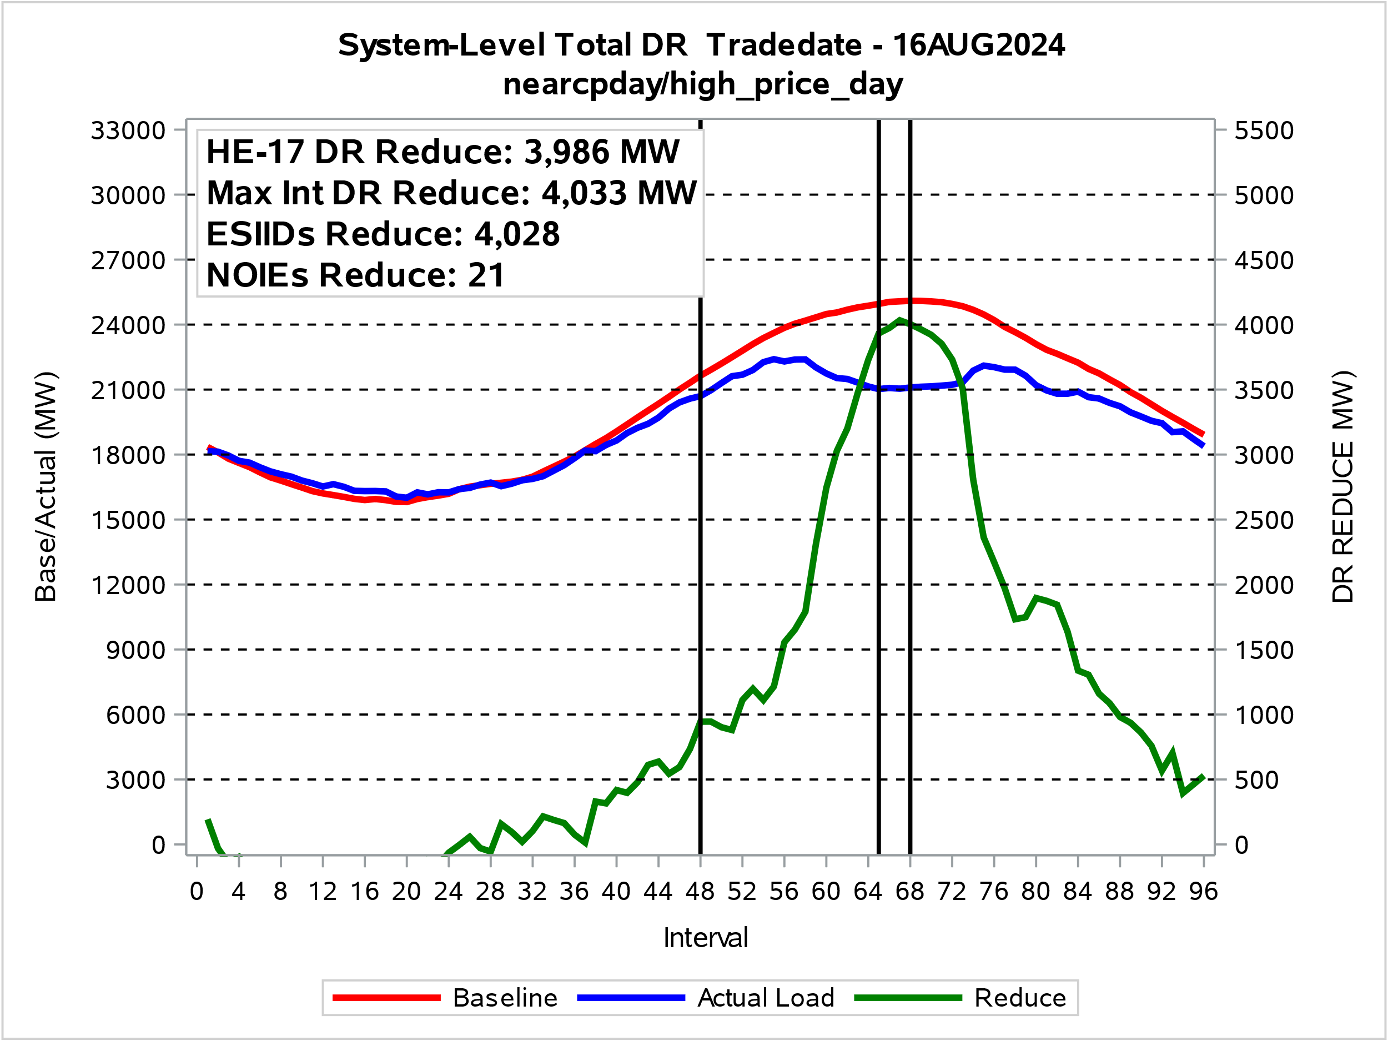
Total Competitive and NOIE Demand Response
Non-High Price Day with HE 17 Highest Total System DR

Slide 16
Price Response and Retail DR Participation Trends

Slide 17
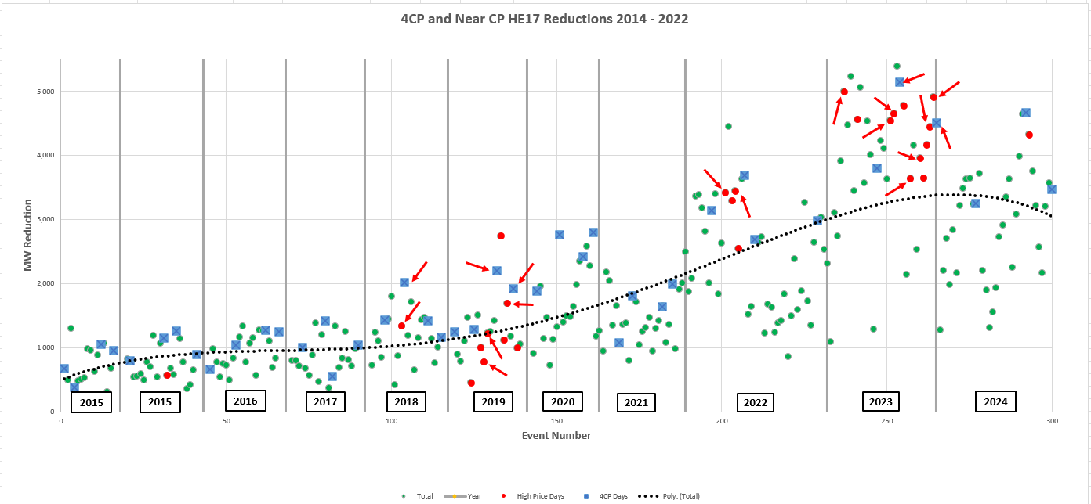
4CP Response Trend
Blue Squares: 4CP Days Red Circles: HE17 Price > $500
Red Arrows: HE17 Price > $1,000

Slide 18
4CP Response Trend

Slide 19
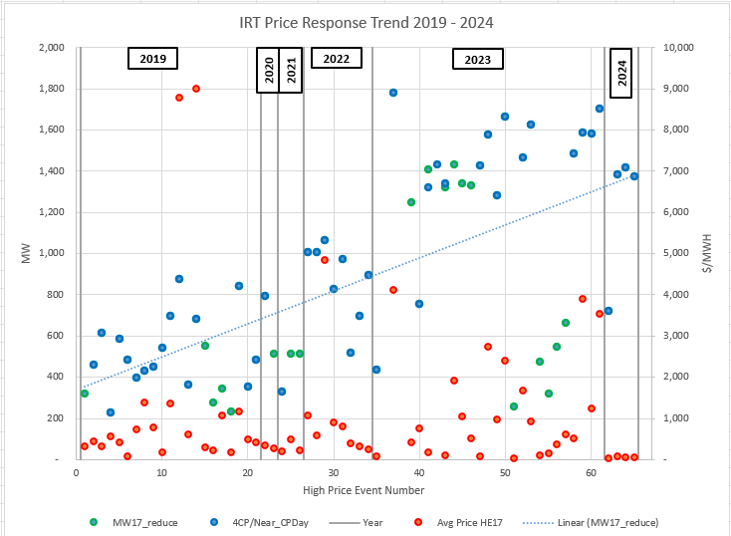
Indexed Real Time Response Trend

Slide 20
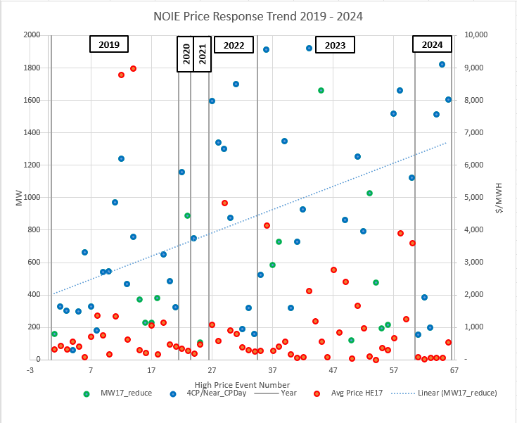
NOIE Real Time Response Trend

Slide 21
DR/PR Events

Slide 22
4CP Events 2024
4CP Days
Date | ESIIDs | HE 17 Reduce MW | NOIEs | HE 17 Reduce MW | Total
30-Jun | - | - | - | - | -
1-Jul | 3,571 | 2,404 | 15 | 848 | 3,252
20-Aug | 3,413 | 2,580 | 21 | 2092 | 4,672
20-Sep | 4,448 | 2,902 | 9 | 569 | 3,471
June 30,2024 was a Sunday … several of the baseline methodologies, would need modification to develop reduction estimates.

Slide 23
4CP/NearCP Events 2024
Near-CP Days
Date | ESIIDs | NOIEs | HE 17 Reduce MW
4-Jun | 2,847 | 4 | 1,280
6-Jun | 2,633 | 7 | 2,209
7-Jun | 3,281 | 6 | 2,702
13-Jun | 2,716 | 7 | 1,988
14-Jun | 3,624 | 10 | 2,840
17-Jun | 3,386 | 5 | 2,169
24-Jun | 3,172 | 16 | 3,223
25-Jun | 3,408 | 13 | 3,484
26-Jun | 3,670 | 18 | 3,633
27-Jun | 3,429 | 16 | 3,654
Date | ESIIDs | NOIEs | HE 17 Reduce MW
28-Jun | 3,799 | 11 | 3,242
2-Jul | 3,553 | 14 | 3,719
3-Jul | 3,686 | 14 | 2,208
16-Jul | 3,011 | 7 | 1,898
30-Jul | 3,001 | 6 | 1,317
31-Jul | 3,384 | 5 | 1,562
1-Aug | 2,991 | 8 | 1,936
2-Aug | 3,483 | 5 | 2,736
6-Aug | 3,046 | 15 | 2,918
7-Aug | 3,179 | 13 | 3,349
32 Near-CP Days, reductions 1,280 – 4,654 MW

Slide 24
4CP/NearCP Events 2022
Near-CP Days (cont.)
Date | ESIIDs | NOIEs | HE 17 Reduce MW
8-Aug | 3,202 | 18 | 3,632
14-Aug | 3,204 | 10 | 2,251
15-Aug | 3,338 | 19 | 3,092
16-Aug | 3,973 | 21 | 3,985
19-Aug | 3,477 | 21 | 4,654
21-Aug | 3,275 | 18 | 4,330
Date | ESIIDs | NOIEs | HE 17 Reduce MW
22-Aug | 3,162 | 17 | 3,755
13-Sep | 2,957 | 7 | 3,216
16-Sep | 3,428 | 9 | 2,570
17-Sep | 3,128 | 6 | 2,172
18-Sep | 3,175 | 10 | 3,204
19-Sep | 3,834 | 12 | 3,575
32 Near-CP Days, reductions 1,280 – 4,654 MW

Slide 25
Indexed Real-Time High Price Events
Date | ESIIDs | HE 17 Reduce MW | Peak Net Load Reduce MW | Avg Price $/MWh
4-Jun | 11,819 | 724 | 873 | $449
7-Aug | 10,763 | 1,383 | 921 | $514
19-Aug | 11,218 | 1,416 | 1,101 | $896
20-Aug | 11,337 | 1,375 | 1,218 | $2,554
4 Days with High Real-Time Prices (>$200)
All days with 4CP/NearCP Response

Slide 26
Indexed Day-Ahead High Price Events
No significant load reductions identified

Slide 27
NOIE High Price Response Events
Date | NOIEs | HE 17 Reduce MW | Peak Net Load Reduce MW | Avg Price $/MWh
4-Jun | 4 | 156 | 176 | $356
7-Aug | 4 | 198 | 142 | $513
19-Aug | 13 | 1,513 | 763 | $406
20-Aug | 15 | 1,820 | 854 | $3,074
21-Aug | 10 | 1,605 | 987 | $320
Table lists days with High Real-Time Prices (>$200)

Slide 28
Direct Load Control Events
Date | ESIIDs | HE 17 Reduce MW | Peak Net Reduce MW | Avg Price $/MWh
10-Jun | 648 | 54 | 1
17-Jun | 101 | 77 | -2
24-Jun | 80 | 44 | -2
26-Jun | 18,303 | 23 | -1
28-Jun | 98 | 77 | -4
2-Jul | 101 | 77 | -5
8-Jul | 58 | 13 | 5
6-Aug | 11,273 | 11 | 7
15-Aug | 8,258 | 84 | -1
19-Aug | 15,606 | 14 | 5 | $896
Date | ESIIDs | HE 17 Reduce MW | Peak Net Reduce MW | Avg Price $/MWh
20-Aug | 15,393 | 14 | 13 | $2,554
22-Aug | 4,960 | 78 | -4
12-Sep | 104 | 67 | -3
13-Sep | 100 | 67 | -8
16-Sep | 439 | 69 | -2
17-Sep | 4,017 | 74 | -3
18-Sep | 99 | 71 | -4
19-Sep | 766 | 76 | -1
20-Sep | 1,133 | 76 | 23
Table lists Event Days with HE 17 Reductions > 10 MW
29 Event Days with reductions > 1 MW Reductions: 1 – 84 MW

Slide 29
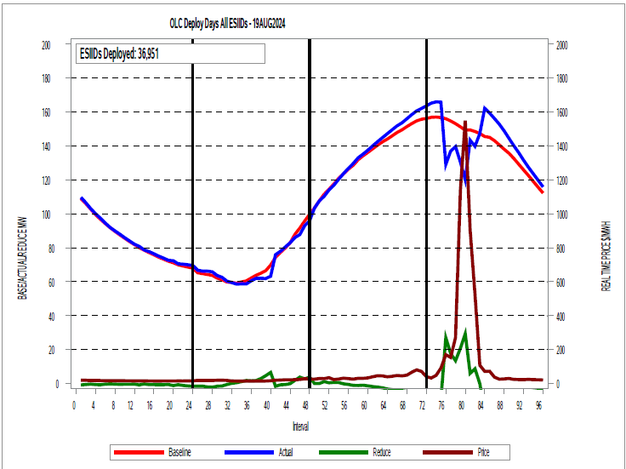
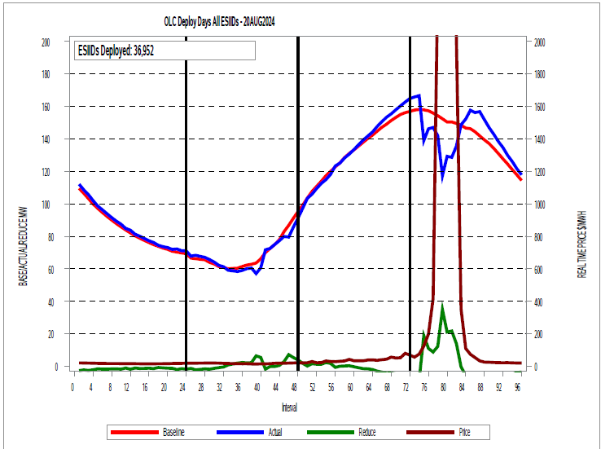
Direct Load Control Events - Residential
MW Reductions
Interval | 75 | 76 | 77 | 78 | 79 | 80 | 81 | 82
19-Aug | -9 | 27 | 18 | 14 | 21 | 29 | 6 | 9
20-Aug | 19 | 11 | 9 | 12 | 35 | 21 | 22 | 14

Slide 30
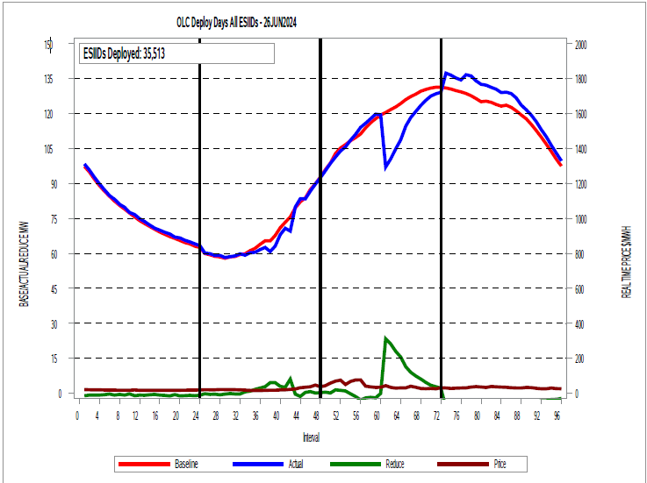
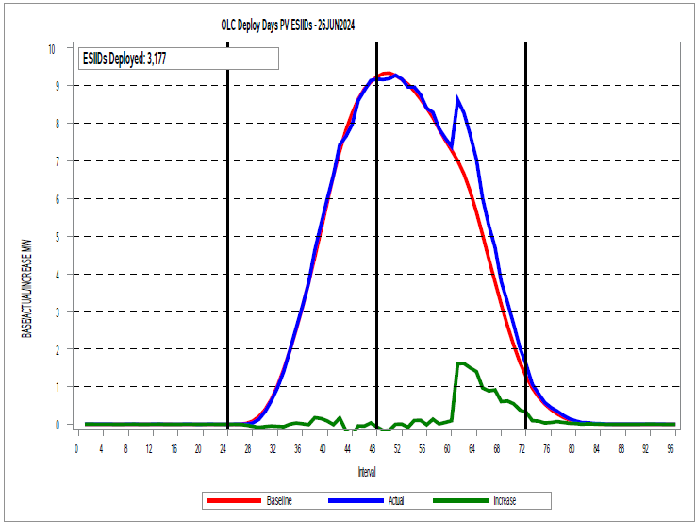
Direct Load Control Events – Residential PV
MW Reduction/Increases
Interval | 61 | 62 | 63 | 64 | 65 | 66 | 67 | 68 | 69 | 70 | 71 | 72
Reduce Load | 23.37 | 21.16 | 18.00 | 15.54 | 11.39 | 8.97 | 7.42 | 6.10 | 4.66 | 3.43 | 2.82 | 2.16
Increase Export | 1.62 | 1.62 | 1.50 | 1.40 | 0.97 | 0.89 | 0.92 | 0.61 | 0.62 | 0.55 | 0.39 | 0.32

Slide 31
Peak Rebate Events
Date | ESIIDs | HE 17 Reduce MW | Peak Net Reduce MW | Avg Price $/MWh
19-Aug | 69,233 | 51 | 11 | $896
20-Aug | 68,027 | 49 | 16 | $2,554
16-Sep | 17,694 | 13 | 3
19-Sep | 17,029 | 13 | 4
20-Sep | 16,505 | 12 | 6

Slide 32
Next Steps
Revise 2023 analysis to incorporate ‘Super’ Responder identification and treatment.
NPRR to coordinate data submission for the Annual DR Survey with the data submission requirements in PUCT Substantive Rule 25.186.
Update Residential Consumption Analysis
Update Residential PV Analysis.
Training Session (timing? After Aug 1 so participation is locked down)

Slide 33
Questions?
ON
OFF
craish@ercot.com

