Slide 1
PUCT Rule Regarding Residential Demand Response Using Smart Devices
Carl L Raish
Principal Load Profiling and Modeling
Retail Market Subcommittee – Feb 11, 2024

Slide 2
Rule Language
  Substantive Rule §25.186. Goal for Average Total Residential Load Reduction
    Applicability – REPs, TDSPs and ERCOT.
    Definition – smart (remote control enabled) responsive appliance or device.
    REP Responsive Device Program
      Residential Customers.
      Excludes participants in ERS and TDSP Load Management, other emergency programs.
    REP Reporting Requirement (to ERCOT)
      45 days after each calendar quarter (May 15, Aug 14, Nov 14, Feb 14).
      ESIIDs enrolled.
      Events (ESIIDs deployed, start-time, stop-time).
    ERCOT Reporting Requirement (to PUCT)
      Mar 31 for prior calendar year.
      For each event day:
        Aggregated load reduction of all participants
        Aggregated load reduction of all deployed participants
        Aggregated load of all deployed participants
        Number of customers deployed

Slide 3
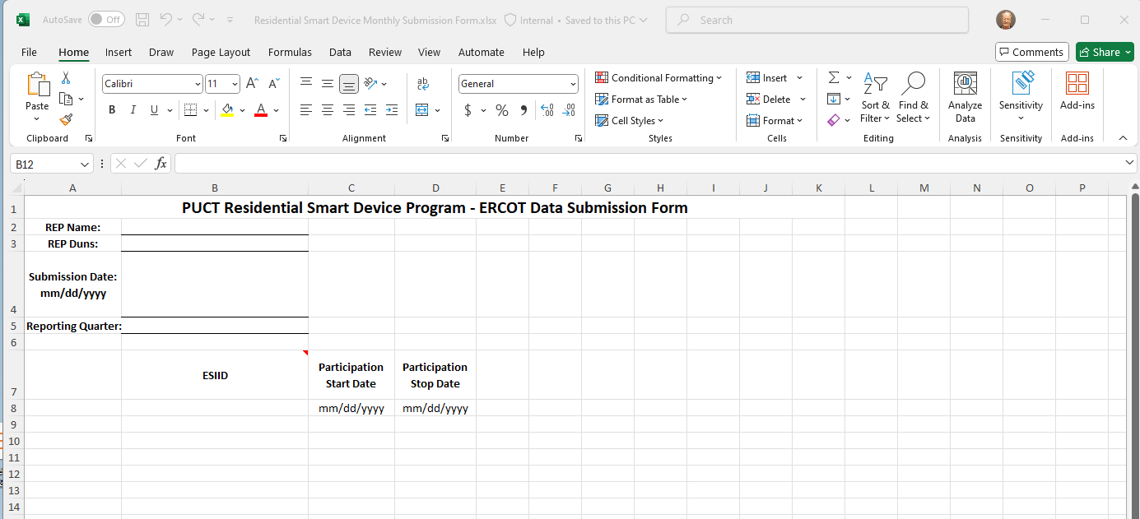
REP Reporting to ERCOT
  Submission process
    Initially will use Secure File Share (currently in use for Annual DR Survey)
      REP will need to notify ERCOT so we can set up a file share for them.
      REP will need to advise ERCOT of personnel changes
    May be changed in the future (NAESB, other).
    File Type: Excel/.csv/.txt/other
    Enrollment form:

Slide 4
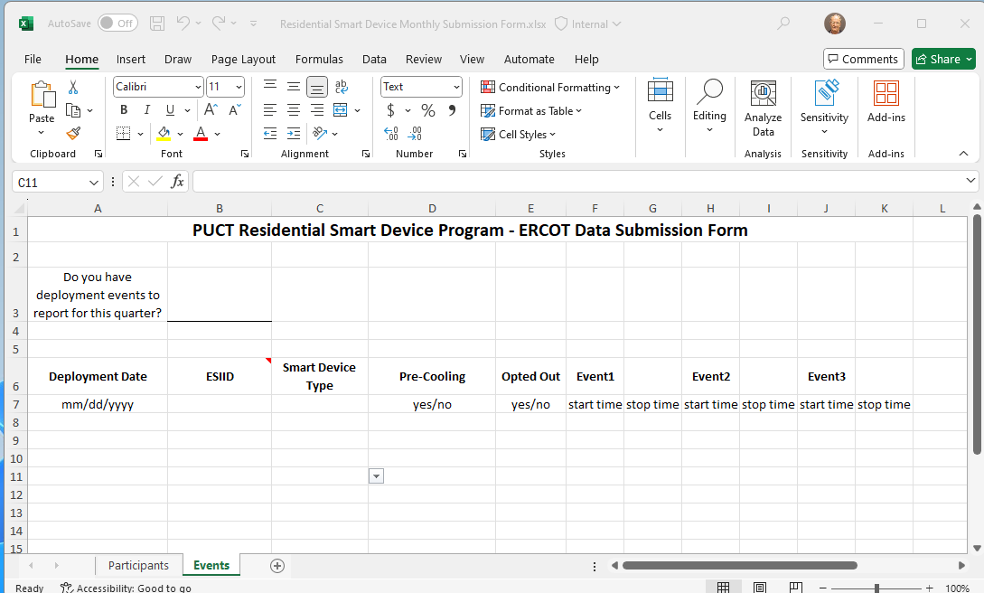
REP Reporting to ERCOT
  Submission process (continued)
    Event form form:

Slide 5
ERCOT Submitted NPRRs
  ERCOT is expecting to submit an NPRR to move OBD language for the Annual DR Survey into the Protocols.
  ERCOT will submit an NPRR to eliminate duplication in submission requirements
    ESIIDs submitted under 25.186 do not need to be submitted for ‘OLC’ in the Annual Demand Response Survey
    Events submitted under 25.186 do not need to be submitted for ‘OLC’ in the Annual Demand Response Survey.
  ERCOT will submit an NPRR to change Annual DR Survey Report posting date to allow analysis time for data submitted under 25.186 (Nov 14).

Slide 6
Questions?
ON
OFF
craish@ercot.com

