Slide 1
Technical Working Group (TWG)
RTC+B ICCP Telemetry Points Modeling
Tejaswi Potluri
Kevin McGarrahan
01/30/2025

Slide 2
RTC+B ICCP Telemetry Points Modeling
RTC+B ICCP Telemetry Model changes
  QSEs to Submit new ICCP telemetry point requests
  QSEs/ERCOT to maintain the new ICCP telemetry points for both current system and RTC+B system through weekly model loads.

Slide 3
RTC+B ICCP Telemetry Points Modeling
  In RTC+B, single model ESR device names are changed to ESR1, ESR2,..,ESR# under a given site.
  All current Combo Model ESR GN telemetry points that are not marked for deletion after RTC+B go live along with the new RTC+B telemetry points are required to be modeled under Single Model ESR device.
  Station specific ICCP telemetry like line flows, auxiliary load are NOT required to be modeled again.
  ERCOT will publish new Single Model ESR names for existing combo-model ESRs and communicate through a Market Notice.
  Non-ESR Generation Resources as well as Controllable and Non-Controllable Load Resources are required to model the new RTC+B telemetry points under the existing non-ESR device.

Slide 4
RTC+B ICCP Telemetry Points Modeling
  All ICCP points mentioned in the handbook for a given resource type are expected to be modeled irrespective of participation in the A/S market.
  A resource type specific ICCP modeling template will be published to ercot.com.
  RTC+B ICCP Handbook was updated to clarify RTC+B specific telemetry points (example: RSTR, PFRA etc.)
*Link to RTC+B ERCOT Nodal ICCP Communications Handbook

Slide 5
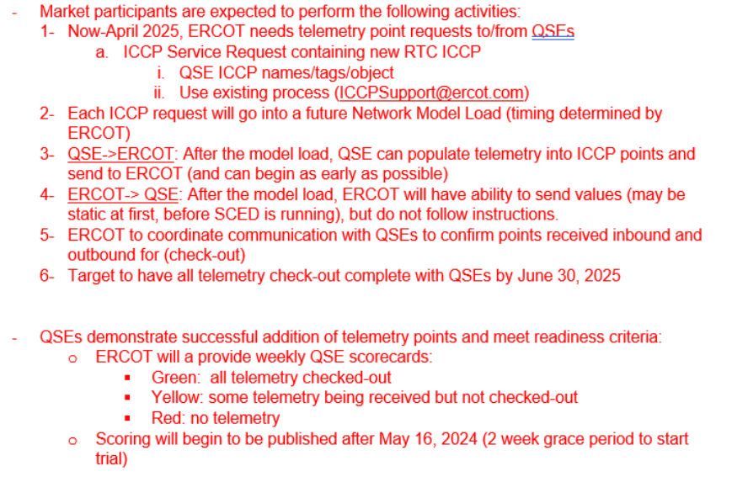
Market Trial Handbooks
QSE Telemetry Check-Out (Handbook #2)

