Slide 1
TDTMS Update
Leadership 2025:
Chair - Sheri Wiegand, Vistra
Vice Co-Chairs – Monica Jones, CNP
Sam Pak, Oncor
RMS
February 11th, 2025

Slide 2
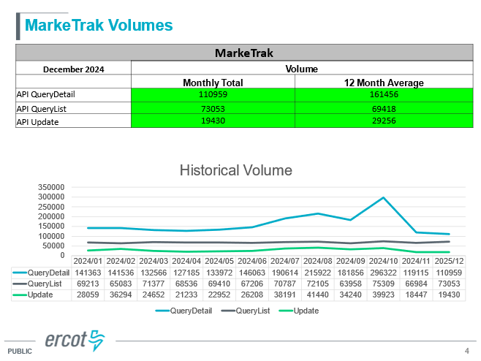
TDTMS
ERCOT Reporting
System Instances & MT Performance – All December SLAs met. All SLAs for 2024 were met despite April 2024 incident. MarkeTrak performance remains well within SLO. New slide on MarkeTrak volumes is provided which could contribute to slow down of query detail processing.
VOTE
Listservs – No issues
Volumes peaked in Oct due to REP who inadvertently processed a broker file resulting in ~1000 IAGs

Slide 3
TDTMS
TDTMS Meeting 1/14/25
727 Extract Enhancements – with new attributes (i.e. county name, meter service type), it was suggested these were included in existing 727 extracts. ERCOT explained architecture of extracts were designed to join various elements of different extracts to create and customize a shadow settlement database “to see what ERCOT sees”. If any new extracts or modifications are desired, vetting through the stakeholder process would be required.
Critical Care Flags Post IAG – business processes for each TDSP were reviewed on how critical care status is reinstated in the resolution of an IAG
Tampering Flags Post IAG – business processes for each TDSP were reviewed on how Tampering Switch Holds are reinstated in the resolution of an IAG
Switch Hold Removal & new Retail Release Calendar – reviewed SH removal language in RMG and NPRR1259 to determine if new calendar times would address potential delays of the “four business hours” processing window. No further action will be taken.

Slide 4
TDTMS
2024 Accomplishments
Performed the bi-annual reviews of the MarkeTrak Subtype Analysis volumes communicating observations to RMS.
Supported implementation of SCR817 - MarkeTrak Enhancements Aligning w/ TXSET 5.0 business requirements offering guidance on development.
Developed communication plan for transition of in-flight Inadvertent Gain MarkeTraks from TXSET 4.0 to 5.0 before, during, and after implementation weekend
Supported and communicated the workshop on the MarkeTrak API changes associated with SCR817
Conducted two market training sessions attended by nearly 400 market participants to review changes of SCR817
Approving MarkeTrak User’s Guide revisions
Facilitated discussion on new ERCOT MIS views for Find ESI and Find Transaction post go-live
Completed deeper dive of more common subtype analysis: volumes by REP, unexecutable reasons, timing for completion.
Improved the visual representation of some findings
Collaborated with Client Services to provide data and talking points for REP outreach on the MarkeTrak analysis
Reviewed monthly ERCOT IAG report noting observations and presenting findings to RMS.
Discussion on ERCOT’s Digital Certificate initiative moving to multi-factor authentication along with root certificate update in May.

Slide 5
TDTMS
2024 Accomplishments – cont.
Discussed proposed approach to ERCOT 2025 Retail Release calendar and approved calendar
MarkeTrak Inadvertent Gain/Inadvertent Loss Analysis for 2023 and first half of 2024 MTs – deep dive on REP performance for each phase of the IAG process. Presented results to RMS.
Follow up from MIS API project released in late 2023 – post integration missing ‘key date’
Approval of RMGRR 177 Switch Hold Removal Clarification offering clarity on the documentation required for the lease agreement option

Slide 6
TDTMS
2025 Goals
Perform biannual review of overall MarkeTrak subtype volumes for trends and the need for further performance analysis of various subtypes
Support Texas data transport improvement initiatives and continue joint efforts with other retail market working groups
Perform IAG & MT data analysis using established framework to identify metrics/trends for market participants and market performance using ERCOT provided data
Perform monthly review of the Retail Market Services and Market Data Transparency Service Level Agreements (SLAs), including Listserv performance, and work with ERCOT to evaluate and implement any potential changes, as needed
Collaborate with the Retail Market Training Task Force for any operational education opportunities
Support TXSET on any MarkeTrak related issues/solutions
Quarterly review of monthly ERCOT IAG report
Review the quarterly ERCOT Retail Market Performance Measures, as needed
Support ERCOT resolution efforts in addressing each outage and/or degradation of service

Slide 7
TDTMS
Next Meeting – Wednesday, Feb 19th
DRAFT Agenda:
Wednesday, February 19th @ 9:30 AM WebEx Only
System Instances & MT Performance
MarkeTrak Subtypes Volume Analysis –IAL results
Listserv
SCR817 – Mapping of 867 vs Sum of LSE Data
Goals 2025 Review
ERCOT Reports
SCR817 – Review of Lessons Learned – what worked, what could we have done better, any misses
Critical Care Flags – process to re-establish post an IGL

