Slide 1
TEXAS SET UPDATE
Retail Market Subcommittee
February 11, 2025

Slide 2
UPDATE
Elections
Kyle Patrick (NRG): Chair
Monica Jones (CNP): Vice Chair
Stephen Wilson (Vistra): Vice Chair
Flight 0225 Update
Updated Texas SET script book
Reviewed Section 8.2 of the TMTP
Reviewed OBDRR
Discussed FlighTrak and User Guide updates
2024 Goals & Accomplishments

Slide 3
Accomplishments
For TEXAS SET 5.0:
Collaborated with TDTMS and MCT in holding TEXAS SET 5.0 training.
Reviewed TEXAS SET 5.0 scripts prior to Flight 1024
Worked with MCT on TEXAS SET 5.0 implementation timeline
Held meetings to review the TEXAS SET implementation schedule to address any market questions/concerns prior to go live
Worked with ERCOT to facilitate calls to clarify confusion around testing tasks
Six Change Controls
Continued to support Market Testing
Recommended Approval 2025 Flight Schedule
Supported Summer and Winter Preparedness Workshops
Reviewed NPRR1237: Retail Market Qualification Testing Requirements

Slide 4
GOALS
Continue to Update Texas SET procedures, Retail Market Guide and Protocols as directed by RMS
Support and Review Changes to the Texas Market Test Plan (TMTP)
Analyze Issues as they are presented to Texas SET
Monitor Flight Testing and Recommend Changes to Scripts as Needed
Review and Endorse Flight Testing Schedule Changes as Needed
Support the Business and Functional Requirements for Texas SET 5.0
Monitor Mass Transition Preparedness Testing

Slide 5
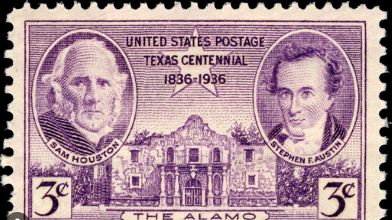
NEXT MEETING
February 18th
WEBEX Only
Change Control Call

