Slide 1
HEN Comments on NPRR1268 related to AORDC
Shams Siddiqi, Ph.D.
Hunt Energy Network (HEN)
(512) 619-3532
shams@crescentpower.net
RTCBTF Meeting
February 7, 2025

Slide 2
ERCOT Interpretation of AORDC Protocols
Based on ERCOT’s “Ancillary Service Demand Curves (ASDCs)” presentation dated 2/21/24:
For all SCED intervals where (RTOLCAP+RTOFFCAP)<10,000MW, ERCOT used the historical RTOLCAP and RTOFFCAP values to calculate the composite LOLP and composite price [i.e., ORDC adder] defined as:
(𝟎.𝟓∗(𝟏−𝒑𝒏𝒐𝒓𝒎(𝑹𝑻𝑶𝑳𝑪𝑨𝑷−𝑿, 𝟎.𝟓∗𝟗𝟐𝟓,𝟎.𝟕𝟎𝟕∗𝟏𝟐𝟏𝟑))
+𝟎.𝟓∗(𝟏−𝒑𝒏𝒐𝒓𝒎(𝑹𝑻𝑶𝑳𝑪𝑨𝑷+𝑹𝑻𝑶𝑭𝑭𝑪𝑨𝑷−𝑿, 𝟗𝟐𝟓, 𝟏𝟐𝟏𝟑)))
∗(𝑽𝑶𝑳𝑳−𝒎𝒊𝒏(𝑺𝒚𝒔𝒕𝒆𝒎 𝑳𝒂𝒎𝒃𝒅𝒂, 𝟐𝟓𝟎))
To account for lower reserve level areas where there are no historical observations, create a single point using the following assumptions:
RTOFFCAP = 0, RTOLCAP = 2,000MW
Set System Lambda equal to the average of system lambda, with the historical values capped at $250/MWh, during SCED timestamps with less than or equal to 4,000MW of total reserves
Using the results of (a) and (b) above, use regression methods to fit a curve to the average reserve pricing outcomes for the various MW reserve levels.

Slide 3
Use ORDC instead of Adder-fitted AORDC
Protocols do not define exactly what curve to fit. ERCOT chose the following curve:
AORDC=(VOLL-250)*(1-CDF(RTOLCAP+RTOFFCAP, mu, sigma)) which resulted in mu=3760 and sigma=1180
ERCOT did NOT use (nor does it make sense to use) the following:
AORDC = (𝟎.𝟓∗(𝟏−𝒑𝒏𝒐𝒓𝒎(𝑹𝑻𝑶𝑳𝑪𝑨𝑷−𝑿, 𝟎.𝟓∗𝟗𝟐𝟓,𝟎.𝟕𝟎𝟕∗𝟏𝟐𝟏𝟑))
+𝟎.𝟓∗(𝟏−𝒑𝒏𝒐𝒓𝒎(𝑹𝑻𝑶𝑳𝑪𝑨𝑷+𝑹𝑻𝑶𝑭𝑭𝑪𝑨𝑷−𝑿, 𝟗𝟐𝟓, 𝟏𝟐𝟏𝟑)))
∗(𝑽𝑶𝑳𝑳−𝒎𝒊𝒏(𝑺𝒚𝒔𝒕𝒆𝒎 𝑳𝒂𝒎𝒃𝒅𝒂, 𝟐𝟓𝟎)) [Protocols are incorrect]
ERCOT could have fit a more appropriate curve for creating ASDCs:
AORDC=VOLL*(1-CDF(OperatingReserve-MCL, mu, sigma))
ERCOT’s use of (VOLL-250) reduces VOLL by $250/MW for entire curve
ERCOT’s use of (RTOLCAP+RTOFFCAP) is much greater than OperatingReserve [i.e., Ancillary Service capacity] under RTC
ORDC=VOLL*(1-CDF(OperatingReserve-MCL, mu, sigma)) is by definition the Demand Curve for OperatingReserves [i.e., AS]
Thus, unaltered ORDC should be used as the sloping portion of AORDC rather than the convoluted AORDC derived from simulated ORDC adder values and curve fitting an arbitrarily selected AORDC

Slide 4
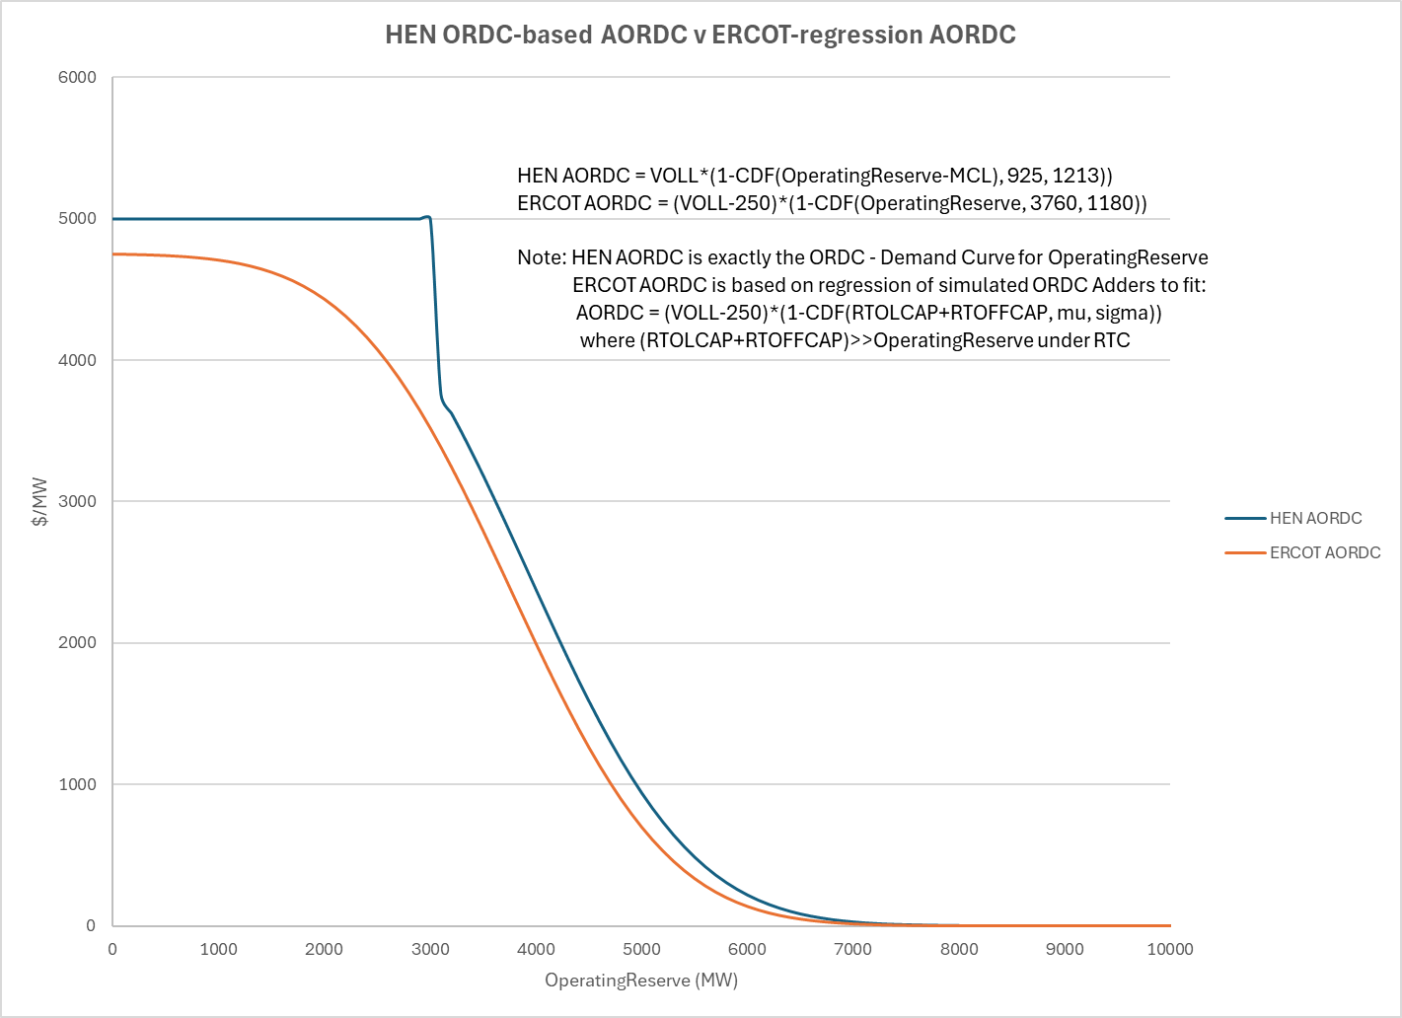
Use ORDC instead of Adder-fitted AORDC

Slide 5
Summary of HEN Changes
Use unaltered ORDC [by definition the Demand Curve for Operating Reserves] to create ASDCs instead of the ERCOT-estimated [but not defined in Protocols] AORDC based on regression of simulated historical ORDC adders: this also helps mitigate some of the market price suppression with RTC implementation.
ORDC Adders should not and were never used to Procure Ancillary Services and are actually lower when System Lambdas are higher in scarcity – contrary to the value or what the “demand curve” should be for the Operating Reserve
It’s unclear from the Protocol language what AORDC should be fit using historical simulated data. ERCOT has chosen to fit AORDC=(VOLL-250)*(1-CDF(RTOLCAP+RTOFFCAP, mu, sigma)). This implies that the AORDC can never reach VOLL, reduces the VOLL by $250/MW/hour for the entire curve thereby undervaluing all points on the AORDC, and is further undervaluing AS capacity since AS capacity is typically much less than (RTOLCAP+RTOFFCAP).
Also, there is no need to post mu and sigma values once RTC is implemented and ORDC-related OBD is no longer needed. Thus MCL, mu and sigma values should be specified is this section of the Protocols.

