Slide 1
PDCWG Report to ROS
Chair: Kevin Bunch, EDF Trading North America
Vice Chair: Chad Mulholland, NRG
ROS
February 6th, 2024

Slide 2
Report Overview & Notes
Report Overview
Meeting Minutes
PDCWG Leadership Volunteers
ERCOT Frequency Control Metrics and Regulation Reports
TRE Report
Analysis of Disturbances
BAL-001-TRE-2 FMEs and IMFR
0 FME in the month of December
Note that occurrence of FMEs is down a lot – 2021 had 19; 2022 had 16; 2023 had 7; 2024 had 6
Frequency Control Report

Slide 3
Frequency Measurable Events Performance

Slide 4
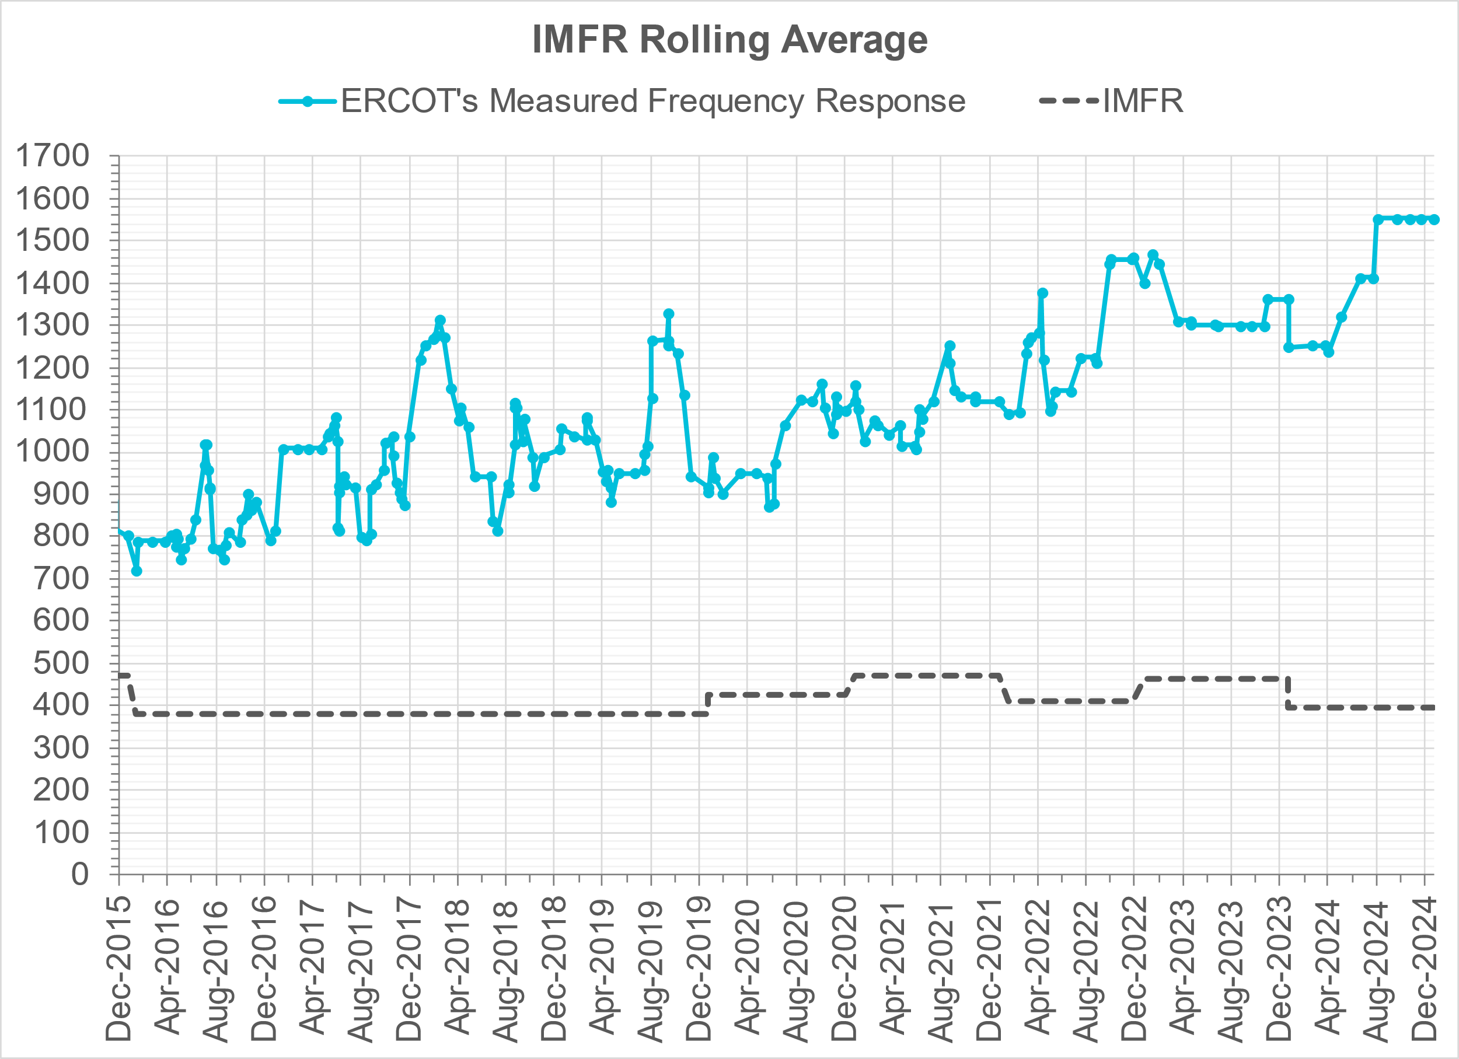
Interconnection Minimum Frequency Response (IMFR) Performance
IMFR Performance currently
1552.00 MW/0.1HZ
Frequency Response Obligation (FRO): 395 MW/0.1 Hz

Slide 5
Questions?

Slide 6
Frequency Control Report
October 2024

Slide 7
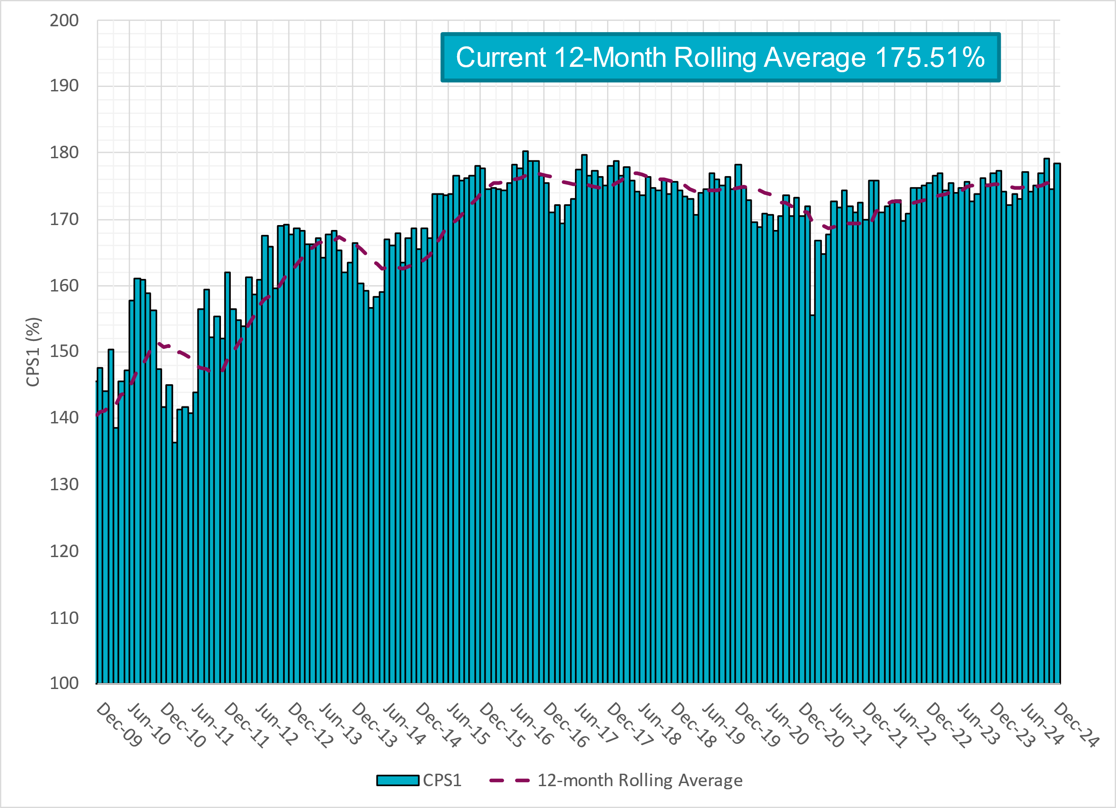
CPS1 Performance

Slide 8
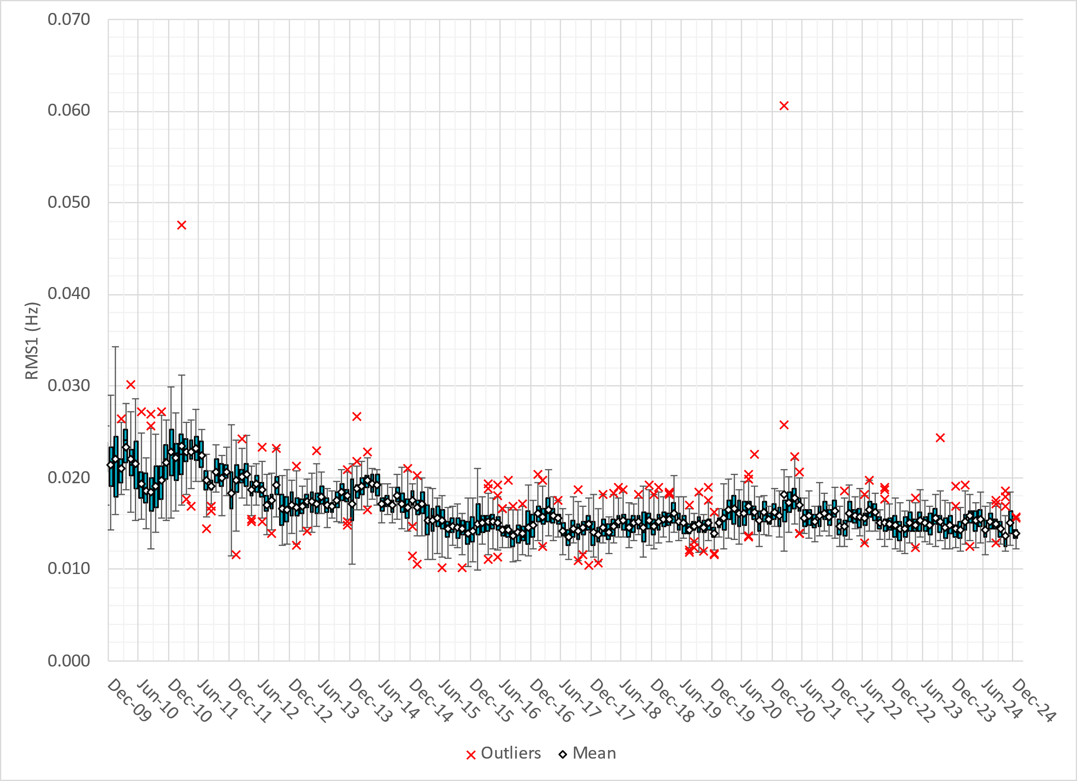
RMS1 Performance of ERCOT Frequency
Notes:
13.95 mHz on avg for December 2024

Slide 9
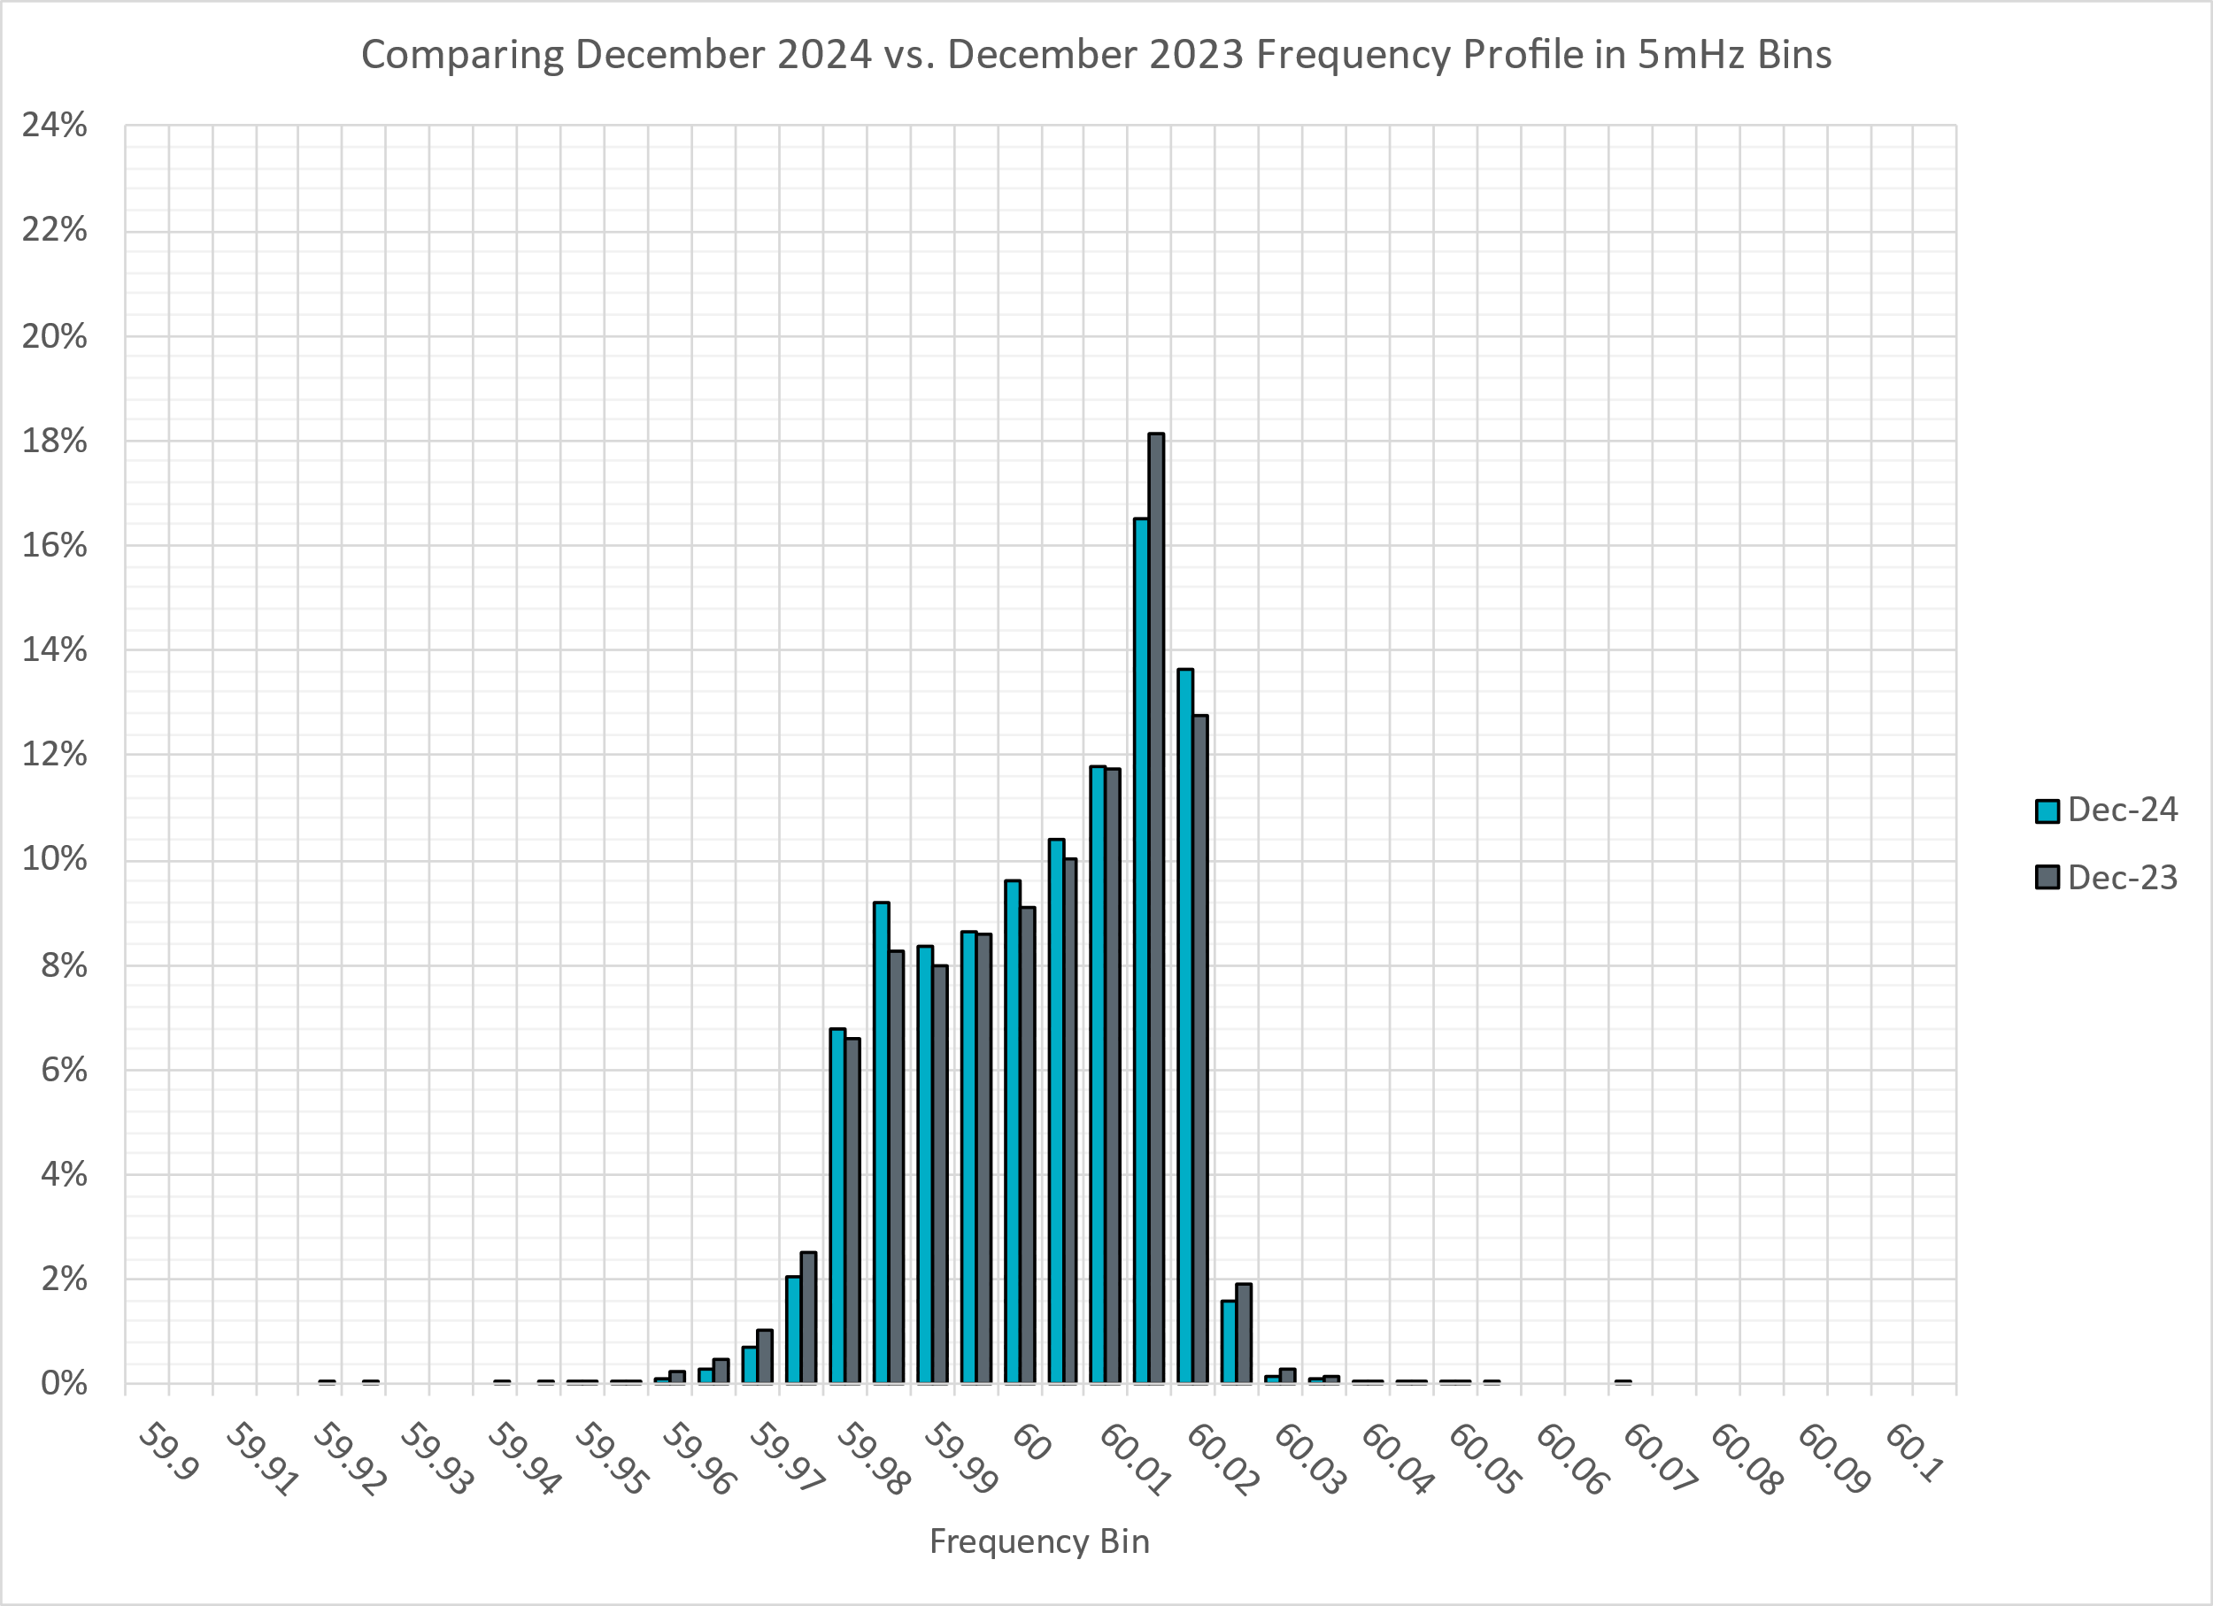
Frequency Profile Analysis

Slide 10
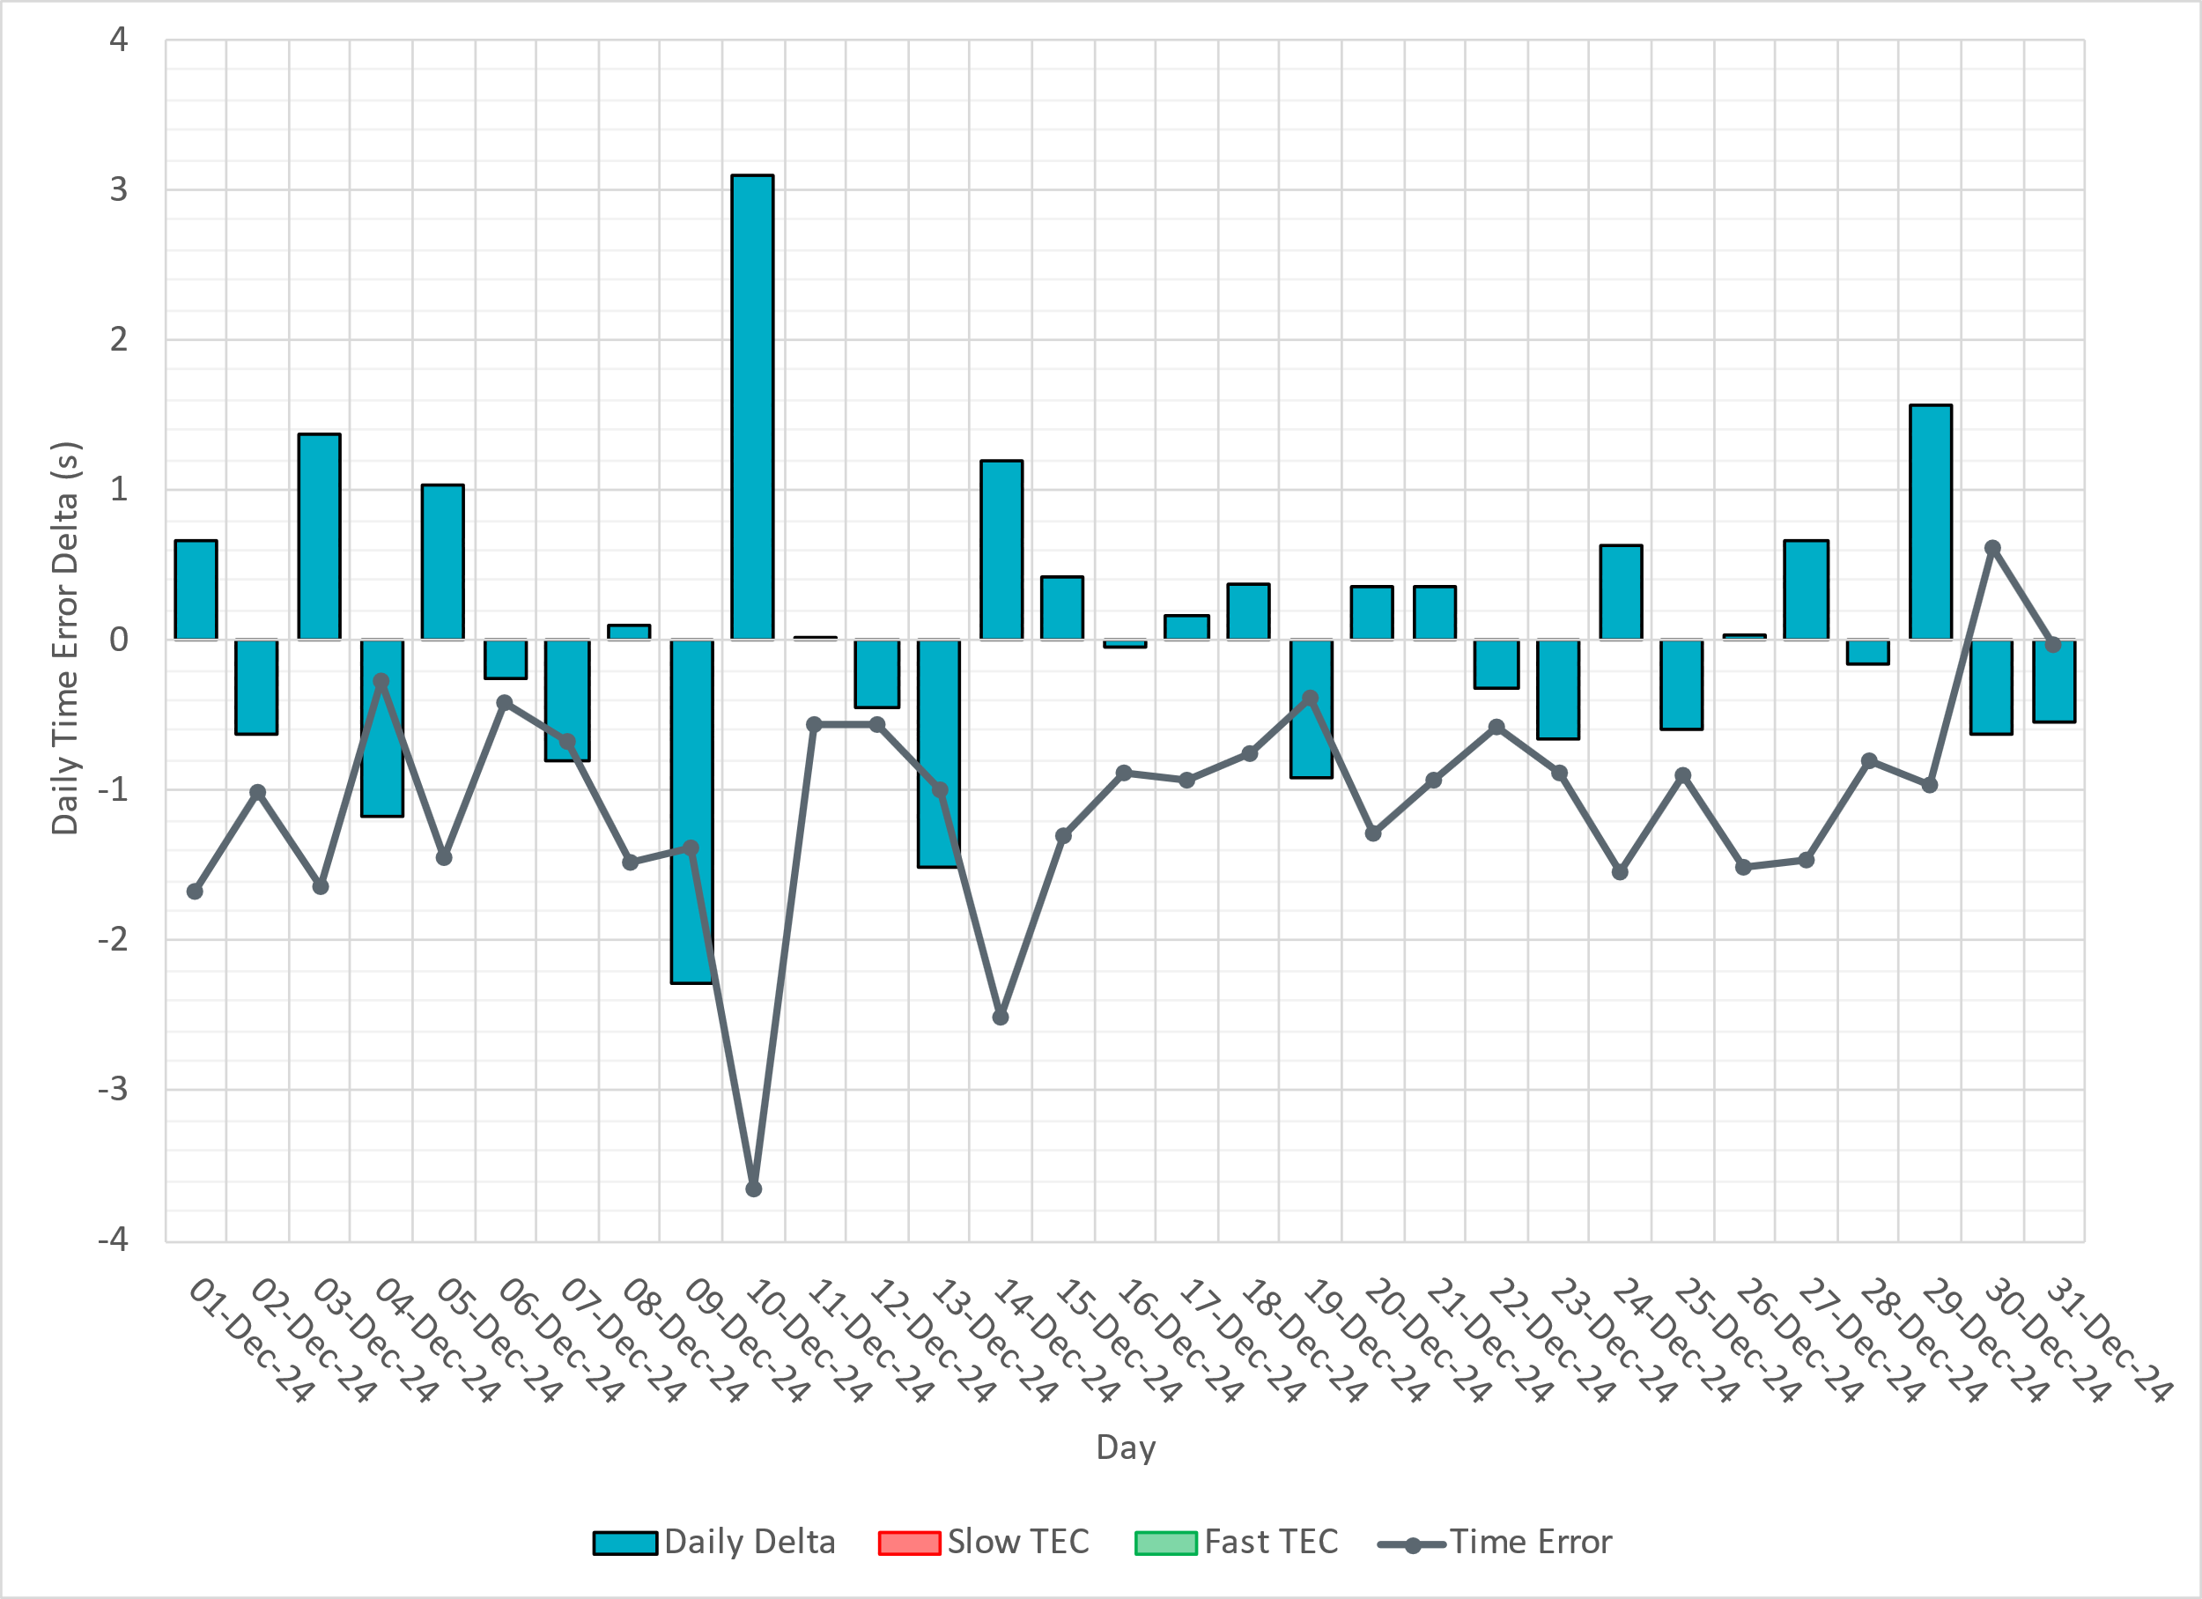
Time Error Corrections

Slide 11
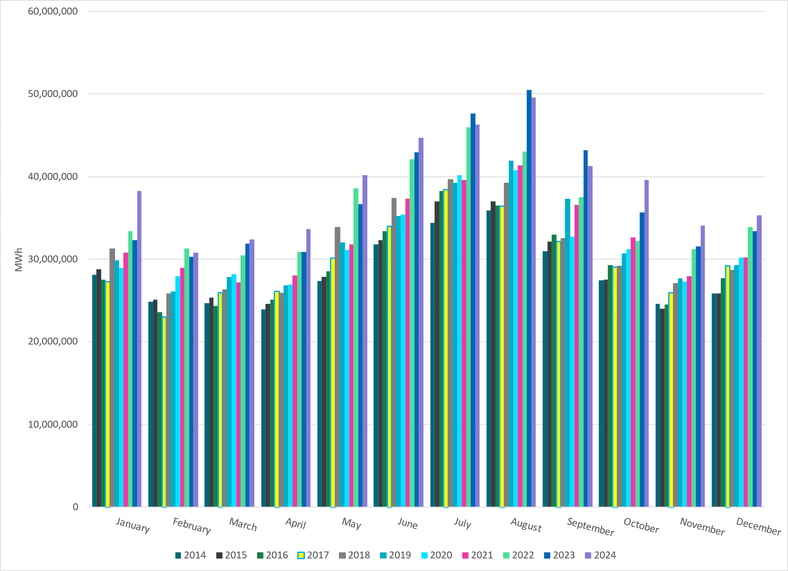
ERCOT Total Energy
Notes:
35,297,482 MWh

Slide 12
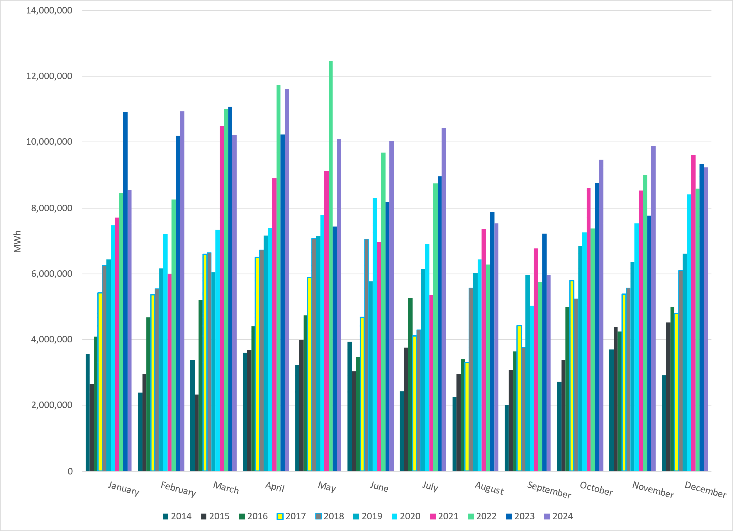
ERCOT Total Energy from Wind Generation
Notes:
9,236,413 MWH

Slide 13
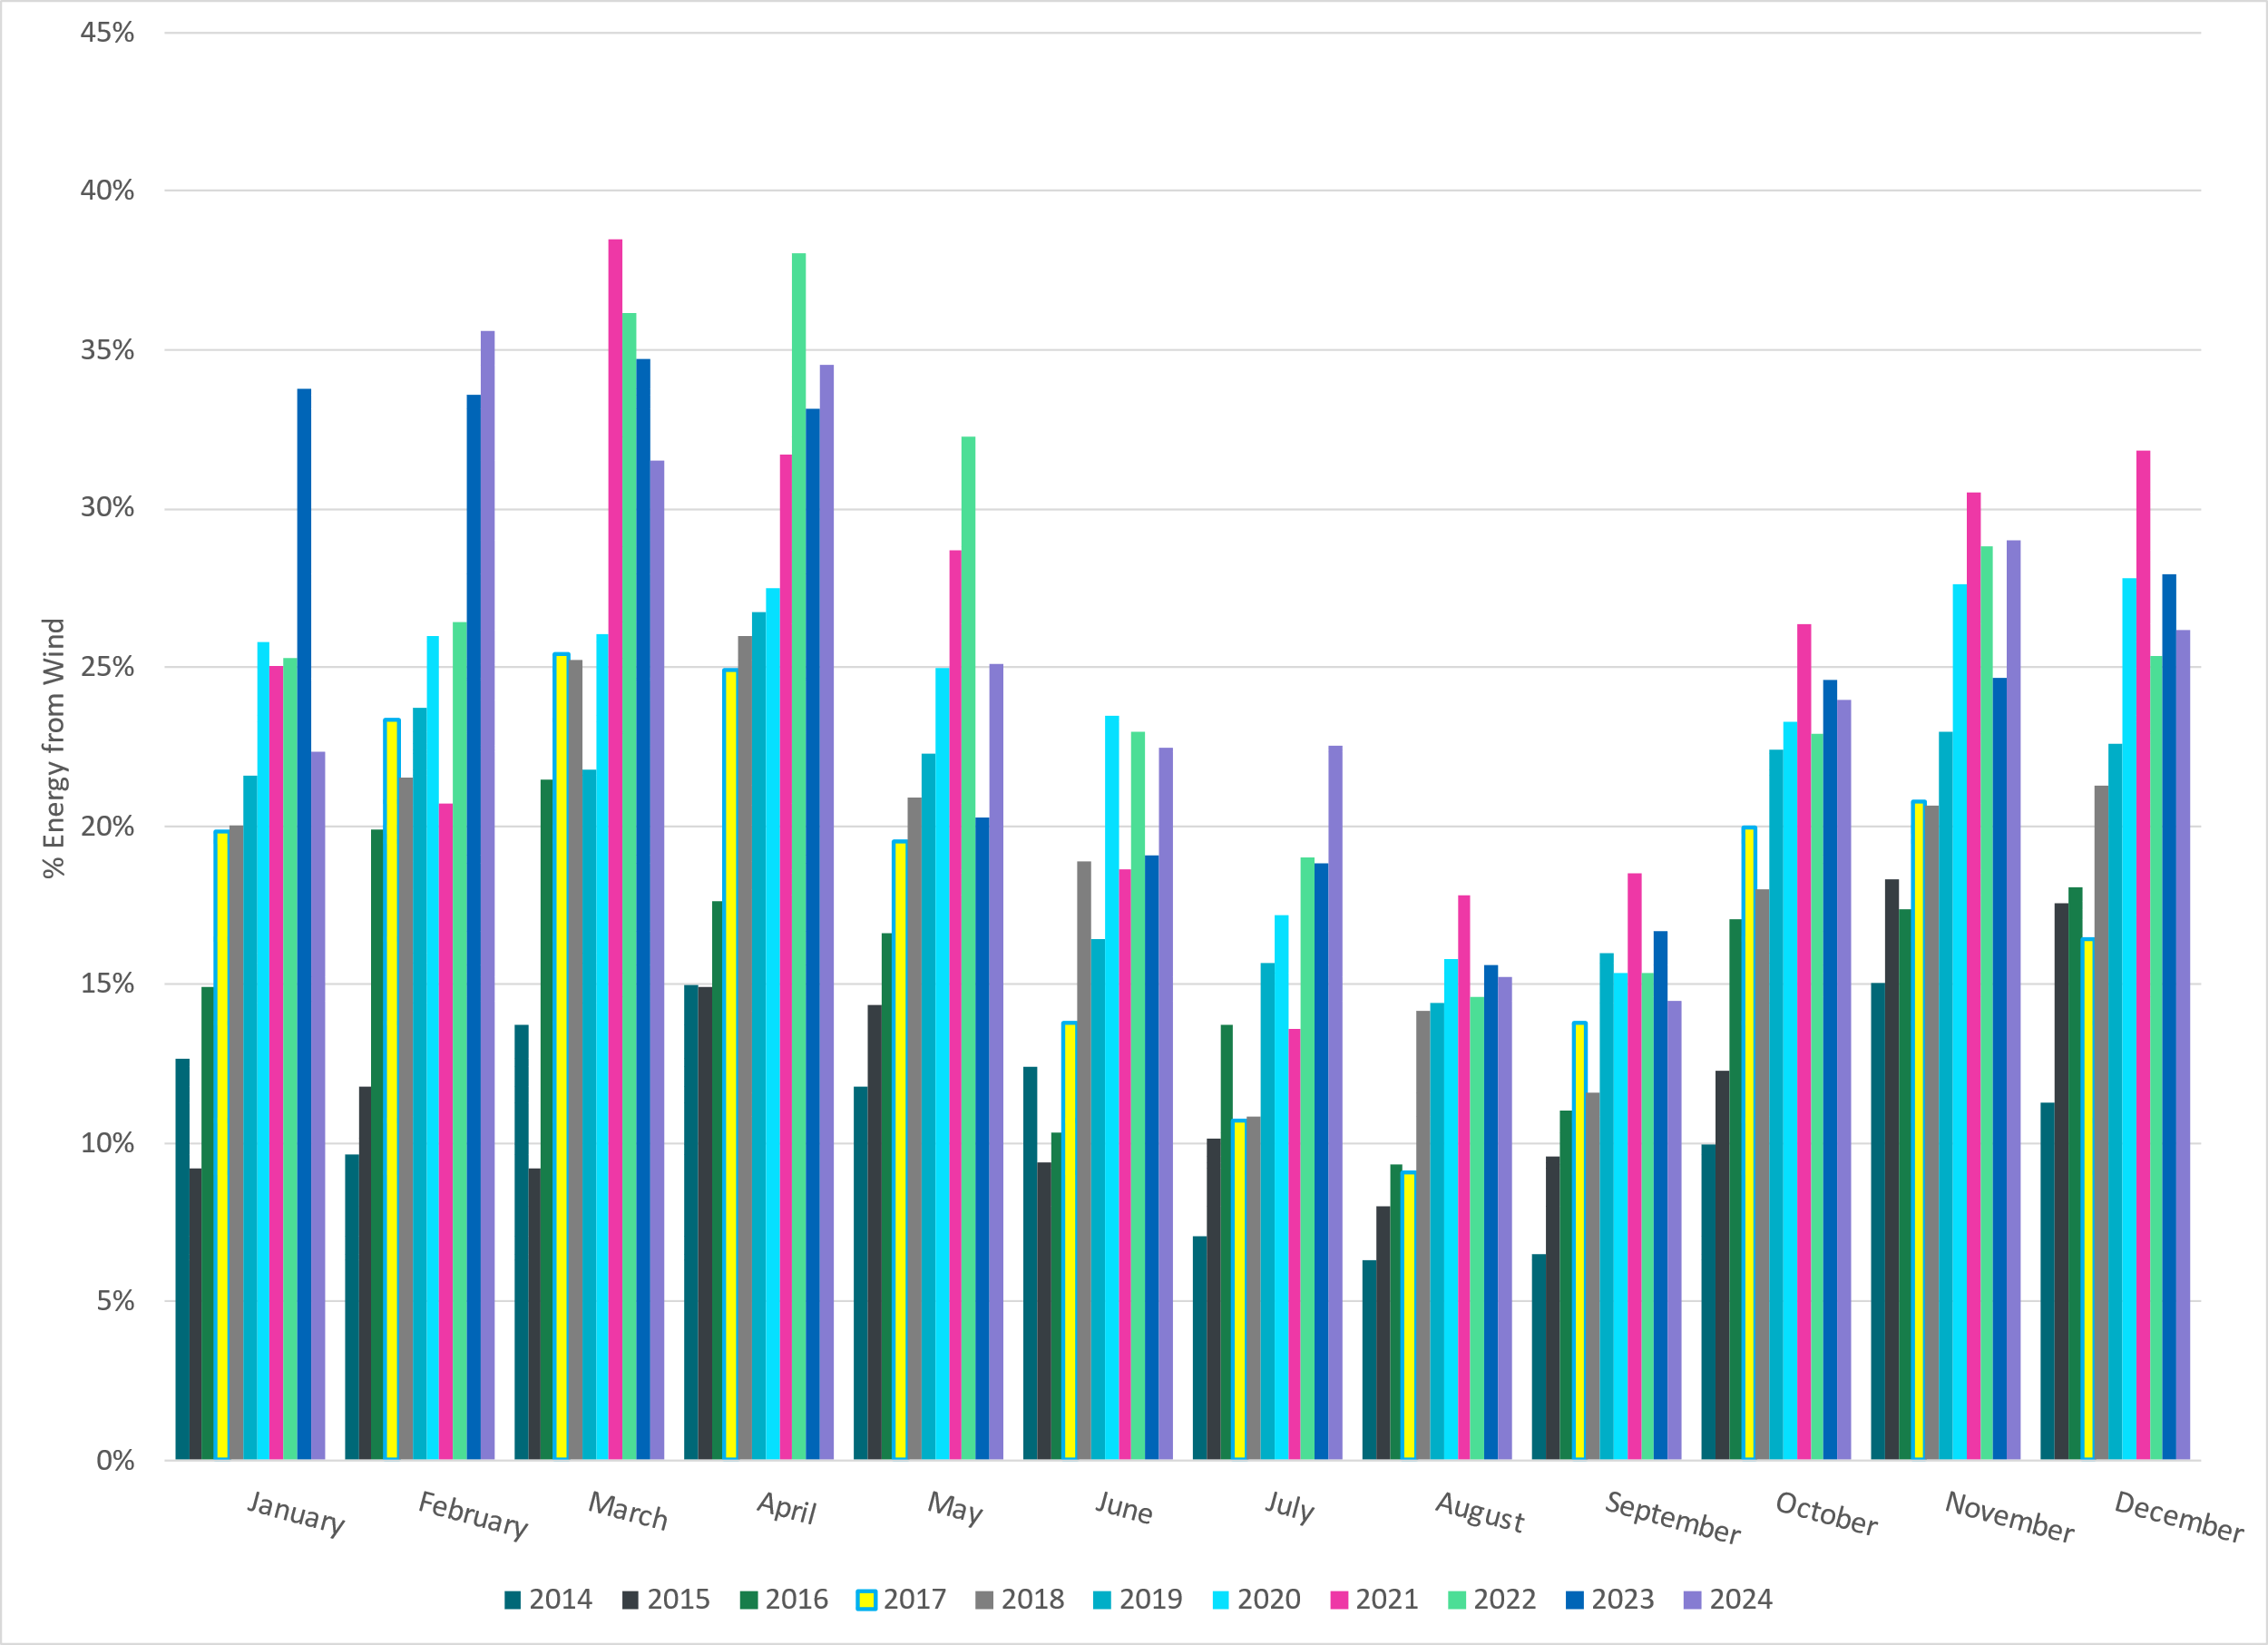
ERCOT % Energy from Wind Generation
Notes:
26.17% of total energy was provided by wind generation

Slide 14
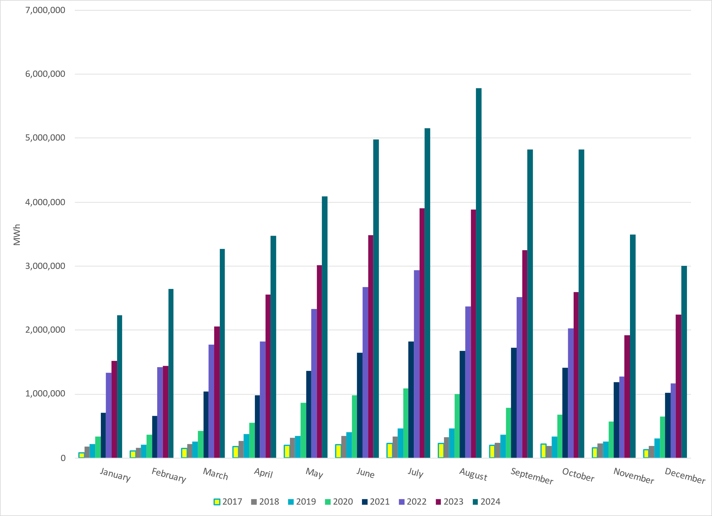
ERCOT Total Energy from Solar Generation
Notes:
3,002,040 MWh

Slide 15
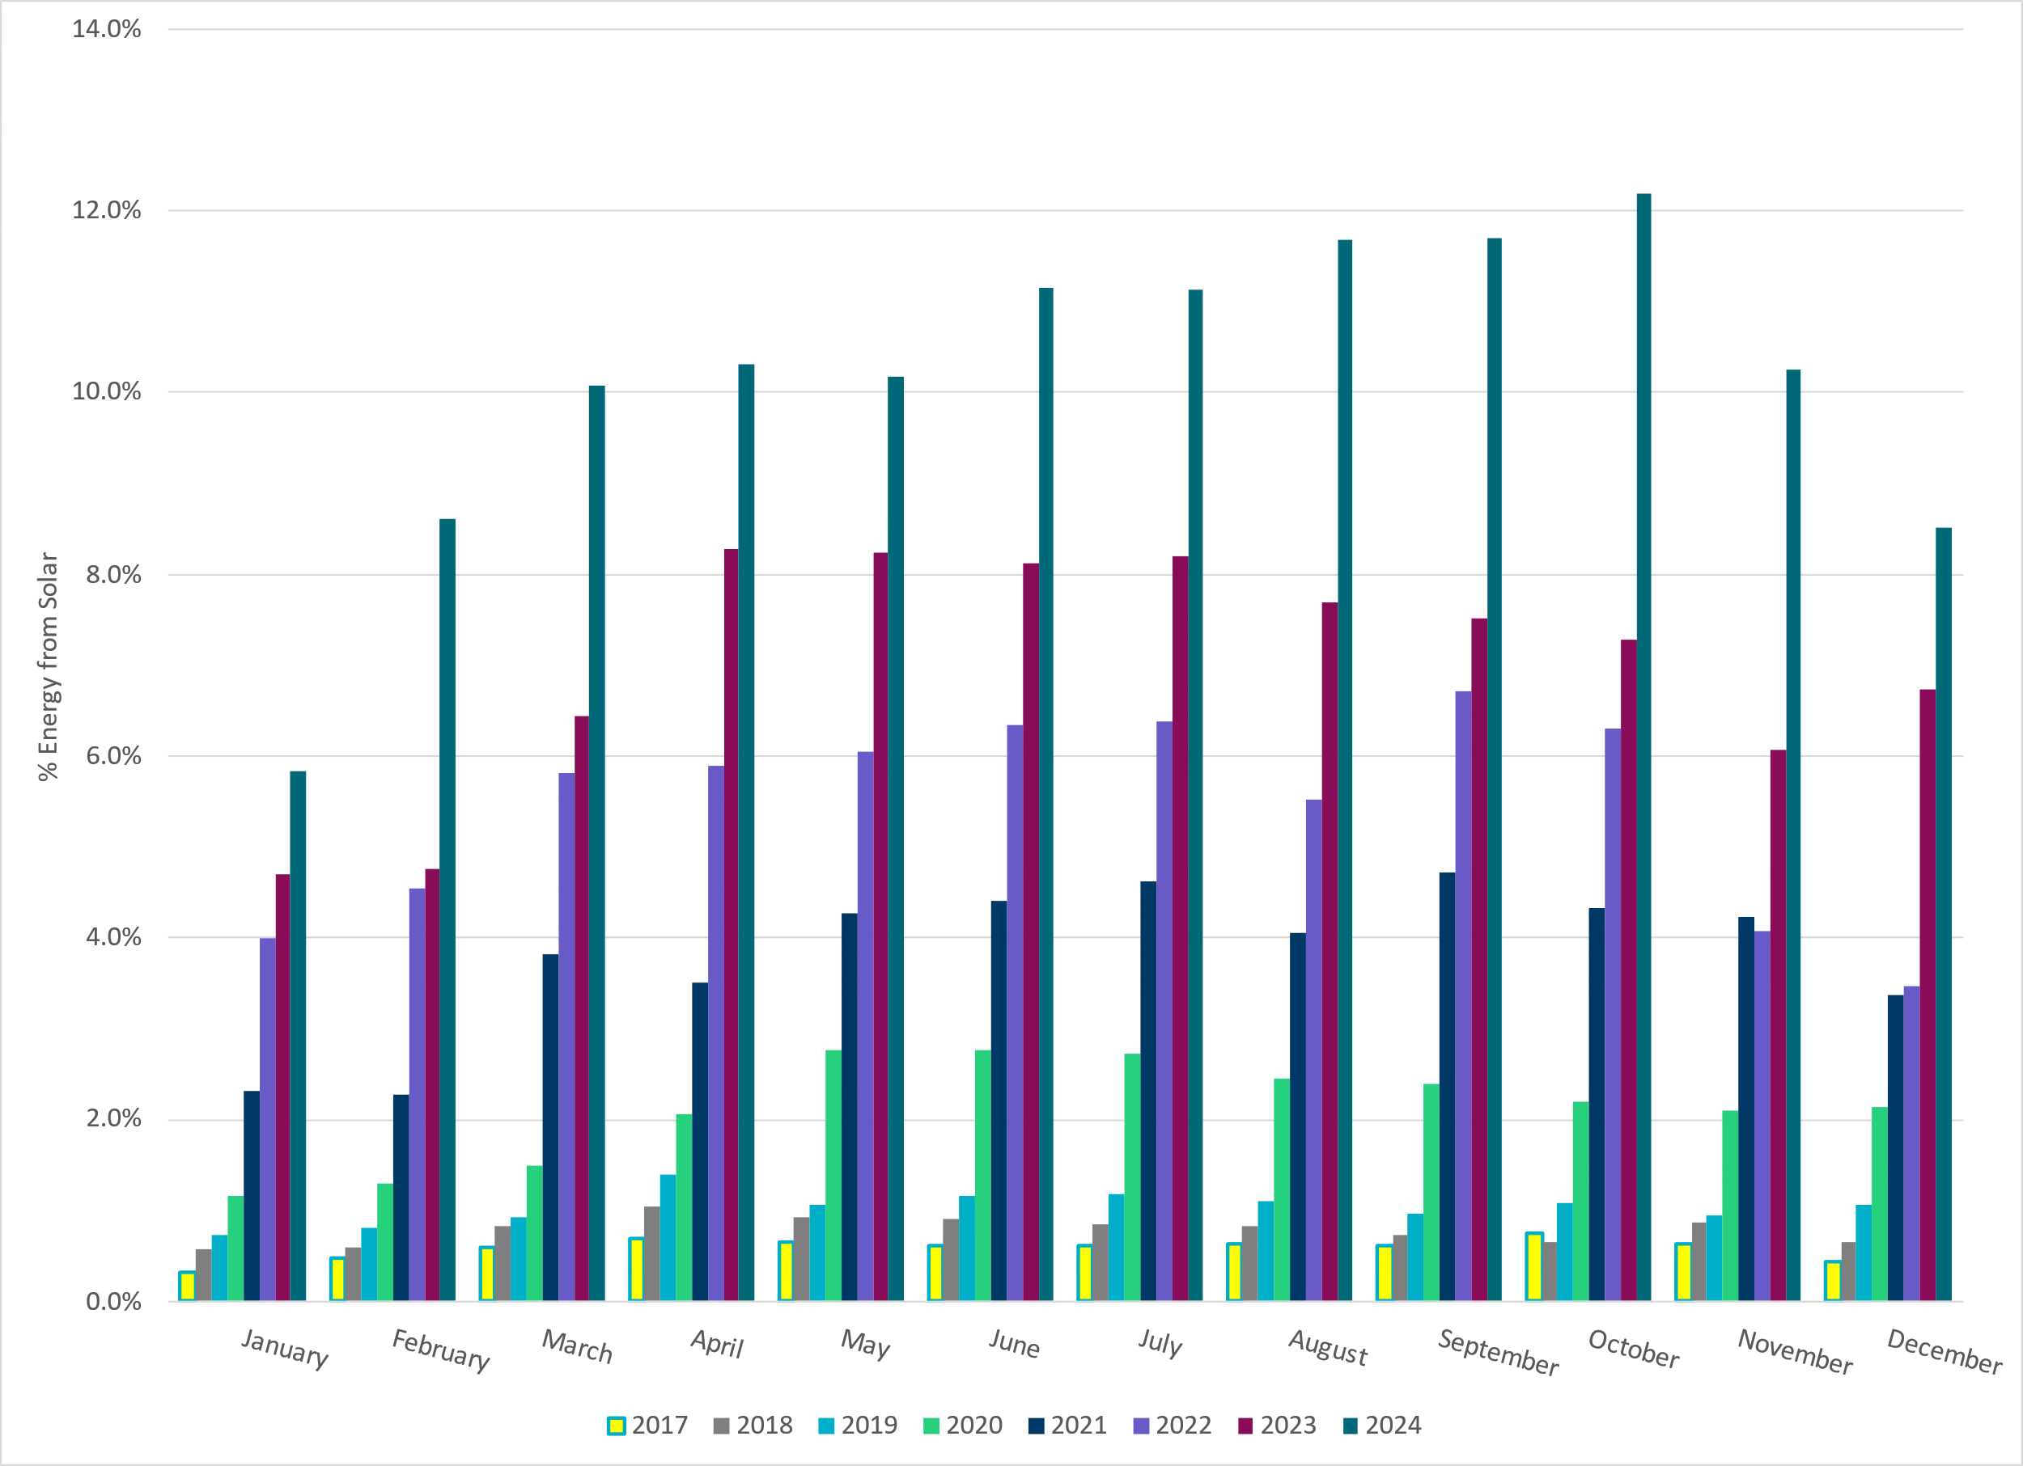
ERCOT % Energy from Solar Generation
Notes:
8.50% of total energy was provided by solar generation

Slide 16
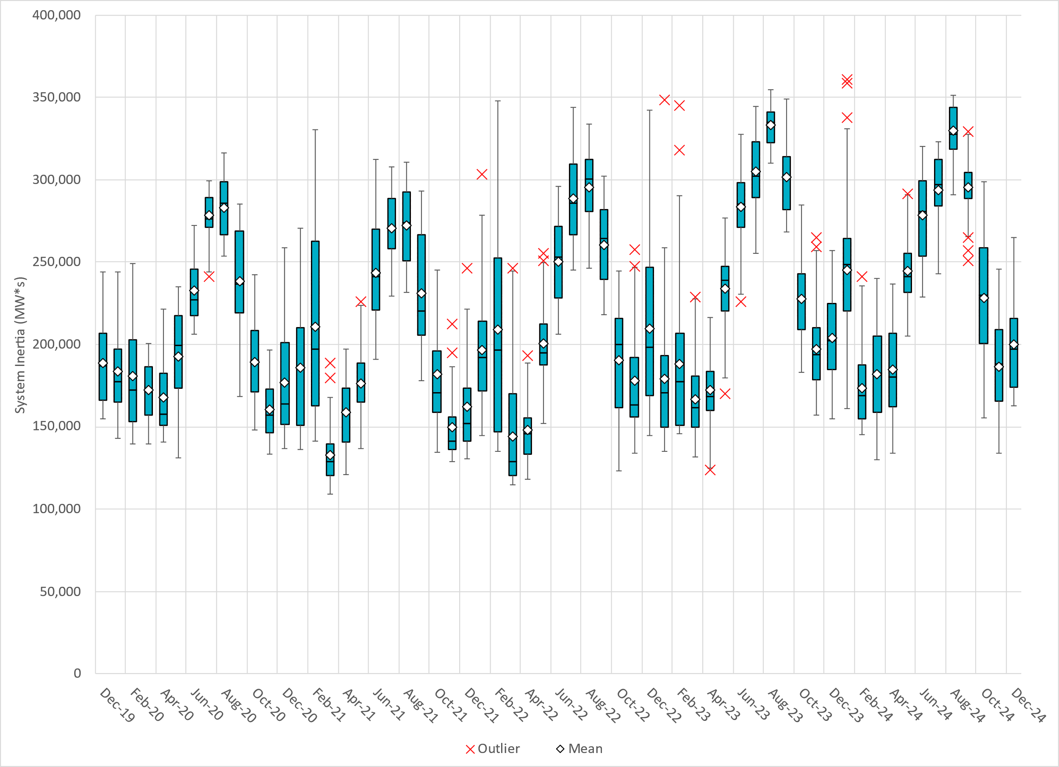
ERCOT Daily Minimum System Inertia
Notes:
Minimum Inertia in December 2024 = 162,482 MW*s on December 30th
Historical Overall Minimum was 109,029 MW*s on 3/22/2021
December Data:
Mean: 199,978 MW*s
Max: 264,996 MW*s on December 6th
Min: 162,482 MW*s on December 30th

Slide 17
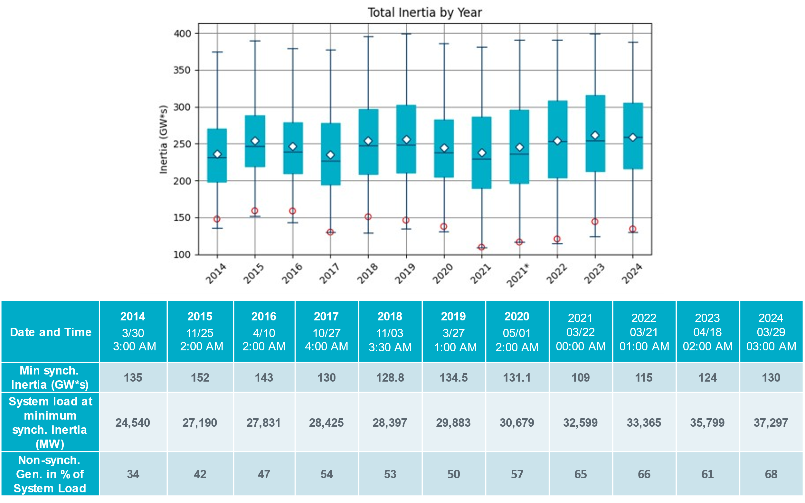
ERCOT Inertia Trend
Notes:
Summary of ERCOT inertia for the previous 10 years. Lowest inertia this year was on March 29th.
For each box, the central mark (red line) is the median, the edges of the box (in blue) are the 25th and 75th percentiles, the whiskers correspond to +/- 2.7 sigma (i.e., represent 99.3% coverage, assuming the data are normally distributed. The corresponding lowest inertia in each year is given in the table.
The circle on each boxplot is showing inertia during time when highest portion of load was served by wind/solar generation in that year.

