Slide 1
RTC+B Task Force
Update
Matt Mereness
TWG
January 30, 2025

Slide 2
Outline
Program update: RTC+B Program Update from Board T&S
Reminder of Scope of RTC+B Program (no change)
Current Issues for RTCBTF Review

Slide 3
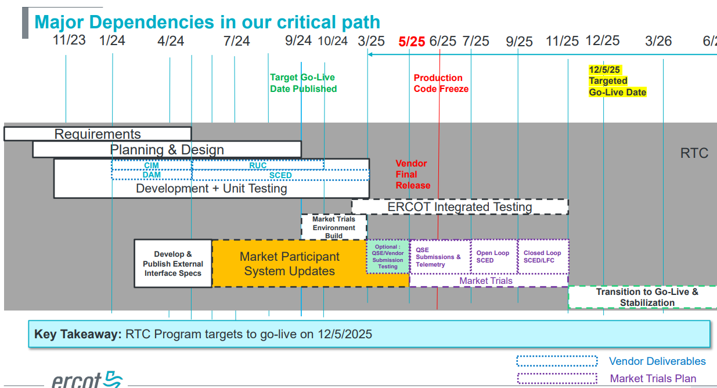
RTC+B Program Update
(excerpt from December Board T&S RTC Update)

Slide 4
Sequence and Dates for Market Trials to Go-Live
NEW
30-day Market Notice
11/5/25
March/April
2025
Start
5/5/25
Start
7/7/25
Start
9/2/25
Go-Live
12/5/25*
May 2025
June 2025
July 2025
Aug 2025
Sep 2025
Oct 2025
Nov 2025
Dec 2025
QSE Scorecards & Exit Criteria for each Trial Phase
RTC QSE Submission Testing
(Submit COP, RT AS Offers,
DAM Virtual AS, Outages for ESRs)
Open-loop RTC SCED
(QSE offers, SCED non-binding award/dispatch)
Ongoing Open-Loop
& Periodic Closed-loop SCED/LFC
(QSE RTC offers and telemetry to support closed-loop frequency control test 2-3 tests of 2-4 hour durations)
Transition to Go-Live
Upon completion of testing, confirmation of ERCOT and market readiness for Go-Live.
QSE/Vendor Submission Sandbox and Telemetry Points added to network model.
RTC QSE Telemetry Check-out (QSEs add/verify new telemetry points for UDSP, New ramp rates, ESR telemetry)
QSE Telemetry Tests
(Individual QSE to follow UDSP and support new ramp rate and ESR telemetry)
Day-Ahead Market
(Non-binding DAM using QSE offers for at least 2 tests)
* Go-Live date reflects 12/5/2025 as first Operating Day
where 12/4/2025 is planned software migration.

Slide 5
Reminder of Details Scope of RTC+B Program
(Excel version posted with meeting)
No change from
October 2024

Slide 6
Meeting discussions
1. Antitrust Admonition (Matt Mereness)
2. RTCBTF Updates and Issues (Matt Mereness) - ADDED January 23 and Feb 7 afternoon meeting
3. Discussion of NPRR for RTC+B Parameters (ERCOT staff)
- Ramp Rate sharing (NPRR language)
- AS Proxy Offer Floor (NPRR language with more ASDC discussion)
- ASDC for RUC discussion (NPRR sections impacted and presentation)
- AS Duration Requirements (initial discussion)
4. Proposed changes for AS Qualification (Nitika Mago)
- Follow-up on discussion of IRR AS qualification
5. Review any Market feedback on Market Trials Handbooks (Matt Mereness)
- QSE Market Submissions (Handbook #1) – No comments received
- QSE Telemetry Check-Out (Handbook #2) – No comments received
6. Discussion of AS Demand Curves (Jonas Kersulis- IMM)
- ASDC sensitivity analysis for different ASDC proposals and draft NPRR
7. Refreshed RTC Efficiency Cost Savings (Matthew Schmidt)
- ERCOT study of annual RTC cost savings in 2023-2024
8. Other Business
- WMS question about WSL in Load Forecast (NPRR1253)

Slide 7
Additional Meetings added Jan 23 and Feb 7 prior to Feb 19 meeting

