Slide 1
Project Update
January 15, 2025
Troy Anderson
ERCOT Portfolio Management

Slide 2
Project Update Agenda
  Recent / Upcoming Project Highlights
  2024 Releases
  2025 Release Targets
  Major Projects
  Revision Request Additional FTEs
  Priority/Rank Recommendations for Revision Requests with Impacts
    NPRR1253 – Incorporate ESR Charging Load Information into ICCP
    NPRR1257 – Limit on Amount of RRS a Resource can Provide Using Primary Frequency Response
    SCR828 – Increase the Number of Resource Certificates Permitted for an Email Domain in RIOO
  Technology Working Group (TWG)
    Next meeting is 1/30/2025
Location of Revision Request Project Information: http://www.ercot.com/services/projects

Slide 3
Recent / Upcoming Project Highlights
2024 December Release – 12/12/2024 Complete
  NPRR1183 – ECEII Definition Clarification and Updates to Posting Rules for Certain Documents without ECEII
  NPRR1184 – Update to Procedures for Managing Interest on Cash Collateral
  PGRR082 – Revise Section 5 and Establish Small Generation Interconnection Process
  PGRR094 – Clarify Notification Requirement for Generator Construction Commencement or Completion
  PGRR108 – Related to NPRR1183
2025 January Off-Cycle Release – 1/1/2025 Complete
  NPRR1219 – Methodology Revisions and New Definitions for the Report on Capacity, Demand and Reserves in the ERCOT Region (CDR)
2025 January Release – 1/30/2025 In Flight
  NPRR945 – Net Metering Requirements
2025 March Release – 3/28/2025 In Flight
  NPRR1145 – Use of State Estimator-Calculated ERCOT-Wide TLFs in Lieu of Seasonal Base Case ERCOT-Wide TLFs for Settlement
Note: Projected Go-Live dates are subject to change.
Please watch for market notices as the effective dates approach.

Slide 4
2024 Releases – Approved NPRRs / SCRs / xGRRs
R1
R3
R5
January 1/25 | February 2/22 | March 3/28 | April 4/25 | May 5/30 | June 6/27
NPRR1092(b) PGRR098(a) ESR Telemetry Public API Enhancements | NPRR1132(a) RRGRR032 NOGRR249(b) NPRR1184(a) NPRR1026(b) NPRR1172(a) | NPRR1040 NOGRR247(a) NPRR1165 NPRR989(a) NPRR1038 NOGRR204(a) |  | SCR819 NPRR1111 Securitization Default Charge Supporting Data | NPRR1149 NPRR1186 NPRR1196 NPRR1121 NPRR1090 NPRR962 NPRR1139 NPRR1205(a)
R2
R4
R6
ü
ü
ü
ü
ü
ü
ü
ü
ü
ü
ü
ü
ü
ü
ü
ü
ü
ü
ü
ü
ü
ü
ü
ü
ü
ü
ü
ü
ü
ü
1/1
3/11
Various effective dates
2/1
2/26
4/1
6/1
2/16
3/1
ü
7/1
10/1
ü
NPRR1217
SCR799
R7
R9
ü
July 7/25 | August 8/22 | September 9/26 |  | TX SET 5.0 11/10 | December 12/11-12/12
 | NPRR1058 NPRR1131 NPRR1186(b) OBDRR040 SCR821 | Forecast Presentation Platform (CDR rpts) NPRR1002 RRGRR023 NOGRR208 | SCR799 SCR799 NPRR1205(b) NPRR1218 NPRR1231 | NPRR1095 NPRR1134 NPRR1168 SCR817 SCR823 RMGRRs: 168,169, 172,179 | NPRR1183 NPRR1184 PGRR082 PGRR094 PGRR108
R8
R11
10/9
ü
ü
ü
ü
ü
ü
ü
ü
ü
ü
ü
ü
ü
ü
ü
ü
11/1
ü
ü
11/15
ü
Go-live dates can differ from Protocol effective dates – Please refer to market notices for more details
APPENDIX
Red Text: New additions and target release changes
Strike-Through Text: Previous target release
(a), (b), etc.: Multiple phase release
Project Status Codes
NS = Not Started
I = Initiation
P = Planning
E = Execution
H = On Hold
NPRR989(a) – ESR tech. req.
NPRR1026(b) – SLF – Reporting
NPRR1092(b) – Limit RUC Opt-Out
NPRR1132(a) – RIOO portion
NPRR1172(a) – RUC Process/Clawback
NPRR1184(a) – Interest calcs
NPRR1186(b) – 60 Day Reports
NPRR1205(a) – Credit Limit %
NPRR1205(b) – Credit Rating
NOGRR204(a) – ESR tech req
NOGRR247(a) – UFLS changes
NOGRR249(b) – MIS posting
PGRR098(a) – Section 4.1.1.8
Release targets are subject to change

Slide 5
2025 Release Targets – Approved NPRRs / SCRs / xGRRs
R1
R3
R5
January 1/30 | February 2/27 | March 3/27 | April 4/24 | May 5/29 | June 6/26
NPRR945 PGRR088 NPRR1219 |  | NPRR1145 | RTC+B Market Trials begin on 5/5/2025
R2
R4
R6
E
ü
E
RTC QSE Submission Testing
1/1
RTC QSE Telemetry Check-out
RTC+B
12/5
July 7/31 | August 8/28 | September 9/25 | October 10/23 |  | December 12/18
 |  |  |  |  | RTC+B Stabilization begins
R7
R8
R9
R10
E
R11
NPRR1007-1013
NPRR963(a)
NPRR965
NPRR1000
NPRR1014
NPRR1054
NPRR1058
NPRR1172
NPRR1204
NPRR1216
NPRR1236
NPRR1245
NPRR1246
NOGRR211
NOGRR268
OBDRR020
OBDRR052
PGRR118
RTC QSE Submission Testing
Open-loop RTC SCED
Closed-loop SCED/LFC
RTC QSE Telemetry Check-out
QSE Telemetry Tests
Day-Ahead Market
Go-live dates can differ from Protocol effective dates – Please refer to market notices for more details
APPENDIX
Red Text: New additions and target release changes
Strike-Through Text: Previous target release
(a), (b), etc.: Multiple phase release
Project Status Codes
NS = Not Started
I = Initiation
P = Planning
E = Execution
H = On Hold
NPRR963(a) – Portion of NPRR
RTC+B Market Trials
RTC+B Stabilization
Release targets are subject to change

Slide 6
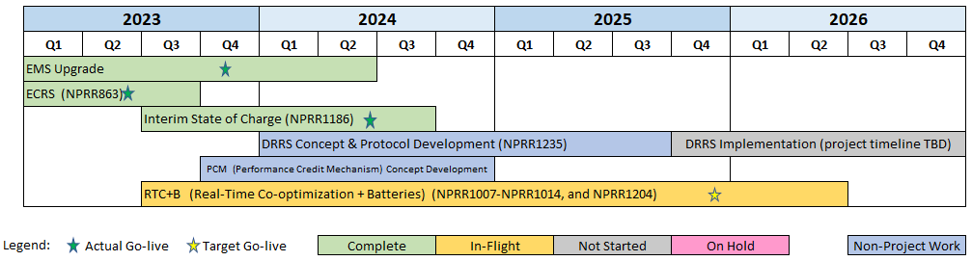
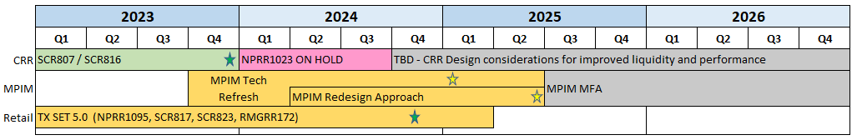
Major Projects
Other Project Highlights

Slide 7
Revision Request Additional FTEs – DRAFT
RR | RR Title | Approval | Dept | FTEs
PGRR082 | Revise Section 5 and Establish Small Generation Interconnection Process | 12/8/2020 | Resource Integration | 3
NPRR1007 | RTC – NP 3: Management Activities for the ERCOT System | 12/8/2020 | EMMS Production Support | 2
NPRR1073 | Market Participant Application Changes | 8/19/2021 | General Counsel | 1
NPRR1108 | ERCOT Shall Approve or Deny All Resource Outage Requests | 5/12/2022 | Outage Coordination | 2
PGRR098 | Consideration of Load Shed in Transmission Planning Criteria | 5/12/2022 | Transmission Planning | 1
NOGRR215 | Limit Use of Remedial Action Schemes | 10/12/2023 | Operations Stability Analysis | 1
NPRR1198 | Congestion Mitigation Using Topology Reconfigurations | 7/25/2024 | Grid Analysis | 1
NOGRR245 | Inverter-Based Resource (IBR) Ride-Through Requirements | 9/26/2024 | Various | 7-10
NPRR1180 | Inclusion of Forecasted Load in Planning Analyses | Pending | Various | 11
NPRR1247 | Incorporation of Congestion Cost Savings Test in Economic Evaluation of Transmission Projects | Pending | Economic Analysis & Long-Term Studies | 2
NPRR1234 | Interconnection Requirements for Large Loads and Modeling Standards for Loads 25 MW or Greater | Pending | Resource Integration | 1
PGRR117 | Addition of Resiliency Assessment and Criteria to Reflect PUCT Rule Changes | Pending | Regional Transmission Planning | 2
PGRR122 | Reliability Performance Criteria for Loss of Load | Pending | Various | 5

Slide 8
Priority / Rank Recommendations for Revision Requests with Impacts
Recommendations for…
Revision Request | Description | Priority | Rank | Comments
NPRR1253 | Incorporate ESR Charging Load Information into ICCP | TBD | TBD | $50k-$70k, 5-7 months Impacted System(s): EMS, Integration, Reporting ERCOT submitting comments for PRS consideration
NPRR1257 | Limit on Amount of RRS a Resource can Provide Using Primary Frequency Response | N/A | N/A | <$10k O&M
SCR828 | Increase the Number of Resource Certificates Permitted for an Email Domain in RIOO | 2025 | 4550 | $50k-$70k, 4-6 months Impacted System(s): RIOO Potential to combine with an internal ERCOT project in mid-2025
PPL Rank Information
Next available 2025 Rank in Business Strategy = 4550
Next available 2026 Rank in Business Strategy = 4720
Next available Rank in Regulatory = 400

Slide 9
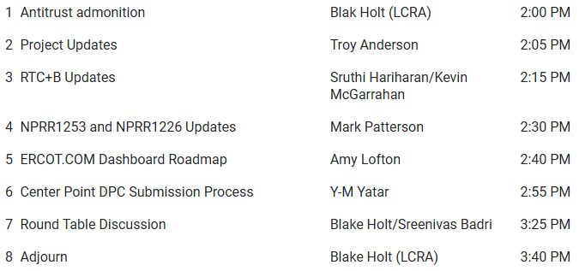
Technology Working Group (TWG)
Agenda for TWG meeting held on 12/19/2024:
Next TWG scheduled for 1/30/2025

