Slide 1
SCR820 – Real-Time Operator Communication System (RTOC)
Preethi Meher
Jan 30, 2024

Slide 2
SCR820
Objective
  This SCR builds on the ERCOT Control Room Hotline communication process by developing a web-based platform supporting Real-Time, bi-directional, “Send-Review” messaging between ERCOT Operators and Transmission Operators (TOs) during emergency event coordination.
  The tool will support one-to-one or one-to-many communications.
  The Messaging System will log and store communications so that parties can stay current during the emergency event and for review subsequent to the emergency.

Slide 3
SCR820
Issue
  During any emergency event, such as the Energy Emergency Alert (EEA) Level 3 event, ERCOT provides Verbal Dispatch Instructions (VDIs) to Transmission Operators (TOs) to support emergency operations communications and/or instructions, including instructions to shed Load and for the restoration of Load.
  During Winter Storm Uri, AEP Texas operators received over 4000 phone calls. The number of calls can be overwhelming, especially during Real-Time critical emergencies.
  Communications under a Black Start situation would be even more overwhelming while trying to communicate properly with all the different parties of the different island developments.
  AEP is part of four different islands and TOs may drop in and out of the ERCOT Black Start voice bridges due to taking other calls resulting in information exchange that will likely be lost.

Slide 4
SCR820
Key Benefits
A new, secure, web-based Real-Time messaging platform will be created that allows fast, effective operational messaging between ERCOT and the ERCOT TOs. Some of the key benefits of this ERCOT/TO Real-Time Messaging Application are:
Reduction of phone calls as primary communication.
  If there is no response to a message within five minutes, ERCOT follows up with a call.
Provides a log of all messages so that if an operator is pulled away, the operator can quickly reference logged communications with no information lost.
All TOs can confirm receipt for a one-to-many Hotline call vs currently the one randomly selected TO.
The web-based application will allow all TOs to easily integrate with existing or easily accessible hardware and software.
ERCOT or TOs can send or review messages like an internet-based email exchange.
Reference
  An in-house Real-Time Messaging System is leveraged by the Southwest Power Pool (“SPP”) and has proven successful for managing Load shed events and proved beneficial in managing the Winter Storm Uri emergency event.

Slide 5
SCR820 – RTOC Project Updates
What has been accomplished so far?
  Built demo tool and presented to TOs
  Gather the feedback from TOs and incorporated into requirements
Project was initiated and currently it is planning phase
  Requirements are developed
  Finalized design and implementation approach
    New web-based UI will be presented to TOs and QSEs for communication between ERCOT and TOs and ERCOT and QSEs, TOs to TOs.
Tentative Project Implementation Timelines
  Development and Internal ERCOT testing to complete by early Q4
  Available for TOs/QSEs testing from mid Q4
  Parallel Operation and Go Live 2026 Q1
  Detailed roll out plan will be made available to TOs and QSEs by end of Q3

Slide 6
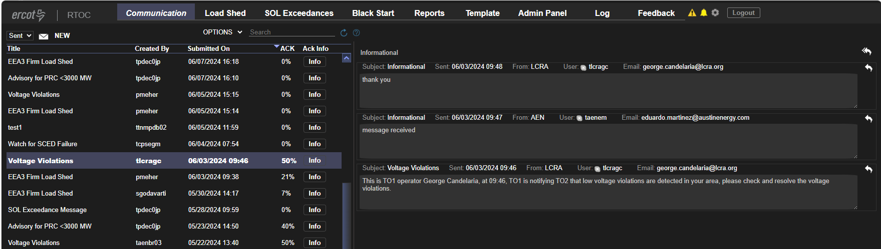
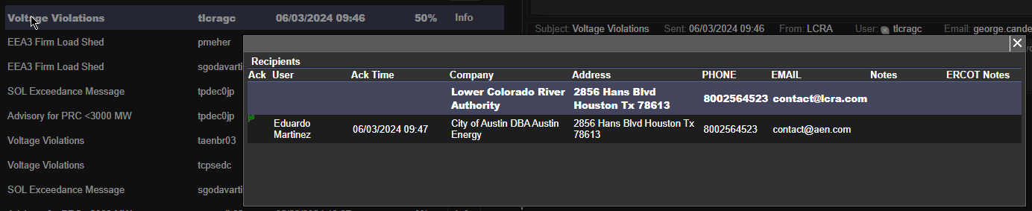
Features in the Tool
The following displays are expected to be built in the tool
  Communications
    Based on predefined templates (example: load shed template)
    Will follow the design of the one used in the POC but will be enhanced with additional features and improvements

Slide 7
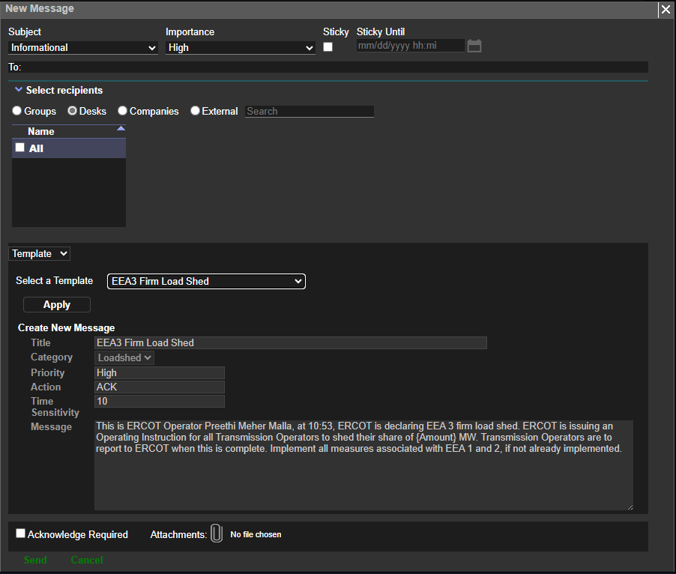
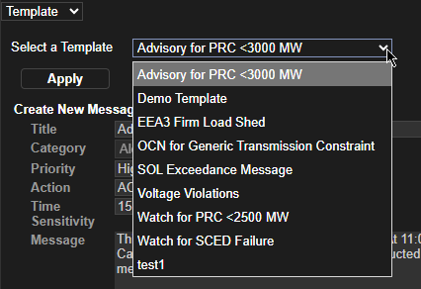
Features in the Tool
    Ability to send message to a specific desk (Shift Supervisor, Reliability Unit Commitment, Reliability Risk, Transmission and Security, DC-Tie, Real-Time, Resource)

Slide 8
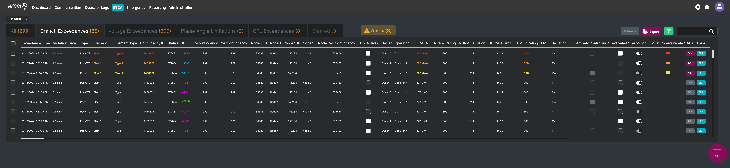
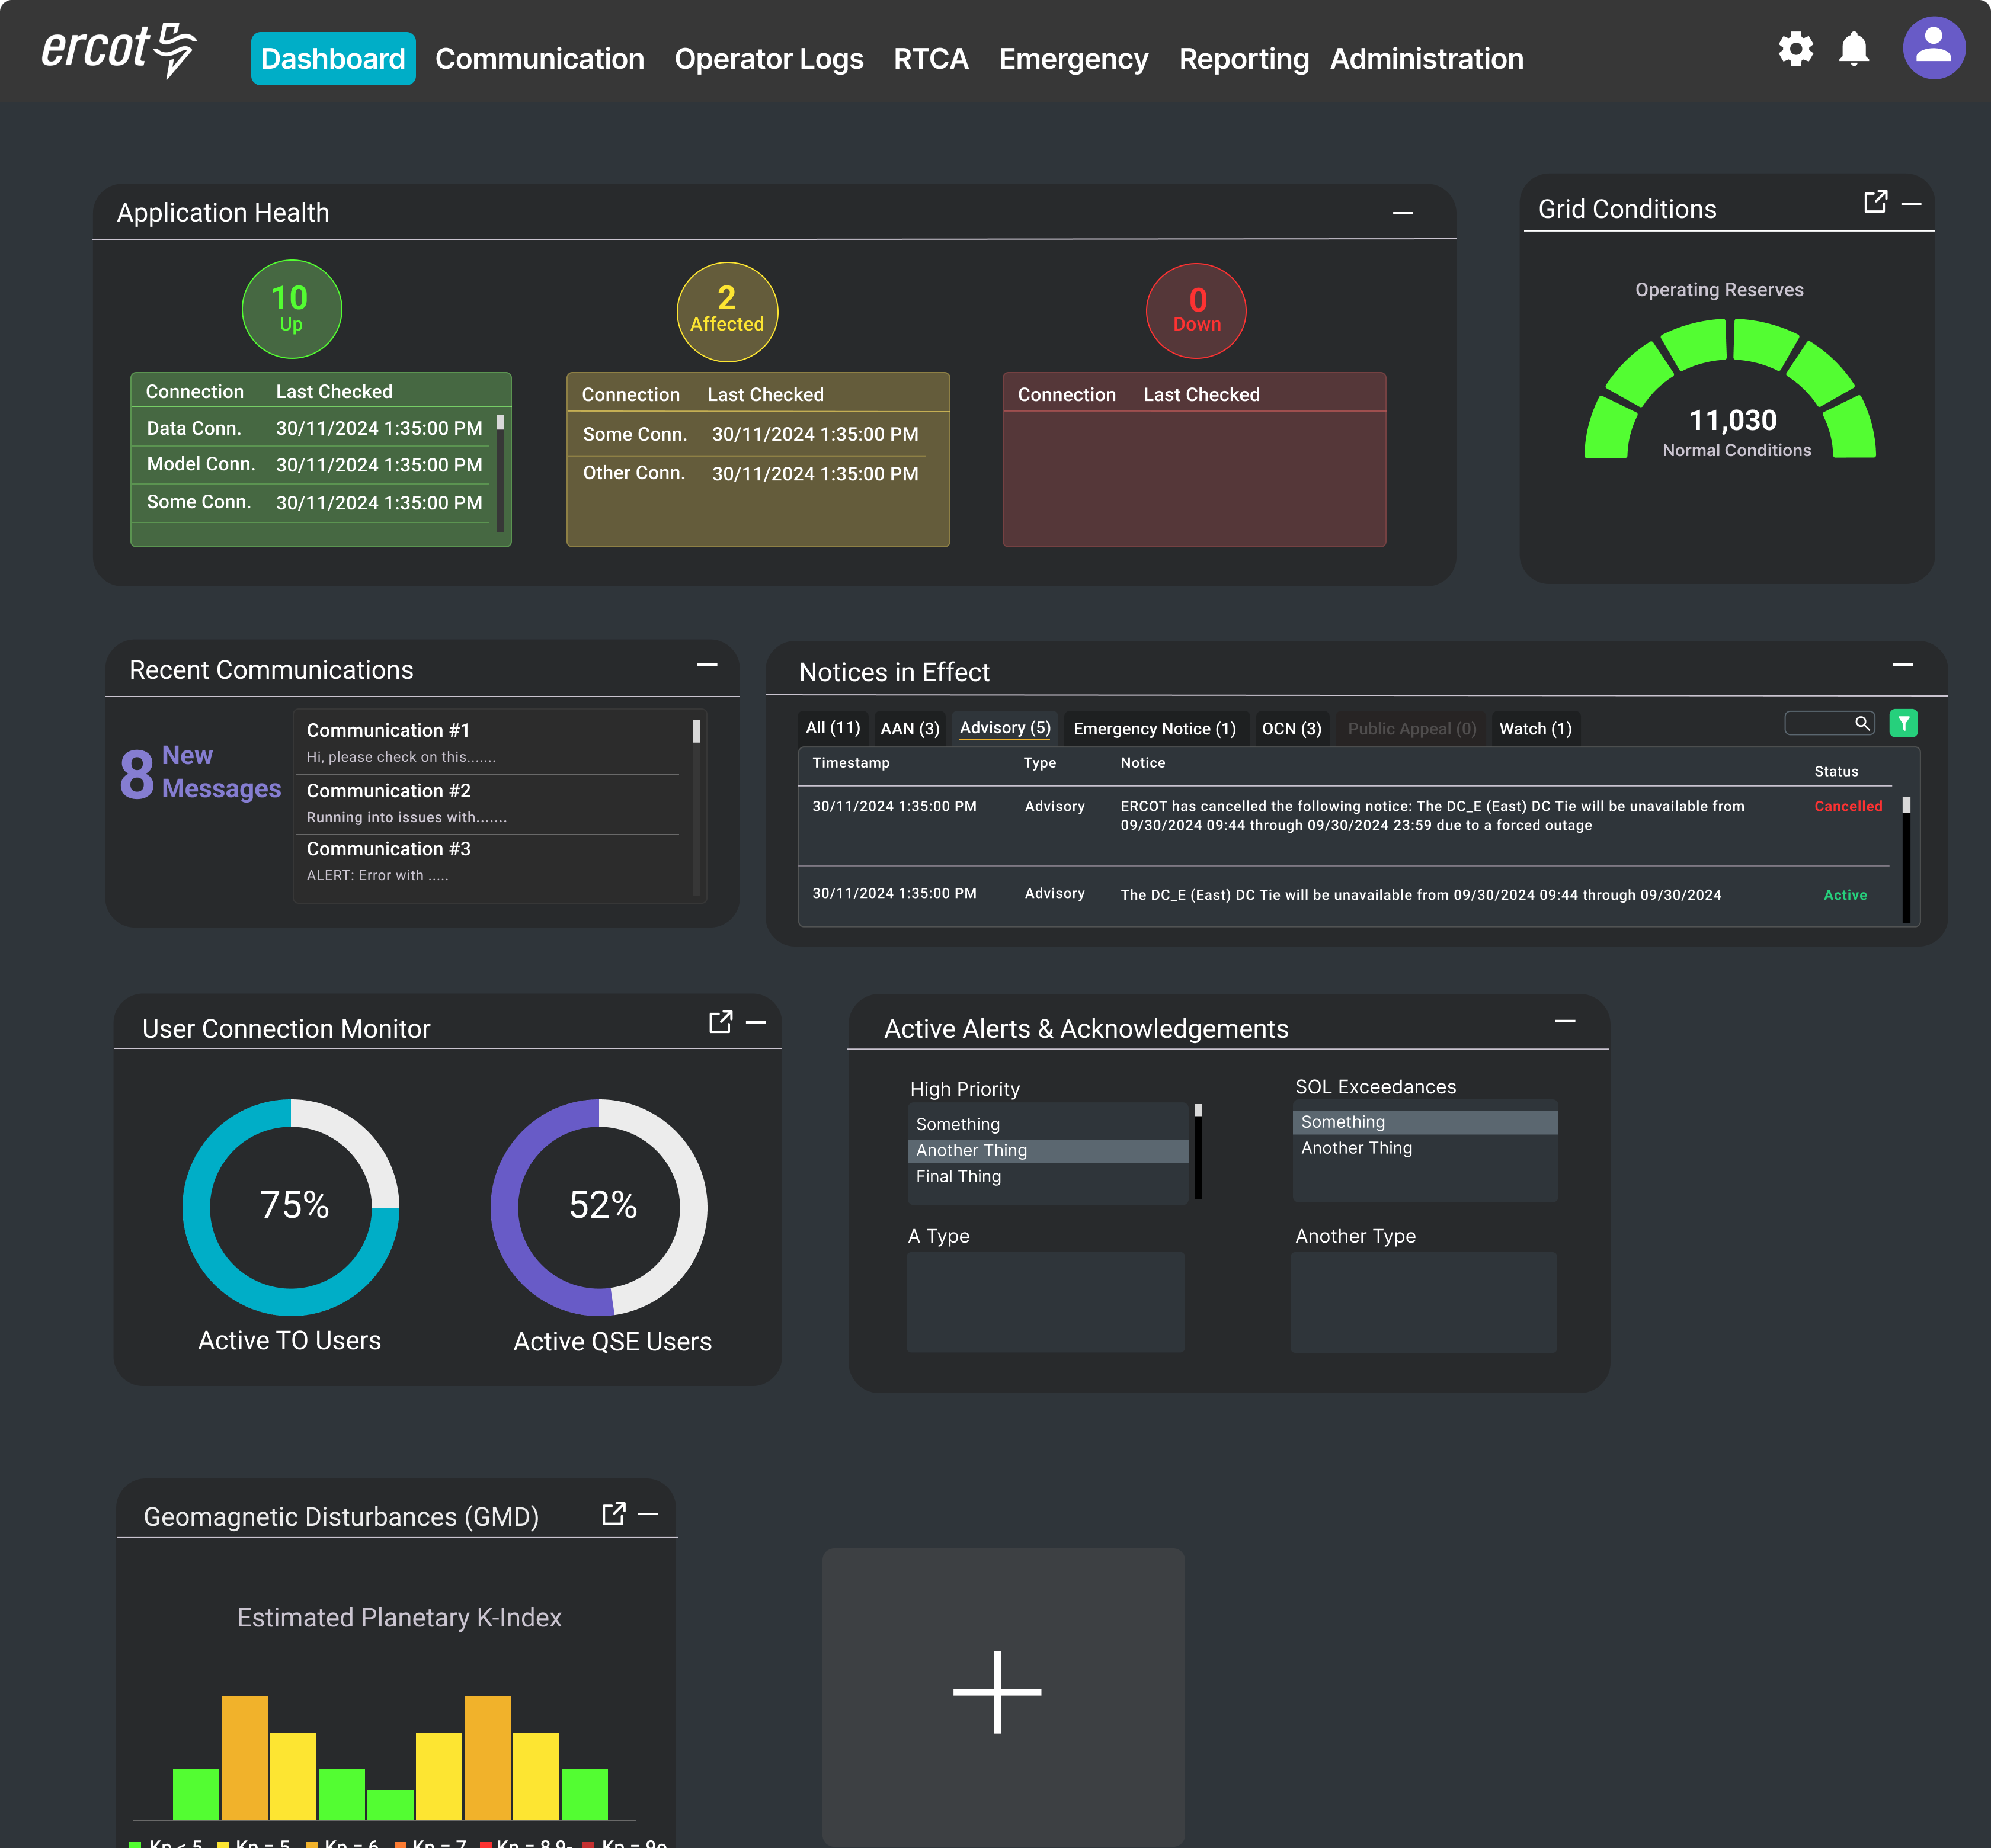
Features in the Tool
  SOL Exceedance
    Enabling users to view/acknowledge constraints on equipment
  Dashboard
    Grid conditions
    Notices in effect
    Recent communications
    Events
    Alerts

Slide 9
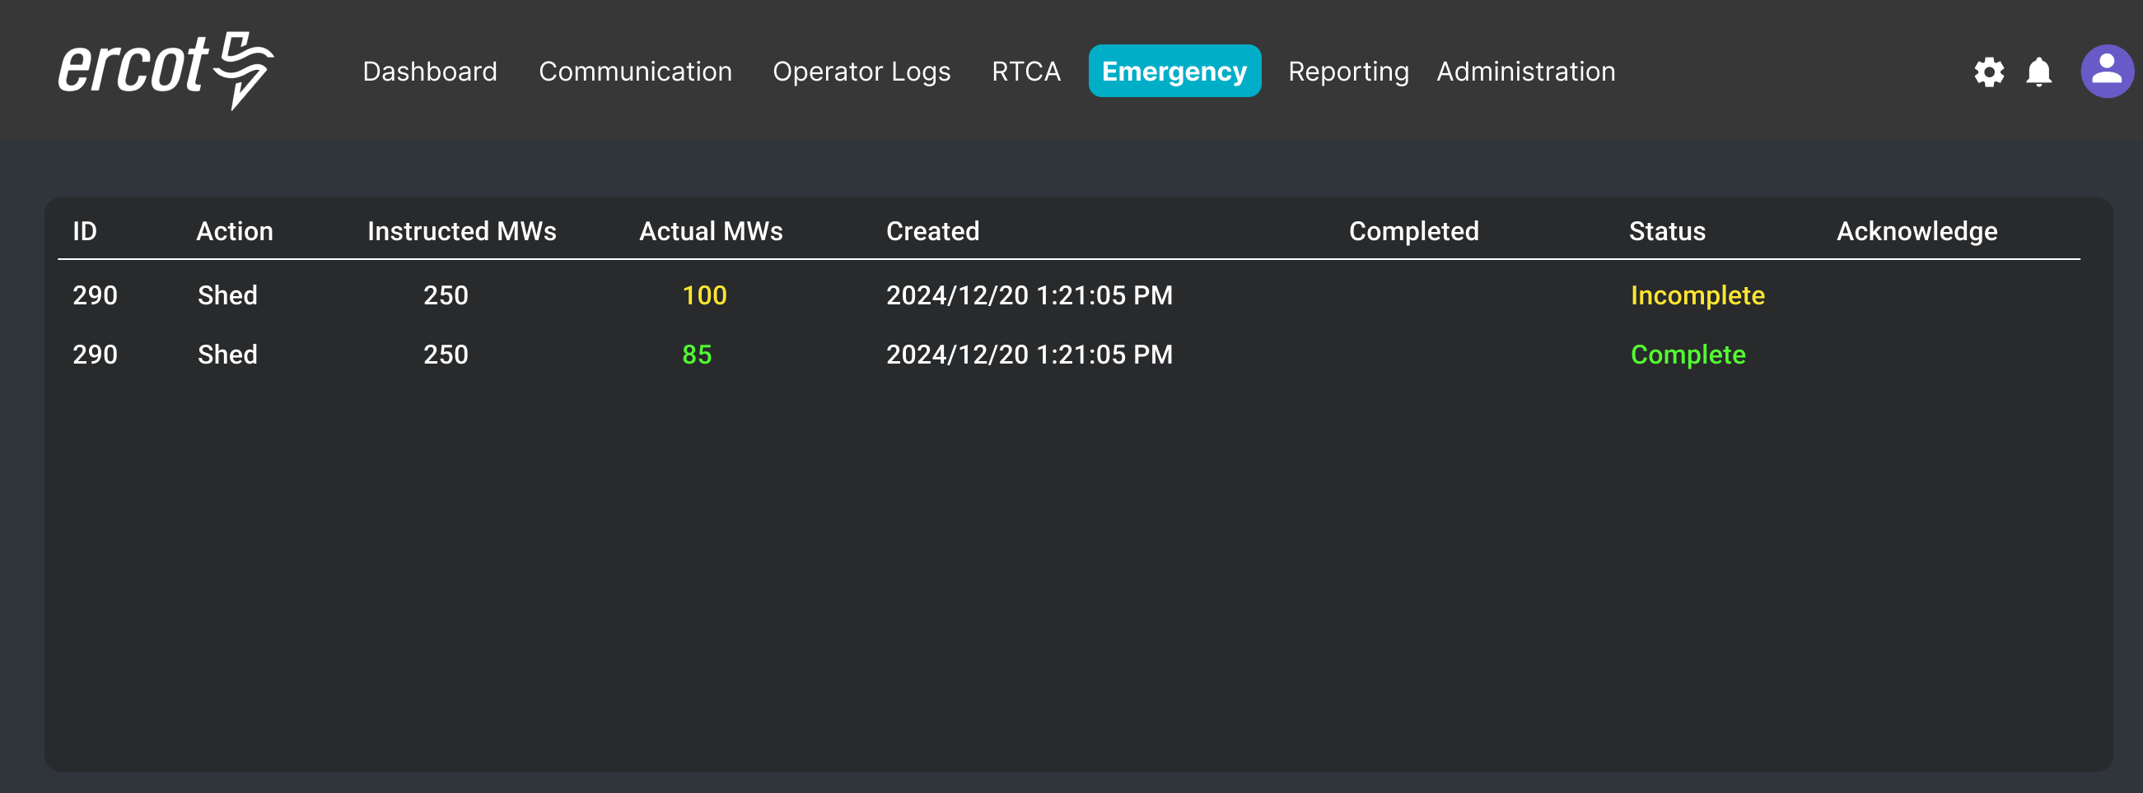
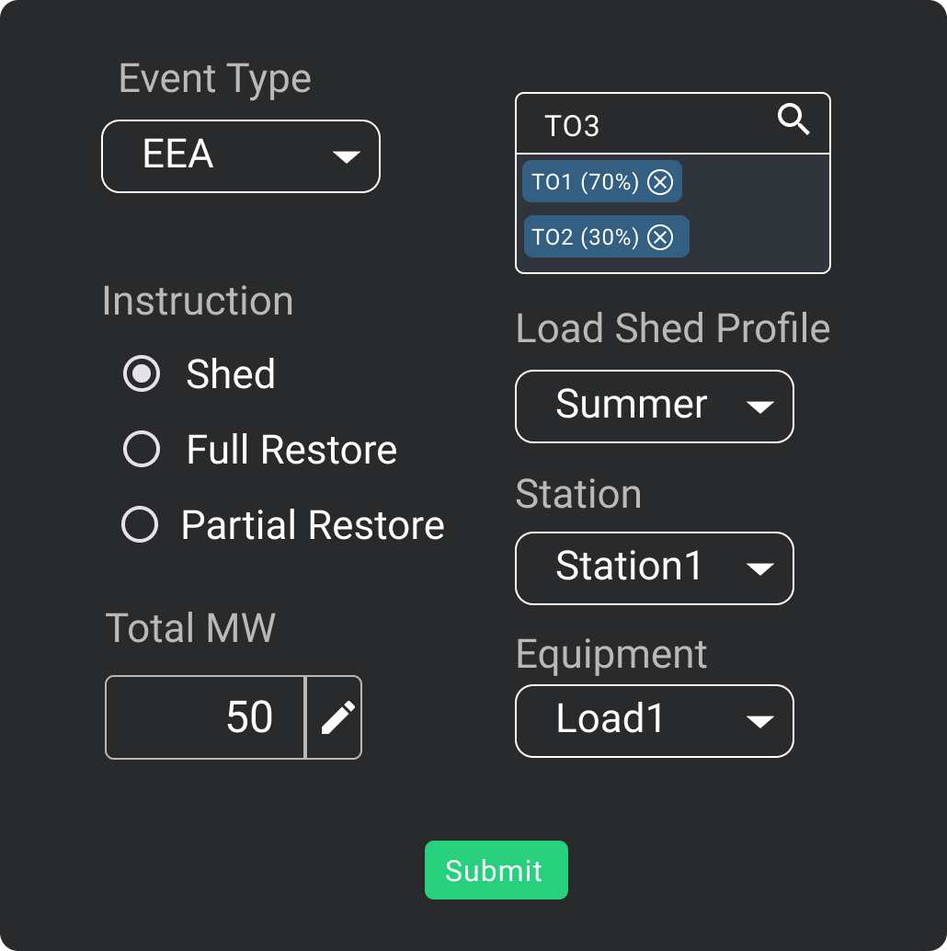
Features in the Tool
  Emergency
    Load shed dashboard

Slide 10
Tool Access
Access control
  Application access will be granted via digital certificates
  A new role must be added to the certificate for authorization

