Slide 1
ERCOT Technology Working Group (TWG)
January 30, 2025

Slide 2
ERCOT TWG
WELCOME

Slide 3
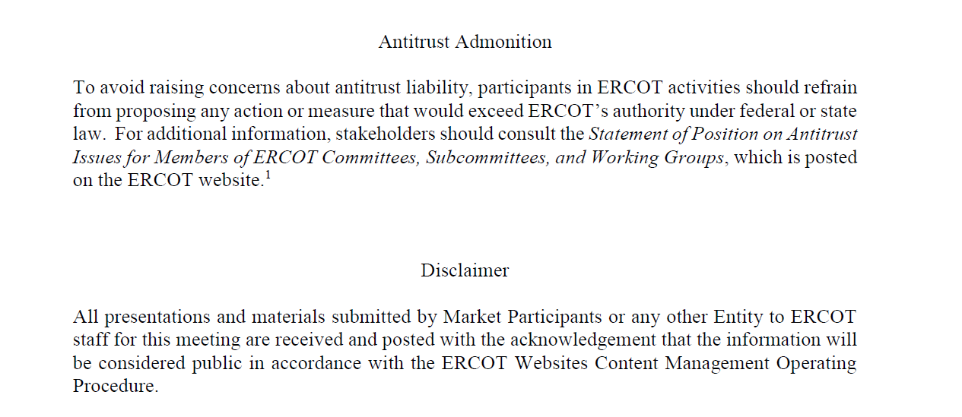
ERCOT TWG

Slide 4
ERCOT TWG Agenda
Item # | Item Description | Presenter | Start Time
1 | Antitrust admonition | Sreenivas Badri | 2:00 PM
2 | Project Updates | Troy Anderson | 2:02 PM
3 | RTC+B Updates Program updates Digital Certs Plan Updates ICCP Telemetry Points Modeling Single Model ESR Names communication to QSEs | Matt Mereness/Sruthi Hariharan/Tejaswi Potluri | 2:10 PM
4 | NPRR1253 – Technical Implementation Approach | Sreenivas Badri/Michael Ackerman | 2:40 PM
5 | CIM16 Schema Upgrade Project – status update | Joel Koepke | 3:00 PM
6 | SCR820 – Real-Time Operator Messaging Tool update | Preethi Meher | 3:15 PM
7 | DPC Automation Process -Technical Implementation Approach | Karthik Gopinath | 3:30 PM
8 | Round Table Discussion Vice-Chair Nominations | Blake Holt (LCRA) | 3:45 PM
9 | Adjourn | Blake Holt (LCRA) | 4:00 PM

Slide 5
Project Updates
Project Updates – Troy Anderson

Slide 6
RTC+B Updates
RTC+B Updates – Matt Mereness/Sruthi Hariharan/Tejaswi Potluri

Slide 7
NPRR1253 – Technical Implementation Approach
NPRR1253 – Technical Implementation Approach – Sreenivas Badri/Michael Ackerman

Slide 8
CIM16 Schema Upgrade Project – status update
CIM16 Schema Upgrade Project – status update – Joel Koepke

Slide 9
SCR820 – Real-Time Operator Messaging Tool update
SCR820 – Real-Time Operator Messaging Tool update – Preethi Meher

Slide 10
ERCOT TWG – Round Table Discussion
ERCOT TWG – Round Table Discussion
  Seeking Vice-Chair Nominations
  Future Topics of Interest
  Topics and presentations from TWG members

Slide 11
ERCOT TWG
Thank You
You can reach Sreenivas at
Sreenivas.Badri@ercot.com and Blake at Blake.Holt@LCRA.ORG

