Slide 1
Demand Side Working Group (DSWG)
ERCOT Update
January 27, 2025
ERCOT Staff

Slide 2
Type of Load associated with ERS Resources and LRs
New requirement for participation
To improve ERCOT’s visibility into the type of Load associated with ERS Resources and LRs, ERCOT will start requiring this information during the respective submission and registration processes
  The types of Loads will be available in a dropdown list
  A draft list has been posted on the 1/27/2025 DSWG meeting webpage for review and comment
    Please send any feedback or questions to ERS@ercot.com and ERCOTLRandSODG@ercot.com
    The completed list will be posted for the next DSWG meeting

Slide 3
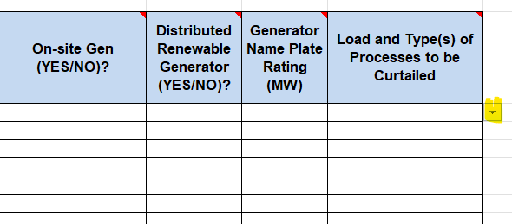
Type of Load associated with ERS Resources and LRs
For ERS Resources:
  The “Load and Type(s) of Processes to be Curtailed” data field (column W) in the ERS Resource ID (ERID) file will be required in both the R tab and the Alt tab
    This field is currently optional
  This requirement will become effective with the ERID submissions for the JUN-SEP 2025 Standard Contract Term (SCT), which will begin on 4/7/2025

Slide 4
Type of Load associated with ERS Resources and LRs
For Load Resources:
  The “Type of Load being served” will be a required field for all new LRs created using the Resource Integration & Ongoing Operations – Interconnection Services application (RIOO – IS)
  This field likely will not be added to RIOO until the 2nd half of this year, and ERCOT will communicate the effective date before it’s implemented
  After the field is added to RIOO – IS, ERCOT will also contact Resource Entities to collect the type of Load for all existing LRs so data can be added to RIOO – Resource Services (RS)

Slide 5
Type of Load associated with ERS Resources and LRs
Reminder to review the list and send any feedback or questions to ERS@ercot.com and ERCOTLRandSODG@ercot.com
    The completed list will be posted for the next DSWG meeting

Slide 6
Summary of DR Activities
NPRR1253 - Incorporate ESR Charging Load Information into ICCP
  During the January 22 TAC meeting ERCOT communicated that upon further review we support the approval of NPRR1253 as recommended by PRS
  Distribute by ICCP and post to the ERCOT Website
  Implement by June 1, 2025
  Also, data currently available through the Energy Storage Resources Dashboard
NPRR1226 – Demand Response Monitor
  Remains tabled at PRS
  Limited development
NPRR1265 – Unregistered Distributed Generator (UDG)
  Evolved out of HB 3390
  Creates Definition for UDG
  Requirement for UDGs to provide information to their respective DSP

Slide 7
Summary of DR Activities
NPRR 1260 - Corrections for CLR Requirements Inadvertently Removed
  Reinstates requirements applicable to CLRs that were inadvertently removed during the process to approve and implement NPRR863 (ECRS)
  TAC Approved
NPRR 1238 - Voluntary Registration of Loads with Curtailable Load Capabilities
  Establishes process by which Loads may inform ERCOT that the Load consumer is willing to curtail in the event of a PRC shortfall
  Assist Utilities during Firm Load Shed events

