Slide 1
ERCOT Frequency Events
November 2024
ERCOT
Operations Planning
PDCWG | January 23, 2025

Slide 2
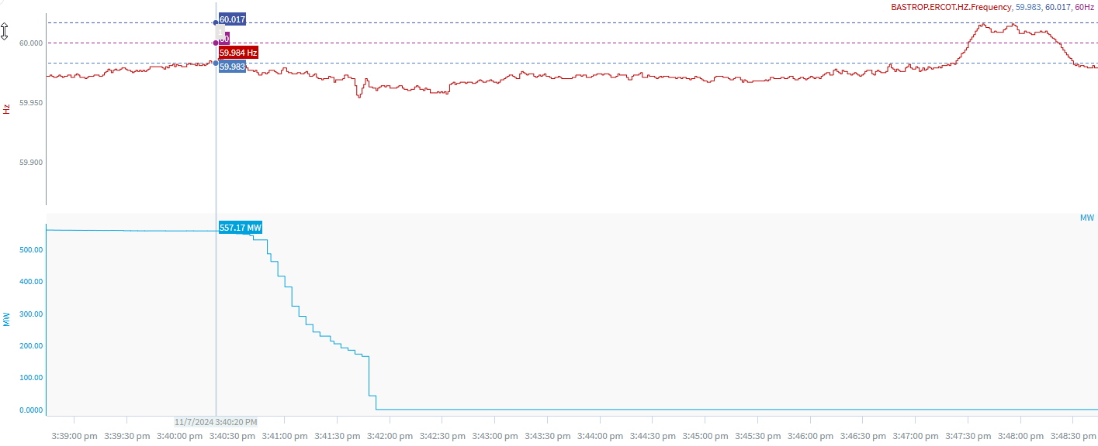
11/7/2024 15:40:20 (Non-FME)
Notes:
The unit experienced runback when carrying ~557 MW and tripped offline while carrying ~ 166 MW
Minimum Frequency: 59.954 Hz
Recovery Time(back to deadband): 5 minutes 41 seconds
ECRS Released: 0 MW
Trip Reason: ID Fan issues
Contextual Information: A total of 543 MW of regulation Up was deployed during the event
No Selection Reason: Unit trip is not clean and small event

Slide 3
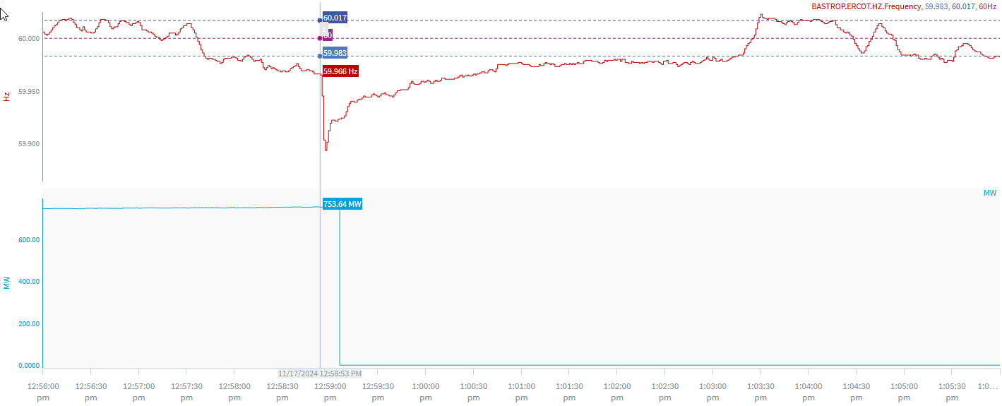
11/17/2024 12:58:53 (Non-FME)
Notes:
The unit tripped for a loss of approximately 754 MW
Starting Frequency: 59.965 Hz
Minimum Frequency: 59.893 Hz
A-C Time : 3 seconds
Recovery Time(back to deadband): 4 minutes 20 seconds
ECRS Released: 476 MW
Trip Reason: Unknown at this time.
Contextual Information: A total of 391 MW of regulation Up was deployed and SCED manual offset of 400 MW was applied during the event.
No Selection Reason: Starting Frequency is outside low deadband

Slide 4
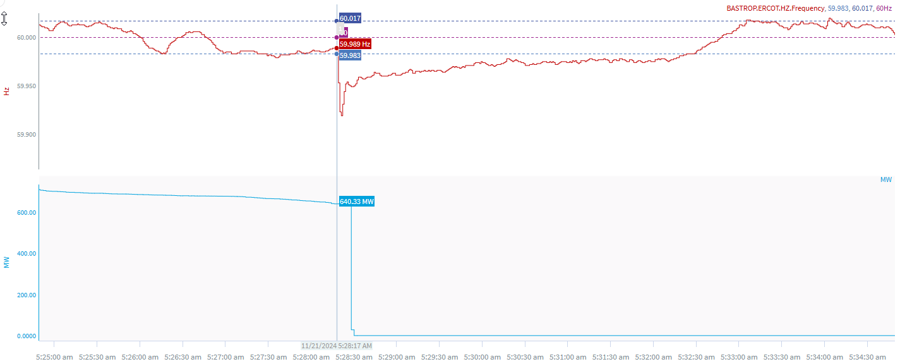
11/21/2024 5:28:17 (Non-FME)
Notes:
The unit experienced runback and tripped offline while carrying ~637 MW
Starting Frequency: 59.989 Hz
Minimum Frequency: 59.921 Hz
A-C Time : 4 seconds
Recovery Time(back to deadband): 4 minutes 6 seconds
ECRS Released: 0 MW
Trip Reason: Instrument air issues
Contextual Information: A total of 387 MW of regulation Up was deployed during the event
No Selection Reason: Frequency is outside low deadband

Slide 5
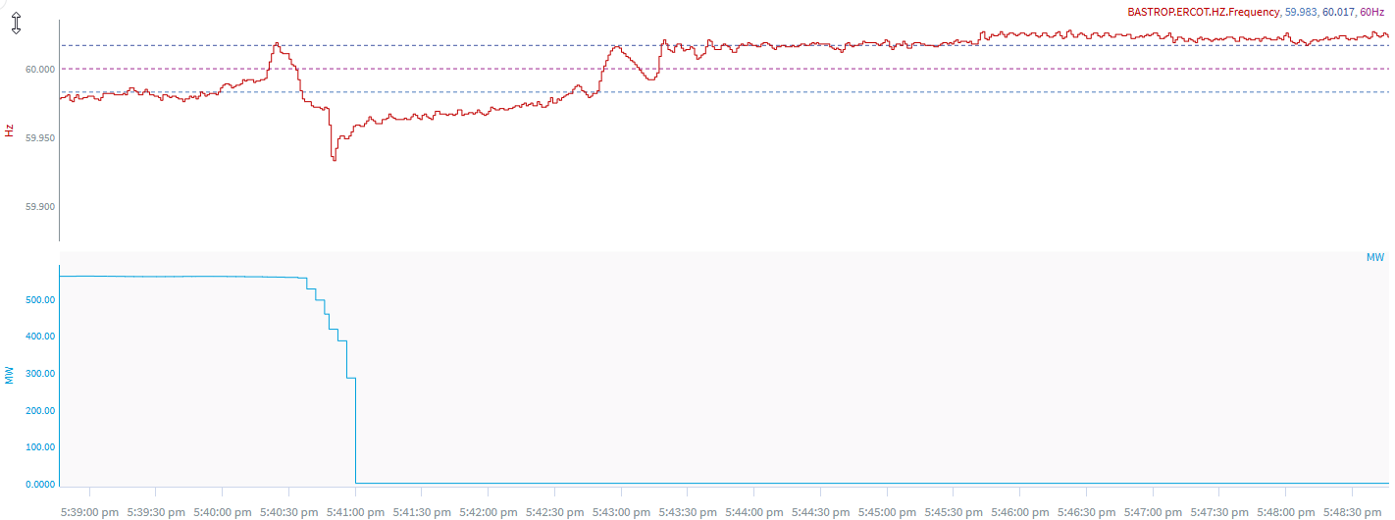
11/23/2024 17:40:46 (Non-FME)
Notes:
The unit experienced runback and tripped offline while carrying ~ 558 MW
Starting Frequency: 59.971 Hz
Minimum Frequency: 59.934 Hz
A-C Time : 3 seconds
Recovery Time(back to deadband): 2 minutes 16 seconds
ECRS Released: 0 MW
Trip Reason: ID fan issue
Contextual Information: A total of 391MW of regulation Up was deployed during the event
No Selection Reason: Frequency is outside low deadband and unit experienced runback

Slide 6
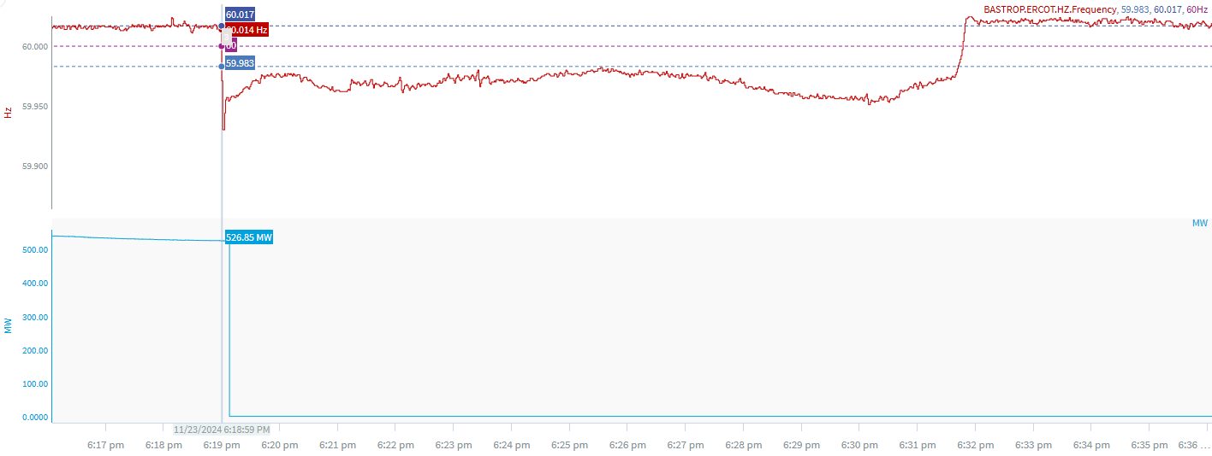
11/23/2024 18:18:58 (Non-FME)
Notes:
The unit tripped offline while carrying ~527 MW
Starting Frequency: 60.014 Hz
Minimum Frequency: 59.930 Hz
A-C Time : 3 seconds
Recovery Time(back to deadband): 12 minutes 44 seconds
ECRS Released: 0 MW
Trip Reason: Due to aux transformer
Contextual Information: A total of 716 MW of regulation Up was deployed during the event
No Selection Reason: C point is 59.93

Slide 7
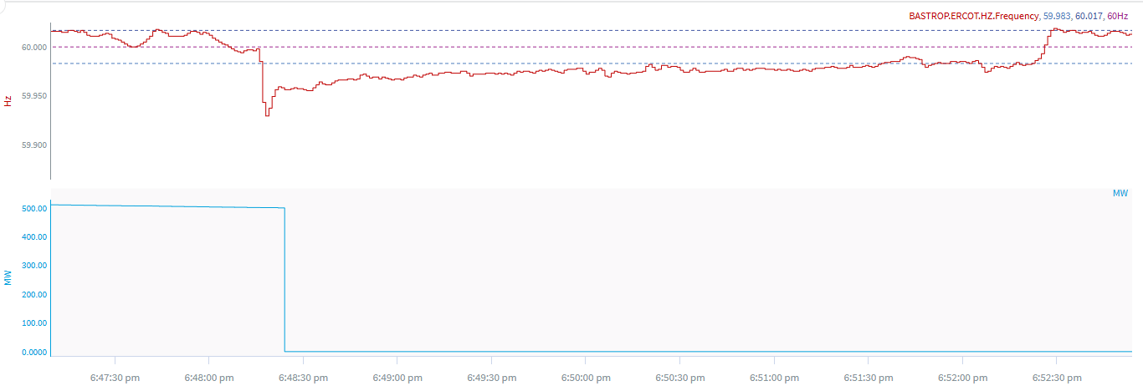
11/23/2024 18:48:15 (Non-FME)
Notes:
The unit experienced slight runback and tripped offline while carrying ~499 MW
Starting Frequency: 59.998 Hz
Minimum Frequency: 59.929 Hz
A-C Time : 3 seconds
Recovery Time(back to deadband): 3 minutes 20 seconds
ECRS Released: 0 MW
Trip Reason: Unknown at this time.
Contextual Information: A total of 177 MW of regulation Up was deployed during the event
No Selection Reason: C point is 59.929 Hz

Slide 8
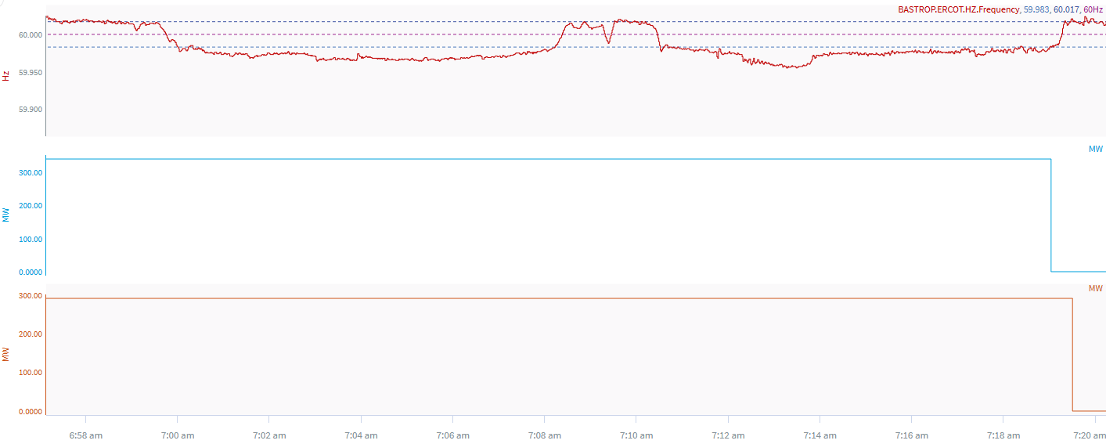
11/27/2024 6:59:36 (Non-FME)
Notes:
The two units tripped offline while carrying a total of ~630 MW
Starting Frequency:
Minimum Frequency: 59.955
A-C Time :
Recovery Time(back to deadband):
ECRS Released: 0 MW
Trip Reason: Unknown at this time.
Contextual Information: A total of 294 MW of regulation Up was deployed during the event.
Unit telemetry failed at the time of the trip and the QSE reported that they have no information when the unit came offline or the manner in which the units came offline.

Slide 9
Questions?
Thank you!

