Slide 1
ERCOT Frequency Events
December 2024
ERCOT
Operations Planning
PDCWG | January 23, 2025

Slide 2
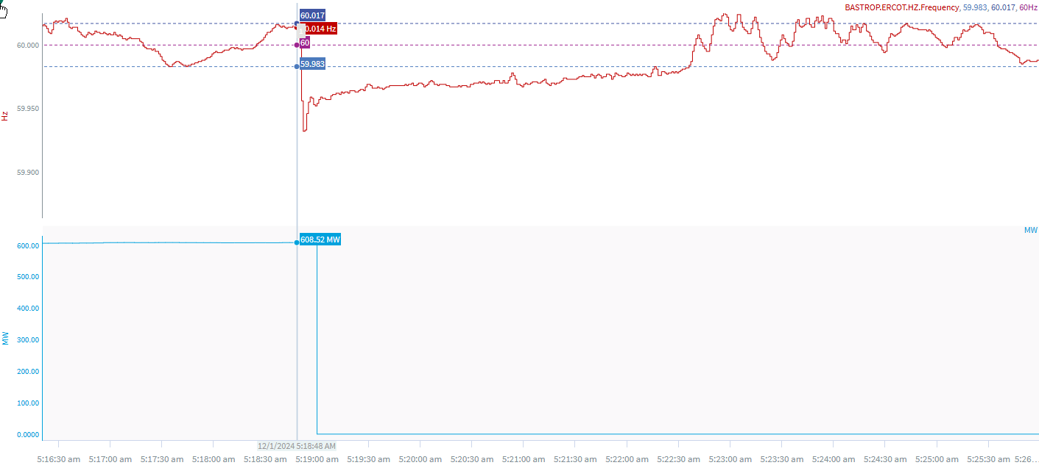
12/1/2024 5:18:48 (Non-FME)
Notes:
The unit tripped offline while carrying approximately 609 MW
Starting Frequency: 60.014 Hz
Minimum Frequency: 59.932 Hz
A-C Time : 4 seconds
Recovery Time(back to deadband): 3 minutes 48 seconds
ECRS Released: 0 MW
Trip Reason: Unknown at this time.
Contextual Information: A total of 255 MW of regulation Up was deployed and SCED manual offset of 300 MW was applied during the event
No Selection Reason: C point is 59.932 Hz

Slide 3
Questions?
Thank you!

