Slide 1
CDR Preparation Update
Pete Warnken
Resource Adequacy
Supply Analysis Working Group
January 24, 2025

Slide 2
Release Update
  Targeting the CDR release during mid-February.
  Another Market Notice will be issued indicating the firm release date.

Slide 3
Overview of New CDR Tabs
  The “Load-Resource Scenarios” tab will show variations in officer letter load amounts and Texas Energy Fund projects not currently reflected as CDR-eligible planned resources.
    Both peak Load and peak Net Load views are included
    Scenarios for both summer and winter
  Revamped Unit Details table (covered later in this presentation)
  New “Installed capacity by Resource Type” table similar to the ones included in the Monthly Outlook for Resource Adequacy reports
  “Wind-Solar County Mapping” tab that lists the counties assigned to each Wind and Solar Fuel Type (Wind-C, Wind-P, Wind-O, Solar-W, Solar-FW, Solar-O)
  “Background” tab.
  “Acronyms” tab (similar to the MORA)

Slide 4
Overview of Modified and “Retired” CDR Tabs
  Modified Tabs:
  The Executive Summary tab has been replaced with a more extensive “Findings & Discussion” tab that includes graphics.
  The “Changes” tab has been shortened to only include the table with “New CDR-Eligible Resources.”
    Other significant changes relative to the prior CDR are now documented in the Findings & Discussion tab.
  Retired Tabs:
  “Decommissioned Gen. Resources”
    To be replaced with quarterly Decommissioned Resource report
  “Fuel Type Capacity Mix”
  “Unconfirmed Retirement Capacity”
  “Fossil Fuel SODG Capacities”
    Another NPRR is planned to address fossil fuel SODG capacity contributions among other desired CDR changes; these resources will be included in the Unit Details tab.

Slide 5
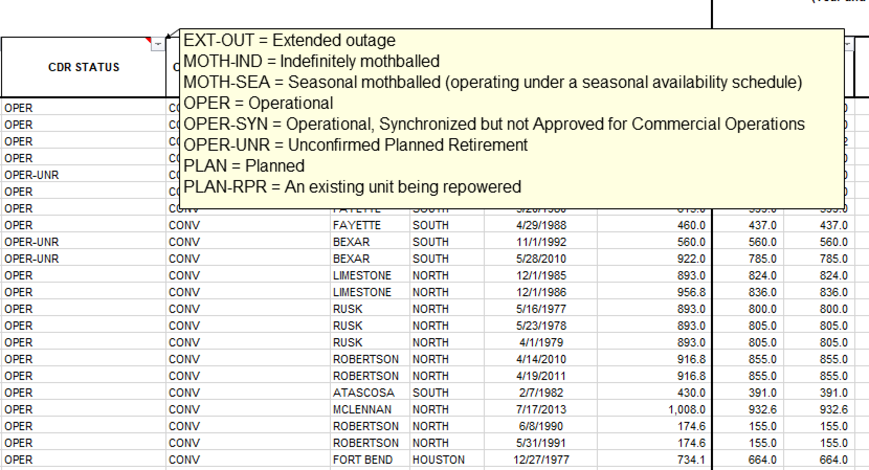
Unit Details: CDR Status Codes

Slide 6
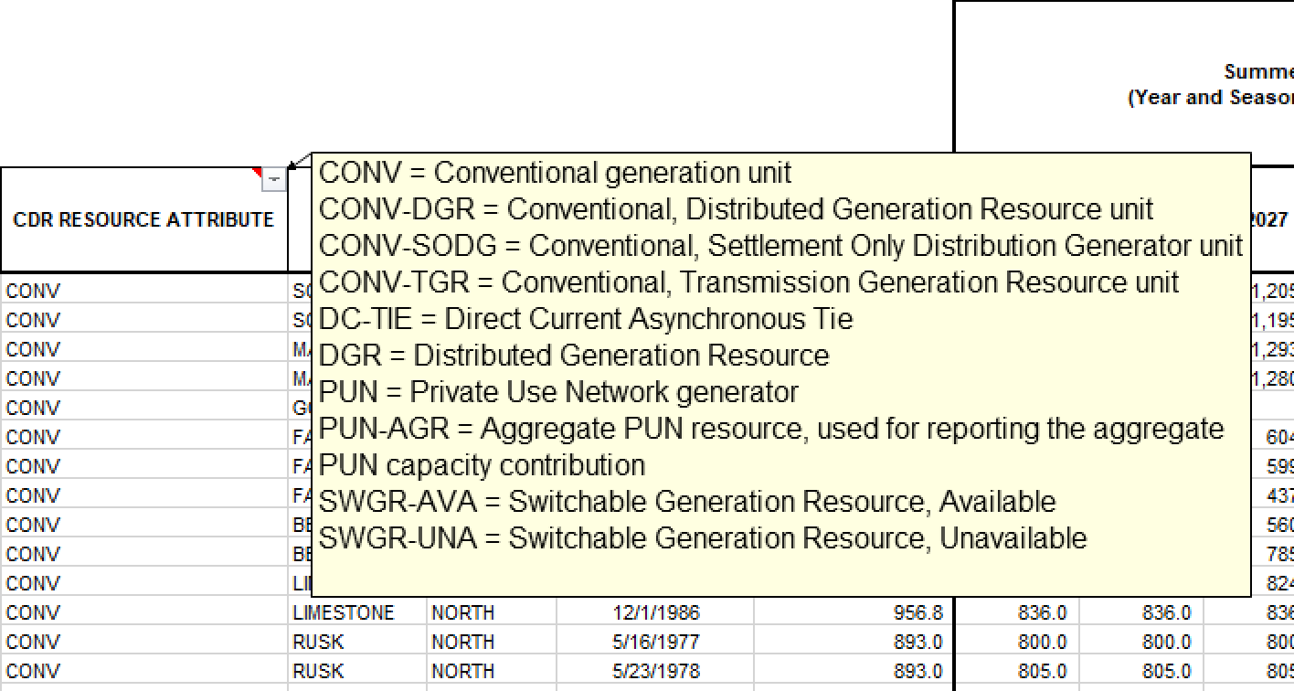
Unit Details: Resource Attribute Codes

Slide 7
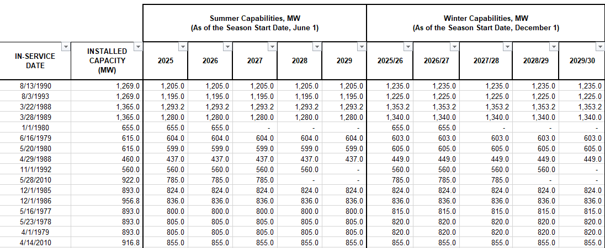
Unit Details: In-Service Dates and Consolidated Seasonal Reporting

