Slide 1
BAL-001-TRE-2 PFR Responsibility Exclusion Process Update
ERCOT Staff
IBRWG| January 17th, 2025

Slide 2
BAL-001-TRE-2 PFR Exclusion
Requirement 9.3 and 10.3 in the BAL-001-TRE-2 NERC Reliability Standard allow the Balancing Authority to exclude a generating unit’s initial and sustained PFR performance during a Frequency Measurable Event (FME) from the rolling average calculation due to a legitimate operating condition that prevents the normal PFR performance.
Per ERCOT Nodal Operating Guide Section 2.2.8 (2), the Market Participants shall request an exemption from, or correction of, performance during an FME within 30 days of the MIS posting date of the Initial and Sustained Frequency Response Unit Performance report
The BAL-001-TRE-2 PFR Responsibility Exclusion Process document is posted on Compliance in ERCOT site.

Slide 3
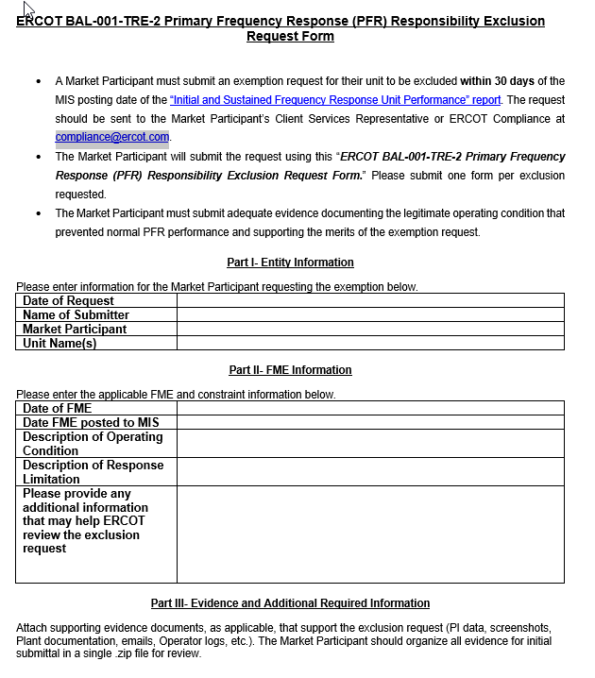
What has changed
During the annual review of the BAL-001-TRE-2 exclusion process, ERCOT added “BAL-001-TRE-2 Primary Frequency Responsibility Exclusion Request Form” to the existing process document.
With the new process, the MPs are expected to use the form to submit the exclusion requests along with supporting evidence documents to the MPs Client Service Representative or ERCOT compliance at compliance@ercot.com.

Slide 4
Questions?

