Slide 1
CRR Updates and Annual CRR Activity Calendar Review
Samantha Findley
CRR Market Operations
CMWG
January 16, 2025

Slide 2
Agenda
LTAS transactions and solution times
Continuation of CRR auction transaction limits discussion
Draft – Annual CRR Activity Calendar update

Slide 3
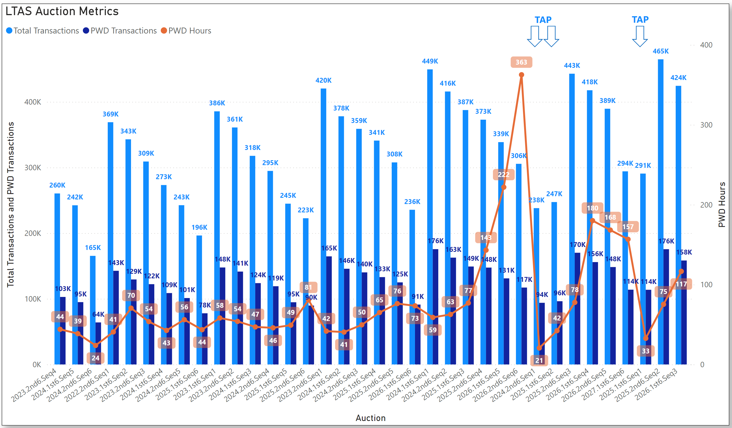
Historical LTAS transactions and solution times

Slide 4
CRR Auction Transaction Limits discussion, cont’d.
As we consider re-design and hardware options, what are the target transaction levels per Counter-Party that ERCOT should be considering?
Currently:
30,000 transactions per Counter-Party per monthly auction
9,000 transactions per Counter-Party per LTAS
Based on feedback, these levels are inadequate for many companies.
What is the business case for more transactions?
Said another way… Why are the current transactions not enough?
What is the desired outcome? 10% more, 50% more, 10x more?
Said another way… What should ERCOT be building toward?
Some opinions at ERCOT are that we may already have adequate liquidity and need to be more focused on growth of settlement points and increased market participants, and that’s why we are asking these questions.

Slide 5
Update on CRR NPRRs in progress
NPRR1261 Operational Flexibility for CRR auction limits will go to TAC on January 22.
https://www.ercot.com/mktrules/issues/NPRR1261
Until NPRR1261 is implemented, 3,000 limit will be used for all LTAS auctions.
ERCOT is working with the vendor to get IAs for NPRRs for Removing Multi-month Bidding functionality and Option Pricing Report.
It’s worth noting that NPRR749 was implemented in 2019 to provide clearing prices for all CRRs in baseload after each auction. The updated ShadowPricePerMWH can be found in the Baseloading report for each auction after auction results are posted. The Baseloading report is in the CRR MUI and is also posted with CRR Auction Results on MIS public.

Slide 6
CRR activity calendar – overview
Protocol 7.5.1(4)(c) requires ERCOT to post an updated calendar no later than April 1 of each calendar year
Each calendar includes auction activity dates for the remainder of the current calendar year and for the two subsequent calendar years
The calendar must be approved by WMS prior to the annual posting
Would like feedback today from CMWG on the draft calendar before seeking final approval from WMS on February 5

Slide 7
CRR activity calendar – general reminders
The model build process begins 3 weeks prior to the model posting date (get outages and Common Information Model snapshot)
Added a 3rd week at the beginning of 2023 due to changes to model build tools
We hold a monthly auction and a long-term auction every month of the year
Typical pattern is monthly auction bid window in the first half of the month followed by the long-term auction bid window the very next week (occasionally, there will be a one-week gap to avoid holidays)
Monthly auction results are posted one week after the bid window closes; long-term auction results are posted two weeks after the bid window closes

Slide 8
CRR activity calendar – general reminders
There are two additional tabs on the calendar
“Calendar Protocol References” includes any specific protocol sections related to the selection of dates
“PCRRs” contains activity dates and protocol sections related to the annual PCRR allocation process

Slide 9
CRR activity calendar – description of changes
Current calendar goes through the 2027.MAR.Monthly.Auction
Draft dates cover CRR activities through the 2028.MAR.Monthly.Auction
Applied the same patterns to assign the dates as have been used for previous calendars to maintain Protocol requirements and consistency
PCRR-eligible NOIEs are encouraged to view the dates on the “PCRRs” tab of the calendar

Slide 10
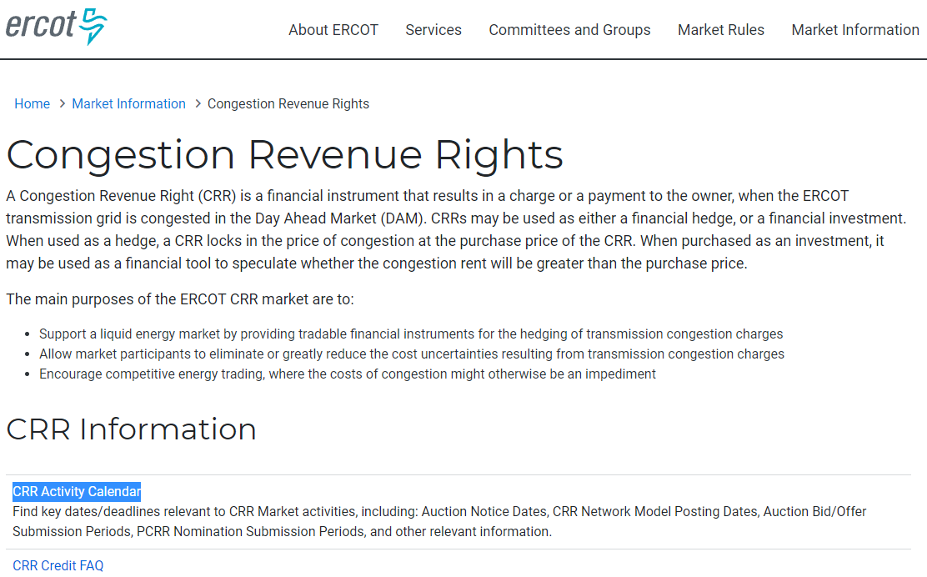
CRR activity calendar – next steps
Will take to WMS for final approval on February 5
Last chance to get WMS approval will be on March 5
Approved calendar will be posted on the CRR webpage by April 1

