Slide 1
How Wholesale Storage Load (WSL) will be treated in Load Forecasting … Once the RTCB project Goes Live
ERCOT Staff
January 14, 2025
RTCBTF

Slide 2
Background:
During the discussion on the agenda item “WSL Treatment in Load Forecasts” at the 12-10-24 WMWG meeting ….. questions, concerns and suggestions surfaced on this topic in consideration of the RTCB project.
It was noted during the 12-10-24 meeting that currently (in the Combo Model World) the charging consumption by batteries is included in the load forecast (MTLF) and GTBD. Also note the 4-CP prediction challenges this summer and NPRR1253.
This short slide deck presents how the WSL (charging consumption) is treated in Load forecast (MTLF) and GTBD will be different once the RTCB project (single model ESR construct) is implemented.

Slide 3
Typical One-Line (Battery and Other Generation Resources) Current Approach = Combo Model
138 kV
34.5 kV
M2
M1
GR4-esr
SS_AUX
WGR 2
WGR 1
CLR4-esr

Slide 4
Typical One-Line (Battery and Other Generation Resources) [with Single Model] {After RTCB Go-live}
34.5 kV
M2
138 kV
SM Pseudo Switch
M1
Substation Name
ESR1
WGR 2
WGR 1
SS_AUX

Slide 5
Implementation of the Single Model ESR
Once the single model ESR approach goes live …… the GR-esrs and the CLR-esrs that are currently being used represent the batteries ---- will no longer exist. Each GR-esr and CLR-esr pair is replaced with a single model ESR. For each single model ESR, there will be a metered/calculated value for the ESR charging consumption and a metered/calculated value for the ESR injection.
One of the benefits of moving to the single model ESR construct ….. is that once implemented, the charging consumption values of single model ESRs will not be included in the ERCOT Load estimate in the Midterm Load Forecast (MTLF) as well as in the GTBD.

Slide 6
Information on the implementation of the Single Model ESR
RTCB Calculation:
Input to MTLF by weather zone:
Load for the weather zone = GR_NETMW + ESR_NETMW – Export from Weather Zone + Import into Weather Zone
GR_NETMW
The sum of the output from the Generation Resources. Once the single model ESR is implemented, this term will NOT include any injections from the ESRs ------ since the ESR will no longer be seen as a Generation Resource and a Controllable Load Resource.
ESR_NETMW
The sum of the ESR injections and the ESR withdrawals. This can be a negative number or a positive number. (ESR injections are positive numbers and ESR withdrawals are negative numbers.)
“Export/Import from/into Weather Zone”: Assume = “0” to make the example easier

Slide 7
Simple Illustrative Example (With RTCB implementation)
Given:
“True” Load is 300 MW
3 Generation Resources
2 Energy Storage Resources
Load for the weather zone = GR_NETMW + ESR_NETMW - Export from Weather Zone + Import into Weather Zone
RTCB Implentation Live (with single model ESR)
GR1 | 100
GR2 | 75
GR3 | 118
ESR 4 | 25
ESR 5 | -18
GR_NETMW | 293
ESR_NETMW | 7
Load Forecast | 300
Note that the Load Forecast is aligned with the 4-CP “forecast”. Charging Consumption is not included in the Load Forecast and not included in the 4-CP “forecast”.

Slide 8
Just for a reference …… (Today with Combo Model)
Given:
“True” Load is 300 MW
3 Generation Resources
2 Energy Storage Resources ---- but the 2 ESRs are modeled as two pairs of a GR and CLR
Load for the weather zone = GR_NETMW + ESR_NETMW - Export from Weather Zone + Import into Weather Zone
COMBO World To be retired upon RTCB Go-Live
GR1 | 100
GR2 | 75
GR3 | 118
GR4 - esr | 25
GR5 - esr | 0
CLR4-esr | 0
CLR5-esr | 18 | consumption
GR_NETMW | 318
Load Forecast | 318
This term does not exist today.
Today, this term includes injections by batteries since they are seen as GRs. (GR4 and GR5).
Note that the Load Forecast is NOT aligned with the 4-CP “forecast”.

Slide 9
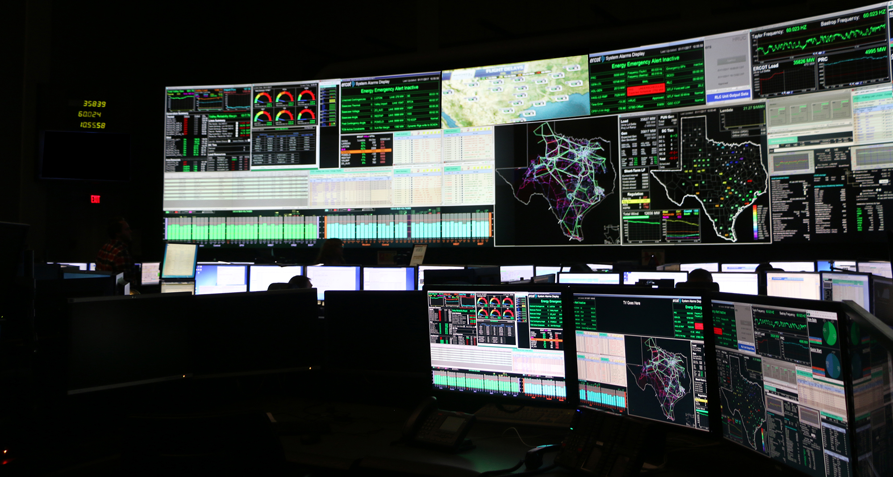
Questions:

