Slide 1
ASDC Study
Andrew Reimers, Jonas Kersulis
ERCOT IMM
RTCBTF
January 14, 2025

Slide 2
Introduction
Under Real-Time Co-optimization, the Ancillary Service Demand Curves (ASDCs) reflect the penalty price for going short on AS relative to volumes defined by the AS Plan
At November RTCBTF, IMM presented initial results demonstrating improved pricing and reliability outcomes resulting from AORDC disaggregation via “blending” as compared to KP 1.1(5)
Feedback:
  Implement suggested adjustments to blended ASDCs based on stakeholder feedback
  Run larger studies to build confidence in results. Capture long-term trends and seasonality
  Post solution data for stakeholder scrutiny

Slide 3
Suggested ASDC Adjustments
Adjust max prices to increase demand gap between RegUp/RRS and ECRS/Non-Spin:
(Note that Undergeneration penalty price is always equal to offer cap + highest ASDC price.)
Adjust MCL partitioning parameters to shift additional demand from ECRS and Non-Spin to RRS:
Product | IMM Max Price ($/MWh) | Adjusted Max Price ($/MWh)
RegUp | 5,250 | 9,052
RRS | 5,100 | 7,051
ECRS | 5,050 | 5,050
Non-Spin | 5,000 | 5,000
Parameter | IMM Value | Adjusted Value
RegUp Percent | 0.9 | 0.9
RRS Max Percent | 0.8 | 0.9
ECRS Max Percent | 0.3 | 0.3
ECRS Min MW | 200 | 40
Non-Spin Min MW | 100 | 10

Slide 4
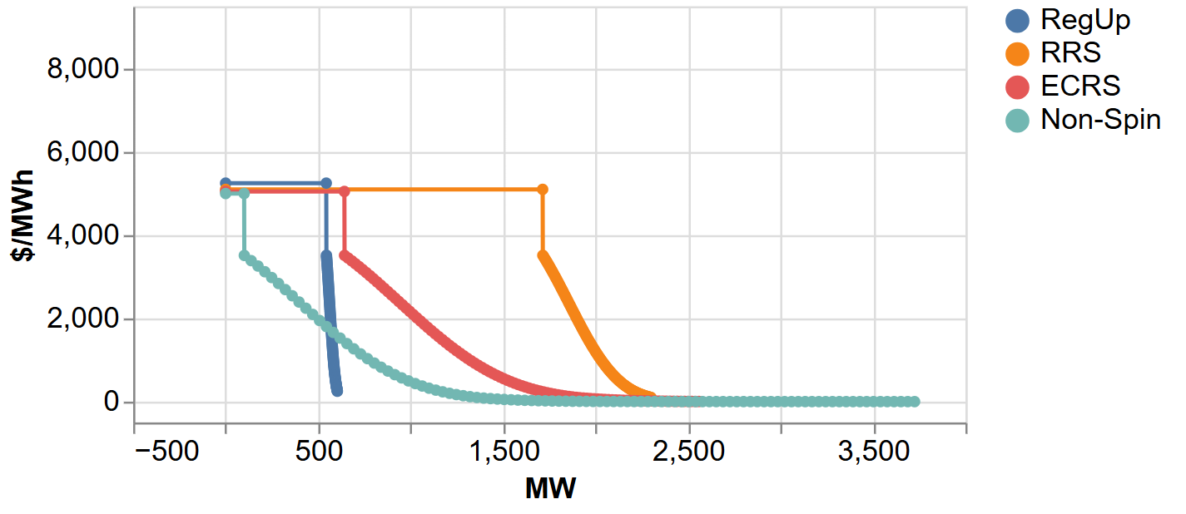
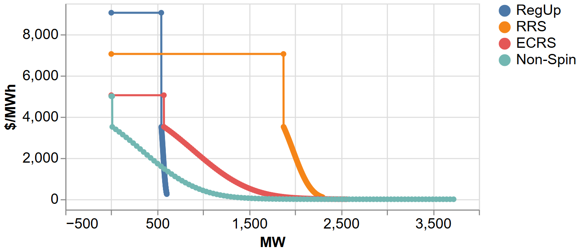
IMM vs Adjusted ASDCs: Example
Requirements per 8/19/24 1900 AS Plan
Top: IMM Blended ASDCs
Bottom: Adjusted Blended ASDCs based on stakeholder feedback

Slide 5
Methodology for AS Proxy Offers
Because we are using historical market data prior to implementation of RTC, resources often have incomplete or nonexistent offer curves for AS. Thus, proxy offers have to be constructed for simulating SCED RTC
Study was run with two AS Offer proxy methodologies:
  Proxy price based on 95th percentile of ASDC
  $0/MWh flat price
Method 1 was initially chosen to reflect stakeholder input on proxy offers for AS. This methodology made it difficult to isolate the effects of ASDC shape on price and procurement volumes
To remove confounding effects of proxy offers on price and procurement volumes, all results in this presentation are based on the $0/MWh proxy offer methodology
This decision was made based on experimental design principles and should not be construed as insistence on one AS proxy offer methodology over another. These analyses are meant to focus on the effects of ASDCs and not the effects AS proxy offer methodology

Slide 6
SCED Intervals Included in Study
Study 1: 3,000 intervals.
  Time ranges selected based on highest time-weighted System Lambda
  Coverage of 8 (out of 20) days highlighted by Luminant, and 8 (out of 23) highlighted by LCRA
Study 2: Daily single interval
  Time range: 6/10/23 (ECRS go-live) thru 12/31/24
  18:55 selected based on highest time-weighted System Lambda
  These results were only produced using Method 1 for AS Proxy offers and are not included in the following slides
System-level results for both studies to be posted publicly by the end of this week
Time Range | Purpose | Intervals
Jan 2024 0600 – 0800 | Winter Morning Ramp | 751
Jan 2024 1700 – 1900 | Winter Evening Ramp | 741
April 2024 1900 – 2100 | Shoulder Evening Ramp | 764
August 2024 1900 – 2100 | Summer Evening Ramp | 761
 | Total: | 3,017

Slide 7
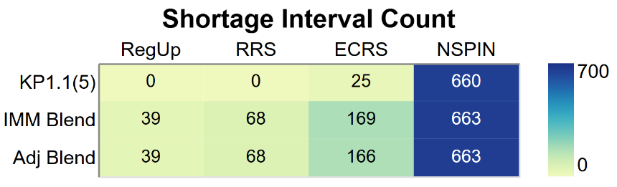
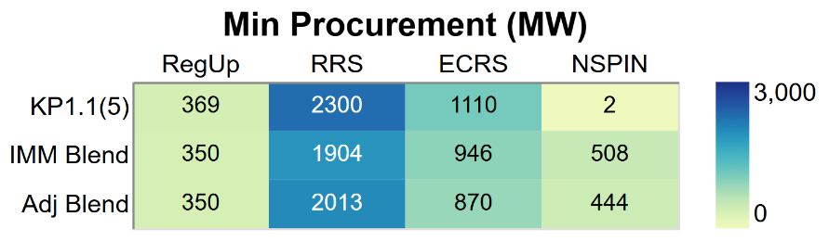
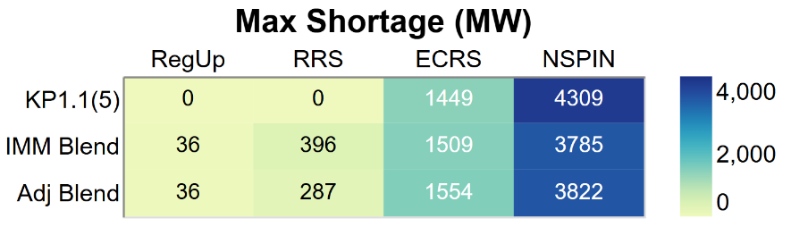
Results: Procurement Volumes for AS
The biggest differences are between KP1.1(5) and the two sets of blended curves. KP1.1(5) tends to produce larger NSPIN shortages on average and lower shortages of other AS products
Main difference between IMM and adjusted blended curves is lower shortages of RRS and Reg in the adjusted curves
No shortages for energy in any of the intervals tested
Notes:
6 MW of Non-Spin are needed to procure an additional MW of Energy.
Differences may be determined by ramp rate, location?

Slide 8
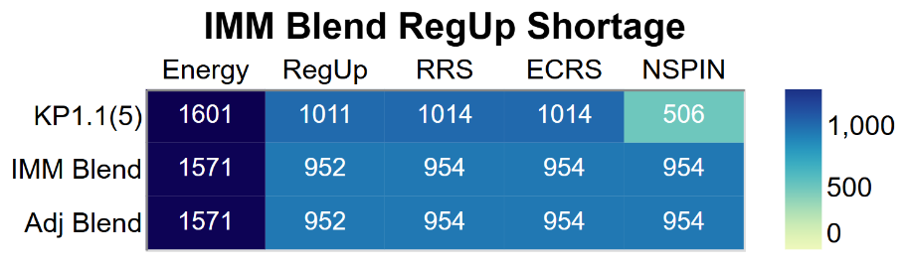
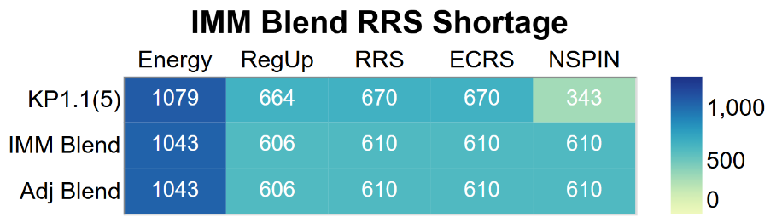
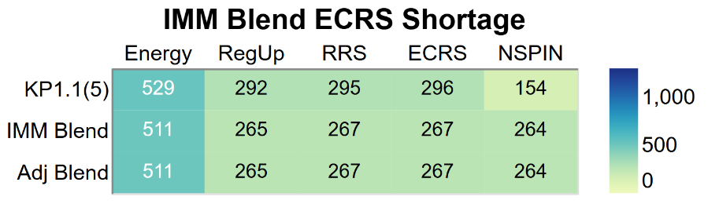
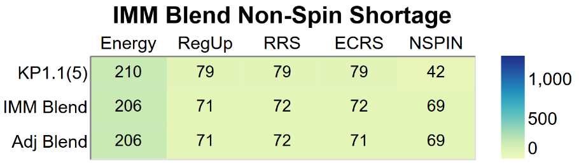
Results: Pricing for Energy and AS
Averages presented in each table refer to SCED intervals in which a shortage of the referenced product was present in the solution associated with the the IMM blended curve
Average prices for energy and most AS products during shortage are slightly lower for both sets of blended ASDCs than for KP 1.1(5) curves
NSPIN shortage prices are higher on average for the blended curves than for KP1.1(5) curves
Average price differences between the two sets of blended curves are de minimis
Energy price difference between KP1.1(5) and blended curves is approximately $1/MWh averaged over all intervals, ie, including those without any AS Shortage

Slide 9
Discussion and Conclusions
Blended AS demand curves result in modest decreases in the average cost of energy and most ancillary services
Concurrently, blended curves produce higher prices for NSPIN, promoting revenue sufficiency and resource adequacy
At the extreme, Reg and RRS shortages are expensive enough that SCED never goes that short on them (see minimum procurement)
Thus, blended demand curves improve market performance without sacrificing reliability

