Slide 1
RTC AS Duration parameter Discussion
Topic Introduction
ERCOT Staff
January 14, 2025
RTCBTF

Slide 2
Background
Ancillary Services (AS) are an important mechanism for maintaining the reliability of the ERCOT Interconnection. The importance of AS has grown and continues to grow as variability and uncertainty of both supply resources and demands on the grid continue to increase.
AS are needed to provide supplemental operational capabilities that would not otherwise be provided solely by, or explicitly incented by, the energy market.
AS are procured to satisfy two purposes:
  Meet certain supply and demand balancing related reliability objectives defined in NERC Reliability Standards, and
  Reduce operational risks associated with variability and uncertainty.
Balancing i.e. Frequency Control Related
Operational Risk of Under Commitment of Resources to Meet Demand plus Unexpected Variations Related
Need | AS
Moment-to-moment balancing of supply and demand; respond to imbalances caused by normal variability and 5-minute net load forecast errors | Regulation Service
Arrest frequency decline caused by trip of large unit(s) | RRS
Restore frequency following trip of large unit(s) | ECRS
Need | AS
Reserves that can quickly respond to intra-hour net load forecast errors and/or forced outages | ECRS
Reserves that can respond to multi-hour net load forecast errors and/or forced outages | Non-Spin
Reserves that can respond to long-duration, multi-hour net load forecast errors and/or forced outages (Under Development) | DRRS

Slide 3
NERC Rules continue to apply
 | NERC Reliability Standard | Requirement Summary
Frequency Related | BAL-001-2 R1 | Maintain 12 month rolling average CPS1 score ≥ 100%
 | BAL-001-2 R2 | Average ACE does not exceed BAAL for more than 30 minutes (including during EEA)
 | BAL-003-2 R1 | BA must maintain its annual Frequency Response Measure above its Frequency Response Obligation
 | BAL-002-3 R1.1 | BA must recover frequency to pre-disturbance value within 15 minutes
Reserves Related | BAL-002-3 R2 | BA shall have a plan to maintain contingency reserves to cover the most severe single contingency (MSSC)
 | BAL-002-3 R3 | BA must restore its contingency reserve to at least its MSSC within 90 minutes
Key Takeaway: As is the case today, under RTC, NERC rules requiring ERCOT to restore contingency reserves within 90 minutes will continue to apply.

Slide 4
Grid Needs Driven by Net Load Forecast Error continue to exist
ERCOT relies primarily on Market Participants to commit Resources for any Operating Day.
ERCOT uses Reliability Unit Commitment (RUC) studies to gauge if additional commitments are necessary.
  Under RTC as well, the startup time of thermal Resources is an important factor in determining if ERCOT is able to resolve any commitment issues identified via the RUC process.
  ERCOT will not RUC batteries to solve commitment problems.
An under forecast of Net Load used in these studies can increase Real Time energy needs relative to when the last RUC study that could have made a difference was run.
  These RT energy needs must be met to ensure reliability.
While the tools for forecasting load and intermittent resources are highly sophisticated and constantly improving, there will always be some amount of error that cannot be eliminated.
  Forecast errors are expected to continue to increase in the future with continued growth in intermittent resources.
  Further, analysis of historic data has shown, large under forecast errors in net load forecast do occur and last for several consecutive hours.
  An added complexity of operating with sustained large net load forecast error is that it could result in reserve shortages across longer durations if the state of charge for an ESR or fuel for a dispatchable supplier is limited (e.g., during winter conditions).
  Hence, it continues to be important to study the system’s energy (i.e. MWh) needs across a certain period of time in addition to the MW needs.
Key Takeaway: AS will continue to be needed to manage the risk of large under forecast of net load that can last for a sustained period of time. Hence even under RTC, it is important to specify a duration requirement for AS that takes into consideration the risk of under forecast in net load for sustained period of time.

Slide 5
Some Facts related to Duration
The table summarizes AS duration as specified under current RTC protocols.
  Worth noting, current protocols are silent on AS duration to be used for DAM and RTC studies.
ERCOT has surveyed several ISOs on their policies related to duration.
  CAISO
    Duration requirement for Real Time energy: 5 minutes
    Duration requirement for Real Time AS procurement including Regulation: 30 minutes
    Duration requirement for DAM & RUC AS procurement: 60 minutes
    Notes (1) in CAISO ESRs are incented to have a duration of 4 hours due to resource adequacy related requirements; (2) duration requirements are designed to stay compliant with WECC rules; (3) CAISO ‘s ESR fleet is comparable to ERCOT
  Rest (MISO, NYISO, NEISO)
    Duration requirement for Real Time energy: 5 minutes
    Duration requirement for Real Time AS procurement including Regulation: 60 minutes
    Duration requirement for DAM & RUC AS procurement: 60 minutes
    NYISO & NEISO’s duration requirements are designed to stay compliant with NPCC rules.
AS Type | Real Time |  | Qualification
 | Duration | Protocol Reference | Duration | Protocol Reference
Regulation Service | 15 minutes | 8.1.1.3.1 (2) | 15 minutes | 8.1.1.2.1.1 (5)
Responsive Reserve Service | 15 minutes | 8.1.1.3.2 (4) | 15 minutes | 8.1.1.2.1.2 (9)
ERCOT Contingency Reserve Service | 2 hours | 8.1.1.3.4 (2) | 2 hour | 8.1.1.2.1.7 (3)*
Non-Spinning Reserve Service | 4 hours | 8.1.1.3.3 (2) | 4 hour | 8.1.1.2.1.3 (8)*
*The current RTC gray boxes in these sections are out of alignment with the monitoring criteria and a future NPRR will correct these.
Key Takeaway: A majority of the ISOs in North America have set 60 minutes as the duration requirement for AS.

Slide 6
Where does this leave us
ERCOT is in the process of studying historic net load forecast error data and comprehending how tools/studies under RTC are expected to evolve to determine if duration requirements under certain processes can be altered.
ERCOT plans to bring its initial recommendation at the next RTCTF meeting.

Slide 7
Appendix

Slide 8
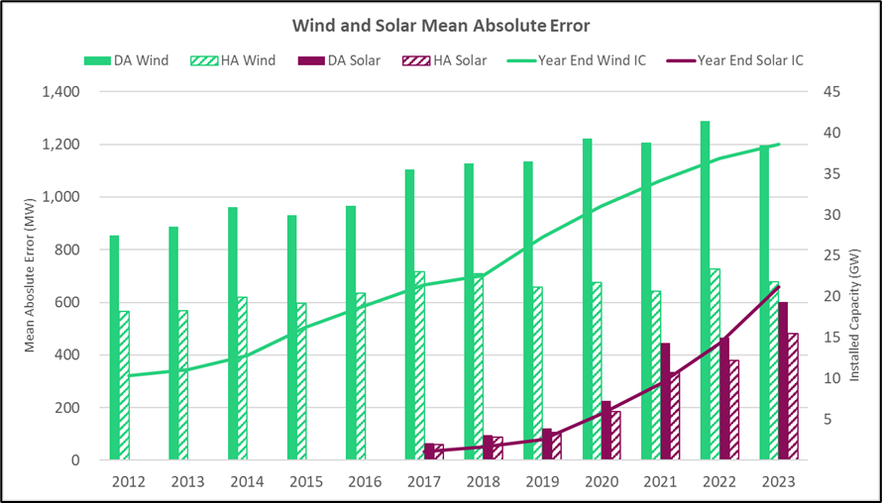
Resource Mix Change Impact on Net Load Forecast Error
As the installed capacities of intermittent resources has grown, in the mean absolute error (MW) in net load (load minus wind minus solar) forecast is increasing.
.
Key Takeaway: Increased net load forecast errors caused, in part, by wind and solar capacity increases have increased the risks that ECRS and Non-Spin mitigate.

