Slide 1
RTC+B Task Force
Update
Matt Mereness
RTCBTF
January 14, 2025

Slide 2
Outline
Program update: RTC+B Program Update from Board T&S
Reminder of RTCBTF Review Cycle (no change)
Reminder of Scope of RTC+B Program (no change)
Current Issues for RTCBTF Review
Proceed with rest of RTCBTF Agenda

Slide 3
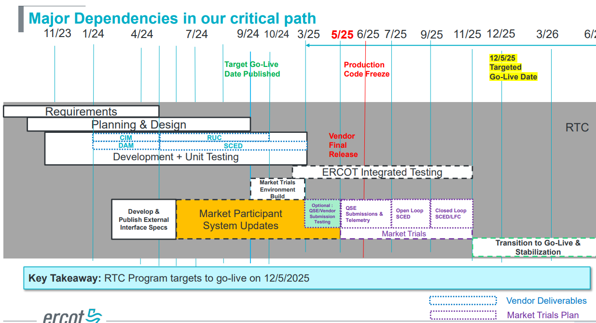
RTC+B Program Update
(excerpt from December Board T&S RTC Update)

Slide 4
Sequence and Dates for Market Trials to Go-Live
NEW
30-day Market Notice
11/5/25
March/April
2025
Start
5/5/25
Start
7/7/25
Start
9/2/25
Go-Live
12/5/25*
May 2025
June 2025
July 2025
Aug 2025
Sep 2025
Oct 2025
Nov 2025
Dec 2025
QSE Scorecards & Exit Criteria for each Trial Phase
RTC QSE Submission Testing
(Submit COP, RT AS Offers,
DAM Virtual AS, Outages for ESRs)
Open-loop RTC SCED
(QSE offers, SCED non-binding award/dispatch)
Ongoing Open-Loop
& Periodic Closed-loop SCED/LFC
(QSE RTC offers and telemetry to support closed-loop frequency control test 2-3 tests of 2-4 hour durations)
Transition to Go-Live
Upon completion of testing, confirmation of ERCOT and market readiness for Go-Live.
QSE/Vendor Submission Sandbox and Telemetry Points added to network model.
RTC QSE Telemetry Check-out (QSEs add/verify new telemetry points for UDSP, New ramp rates, ESR telemetry)
QSE Telemetry Tests
(Individual QSE to follow UDSP and support new ramp rate and ESR telemetry)
Day-Ahead Market
(Non-binding DAM using QSE offers for at least 2 tests)
* Go-Live date reflects 12/5/2025 as first Operating Day
where 12/4/2025 is planned software migration.

Slide 5
Plans for Meetings and Review Cycles
Reminder of RTC+B Program Scope
  RTC Key Principles were approved to lay foundation of NPRR1007-1013
    Consolidated Key Principles: https://www.ercot.com/files/docs/2020/04/01/RTC_Key_Principle_Quick_Reference.docx
    Library of Key Principles: https://www.ercot.com/mktrules/puctDirectives/rtCoOptimization
  Battery Key Topic Concepts approved to lay foundation of NPRR1014
    https://www.ercot.com/mktrules/keypriorities/bes
  RTC State-of-Charge accounting in NPRR1204
Objective is to present concepts or issues that need to be resolved for an effective implementation.
  Coordinating timelines for interface requirements and testing,
  Providing the forum for any analysis or policy decisions (such as parameter values)
  Coordinating market readiness and cutover activities,
  Review draft Revision Requests or other artifacts necessary to successfully implement the program within the identified timeframes, and discussing other details as needed.
Lessons learned from RTCTF to avoid being delayed in decisions:
  Meeting #1: Initial concept presented by ERCOT staff
  Meeting #2: Comments and alternatives presented by MPs
  Meeting #3: RTCTF consensus achieved or escalated to TAC for a vote to decide the matter.

Slide 6
Reminder of Details Scope of RTC+B Program
(Excel version posted with meeting)
No change from
October 2024

Slide 7
RTCBTF Issues List
First red box will be a single ERCOT NPRR for 4 policy issues
Second red box is a single IMM NPRR for ASDC changes
Third red box is a clean-up NPRR and includes explicit AS Qualification issue

Slide 8
Proceed with rest of meeting
1. Antitrust Admonition (Matt Mereness)
2. RTCBTF Updates and Issues (Matt Mereness) - ADDED January 23 afternoon meeting
3. Discussion of NPRR for RTC+B Parameters (ERCOT staff)
- Ramp Rate sharing (NPRR language)
- AS Proxy Offer Floor (NPRR language with more ASDC discussion)
- ASDC for RUC discussion (NPRR sections impacted and presentation)
- AS Duration Requirements (initial discussion)
4. Proposed changes for AS Qualification (Nitika Mago)
- Follow-up on discussion of IRR AS qualification (defer to Jan 23 meeting)
5. Review any Market feedback on Market Trials Handbooks (Matt Mereness)
- QSE Market Submissions (Handbook #1) – No comments received
- QSE Telemetry Check-Out (Handbook #2) – No comments received
6. Discussion of AS Demand Curves (Jonas Kersulis- IMM)
- ASDC sensitivity analysis for different ASDC proposals and draft NPRR
7. Refreshed RTC Efficiency Cost Savings (Matthew Schmidt)
- ERCOT study of annual RTC cost savings in 2023-2024
8. Other Business
- WMS question about WSL in Load Forecast

Slide 9
Discuss January 23th RTCBTF Meeting

