Slide 1
Guide for Determining Size of BESS Project
RIWG
12/19/2024

Slide 2
Key Considerations
What should be the project size (MW) in RIOO main page?
  At the 34.5kV bus, but how to account for the aux load?
What should be the MVA rating of Main Power Transformer?
How can we make use of (preliminary) Reactive Study results in determining the project size?

Slide 3
Reactive Study Requirements

Slide 4
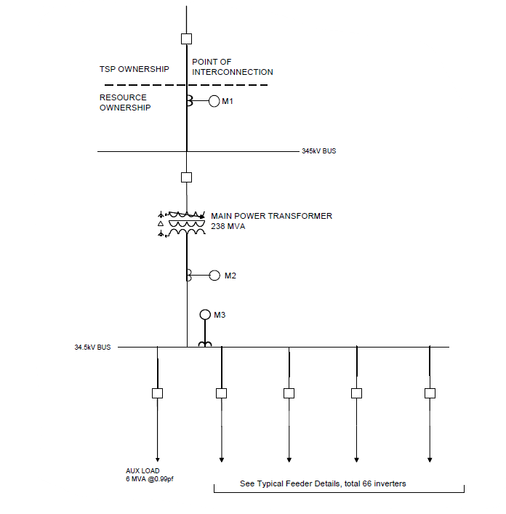
A Sample 200 MW BESS Project
Meter 1 (M1) – Measurement at the POI
Meter 2 (M2) – Measurement at the 34.5kV side of MPT
Meter 3 (M3) – Measurement at the 34.5kV bus, from all feeders before aux load
i.e., M3 = M2 + Aux load

Slide 5
A Sample 200 MW BESS Project
ERCOT wants RIOO to show the MW size of the project at the 34.5 kV bus
For any given project, there will be a family of possible values depending on:
  The size of the aux load and whether it is known or can be estimated
  The reactive operating conditions (lag, neutral, or lead), and system conditions (POI voltage)
In this example, the owner considers the project to be a nominal 200 BESS
The MPT was ordered before the reactive study was done
When the reactive study is done, if the MPT is found to be overloaded at any of the four study points, the project will either have to be downsized or redefined as a Self-Limiting Facility

Slide 6
Details of Valid Reactive Study Load Flows
A | B | C | D | E | F | G | H | I | J | K | L | M | N | O | P | Q | R
POI Voltage, pu | Dispatch | Reactive Test | OLTC Tap Position | Lowest voltage at inverter terminals, pu | Highest voltage at inverter terminals, pu | MW Delivered to POI (meter 1) | MVAr Delivered to POI (meter 1) | MVA Delivered to POI (meter 1) | MW Delivered to 34.5kV side of MPT (meter 2) | MVAR Delivered to 34.5kV side of MPT (meter 2) | MVA Delivered to 34.5kV side of MPT (meter 2) | sum(MW at Inverter Terminals) | sum(MVAR at Inverter Terminals) | MW Delivered to 34.5kV Bus (meter 3) | MVAr Delivered to 34.5kV Bus (meter 3) | MW Aux Load | MVAR Aux Load
0.95 | HSL | Max Lag | 2 (1.25%) | 1.005 | 1.008 | 201.35 | 67.35 | 212.32 | 202.27 | 105.59 | 228.17 | 210.31 | 119.39 | 208.17 | 106.39 | 5.90 | 0.80
 | LOP | Max Lag | 2 (1.25%) | 0.988 | 0.993 | 20.64 | 69.68 | 72.67 | 20.75 | 73.97 | 76.83 | 26.90 | 75.79 | 26.65 | 74.77 | 5.90 | 0.80
1.00 | HSL | Max Lead | 8 (-5%) | 1.017 | 1.020 | 201.94 | -68.82 | 213.34 | 202.69 | -38.04 | 206.23 | 210.31 | -26.14 | 208.59 | -37.24 | 5.90 | 0.80
 | LOP | Max Lead | 8 (-5%) | 1.005 | 1.007 | 20.73 | -67.82 | 70.92 | 20.82 | -63.93 | 67.23 | 26.90 | -62.52 | 26.72 | -63.13 | 5.90 | 0.80
1.04 | HSL | Max Lag | 16 (10%) | 1.012 | 1.014 | 201.38 | 67.30 | 212.33 | 202.31 | 103.97 | 227.46 | 210.31 | 118.53 | 208.21 | 104.77 | 5.90 | 0.80
 | LOP | Max Lag | 16 (10%) | 0.985 | 1.000 | 20.66 | 68.21 | 71.27 | 20.77 | 72.25 | 75.18 | 26.90 | 73.97 | 26.67 | 73.05 | 5.90 | 0.80
1.05 | HSL | Max Lead | Nominal | 1.015 | 1.017 | 201.93 | -68.22 | 213.14 | 202.68 | -38.26 | 206.26 | 210.31 | -26.29 | 208.58 | -37.46 | 5.90 | 0.80
 | LOP | Max Lead | Nominal | 1.003 | 1.004 | 20.73 | -66.27 | 69.44 | 20.81 | -63.17 | 66.51 | 26.90 | -61.78 | 26.71 | -62.37 | 5.90 | 0.80
Columns A, B, and C identify the required operating conditions.
Columns E and F are used to check that the MPT tap position is acceptable
Columns G and H are used to check that the resource can provide the required MVARs to the POI. These could be metered at M1.
Columns G and H are used to calculate column I.
Columns J and K are used to calculate column L. These could be metered at M2.
Columns I and L are used to check that the MPT will not be overloaded at any of the boundary conditions.
Columns M and N are the sums of values at each individual inverter. They are used to check that the reactive requirements can be met dynamically with switchable shunts used only to make up losses.
The numbers in columns M and N cannot be metered at a single point.
Columns O and P are smaller than the sum of inverter outputs due to losses in the collector system and in the padmaount transformers.

Slide 7
Where are the losses?
A | B | C | G | H | I | J | L | M | N | O | P | Q | R | S | T | U
POI Voltage, pu | Dispatch | Reactive Test | MW Delivered to POI (meter 1) | MVAr Delivered to POI (meter 1) | MW Delivered to 34.5kV side of MPT (meter 2) | MVAR Delivered to 34.5kV side of MPT (meter 2) | sum(MW at Inverter Terminals) | sum(MVAR at Inverter Terminals) | MW Delivered to 34.5kV Bus (meter 3) | MVAr Delivered to 34.5kV Bus (meter 3) | MW Aux Load | MVAR Aux Load | MW Losses in MPT | MVAR Losses in MPT | MW Losses in Collection System & padmt tx | MVAR Losses in Collection System & padmt tx
0.95 | HSL | Max Lag | 201.35 | 67.35 | 202.27 | 105.59 | 210.31 | 119.39 | 208.17 | 106.39 | 5.90 | 0.80 | 0.92 | 38.24 | 2.14 | 13.00
 | LOP | Max Lag | 20.64 | 69.68 | 20.75 | 73.97 | 26.90 | 75.79 | 26.65 | 74.77 | 5.90 | 0.80 | 0.11 | 4.29 | 0.25 | 1.02
1.00 | HSL | Max Lead | 201.94 | -68.82 | 202.69 | -38.04 | 210.31 | -26.14 | 208.59 | -37.24 | 5.90 | 0.80 | 0.75 | 30.78 | 1.72 | 11.10
 | LOP | Max Lead | 20.73 | -67.82 | 20.82 | -63.93 | 26.90 | -62.52 | 26.72 | -63.13 | 5.90 | 0.80 | 0.09 | 3.89 | 0.18 | 0.61
1.04 | HSL | Max Lag | 201.38 | 67.30 | 202.31 | 103.97 | 210.31 | 118.53 | 208.21 | 104.77 | 5.90 | 0.80 | 0.93 | 36.67 | 2.10 | 13.76
 | LOP | Max Lag | 20.66 | 68.21 | 20.77 | 72.25 | 26.90 | 73.97 | 26.67 | 73.05 | 5.90 | 0.80 | 0.11 | 4.04 | 0.23 | 0.92
1.05 | HSL | Max Lead | 201.93 | -68.22 | 202.68 | -38.26 | 210.31 | -26.29 | 208.58 | -37.46 | 5.90 | 0.80 | 0.75 | 29.96 | 1.73 | 11.17
 | LOP | Max Lead | 20.73 | -66.27 | 20.81 | -63.17 | 26.90 | -61.78 | 26.71 | -62.37 | 5.90 | 0.80 | 0.08 | 3.10 | 0.19 | 0.59
These calculations are interesting but not required. Reviewing them will help catch any big mistakes.
Losses in the MPT = power delivered to POI minus power delivered to 34.5kV side of MPT, or meter 1 values minus meter 2 values
Difference between meter 2 and meter 3 = aux load
Losses in the padmount transformers and collector system = sum(power output of inverters) minus power delivered to 34.5kV bus

Slide 8
Recommendations
Do a rough-draft of the reactive study using as many iterations as necessary to find acceptable tap positions for each of the four boundary conditions.
  Max and Min collection system voltages must be acceptable
Compare the MPT size with the MVA results on the 34.5kV side of the MPT (Meter 2) for lagging, and with the MVA results on the high-side (Meter 1) for leading.
Compare each MVAR result at the POI (Meter 1) with the required amount of 32.9 Mvar per every 100 MW of capacity.
For lagging operations, compare each sum(MVAR at inverter terminals) with the required amount of 32.9 MVAR per every 100 MW of capacity.

Slide 9
Answers and Advice from ERCOT
Should the MW size of the project on the main page of RIOO be based on the MW at the 34.5KV bus as measured by meter 2 or by meter 3?
  Meter 3
For lagging conditions, the MPT loading should be evaluated at the low side. For leading conditions, the MPT loading should be evaluated from the high side.
It is to your advantage to do the reactive study earlier in the process because it will give you insight to the design of your collector system, the MPT loading, and sizing of any switched shunt.

